Slide 1
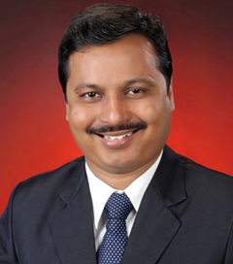

UDIN Compliance
Dungar Chand U Jain
26-Apr-2019 | Ernakulam Branch of SIRC of ICAI
Lake Palace Backwater Resort, Alleppey

Slide 2

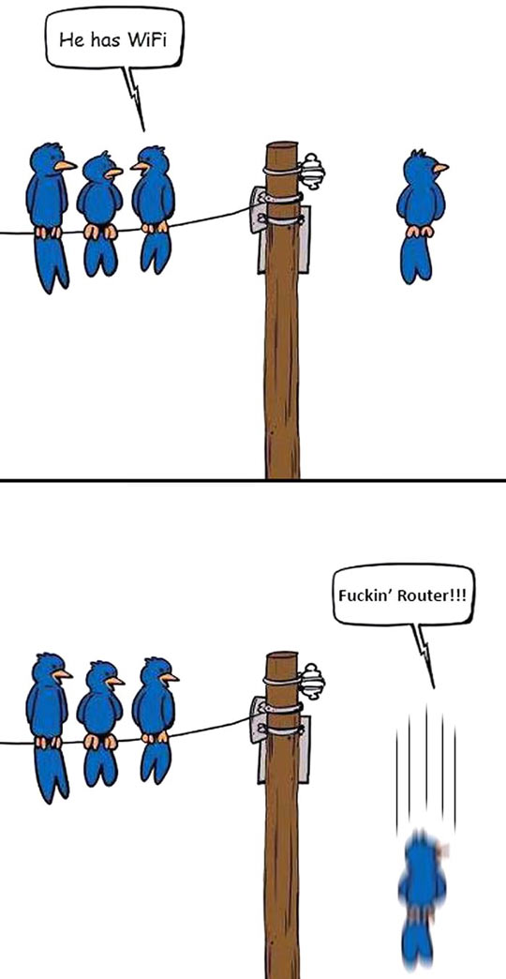
Future is Technology…
Router !!! D

Slide 3
Views… mine… not of SIRC / ICAI…
E & O.E.

Slide 4
What is UDIN ?
Unique Document Identification Number
18-Digits generated by the system
for every document certified / attested by a practicing CA
https://udin.icai.org/

Slide 5
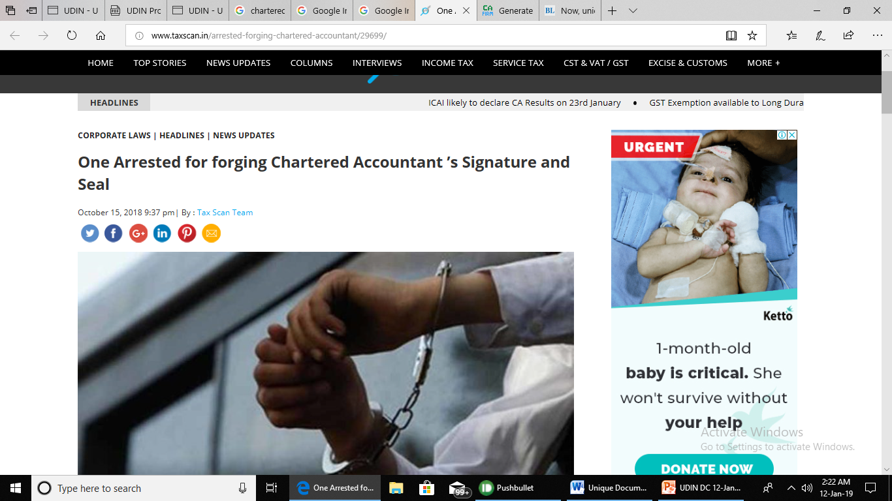

Slide 6
Why UDIN ?
to curb the menace of fake or forged documents
Certification / attestation done by third persons misrepresenting CAs.
Regulators / Banks / third parties can check the authenticity of the documents certified / attested.

Slide 7
UDIN - Specimen
19123456AAAAAB0007

Slide 8
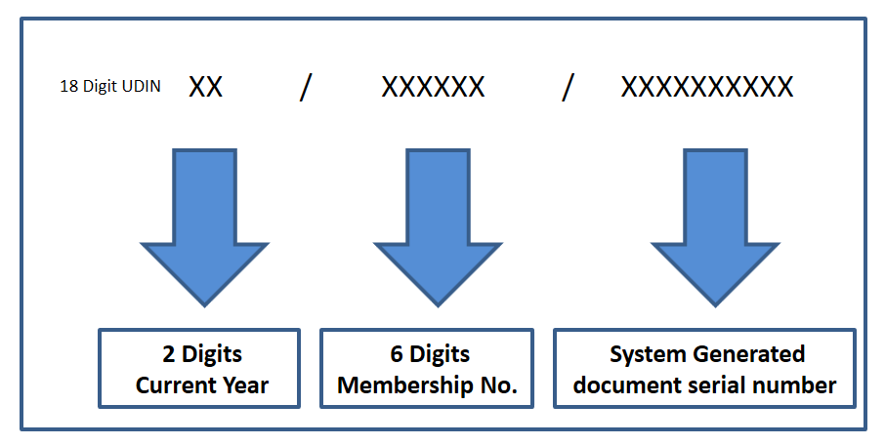
Algorithm of UDIN
Current Year
Membership Number
Document Serial Number (allotted automatically by system)
19123456AAAAAB0007

Slide 9
When to Generate UDIN ?
UDIN is to be generated at the time of signing the Certificate.
However, the same can be generated within 15 days of the signing of the same
(i.e, within 15 days from the date mentioned at Certificates and not beyond that)

Slide 10
ANNOUNCEMENT UDIN - A way to authenticate document
As you are aware that to secure the certificates/documents attested/certified by practicing Chartered Accountants and for tracing forged/wrong documents prepared by any third person misrepresenting himself as a Chartered Accountant, ICAI had implemented an innovative concept of UDIN i.e. Unique Document Identification Number. We wish to inform that for this prestigious project of UDIN, ICAI has engaged Tata Consultancy Services (TCS) who is also automating and will maintain the life cycle of CA Members and Students making them largely online on a digital platform. To enable TCS do the huge data migration and data audit which will require around 30 days before the UDIN Platform becomes mandatory, Central Council of ICAI has decided to mandate UDIN w.e.f 1st Feb., 2019 in a phased manner as against the earlier announced date of 1st Jan., 2019 . Professional Development Committee

Slide 11
Applicability ?
Introduced from 1-Jul-2018
Recommendatory initially
Mandatory from 1 Jan 2019 1 Feb 2019
All GST & Tax Audit Reports w.e.f. 1st April, 2019
All other attest functions w.e.f. 1st July, 2019

Slide 12
Applicability of UDIN
Is it mandatory to obtain UDIN for all Certificates* issued where the Financial Information/related contents is certified as True and Fair / True and Correct
Refer Guidance Note on Reports or Certificates for Special Purposes (Revised 2016) issued by AASB (Auditing and Assurance Standard Board of ICAI)

Slide 13

PROCESS
1 ONE TIME
>> Registration
2 ROUTINE
Login
Revoke
Change Password
Generate UDIN
Search

Slide 14
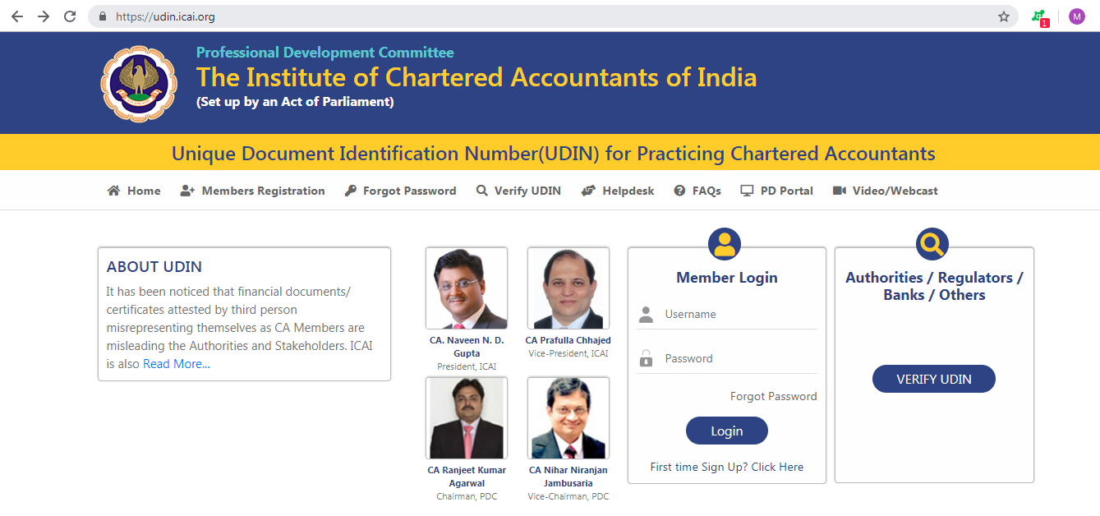

Slide 15
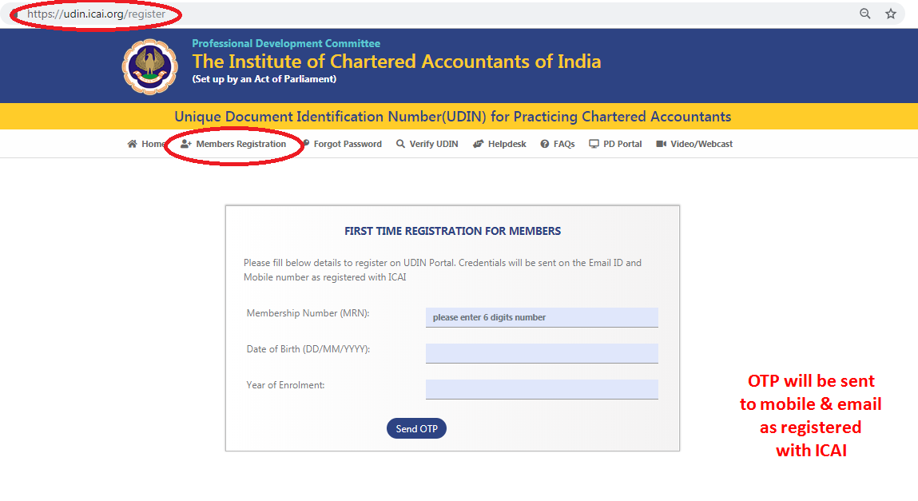

Slide 16
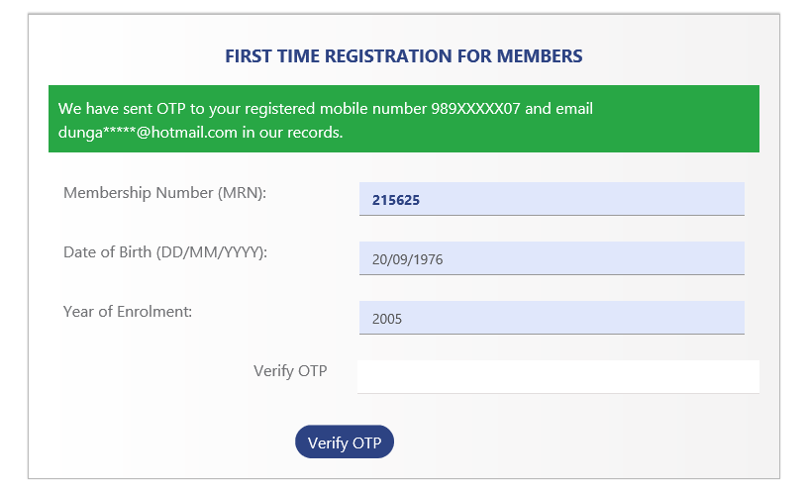
123456
15/08/1947
1976

Slide 17
After OTP is fed
You’ll receive username and system generated password at the mobile and email, as registered with the ICAI.
The password generated is encrypted to ensure its appropriate safety

Slide 18

PROCESS
1 ONE TIME
Registration
2 ROUTINE
Login
Revoke
>> Change Password
Generate UDIN
Search

Slide 19
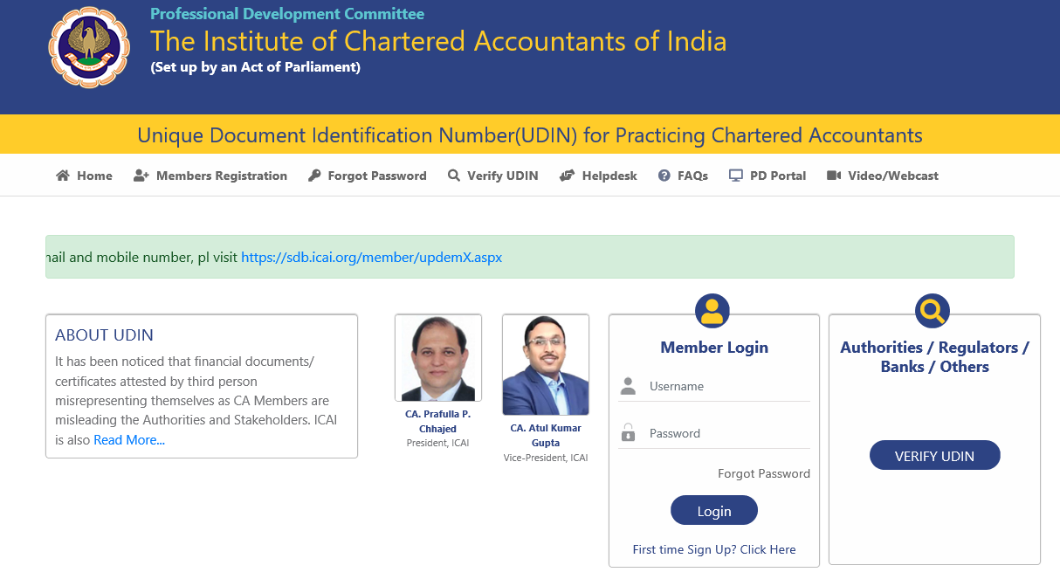

Slide 20
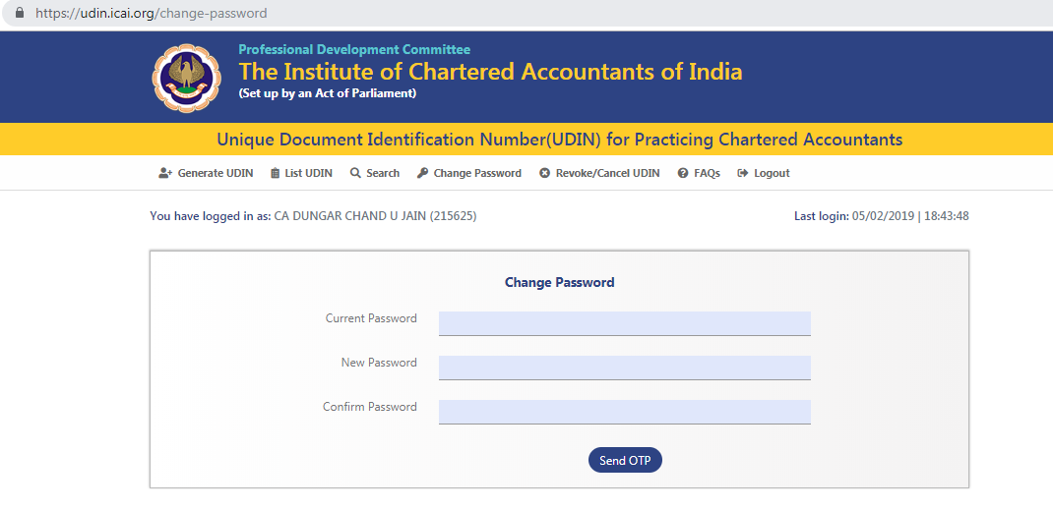
Change Password

Slide 21
PROCESS
1 ONE TIME
Registration
2 ROUTINE
>> Login
Revoke
Change Password
Generate UDIN
Search

Slide 23
PROCESS
1 ONE TIME
Registration
2 ROUTINE
Login
Revoke
Change Password
>> Generate UDIN
Search

Slide 24
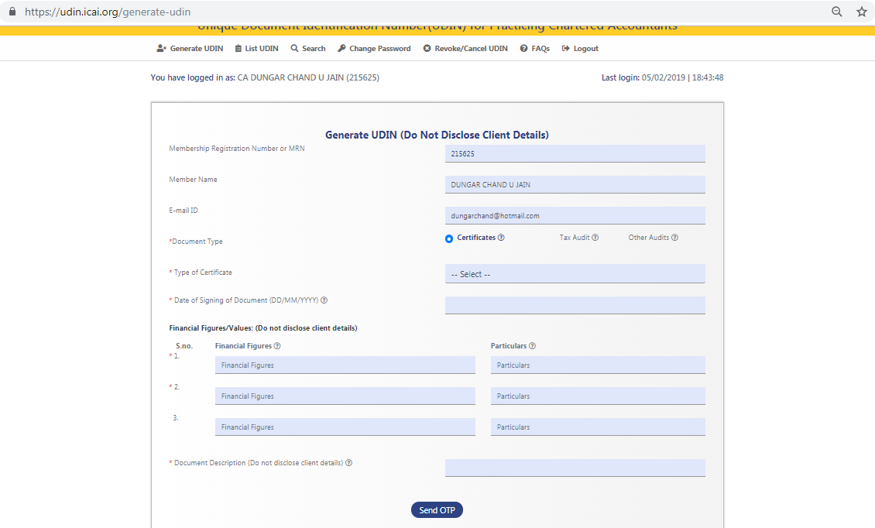

Slide 25
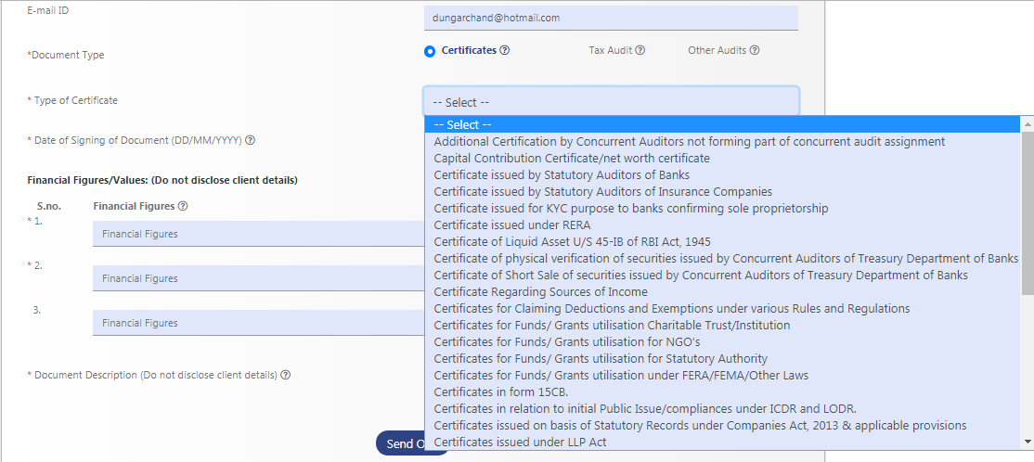
Types of Certificates

Slide 26
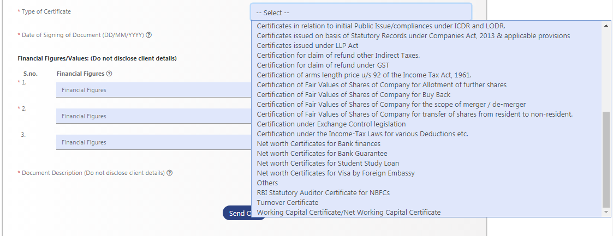
Types of Certificates…

Slide 27
UDIN Not Applicable (in 1st Phase)
Auditor's Opinion/Reports issued by the Practicing Chartered Accountant under any Statute w.r.t. any entity or any person (e.g.: Tax Audit, Transfer Price Audit, VAT Audit, GST Audit, Company Audit, Trust Audit, Society Audit, etc.,
Valuation Reports,
Quarterly Review Reports,
Limited Review Report
Information System Audit,
Forensic Audit,
Revenue / Credit / Stock Audit,
Borrower Monitoring Assignments,
Concurrent / Internal Audit and the like,
Any report of what so ever nature issued including Transfer Price Study Report, Viability Study Report, Diligence Report, Due Diligence Report, Management Report, etc.

Slide 28
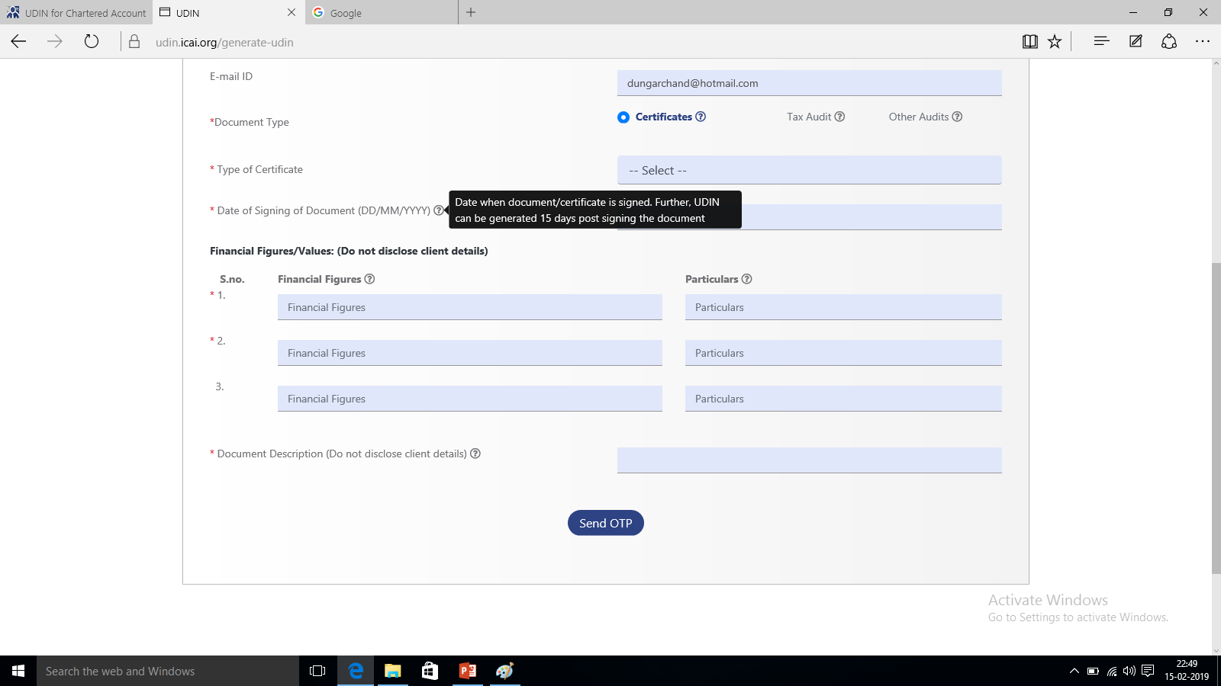
Date of Signing of Document

Slide 29
Financial Figures/ Values
While registering the certificate for generation of UDIN, Two Financial Figures are mandatory out of three fields.
In case, there is no financial figure in the certificate being certified, 0 is to be mentioned in Financial Figure and in its particular please mention “There is no Financial Figure in Certificate”.

Slide 30
Financial Figures/ Values

Slide 31
Document Description

Slide 32
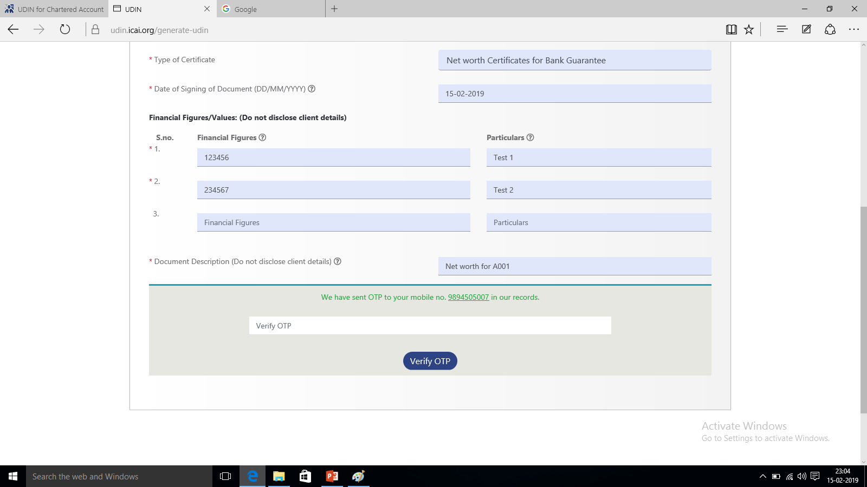
Send OTP…

Slide 33
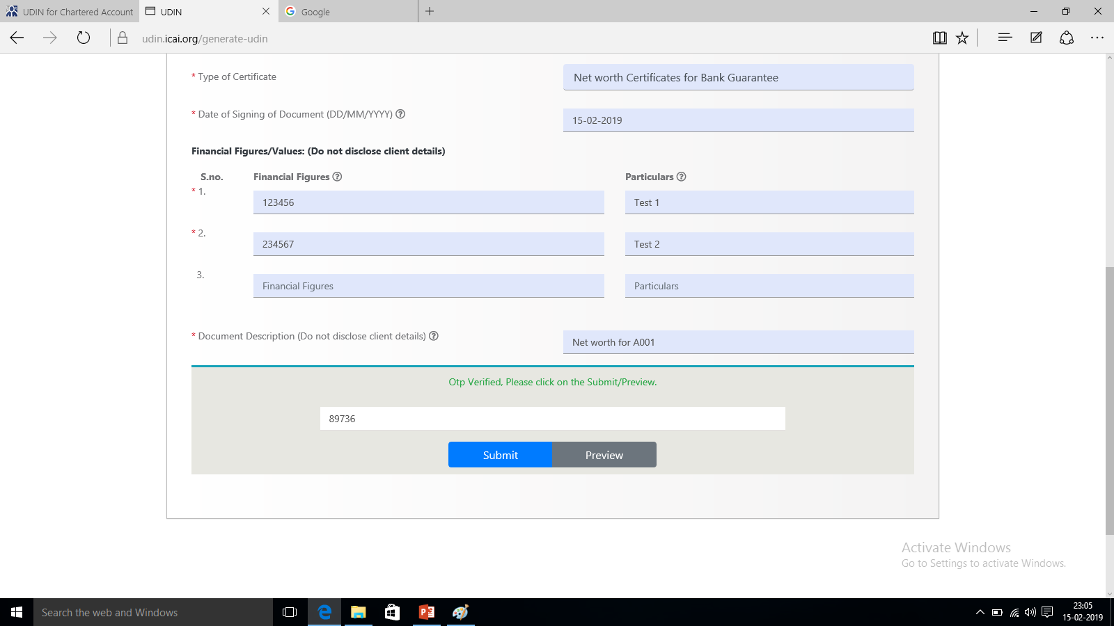
Verify OTP… Submit / Preview

Slide 34
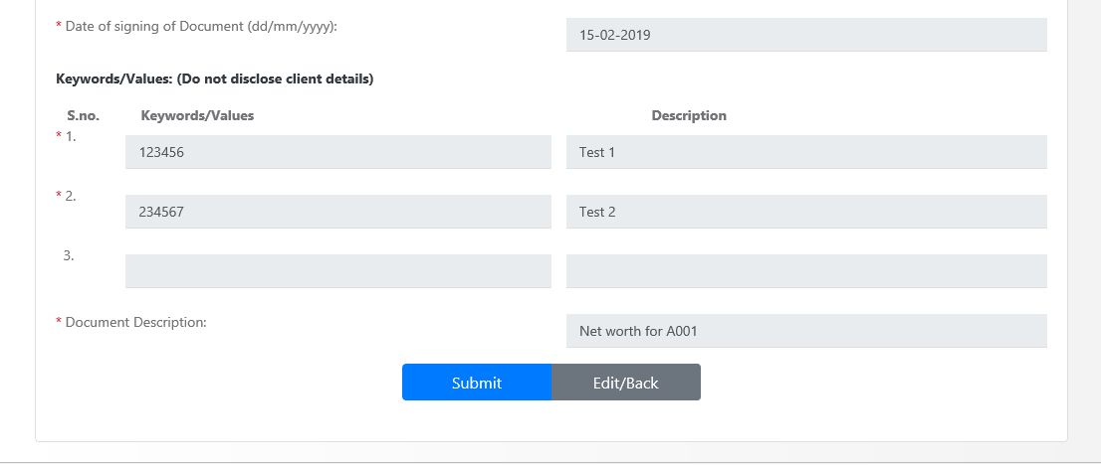
Edit / Back before Submit

Slide 35
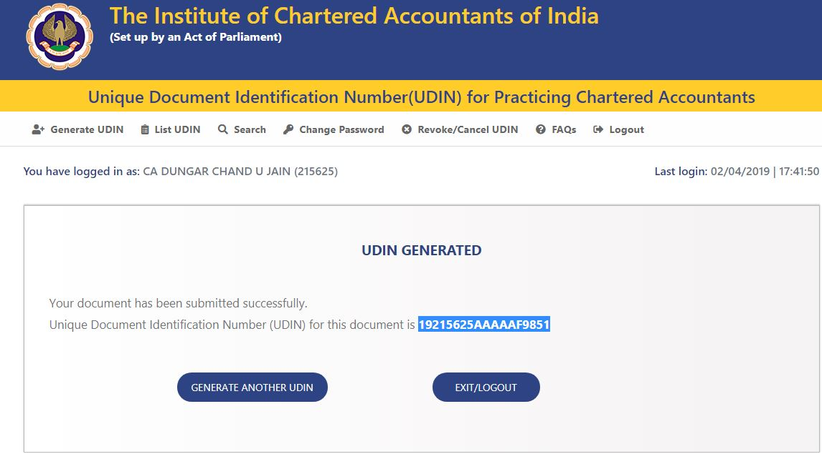

Slide 36
Usage of UDIN on documents
1a “List UDIN” menu can be used to print the UDIN – Watermark (automatically generated)
1b Watermark (Self)
2 Print on Documents below Signature
3 Writing with Pen
4 Rubber Stamp

Slide 37
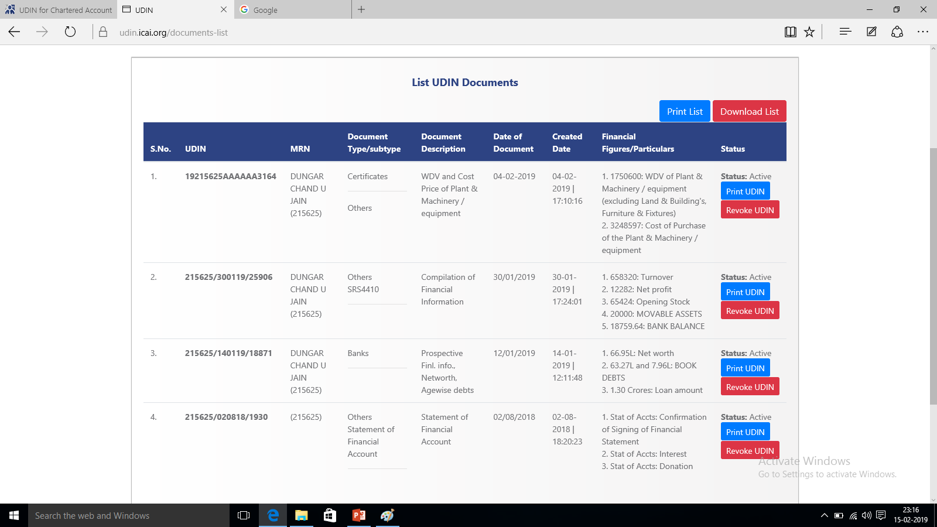

Slide 38
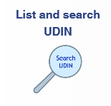
PROCESS
1 ONE TIME
Registration
2 ROUTINE
Login
Revoke
Change Password
>> Search
Generate UDIN

Slide 39
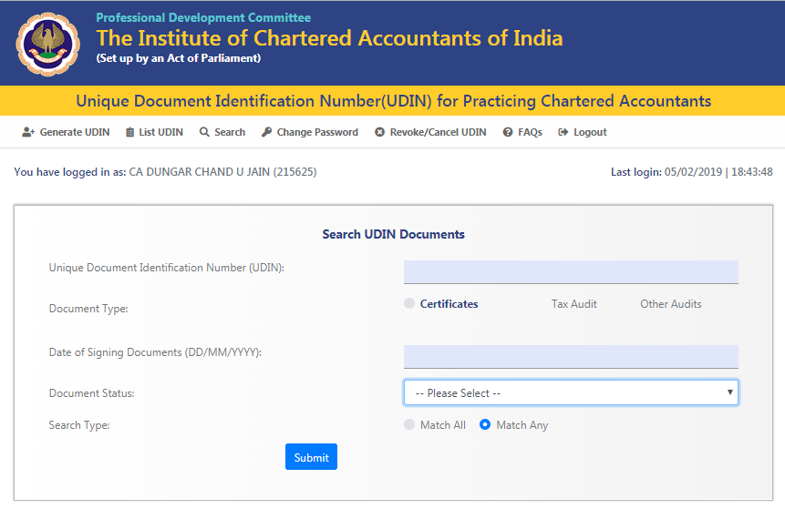
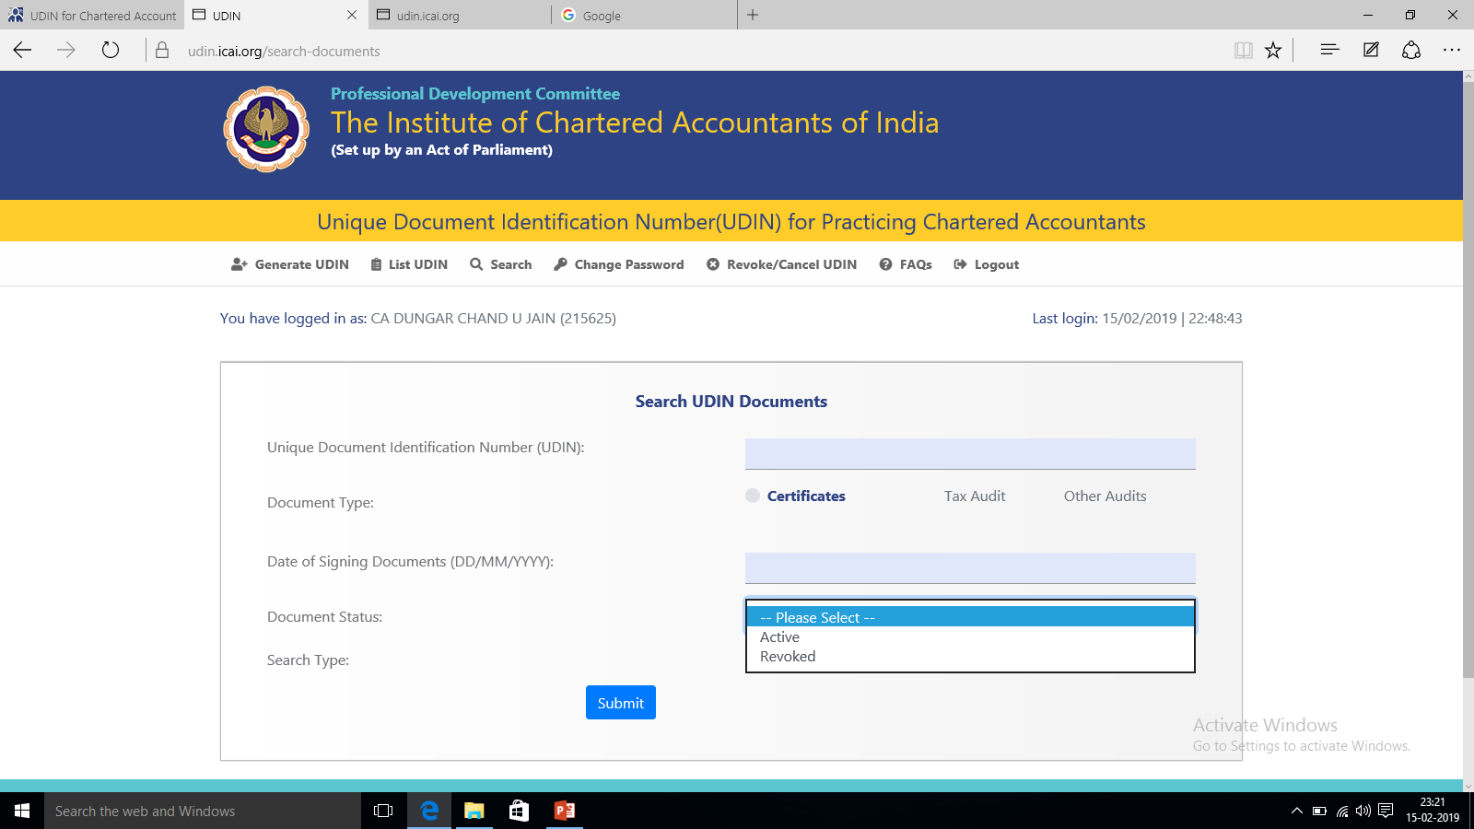

Slide 40
UDIN -BANK Audit and Tax Audit

Slide 41
UDIN mandatory for Stat. Bank Audit
NOT mandatory for Statutory Bank audits as of now.
Mandatory
1-Feb-2019 All Certificates
1-Apr-2019 Tax Audit and GST Audit Reports
1-Jul-2019 All-in-All

Slide 42
UDIN mandatory for Tax audit ?
For Bank branch audit, Separate UDIN must be generated for tax audit.

Slide 43
Different UDINs for different partners
UDIN has to be taken per assignment per signatory.
If different partners are signing different certificates, then separate UDIN has to be taken per signatory.

Slide 44
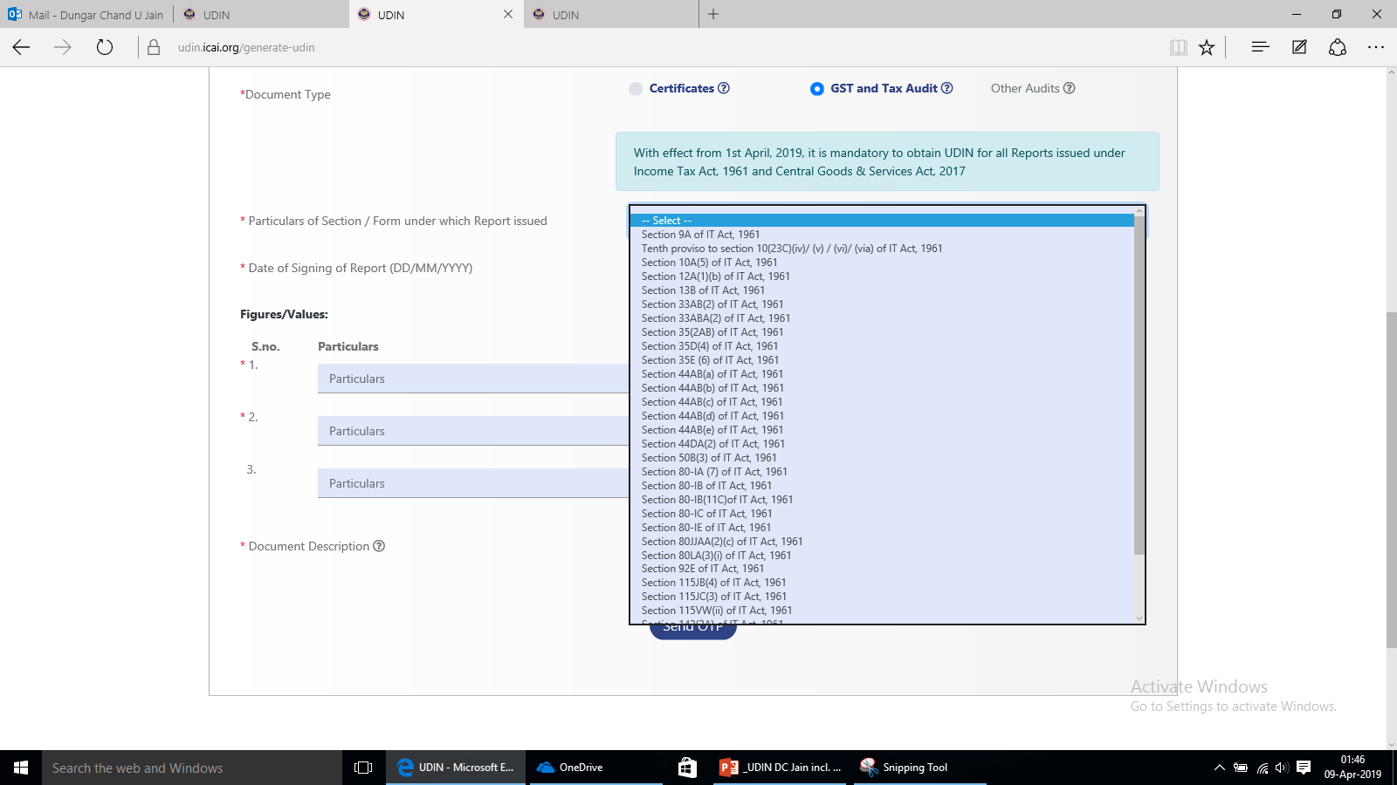

Slide 45
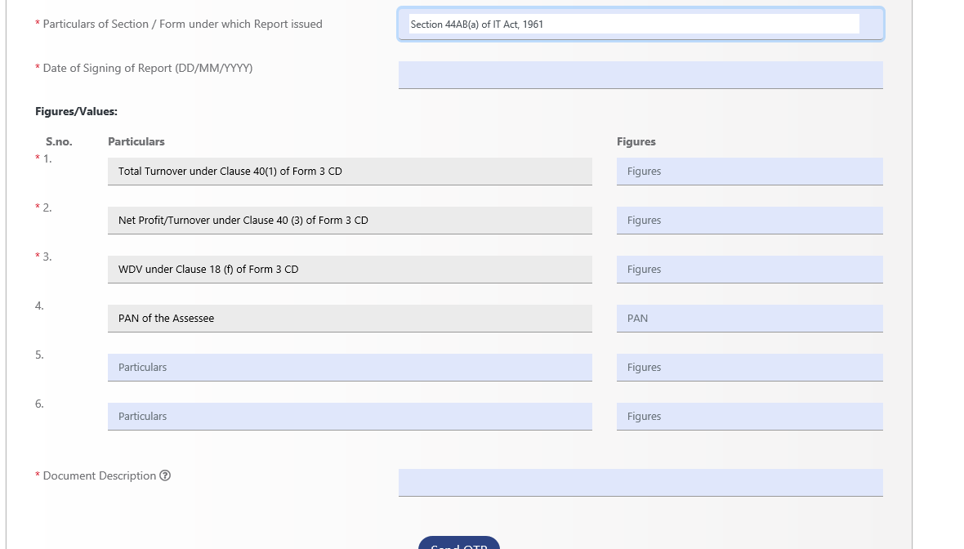

Slide 46
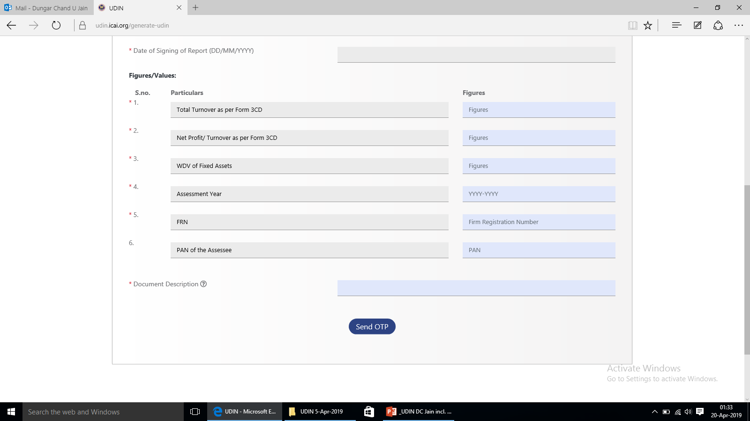

Slide 47
for all Certificates - Separate UDIN ?
UDIN to be generated per Assignment per signatory.
Bank Branch Audit: One audit is One assignment. Hence, one UDIN for all certificates.
Caution: List of all certificates bearing same UDIN must be compiled & handed over to mgt. with covering letter, so that it can’t be misused by affixing on any other certificate not signed by you.

Slide 48
UDIN for Certificates in bank audit - Process
Refer Process as covered earlier.
Names of the Certificates are to be mentioned under the Caption “Document Description”

Slide 49
UDIN for Certificates – Figures ?
Common figures /parameters, if possible
If common figures not available then,
Name of branch, Advances, Deposits etc.
must be one common field, which can be correlated with all certificates.

Slide 50
Applicability
Statutory Central Auditors (SCAs) : YES
LFAR : No
UDIN for Certificate & Tax Audit Reports, Same : No

Slide 51
Tax audit reports filed online using DSC ?
UDIN is applicable for reports signed
Digitally and uploaded online &
Manually
In case of digitally signed / online reports, UDIN has to be generated and retained. (for providing the same on being asked by any third party/ authority.)

Slide 52

PROCESS
1 ONE TIME
Registration
2 ROUTINE
Login
Revoke
Change Password
Search
Generate UDIN

Slide 53
Revocation of UDIN
The UDIN once generated can be withdrawn or cancelled with narration.
thoroughly check the details in preview option before submission of their application.
and if any user search for this UDIN, appropriate narration indicated by Member with the date of revoke will be displayed for reference.

Slide 56
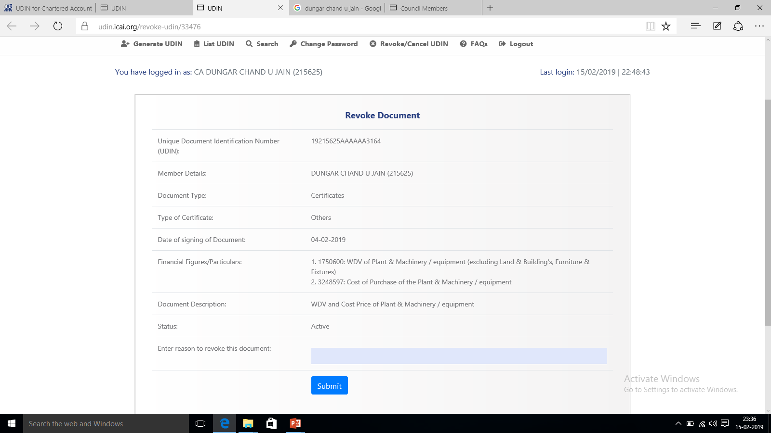
Revoke Document

Slide 57
OTHERS

Slide 58
Others…
How many UDINs one can generate ?
Viewing Certificate numbers generated ?
Validity of a UDIN on the portal for viewing by a third party ?
Fee for Registration and Generation ?
Upload the Certificate ?
ICAI has made awareness to all regulators like RBI, SEBI, CBDT, MCA, IBA and they can very well ask for UDIN.

Slide 59
Others…
Forgot Password
True Copies
Can a Partner generate UDIN for another Partner?
Can Firm register on UDIN Portal
Digitally signed Documents
Joint Audit
Multiple reports in one Assignment
Upload multiple certificate upload in Excel ?
UDIN in Advance

Slide 60
Logout
Click logout, when you wish to leave this application.
Please note, you will be automatically logged out after 5 minutes of non-activity.

Slide 61
UDIN where mandatory - Not Generated ?
will amount to non-adherence of the Council Guidelines and
may attract disciplinary proceedings as per the Second Schedule Part II of The Chartered Accountants Act, 1949.

Slide 62
for verification of UDIN
https://udin.icai.org/search-udin

Slide 64
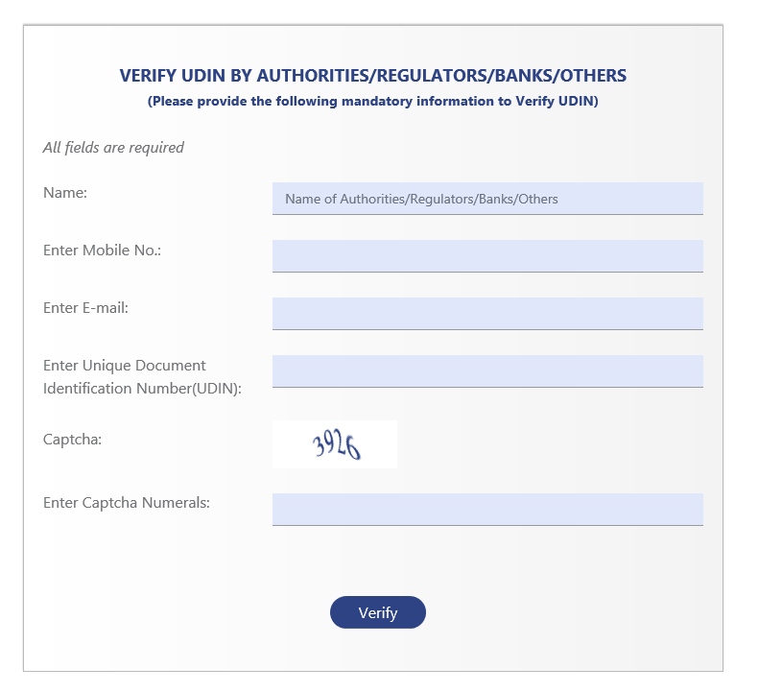

Slide 65
F1

Slide 66
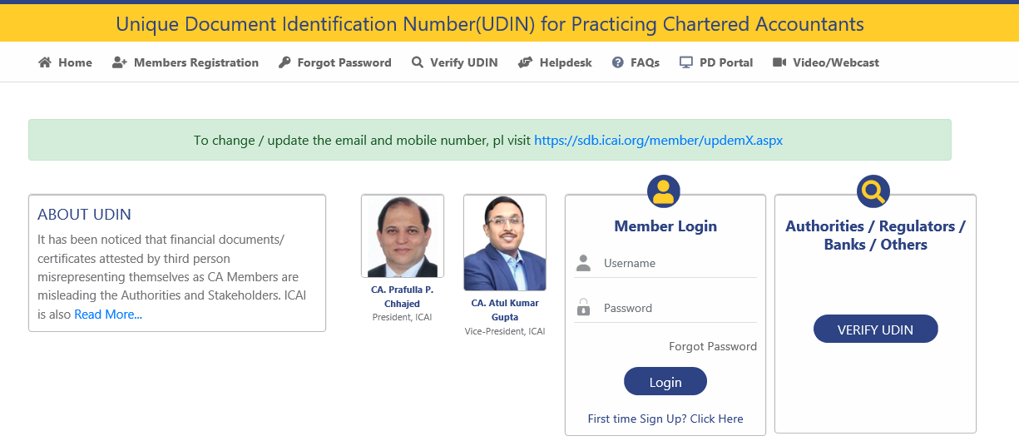

Slide 67
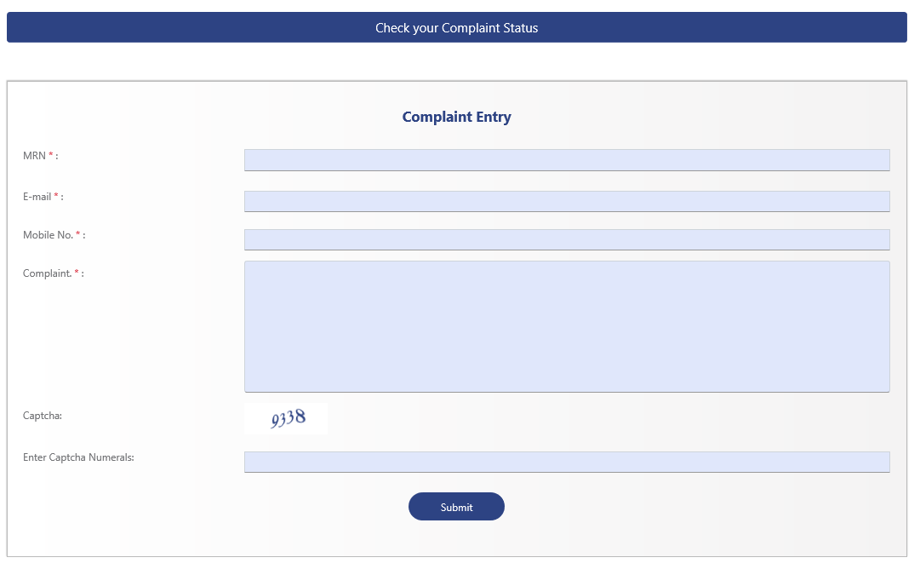
Helpdesk

Slide 68
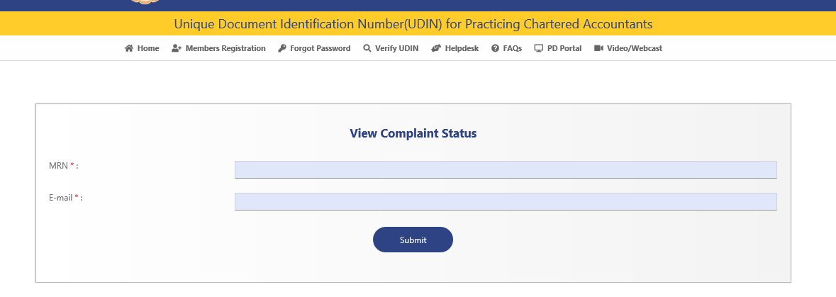
Check your Complaint Status

Slide 69
UDIN Helpdesk
Apart from help desk tab on Menu bar available at https://udin.icai.org one can email at udin@icai.in
Members can alternatively call at 011-30110411/480.
In case of emergency, speak with Mr. Vishal Agarwal at 9911539260

Slide 70
What if ?
What if the information is not accepted or the password is not sent?
for issues relating to the data regarding enrolment dates, DOB, email IDs, mobile number, etc.
Respective Regional Office (SIRC of ICAI) to be contacted

Slide 71
UDIN BEING MADE MANDATORY IN 2nd PHASE FOR GST & TAX AUDIT REPORT
You may be aware that Unique Document Identification Number (UDIN) has been made mandatory as per the Council decision taken at its 379th Meeting held on 17th – 18th December, 2018 in the following phases: All Certification done by Practising CAs w.e.f. 1st Feb., 2019. All GST & Tax Audit Reports w.e.f. 1st April, 2019. All other attest functions w.e.f. 1st July, 2019. Since 1st February 2019 all certificates issued by Chartered Accountants had been made mandatory. Now in 2nd phase, w.e.f 1st April, 2019, UDIN is being made mandatory for GST & Tax Audit Reports. Members are requested to make a note of above schedule of mandating UDIN and also adhere to the same while conducting Bank Audits. Practising CAs have to register at UDIN portal (https://udin.icai.org/) to obtain UDIN. To authenticate the documents by various Regulators / Banks / Authorities / Other Stakeholders, practicing CAs have to provide some financial figures and details which are found in the certificate issued. Further, it is clarified that for generating UDIN, no certificates are required to be uploaded on the portal. For Process, FAQs and helpdesk you may visit https://udin.icai.org/. In case you need any further information/ clarification, please email at udin@icai.in or call at 011-30110480 / 444. You are advised to register the documents certified by them on the UDIN portal and get these secured. UDIN Monitoring Group

Slide 72
It’s just the beginning…
Dungar Chand U Jain
dcjain@icai.org
26-Apr-2019 | Ernakulam Branch of SIRC of ICAI
Lake Palace Backwater Resort, Alleppey

