Slide 1
AS 10: PROPERTY, PLANT AND EQUIPMENT

Slide 2
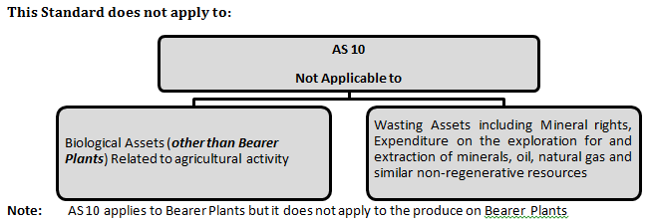
Scope of the Standard

Slide 3
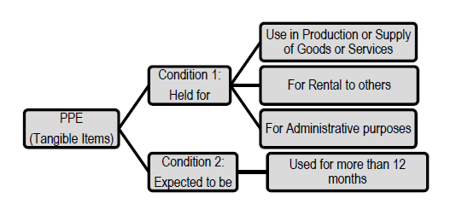
Property, Plant and Equipment (PPE)

Slide 4
Items of acquired for safety or environmental reasons
Items of PPE may also be acquired for safety or environmental reasons (although not directly increasing the future economic benefits of any particular existing item of PPE, may be necessary for an enterprise to obtain the future economic benefits from its other assets

Slide 5
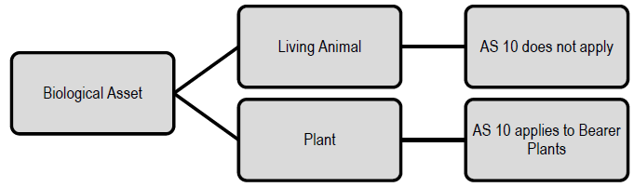
Biological Asset :-

Slide 6
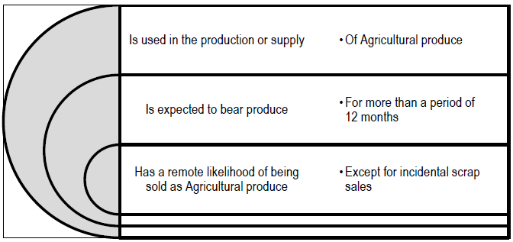
Bearer Plant
Bearer Plant: Is a plant that (satisfies all 3 conditions)

Slide 7
RECOGNITION CRITERIA FOR PPE
The cost of an item of PPE should be recognised as an asset if, and only if:
It is probable that future economic benefits associated with the item will flow to the enterprise, and
The cost of the item can be measured reliably

Slide 8
Treatment of Spare Parts, Stand by Equipment and Servicing Equipment
Case I If they meet the definition of PPE as per AS 10:
Case II If they do not meet the definition of PPE as per AS 10:
Such items are classified as Inventory as per AS
Recognised as PPE as per AS 10

Slide 9
Treatment of Subsequent Costs
Cost of day-to-day servicing (repair & Maintenance)
Replacement of Parts of PPE
(Recognizes in the carrying amount (if the recognition criteria are met)
Charged to profit and Loss A/c

Slide 10
The cost of “Remodelling” a Supermarket

Slide 12
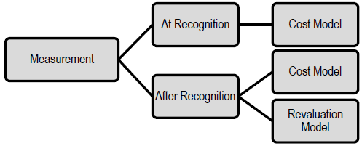
Measurement of PPE

Slide 13
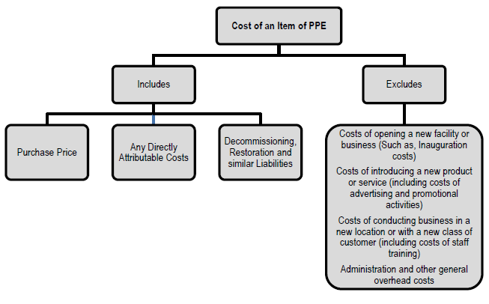

Slide 14
Elements of Cost
Purchase Price:
It includes import duties and non –refundable purchase taxes.
It requires deduction of Trade discounts and rebates
Directly Attributable Costs:
Any costs directly attributable to bringing the asset to the ‘location and condition’ necessary for it to be capable of operating in the manner intended by management

Slide 15
Examples of directly attributable costs are
Costs of site preparation
Initial delivery and handling costs
Installation and assembly costs
Costs of testing whether the asset is functioning properly, after deducting the net proceeds from selling any items produced while bringing the asset to that location and condition (such as samples produced when testing equipment)
Professional fees

Slide 16
Costs Do not included in the carrying amount of an item of PPE
Costs incurred while an item capable of operating in the manner intended by management has yet to be brought into use or is operated at less than full capacity.
Initial operating losses,
Costs of relocating or reorganising.

Slide 17
Costs of opening a new facility or business (Such as, Inauguration costs)
Costs of introducing a new product or service (including costs of advertising and promotional activities)
Costs of conducting business in a new location or with a new class of customer (including costs of staff training)
Administration and other general overhead costs

Slide 18
Cost of a Self-constructed Asset
Cost of a self-constructed asset is always determined at COST
Internal profits are eliminated
Abnormal amounts of wasted material, labour, or other resources incurred in self constructing an asset is not included.
Bearer plants are accounted for in the same way as self-constructed items of PPE

Slide 19
PPE acquired in Exchange for a Non-monetary Asset
Cost of such an item of PPE is measured at fair value unless:
Exchange transaction lacks commercial substance; Or
Fair value of neither the asset(s) received nor the asset(s) given up is reliably measurable.
  If the acquired item(s) is/are not measured at fair value, its/their cost is measured at the carrying amount of the asset(s) given up.

Slide 20
  An exchange transaction has commercial substance if:its future cash flows are expected to change as a result of the transaction.

Slide 21
Entity A exchanges car X with a book value of ` 13,00,000 and a fair value of ` 13,25,000 for cash of ` 15,000 and car Y which has a fair value of ` 13,10,000. The transaction lacks commercial substance as the company’s cash flows are not expected to change as a result of the exchange. It is in the same position as it was before the transaction. What will be the measurement cost of the assets received

Slide 22
ASSET ACQUIRED ON EXCHANE OF ANOTHER ASSET
FMV of Asset Given up
FMV of Asset Acquired
If Fair value of neither the asset received nor the asset given up is reliably measurable. Then it is measured at the carrying amount of the asset given up.

Slide 23
PPE purchased for a Consolidated Price
Where several items of PPE are purchased for a consolidated price, the consideration is apportioned to the various items on the basis of their respective fair values at the date of acquisition.

Slide 24
Measurement after Recognition
Cost model,
Revaluation model

Slide 25
Condition for Revaluation
Entire class of PPE to which that asset belongs should be revalued,
Examples of separate classes: Land, Land and Buildings, Machinery, Ships, Aircraft, Motor Vehicles

Slide 26
Entity A owns a number of industrial buildings, such as factories and warehouses and office buildings in several capital cities. Entity A's management want to apply the revaluation model to the office buildings but continue to apply the historical cost model to the industrial buildings.
State whether this is acceptable under AS 10 (Revised) or not with reasons?

Slide 27
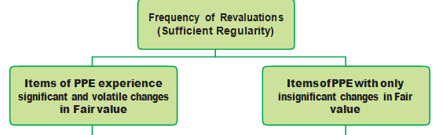

Slide 28
Frequency of Revaluations
Items of PPE experience significant and volatile changes in Fair value.
Annualy
Items of PPE with only insignificant changes in Fair value
3 to 5 years

Slide 29
Cost Model
=Cost - Any Accumulated Depreciation
- Any Accumulated Impairment losses

Slide 30

Revaluation Model

Slide 31
Gross carrying amount
May be restated by reference to observable market data or proportionately to the change in the carrying amount
Accumulated depreciation
Adjusted to equal the difference between the gross carrying amount and the carrying amount of the asset after taking into account accumulated impairment losses
Technique 1:

Slide 32
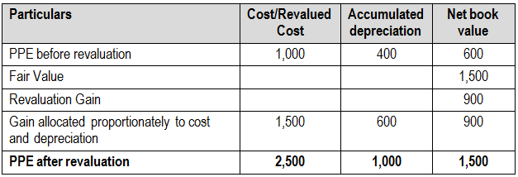
Example on Technique I
PPE is revalued to 1,500 consisting of ` 2,500 Gross cost and Rs 1,000 Depreciation based on observable market data

Slide 33
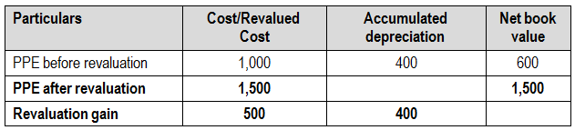
Technique 2
Accumulated depreciation Is eliminated against the Gross Carrying amount of the asset

Slide 34
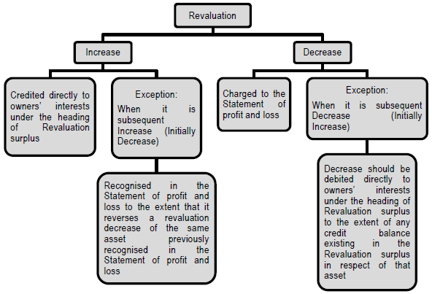

Slide 35
Revaluation Reserve
First Time
Profit
Credited to Revaluation Reserve
Subsequent Time
First Revaluation (Upward)
Loss
Debited to Profit & Loss A/c
Loss
First Revaluation (downward)
Loss
Profit
Profit
Credited to Revaluation Reserve
Adjust with Revaluation Reserve & Balance Transfer to P & L A/c
To the Extend of Earlier Written off transfer to P & L and Balance credited to Revaluation Reserve
Debited to Profit & Loss A/c

Slide 36
The revaluation surplus included in owners’ interests in respect of an item of PPE may be transferred to the Revenue Reserves when the asset is derecognised.

Slide 37
Treatment of Revaluation Surplus
Option 1
whole surplus is transferred
ONLY When the asset is:Retired; Or Disposed of
Option 2
Some of the surplus may be transferred as the asset is used by an enterprise
In such a case, the amount of the surplus transferred would be: Depreciation (based on Revalued Carrying amount) – Depreciation (based on Original Cost)

Slide 38
Transfer an amount equal to the excess depreciation (difference between new depreciation and old depreciation) from the revaluation surplus to Revenue Reserve

Slide 39
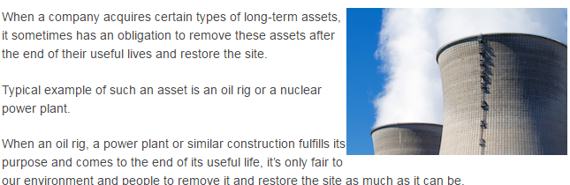

Slide 40
DEPRECIATION
Depreciation charge for each period should be recognised in the Statement of Profit and Loss unless it is included in the carrying amount of another asset.
AS 2: Depreciation of manufacturing plant and equipment is included in the costs of conversion of inventories as per AS 2.

Slide 41
Depreciable amount = Cost- Residual value
Residual value and the useful life of an asset should be reviewed at least at each financial year-end and, if expectations differ from previous estimates, the change(s) should be accounted for as a change in an accounting estimate

Slide 42
Commencement of period for charging Depreciation
Depreciation of an asset begins when it is available for use

Slide 43
Each part of an item of PPE with a cost that is significant in relation to the total cost ofthe item should be depreciated separately.
Example : It may be appropriate to depreciate separately the airframe and engines ofan aircraft, whether owned or subject to a finance lease.

Slide 44
Is Grouping of Components possible?
Yes.
A significant part of an item of PPE may have a useful life and a depreciation method that are the same as the useful life and the depreciation method of another significant part of that same item. Such parts may be grouped in determining the depreciation charge.

Slide 45
Entity A has a policy of not providing for depreciation on PPE capitalised in the year until the following year, but provides for a full year's depreciation in the year of disposal of an asset. Is this acceptable?

Slide 46
Depreciation Method based on Revenue
:
A depreciation method that is based on revenue that is generated by an activity that includes the use of an asset is not appropriate.

Slide 47
Entity B manufactures industrial chemicals and uses blending machines in the production process. The output of the blending machines is consistent from year to year and they can be used for different products.
However, maintenance costs increase from year to year and a new generation of machines with significant improvements over existing machines is available every 5 years. Suggest the depreciation method to the management

Slide 48
Cessesation of Depreciation
when asset’s residual value exceeds its carrying amount
The date that the asset is retired from active use and is held for disposal, and
The date that the asset is derecognised

Slide 49
Therefore, depreciation does not cease when the asset becomes idle or is retired from active use (but not held for disposal) unless the asset is fully depreciated

Slide 50
Land and Buildings
Land and buildings are separable assets and are accounted for separately, even when they are acquired together
Land: Land has an unlimited useful life and therefore is not depreciated
Buildings: Buildings have a limited useful life and therefore are depreciable assets

Slide 51
An increase in the value of the land on which a building stands does not affect the determination of the depreciable amount of the building.

Slide 52
Depreciation Method
The method selected is applied consistently from period to period unless:
There is a change in the expected pattern of consumption of those future economic benefits; Or
That the method is changed in accordance with the statute to best reflect the way the asset is consumed.

Slide 53
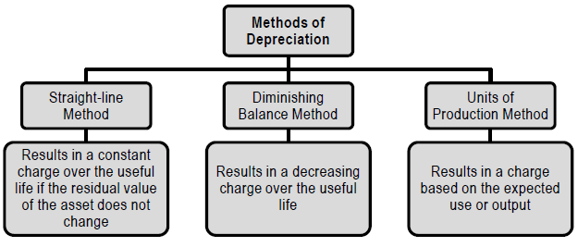

Slide 54
Change in Depreciation Method should be accounted for as a change in an ACCOUNTING ESTIMATE

Slide 55
Changes In Cost of PPE
The cost of PPE may undergo changes subsequent to its acquisition or construction on account of:
Changes in Liabilities
Price Adjustments
Changes in Duties
Changes in initial estimates of amounts provided for Dismantling, Removing, Restoration, and
Similar factors
The above are Adjusted in the cost of the asset

Slide 56
Retirement
Items of PPE retired from active use and held for disposal should be stated at the lower of:
Carrying Amount, and
Net Realisable Value.

Slide 57
Any write-down in this regard should be recognised immediately in the Statement of Profit and Loss. Gains should not be classified as revenue, as defined in AS 9 ‘Revenue Recognition’

