Slide 1
AS 28
IMPAIRMENT OF ASSET

Slide 2
Applicability
Enterprises whose equity or debts securities are already listed OR in the process of listing in the recognised stock exchange in India.
Any commercial, industrial and business reporting enterprises having turnover of more than Rs. 50 Crores in an accounting period.

Slide 3
Depreciation ?

Slide 4
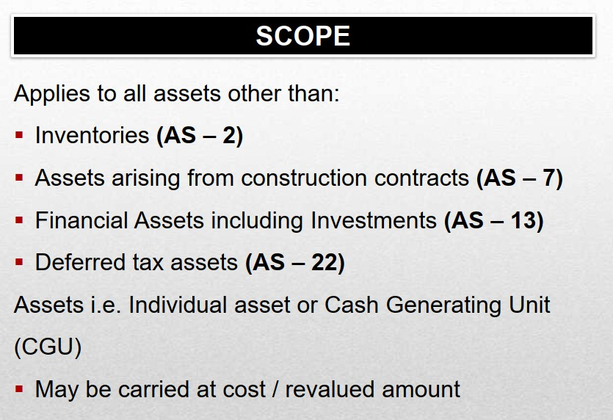

Slide 5
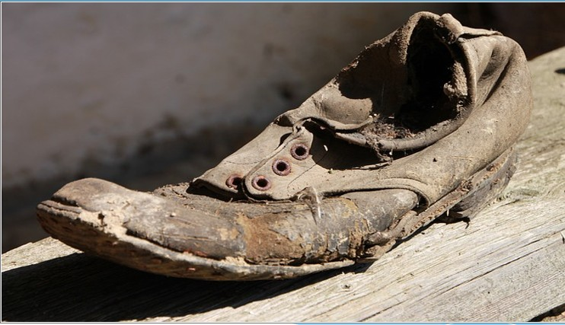
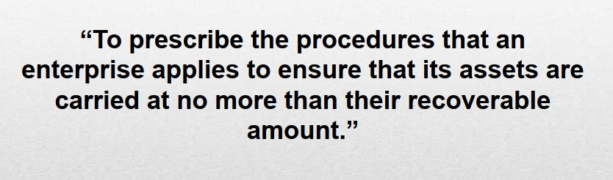
IMPAIRMENT OF ASSET

Slide 6
Impairment loss :
An impairment loss is the amount by which the carrying amount of an asset exceeds its recoverable amount.

Slide 7
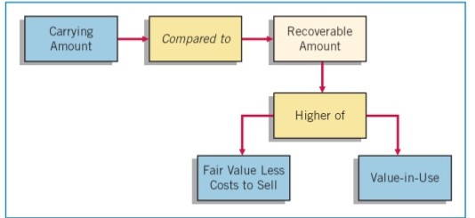

Slide 8
LOSS =2 LACK
44 LACK
46 LACK
42 LACK
44 LACK

Slide 9
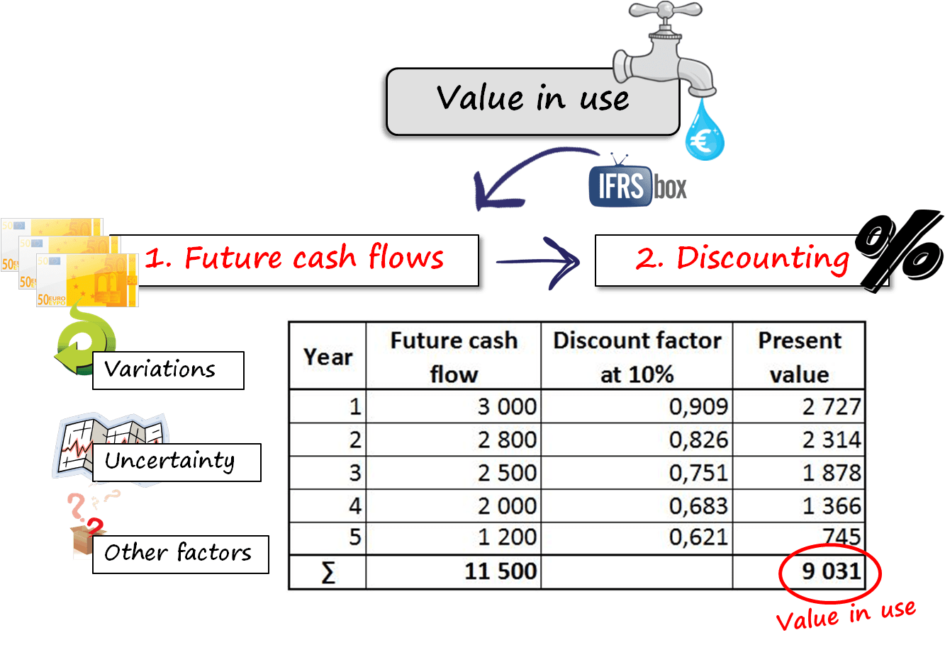

Slide 10
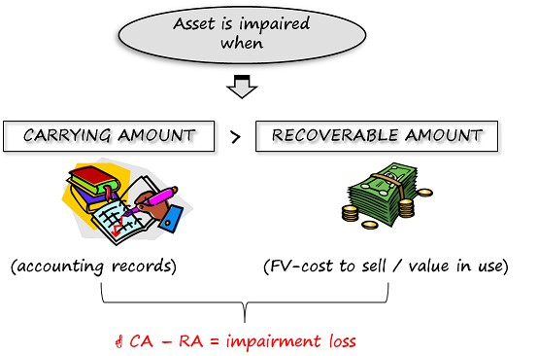

Slide 11
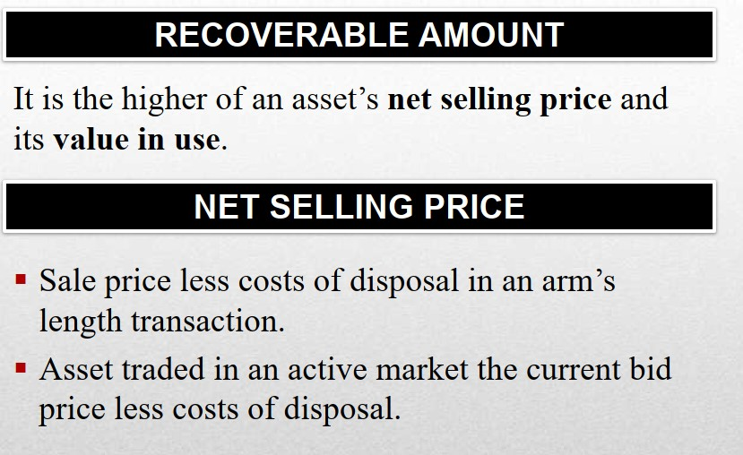


Slide 12
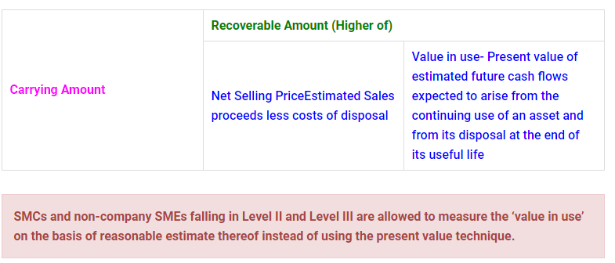

Slide 13
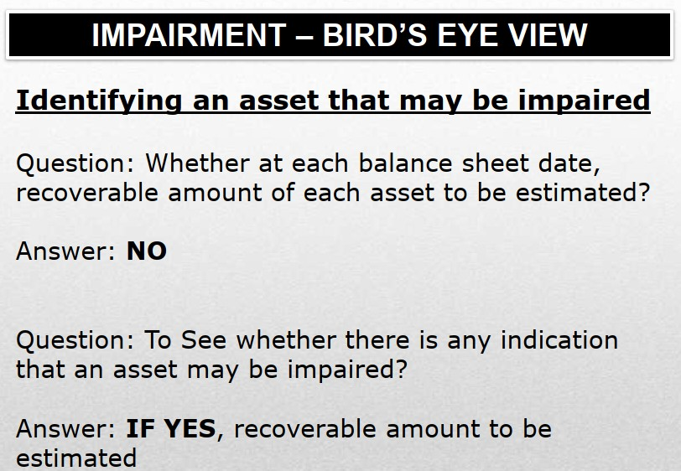

Slide 14
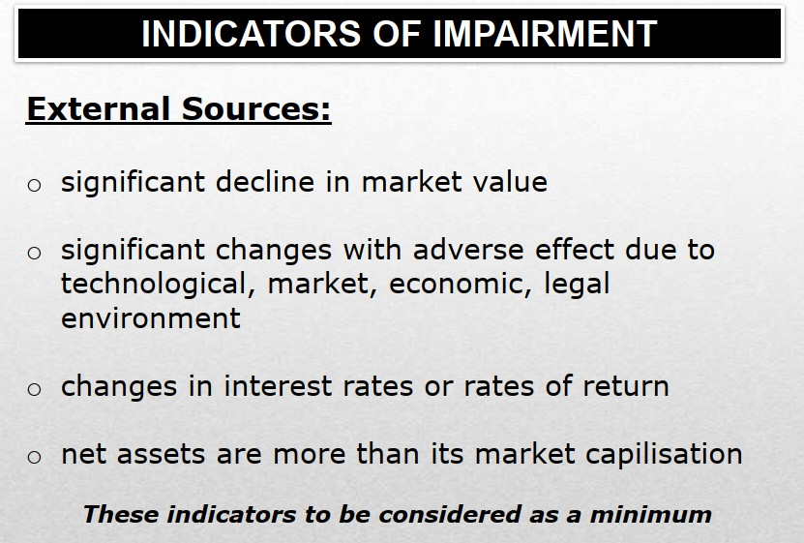

Slide 15
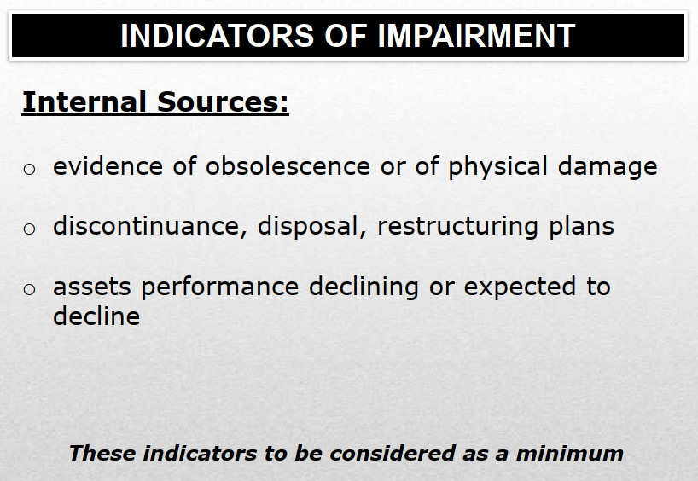

Slide 16
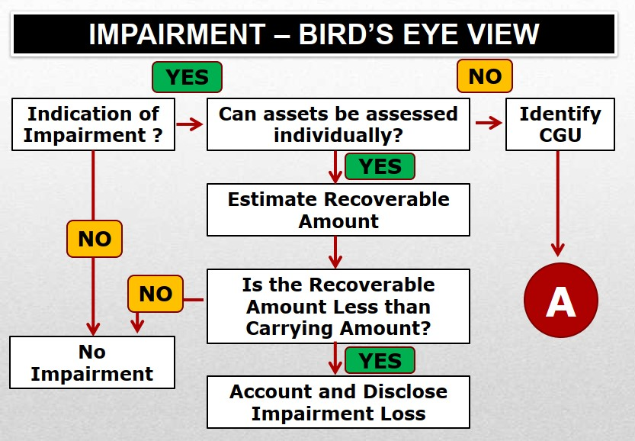

Slide 17
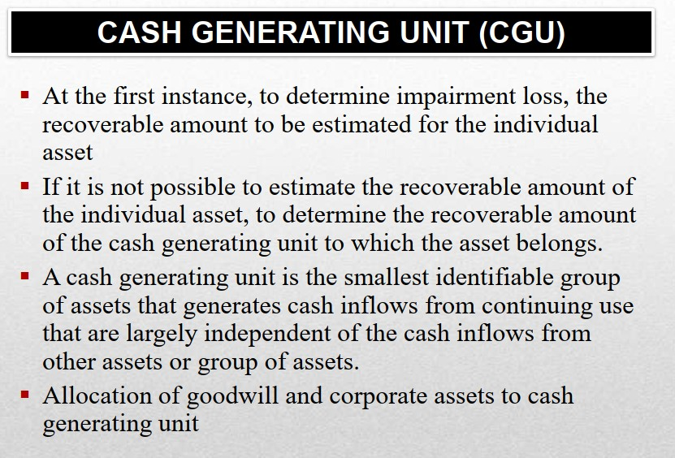

Slide 18
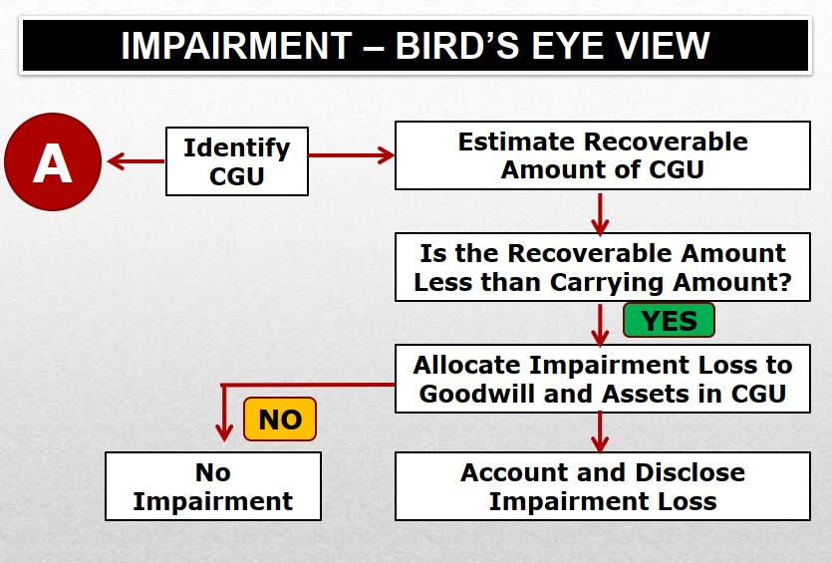

Slide 19
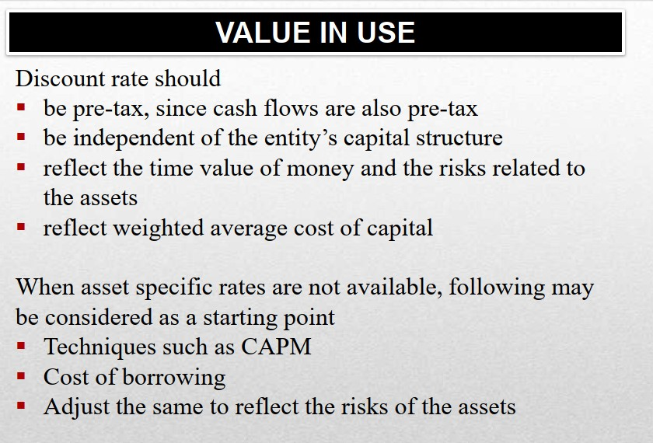

Slide 20
