Slide 1
AS 19
Accounting for Leases

Slide 2
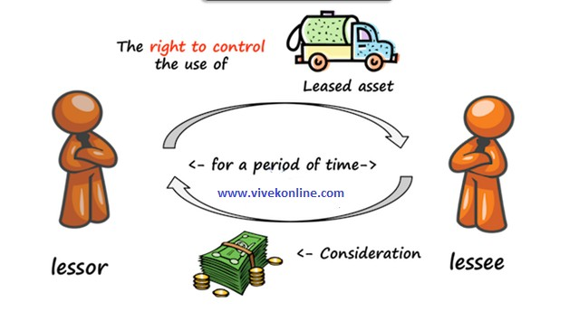

Slide 3
Not Applicable to
Lease agreements to explore for or use of natural resources.
Licensing agreements for items such as motion picture films, patents and copyrights;
Lease agreements to use land
Agreements that are contracts for services, that do not transfer right to use assets from one contracting party to the other.

Slide 4
A Lease is an agreement whereby the Lessor (owner of an asset) conveys to the Lessee (another party) in return for a payment or series of periodic payments (Lease rents), the right to use an asset for an agreed period of time.
FINANCE LEASE
OPERATING LEASE

Slide 5
Finance Lease
It is a lease which transfers substantially all the risks and rewards incident to ownership of an asset.

Slide 6
Indications of Financial Lease
Transfers ownership of the asset to the lessee by the end of the lease term
The lessee has the option to purchase the asset at a price which is expected to be sufficiently lower than the fair value
The lease term is for the major part of the economic life of the asset (eg more than 75%)
Present Value of lease payments is equal to the Fair Value of Asset
The leased asset is of a specialized nature such that only the lessee can use it without major modifications being made.

Slide 7
Indications of Financial Lease
Transfers ownership of the asset to the lessee by the end of the lease term.
The lessee has the option to purchase the asset at a price which is expected to be sufficiently lower than the fair value.
The lease term is for the major part of the economic life of the asset (eg more than 75%)

Slide 8
4 .Present Value of lease payments is equal to the Fair Value of Asset
5 The leased asset is of a specialized nature such that only the lessee can use it without major modifications being made.

Slide 9
Operating Lease
It is a lease which does not transfer substantially all risk and rewards incidental to ownership.

Slide 10
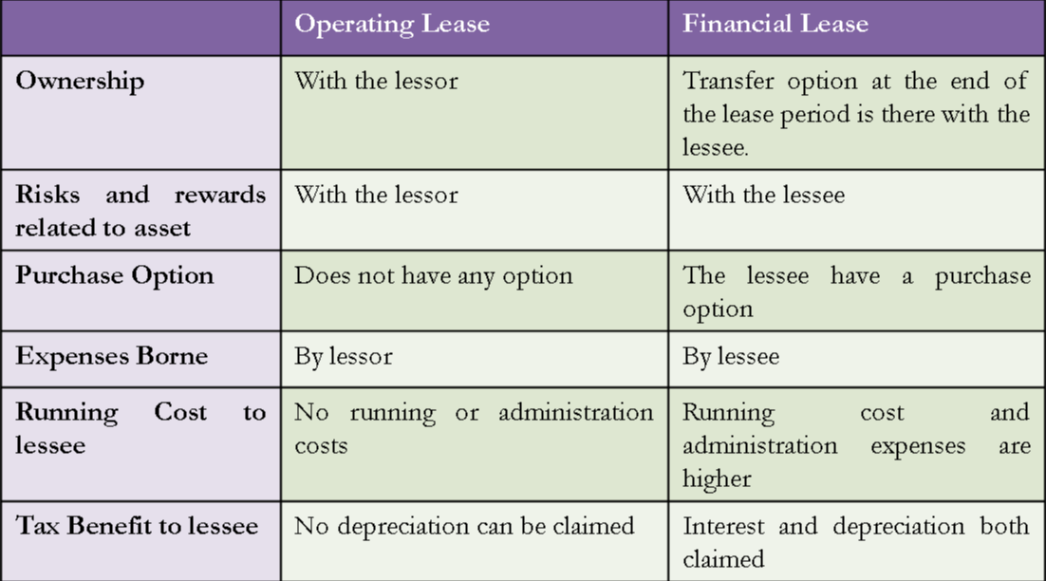

Slide 11
Important Definition
MINIMUM LEASE PAYMENT (MLP)
LESSOR
=MINIMUM RENT + HIGHER OF RESIDUAL VALUE GUARANTEED BY LESSEE OR BY THIRD PARTY
LESSEE
=MINIMUM RENT + RESIDUAL VALUE GUARANTEED BY LESSEE

Slide 12
GUARANTEED RESIDUAL VALUE
LESSOR
Part of Residual value which is Guaranteed by LESSE or an Independent third Party Which ever is Higher
LESSEE
Part of Residual value which is Guaranteed by LESSE

Slide 13
Un Guaranteed Residual Value
= Residual Value – Guaranteed Residual value

Slide 14
GROSS INVESTMENT IN LEASE
= Minimum Lease Payment (Lessor)
+ Un Guaranteed Residual Value

Slide 15
Net Investment in Lease
= Gross Investment in Lease- Unearned Income
Unearned Income
= Gross Investment in Lease- Present Value of Gross Investment in Lease

Slide 16
Interest Rate Implicated in the Lease
Its an IRR
It is a discount rate which equates Gross Investment in Lease to the Fair Value of Leased Asset

Slide 17
CONTINGENT RENT
It is a portion of Lease payment that is not Fixed in amount but is based on Activity .
Eg :- Percentage of Sale
MLP does not include Contingent rent

Slide 18
Accounting for Operating Lease
IN THE BOOKS OF LESSOR
Record Lease Out Asset as a Fixed Asset in the Financial Statement.
Charge Depreciation as per AS 10.
Recognize Lease Income in Profit & Loss Account

Slide 19
In the Books of Lessee
Lease Payment should be charged to Profit & Loss A/c as expense.

Slide 20
Accounting for Finance Lease
IN THE BOOKS OF LESSEE
Lease Asset & Lease Liability should be recognised at LOWER OF
Fair Value of Asset
Present Value of Minimum Lease Payment

Slide 21
Apportionment of Lease Payment
Finance Charge (Interest)
Principal Amount

Slide 22
Depreciation should be Provide by LESSEE

Slide 23
In the Book of Lessor
Recognize as a receivable at an Amount Equal to NET INVESTMENT IN LEASE .
Apportionment of Lease receipt
Principle (Should Deduct from Amount receivable)
Interest ( Credited to Profit & Loss A/c)

Slide 24
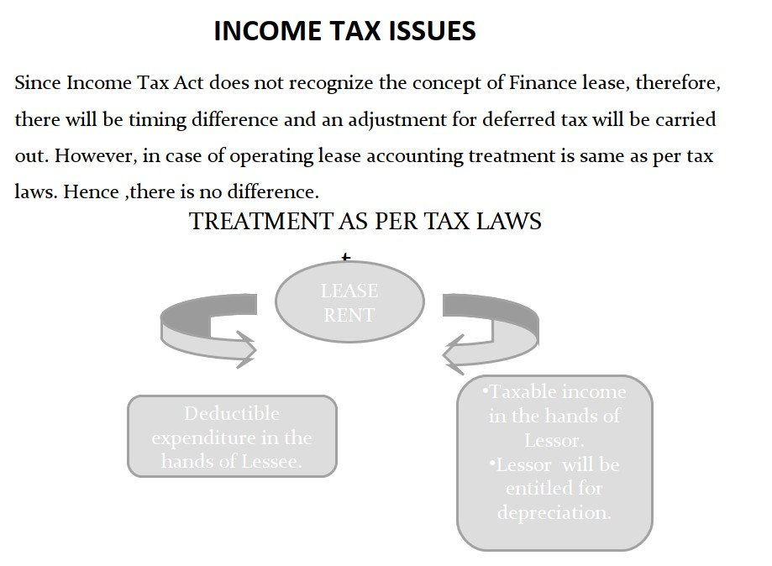

Slide 25
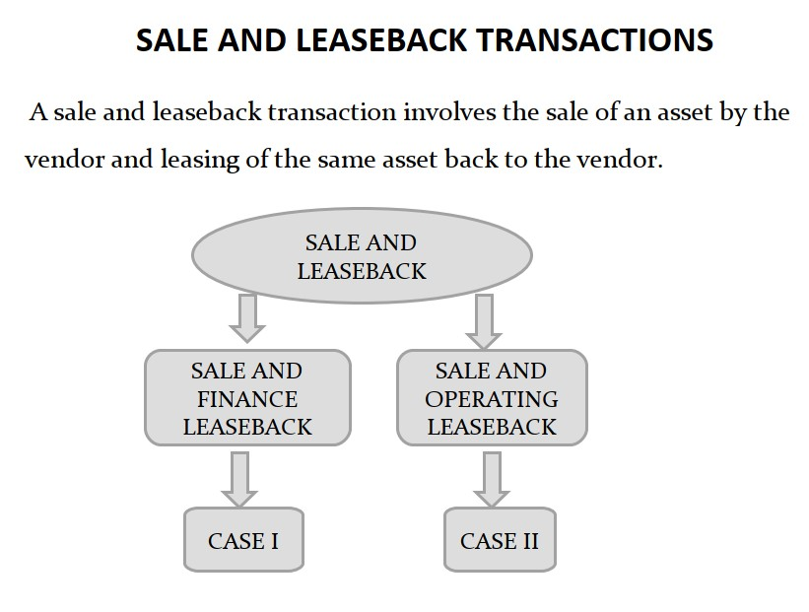

Slide 26
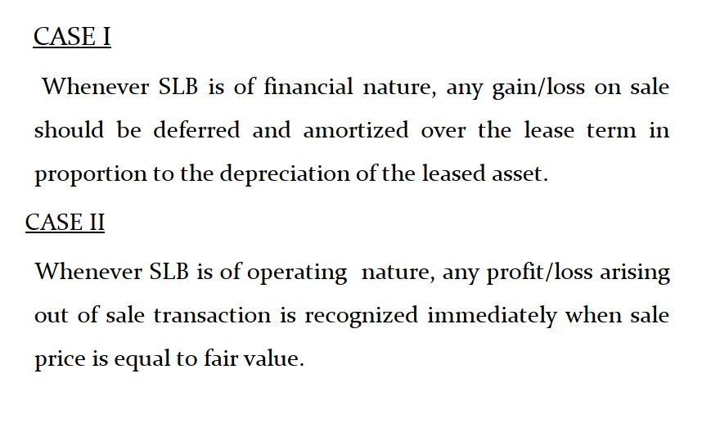

Slide 27
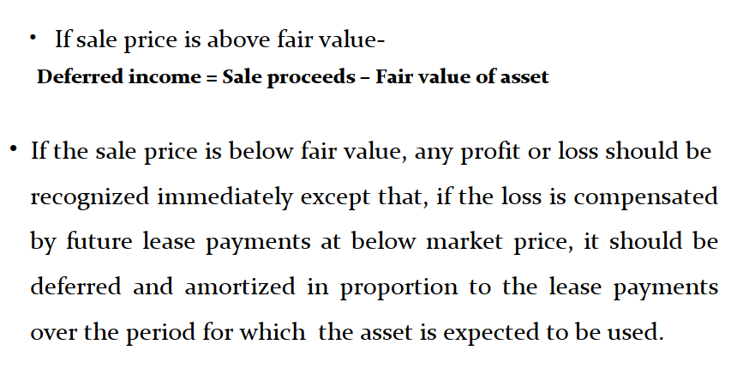

Slide 28
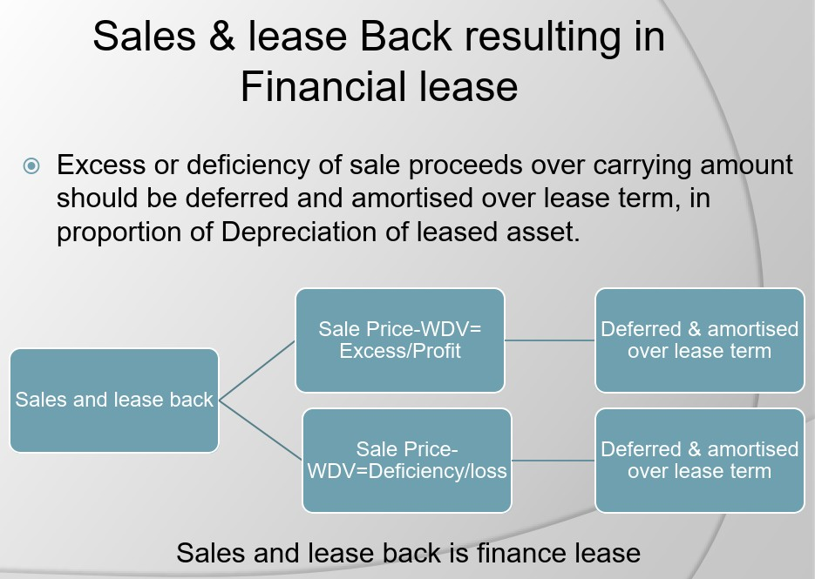

Slide 29
