Slide 1
Disclosure of Accounting Policies
AS 1

Slide 2
This Standard deals with the disclosure of significant accounting policies which
are followed in preparing and presenting financial statements.

Slide 3



Slide 4
To ensure proper understanding of financial statements, it is necessary that all
significant accounting policies adopted in the preparation and presentation of
financial statements should be disclosed.
Such disclosure should form part of the financial statements.

Slide 5
Accounting Policies
The accounting policies refer to the specific accounting principles and the methods used for preparation of Financial Statement by the entity.

Slide 6

Examples for Different Accounting Policies
Valuation Inventory
Method of providing Depreciation
Valuation of Investment
Valuation of Goodwill

Slide 7
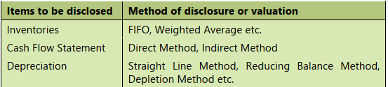

Slide 8
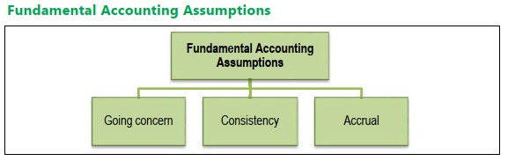
Fundamental Accounting Assumptions

Slide 9
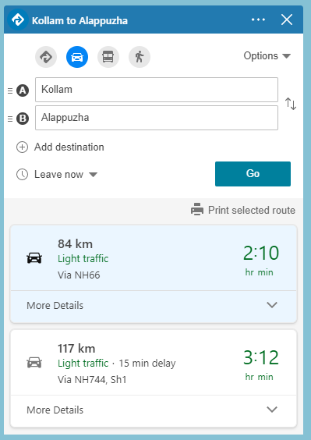


Slide 10
Consideration in Selection of Accounting Policies
Prudence
Substance over form
Materiality

Slide 11
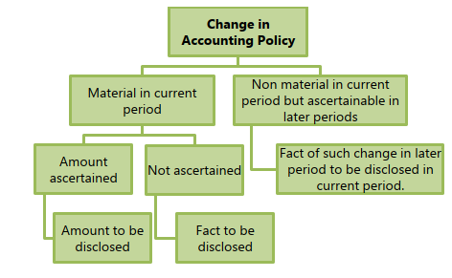
Change in an Accounting Policy

