Slide 1


Income tax
Transition from
1961 to 2025
CA Chandrashekhar V. Chitale

Slide 2

Agenda
Finance Act 2026
Income Computation
Income Tax Act 2025
Charity
Computation Structure
Procedural
Current Year

Slide 3

FINANCE ACT 2026

Slide 4
Changes in Tax Rate
■ S. 195 – (s. 115BBE) – 60% to 30%
– Surcharge of 25% continues.. Effective rate 39%
– Omit penalty u/s 443 (272AAC) – 10%
– Subsume this penalty in s. 439(11). (misreporting :
Penalty - 200% )
– Clause (g) inserted in s. 439(11) – income referred to
in s. 195(b)
■ Penalty only if AO does assessment

Slide 5
Changes in Tax Rate
■ S. 206 – (MAT S. 115JB)
– 15% to 14%
– No MAT Credit from Tax Year 2026-27
– No fresh MAT credit in old regime. Allowed till
15 years only if shifts to S. 200 (115BAA) 201
– Those who shift – allowed to extent of 25%
of
tax liability for domestic Companies
– Foreign company – full credit

Slide 6
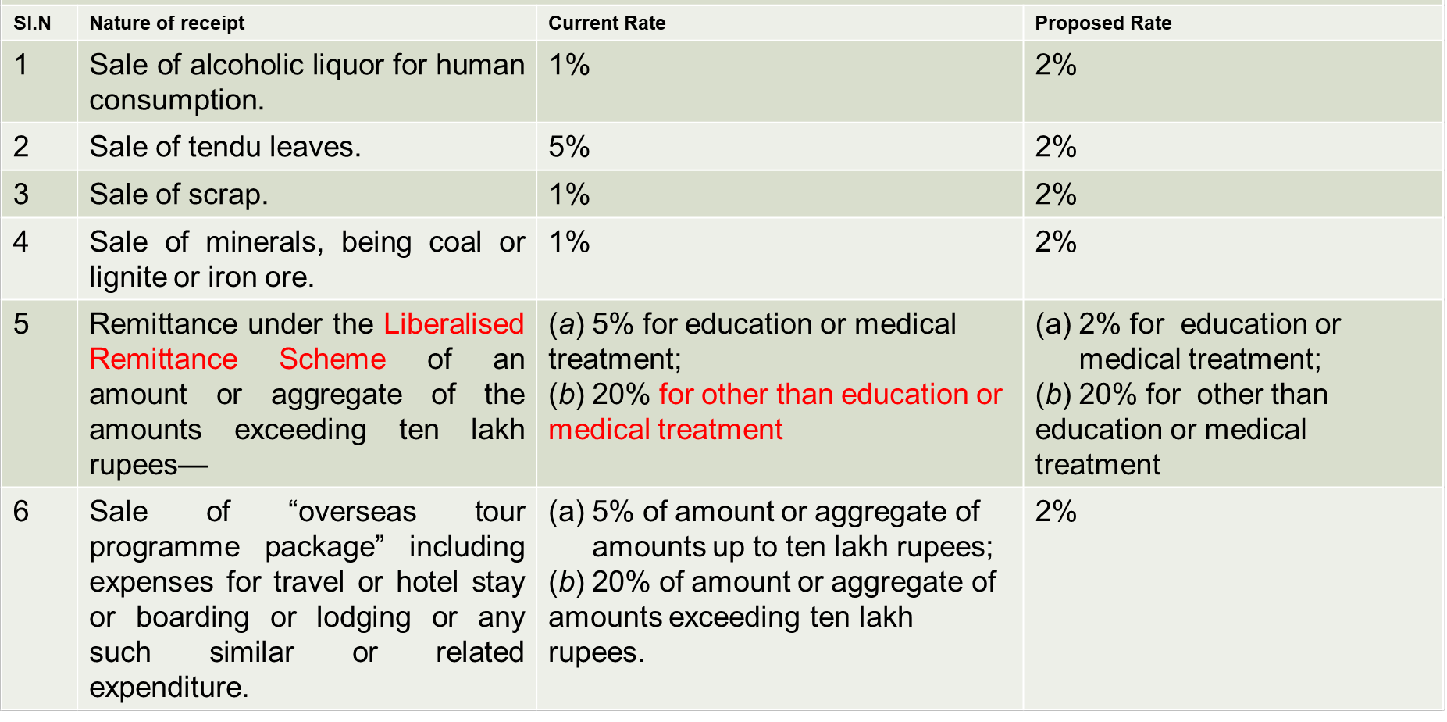
Changes in Tax Rate
TCS

Slide 7
Changes in Due Dates
■ 3 due dates to 4 now – July split to August
– B/F losses, but no business income during year
– Trust – Memorandum / section
– From AY 2026-27 itself
■ Revised return with additional fee from January to March
– If filing 1
time post December, then not belated but
st
updated
– 5k/1k vis-à-vis 25%
– From AY 2025-26 itself

Slide 8





Changes in Revised ITR
Case 1
DD – 31/7 filed 30/7, revised 31/12
•No late fee
Case 2
DD – 31/7 filed 30/9
•Late fee – 5k/1k
Case 3
DD 31/7 filed 30/9, revised 31/12
•Late fee for 30/9 – 5k/1k
Case 4
DD 31/7 – filed 31/12, revised 31/1
•Late fee 2 times

Slide 9
Changes in Updated ITR
■Now allowed for:
–Reduction in losses
–If notice u/s 148 / 280
■ Can file with addl. 10% tax
■ No return then u/s 148/280

Slide 10
Minimum Time Limit for Filing Return in Reassessment
a. Earlier, there was no minimum time prescribed for a taxpayer to file a return in response to a reassessment notice (only a maximum of 3 months was prescribed).
b. Finance Act 2026 now prescribes a minimum of 30 days from the date of notice for the taxpayer to file their return.
Effective from 30 March 2026 under Income Tax Act, 1961 and 1 April 2026 under Income Tax Act, 2025.

Slide 11
Assessments Not Invalid Due to Defects in Approval
Several provisions require prior approval from a higher tax authority before assessment or reassessment proceedings can be initiated. Courts have in the past quashed assessments on the ground of mechanical or inadequate approvals.
Now provides that such approvals are administrative and supervisory in nature and assessments shall not be held invalid merely on account of: (a) inadequate reasons recorded (b) defects in authentication or communication of approval, or (c) absence of digital signature; provided electronic approval exists. [w.r.e.f.1 April 2021 under Income Tax Act, 1961 and from 1 April 2026 under Income Tax Act, 2025.

Slide 12
Faceless Assessment - Authentication Without Digital Signature
Assessment units, verification units, technical units and review units under the faceless assessment scheme can now authenticate electronic records through electronic communication, without affixing digital signatures.
Effective retrospectively from 1 April 2022.

Slide 13
TAN
■ No TAN for resident individual / HUF for purchase
of residential property from NR w.e.f. 1.10.2026
– Rent, etc.??
– NR to NR??
■ Employee contribution to ESI/PF – amendment in
s. 29 - allowed if paid till due date u/s 263(1)
■ No deduction against dividend income – earlier
20% if interest

Slide 14

Income Computation

Slide 15
Exempt Income
■ Compensation amount awarded by Motor Accident
Claims Tribunal (MACT) including interest
■ Compulsory acquisition of any land under the
RFCTLARR Act.
■ Exemption for Sovereign Gold Bonds – from
original till maturity is must

Slide 16

Changes in Buy-Back Tax
Type of Gain
Promoter
Non-Promoter
Domestic
Other than
Company
Domestic Company
LTCG
22%
30%
12.5%
STCG
22%
30%
Applicable / Slab rate
■ Promoter:
– Listed Co- Regulation 2(k) of SEBI (Buy-back) Reg.
– Other:
■ S. 2(69) of Companies Act 2013
■ Person who hold directly/indirectly more than 10%

Slide 17
Business, Other Sources
■ Employee contribution to ESI/PF – amendment in
s. 29 - allowed if paid till due date for furnishing of ROI u/s 263(1)
■ No deduction against dividend income – earlier
20% if interest [Sec. 93(2)]

Slide 18
Fees, Penalty
■ Tax Audit – Penalty to Fee - graded [Sec 428(c)]
■ TP Report – Penalty to fee – graded [Sec 428(d)]
■ SFT – Rs. 200 p.d. Max Rs. 1 L – Penalty to fee
■ Misreporting Penalty 100% / 120% if paid with 30
days++
■ Penalty order along with assessment Order –
Interest on penalty only after 1
appeal order –
st
from 1.4.27

Slide 19
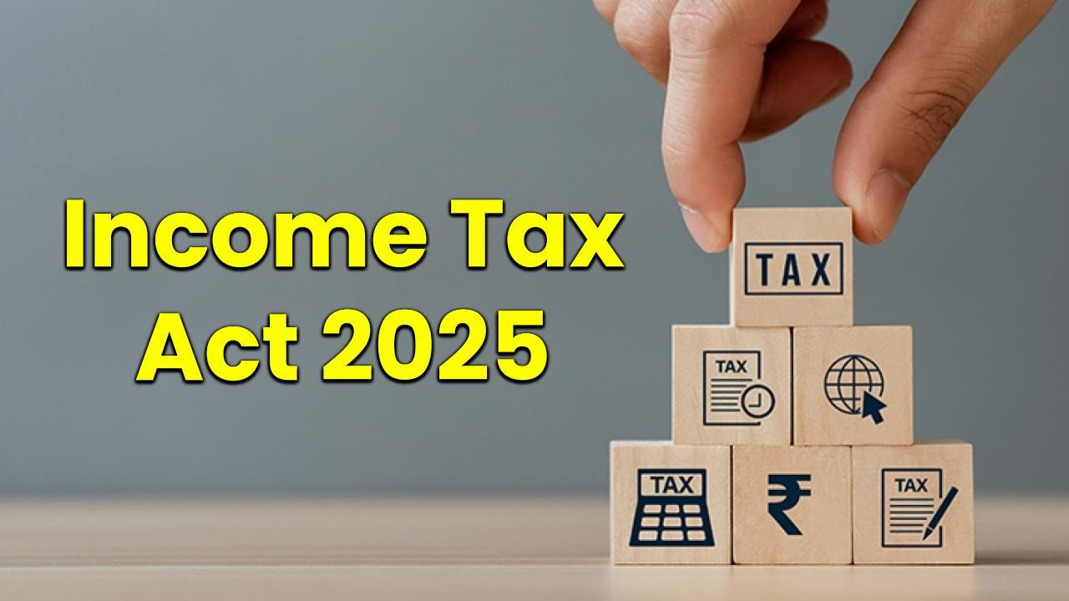

Slide 20


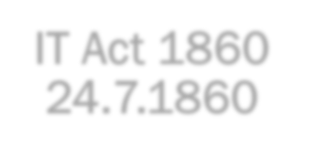











Journey
IT Act 1860
IT Act 1886
IT Act 1918
24.7.1860
IT Act 2025
IT Act 1961
IT Act 1922

Slide 21


Tax year
Assessment &
Previous Year

Slide 22
Transition from 1961 to 2025 – S 536
■ 1961 Act repealed vide s. 536 (Repeal and savings)
■ Repealed Act to continue to apply to any pending
proceedings
■ Penalty can be imposed in the repealed Act
■ Losses allowed to be carried forward
■ MAT / AMT also allowed to be carried forward
■ Many other allowed…
■ General clauses Act applicable

Slide 23
Transition from 1961 to 2025
■ Interest w.e.f. 1-4-2026 – Under IT Act 2025
■ 1961 Act : Circulars, Notifications, Approvals
■ 1961 Act : ITAT, HC, SC Decisions
■ 1921 Act : ??

Slide 24











Exempt Income
Section 10
Sch II
•To any person – 17 incomes including agriculture
Sch III
•Eligible persons – 42 incomes (Sl. No. 38A to
38D inserted in 2026), including partners, HUF
Sch IV
•Non- Residents, Foreign Co – 17 incomes (Sl. No.
13A to 13C inserted in 2026)
Sch V
• Investment funds, business trusts & unit holders – 8 incomes
Sch VI
•IFSC – 12 incomes
Sch. VII
•Persons Exempt – 49 persons
Salary Related
•No Schedule - gratuity, leave encashment,
Voluntary Retirement Scheme, etc in S. 19

Slide 25

Charitable Institutions

Slide 26
NPO
■ 2.50 L ITR for AY 2023-24. They applied Rs 10 L Crs. for
charitable & religious purposes in FY 2022-23
■ 1961 provisions
– Chapter I: Charitable Purpose (S. 2(15))
– Chapter III: S. 10(23C), 11, 12, 12A, 12AA, 12AB, 12AC &
13
– Chapter VIA: Section 80G
– Chapter XII / XIIEB: Sections 115BBC, 115BBI, 115TD,
115TE, 115TF

Slide 27
NPO
■ Now only certain persons specified can register – S.332
■ Application, duration, validity, etc. all in one table
■ Incomes:
– Regular income.
– Specified income.
– Income not to be included in regular income.
– Corpus donation.
– Deemed corpus donation

Slide 28
NPO
■ 2025 Act – Sections 332 to 355
– Unified term "registered non-profit organization" is used
instead of various terms like trust, institution, etc.
– "Registration" replaces "approval"
– All provisions are consolidated in Part B of Chapter XVII
under "Special Provisions for Registered NPOs."
■ Capital gains u/s 11(1A) done away with.
■ Deemed application under Explanation 1(2) of section
11(1) done away wit. Accumulation u/s 11(2) for up to
five years continues

Slide 29



NPO
CHAPTER XVII - PART B
SPECIAL PROVISIONS FOR REGISTERED NON-PROFIT ORGANISATION
Sub-
Heading
Sections
Part
1
Registration
332-333
2
Income of registered non-profit organisation
334-343
3
Commercial activities by registered non-profit
344-346
organisation
4
Compliances
347-350
5
Violations
351-353
6
Approval for purpose of deduction under section
354-355
133(1)(b)(ii)

Slide 30

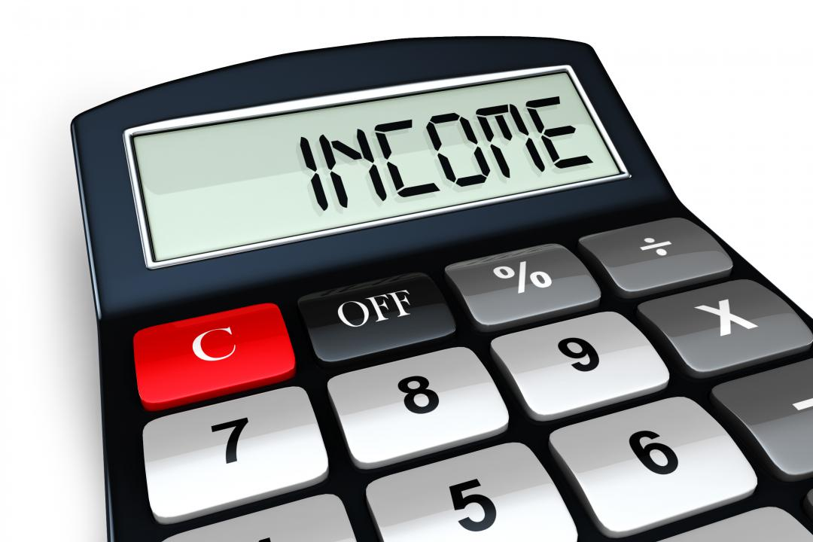
Computation Structure

Slide 31
INCOME COMPUTATION
Chapters
Sub Heading
Sections
IV - Computation of
A.—Heads of income
13-14
Total Income
B.—Salaries
15-19
C.—Income from house
20-25
property
D.—Profits and gains of
26-66
business or profession
E.—Capital gains
67-91
F.—Income from other
92-95
sources

Slide 32
SALARY
■ From S. 16 (1961 Act) to S. 19 now
■ Apart from standard deduction, etc. it includes:
– Gratuity (Old S. 10(10))
– Commutation of Pension (Old S. 10(10A))
– Workmen Compensation (Old S. 10(10B))
– Leave Encashment (Old S. 10(10AA))
– Voluntary Retirement Scheme (Old S. 10(10C))
■ These deductions are allowed in New Tax Regime too,
as per s. 202 (old S. 115BAC).

Slide 33
Business Deductions
■ Section 28 now consolidates:
– Old s. 30 (Rent, rates, taxes, repairs & insurance for
buildings),
– Old s. 31 (Repairs and insurance of machinery, plant
and furniture)
– Old s. 38 (Building, etc., partly used for business,
etc., or not exclusively used)

Slide 34
Business Deductions
■ Provisions related to expenses for contributions to PF, Gratuity Fund,
Superannuation Fund, etc., were spread across various sections in
1961 Act, such as 40A (7), (9) & 36(1)(iv), (iva), (v) & (va). In 2025
Act, these provisions consolidated under single S. 29.
■ It includes:
– Contribution towards recog.PF or approved superannuation fund.
– Contribution towards a pension scheme.
– Contribution towards an approved gratuity fund.
– Contribution received from an employee (ESI, PF).
– Non allowability for setting up or formation of, or as contribution
to, any fund, trust, company, AOP, BOI, society
– Non- allowability for gratuity unless paid.

Slide 35
Partnership
Remuneration and Interest
Clause in partnership Deed
As per Section 40(b)
As per Income tax Act, 1961
As per Income tax Law

Slide 36
Business
– Sections Transition
1961 Act | Subject Matter | 2025 Act
28 | Income under head | 26
29 | Manner of computing | 27
 | Rent, rates, taxes, repairs and insurance. | 28
 | Deductions related to employee welfare | 29
36(4) | Bad debt, Bad &doubtful debts Provision | 31
32 | Depreciation. | 33
37 | Other Deductions | 34
43B | Deduction on Actual Payment | 37

Slide 37
Business
– Sections Transition
1961 Act
Related to
2025 Act
35D
Amortisation of preliminary expenses
44
44AD/44ADA/44AE
Presumptive Taxation for Residents
58
44AA
Maintenance of Books
62
44AB
Tax Audit
63
47
Transactions not regarded as transfer
70
41
Deemed as profits and gains
38
68
Unexplained Credits
102
269SS / 269T
Taking / repayment of deposits, loans, etc
185 / 188
112A
Tax on LTCG in certain cases
198
115BAC
New Tax Regime
202

Slide 38
BOOKS
■ Section 62 as compared to Old S. 44AA
■ Specified profession - Information Technology and Company
secretary professions have been added in the section as specified
professions, earlier - notifications.
■ Earlier books of accounts were required for assessee, who was
engaged in business which was covered u/s 44AD(4) and his TI
Total Income exceeded the MANCT. Now:
– condition of TI exceeding MANCT is not there,
– hence even if an specified assessee is not declaring profits as
per presumptive basis and as his income is below MANCT
– consequently tax audit is not required,
– still the assessee would have to prepare its books of accounts.

Slide 39
EIS, AUDIT
■ Section 58 (Old s. 44AD/44ADA/44AE) r.w.s. 63 (Old S. 44AB)
■ Earlier Old S. 44AD was optional, now seems to be mandatory.
■ Now declaring income lower than specified % of profit, and its TI
exceeds MANCT, requirement is to:
– Maintain books of accounts; and
– Get the audit done u/s 63
■ However, u/s 63, condition of TI exceeding MANCT is not
mentioned.
■ Earlier condition of TI exceeding MANCT was not there for
business of plying, hiring or leasing of goods carriage, which is
now required in 2025 Act.

Slide 40
EIS, AUDIT
  Section 63 Form 26
  Parts A B C and D
Notes:
2. Where any of the requirements in this Form is answered in the negative or with qualification, give reasons therefor.
3. Whenever the assessee is required to furnish an audit report under any other section of the Income-tax Act, 2025, the auditor conducting audit for the purpose of section 63, shall give due consideration to the report of such other audit while finalising this report.
Clauses C D- 53 Under Captions A to K Schedules

Slide 41
Capital Gains
Sec.
2025 Bill
Sec 1961 Act
8
Income on receipt of capital asset
9B Income on receipt of capital asset or
or stock-in-trade by specified
stock-in-trade by specified person from
person from specified entity
specified entity
67 Capital gains
45 Capital gains
68 Capital gains on distribution of
46 Capital gains on distribution of assets by
assets by companies in liquidation.
companies in liquidation
69 Capital gains on purchase by
46A Capital gains on purchase by company of
company of its own shares or other
its own shares or other specified securities
specified securities
70 Transactions not regarded as trnsfer
47 Transactions not regarded as transfer
71
Withdrawal of exemption in certain
47A Withdrawal of exemption in certain cases
cases

Slide 42
Capital Gains
Sec.
2025 Bill
Sec
1961 Act
72
Mode of computation of capital gains
48 Mode of computation of capital gains
73
Cost with reference to certain modes
49 Cost with reference to certain modes of
of acquisition
acquisition
74
Special provision for computation of
50 Special provision for computation of capital
capital gains in case of depreciable
gains in case of depreciable assets.
assets.
75
Special provision for cost of
50A Special provision for cost of acquisition in
acquisition in case of depreciable
case of depreciable asset
asset
76
Special provision for computation of
50AA Special provision for computation of capital
capital gains in case of Market
gains in case of Market Linked Debenture
Linked Debenture

Slide 43
Capital Gains
Sec.
2025 Bill
Sec.
1961 Act
77
Special provision for computation of
50B Special provision for computation of capital
capital gains in case of slump sale.
gains in case of slump sale.
78
Special provision for full value of
50C Special provision for full value of consideration
consideration in certain cases.
in certain cases.
79
Special provision for full value of
50CA Special provision for full value of consideration
consideration for transfer of share
for transfer of share other than quoted share
other than quoted share
80
Fair market value deemed to be full
50D Fair market value deemed to be full value of
value of consideration in certain
consideration in certain cases
cases
81
Advance money received
51
Advance money received
82
Profit on sale of property used for
54
Profit on sale of property used for residence
residence

Slide 44
Capital Gains
Sec.
2025 Bill
Sec.
1961 Act
83
Capital gains on transfer of land used
54B Capital gains on transfer of land used for
for agricultural purposes not to be
agricultural purposes not to be charged in
charged in certain cases
certain cases.
84
Capital gains on compulsory
54D Capital gains on compulsory acquisition of
acquisition of lands and buildings not
lands and buildings not to be charged in
to be charged in certain cases
certain cases.
85
Capital gains not to be charged on
54EC Capital gains not to be charged on investment
investment in certain bonds
in certain bonds.
86
CG on transfer of certain capital
54F Capital gains on transfer of certain capital
assets not to be charged in case of
assets not to be charged in case of investment
investment in residential house
in residential house
87
Exemption of CG on transfer of assets
54G Exemption of capital gains on transfer of
in cases of shifting of industrial
assets in cases of shifting of industrial
undertaking from urban area
undertaking from urban area.

Slide 45
Capital Gains
Sec.
2025 Bill
Sec.
1961 Act
88
Exemption of capital gains on
54GA Exemption of capital gains on transfer of
transfer of assets in cases of
assets in cases of shifting of industrial
shifting of industrial undertaking
undertaking from urban area to any Special
from urban area to any Special
Economic Zone.
Economic Zone
89
Extension of time for acquiring
54H Extension of time for acquiring new asset or
new asset or depositing or
depositing or investing amount of capital
investing amount of capital gains
gains
90
Meaning of “adjusted”, “cost of
55
Meaning of “adjusted”, “cost of
improvement” and “cost of
improvement” and “cost of acquisition”
acquisition”
91
Reference to Valuation Officer
55A Reference to Valuation Officer

Slide 46
Capital Gains – Old 54EC / New 85
■ ’Capital gain’ has changed to ‘Long-term capital gain’
■ ‘Long-term capital asset’ has been omitted.
■ CIT vs. Ace Builders (P) Ltd. (2006) 281 ITR 210 (Bom)
approved in CIT v. Dempo Co. Ltd. (2016) 387 ITR 354
(SC) - ineffective to the extent of claiming deduction u/s
85 for transfer of a depreciable asset being building.
■ Though it remains long term capital asset (due to its
period of holding) but becomes STCG by virtue of s. 74

Slide 47
Unexplained Money, Assets
1961
Heading
2025
Heading
68
Cash Credits
102
Unexplained Credits
69
Unexplained Investments
103
Unexplained Investment
(69 & part of 69B)
69A
Unexplained Money, etc.
104
Unexplained Asset
69B
Amt. of Investments, etc. not
(69A & part of 69B)
fully disclosed in books of
Accounts
69C
Unexplained expenditure, etc.
105
Unexplained Expenditure
69D
Amt. borrowed or repaid on
106
Amt. borrowed or repaid through
hundi
negotiable instrument, hundi,
etc.
■ ‘May’ replaced with ‘Shall’ except for S. 69D (as it already had ‘shall’)

Slide 48
RELATIVE
■ S. 2(94) - expanded to include both maternal as well as paternal lineal ascendant.
–
Husband,
–
Wife,
–
Brother,
–
Sister
–
Any lineal ascendant (maternal as well as paternal)
–
Descendant of that individual;
■ Relatives are also defined in ss. 92(5)(g), 355(i) and 515(8) which is much wider
than as defined in 2(94).
– S. 92(5)(g) (S. 56(2)(x) of 1961 Act), This is also applicable for purposes of
GAAR - s. 184(8).
– S. 355(i) - Special provisions for registered non-profit organization.
– S. 515(8) - defining authorized representative & Accountant (CA).

Slide 49
RELATIVE
■ Relatives defined in ss. 92(5)(g), 355(i) and 515(8):
1.
spouse;
2.
brother or sister;
3.
brother or sister of the spouse;
4.
brother or sister of either of the parents;
5.
any lineal ascendant (maternal as well as paternal) or descendant;
6.
any lineal ascendant (maternal as well as paternal) or descendant of the
spouse;
7.
spouse of the person referred to in 2 to 6
■ Apart from these 3 provisions, term used in the Act would mean as per this sub-
section, unless specifically defined, like in s. 129(3)(e), which is for the purpose of
education loan interest deduction for relative.

Slide 50

Procedural

Slide 51
Forms, Rules
■
333 Rules as compared to 130 ++
■
190 Forms Eg. for PAN allotment - 4 forms (93-96 / 49A &
49AA of 1962 Rules)
■
Form 26 - Form 3CA/CB/CD
■
Form 44 – Form 67
■
Form 48 – Form 3CEB
■
Form 121 – Form 15G/H
■
Form 130 / 131 – Form 16/16A
■
Form 145/146 – Form 15CA/CB

Slide 52
Sections Transition
1961 Act
Related to
2025 Act
115JA to 115JF
MAT & AMT
206
132
Search & Seizure
247
133A
Power of Survey
253
139
Return of Income
263
143
Assessment
270
147
Income Escaping Assessment
279
12A
Application for Registration
332
11 / 12 / 13 / 80G
Charities
334 to 355
246A
Appeals to CIT(A)
357
253
Appeals to ITAT
362
193 to 197A / 206C
TDS / TCS
393 / 394

Slide 53
TDS
■ 65 sections in 1961 Act specifying TDS liabilities, based on payer /
payee's status & applicable limits, consolidated into 2 – S.
392/393.
■ Now it is a ready-reckoner itself. S. 393 contains tables for:
– Sub s. (1) - Payments to Residents – 8 incomes
– Sub s. (2) - Payments to Non-residents – 17 incomes
– Sub s. (3) - Payment to any person – 7 incomes – lottery, 194T..
– Sub s. (4) - No TDS required – 19 Sl. Nos. (exceptions)
– Sub s. (5) - Declaration for no TDS – 15G/H Now Form No. 121
■ UDIN introduced for real-time verification through the ICAI API - Tax
audit /15CB.

Slide 54


Forms, Rules
T SN
Nature of Income
1961 Act sections
1
Commission / Brokerage
194-H & 194D
2
Rent
194-I & 194 IB
3
Transfer of Immovable Property
194-IA, 194-IC & 194-LA
4
Income from Capital Market
194K, 194LBA, 194LBB &
194 LBC
5
Interest Income
193 & 194A
6
Contractors, FTS & Professional Services
194C, 194M & 194J
7
Dividend
194
8
Other cases
194-DA,
194Q,
194P,
194R, 194-O & 194S

Slide 55
TCS
■ Provisions related to TCS also consolidated – S. 394.
■ It includes one table listing the nature of receipts, monetary
thresholds, collectors, and applicable TCS rates.
■ Conditions for no collection of TCS are also in it.
■ Other Provisions that were scattered across existing Act are now
consolidated into independent sections:
■ Certificates (such as Lower Deduction/Collection Certificates) – S.
395
■ Compliance and reporting (filing of statements, etc.) – S. 397
■ Consequences of failure to deduct or collect tax, or failure to pay the
deducted/collected tax – S. 398
■ Processing of statements – S. 399

Slide 56
Old 149 / New 282
Notice Type
Condition (Likely
1961 Act (S. 149)
2025 Act (S. 282)
Income Escaped)
Time Limit
Time Limit
Show cause / Pre Notice
< Rs. 50 Lacs
Within 3 years from end
Within 4 years from end
(S. 148A / S. 281)
of AY
of Tax year
Show cause / Pre Notice
> Rs. 50 Lacs
Within 5 years from end
Within 6 years from end
(S. 148A / S. 281)
of AY
of Tax year
Reassessment
Notice
(S.
< Rs. 50 Lacs
Within 3 years 3 months
Within 4 years 3
148 / S. 280)
from end of AY
months from end of Tax
year
Reassessment
Notice
(S.
> Rs. 50 Lacs
Within 5 years 3 months
Within 6 years 3
148 / S. 280)
from end of AY
months from end of Tax
year

Slide 57
PAN
Form No.
Purpose
PAN CR-01
For Individual – Request for changes or
correction in PAN Data
PAN CR-02
For Non-Individual – Request for changes
or correction in PAN Data
Vide Order dated 1
April 2026 – S. 262(4) read with Rule 158(12)
st

Slide 58
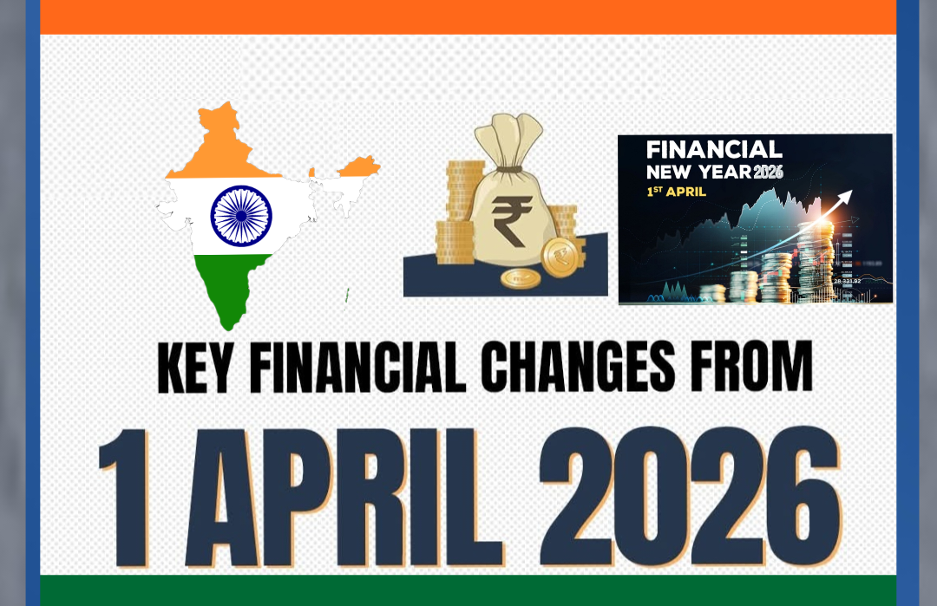
Current Year

Slide 59
2026-27
■
ITR for AY 2026-27
■
TDS / TCS for TY 2026-27
■
Advance Tax for TY 2026-27
■
Self assessment tax for AY 2026-27
■
Presumptive Income
■
Books
■
Lower TDS/TCS certificate form
■
Forms for informing other income / tax regime to be chosen
by employee to employer

Slide 60


Final tips & takeaways
Members to
Think Over
and
Suggest

Slide 61
Thank you
CA Chandrashekhar V. Chitale

