Slide 1

Skill Up, Scale Up
CA Jay Chhaira
B.Com., LL.B., F.C.A., A.C.M.A., M.F.M., M.Com.(FT), M.B.A.(Fin.), P.G.D.F.M., M.F.C., M.Bk.M., M.Com.(CIM), D.I.M., D.B.F., M.Phil.(Mgt.), A.D.B.A., P.G.D.Adv., P.G.D.M.M., I.S.A.(ICAI), M.A.(Eco), M.B.A.(Inv.), P.G.D.I.M., P.G.D.Ent., D.B.M., P.G.D.I.B., A.M.P.G.S.(U.S.), P.G.D.W.M., P.G.D.I.P.R., A.D.M.A.(U.K.)

Slide 2
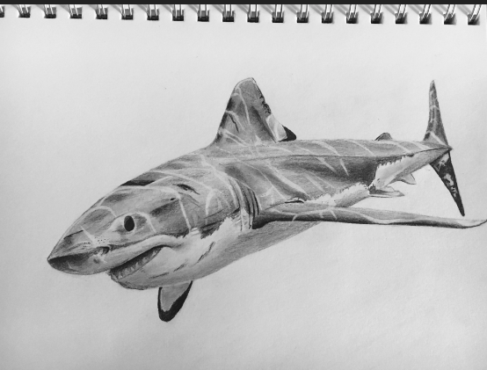
A shark in a fish tank will grow 8 inches, but in the ocean it will grow to 8 feet. The shark will never outgrow its environment and the same is true about you.

Slide 3
The Environment Barrier
A shark in a fish tank will grow 8 inches, but in the ocean it will grow to 8 feet. The shark will never outgrow its environment and the same is true about you.

Slide 4
The Vision Barrier
Working IN Practice rather than Working ON Practice

Slide 5
The Delegation Barrier
Who are we? Chief Executive Officer or Chief Worker?

Slide 6
The Comfort Barrier
We have always done this way.

Slide 7
The Identity Barrier
I am an auditor, I am a tax consultant.

Slide 8
The Busy Trap
“I don’t have time to spare.” Indicates a lack of scalability.

Slide 9


Slide 10






Slide 11


Slide 12
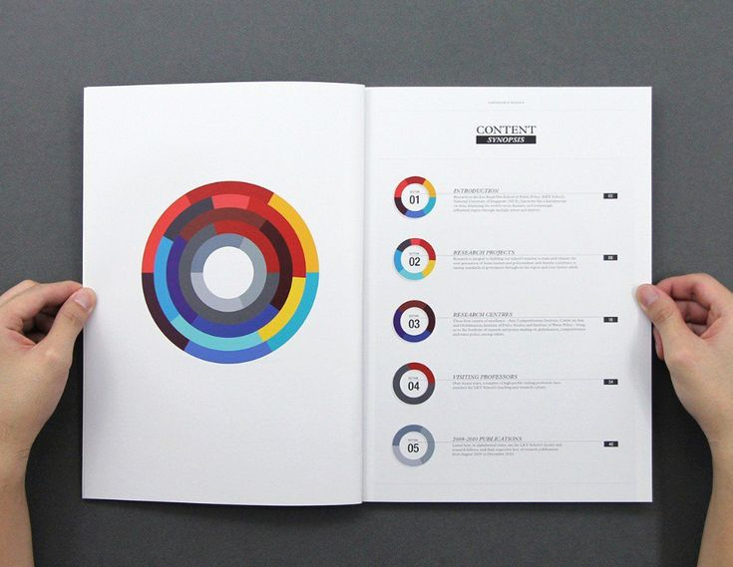

Slide 13


Slide 14


Slide 15


Slide 16


Slide 17


Slide 18


Slide 19



Slide 20


Slide 21
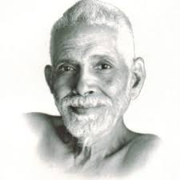

Slide 22
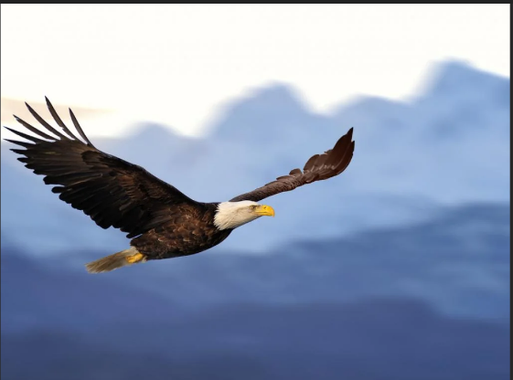

Slide 23


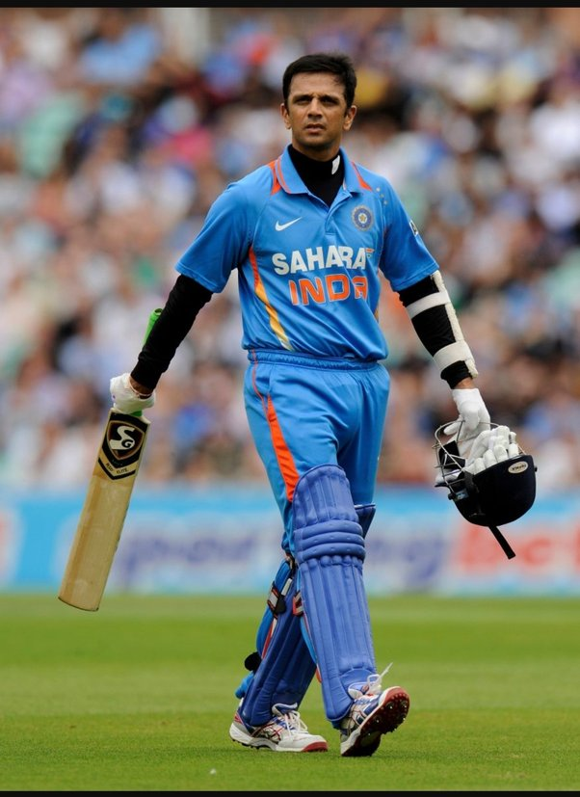
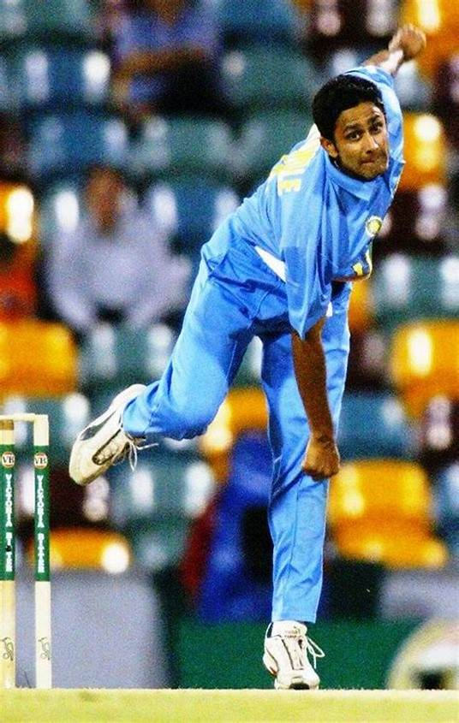
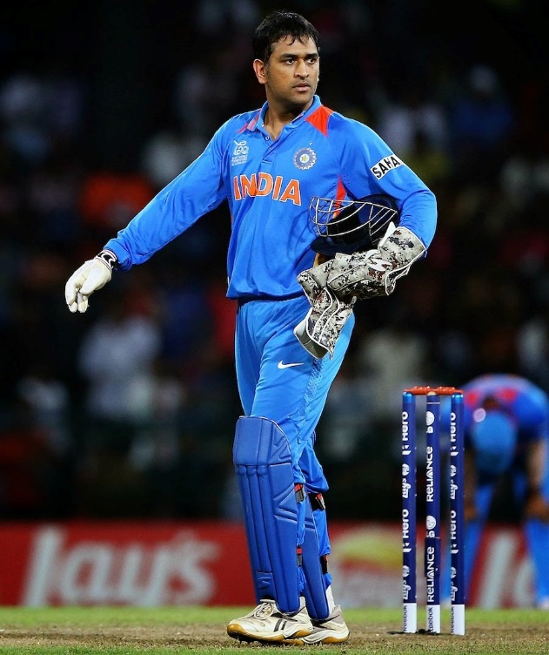

Slide 24



Slide 25


Slide 26
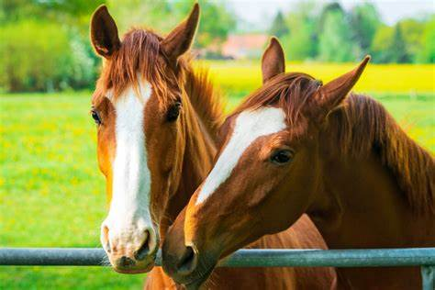

Slide 27
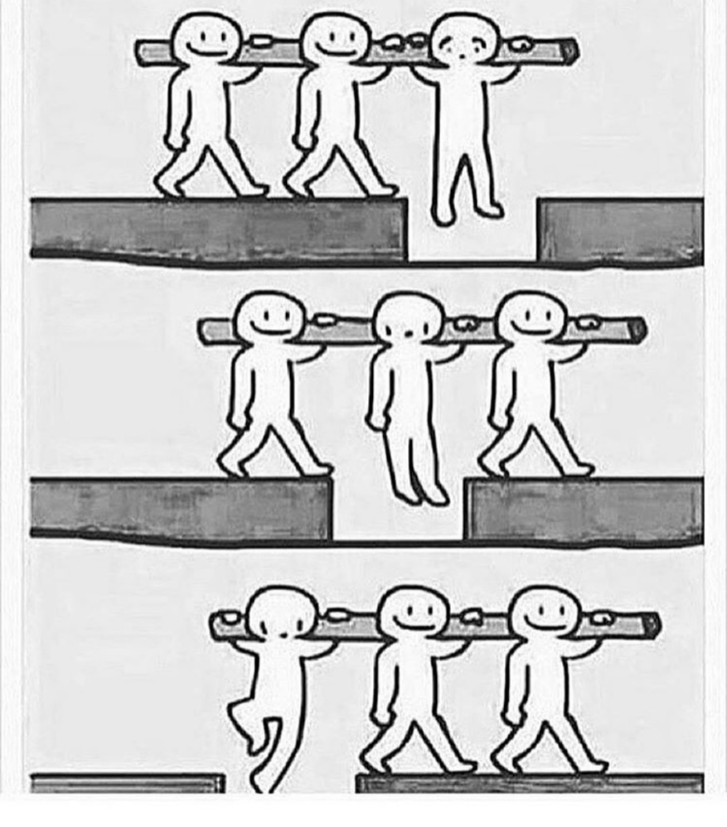

Slide 28
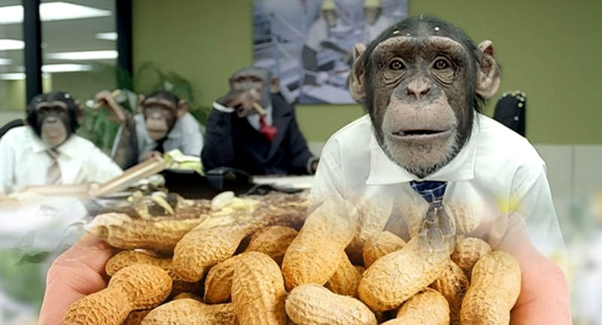

Slide 29


Slide 30


Slide 31



