Slide 1
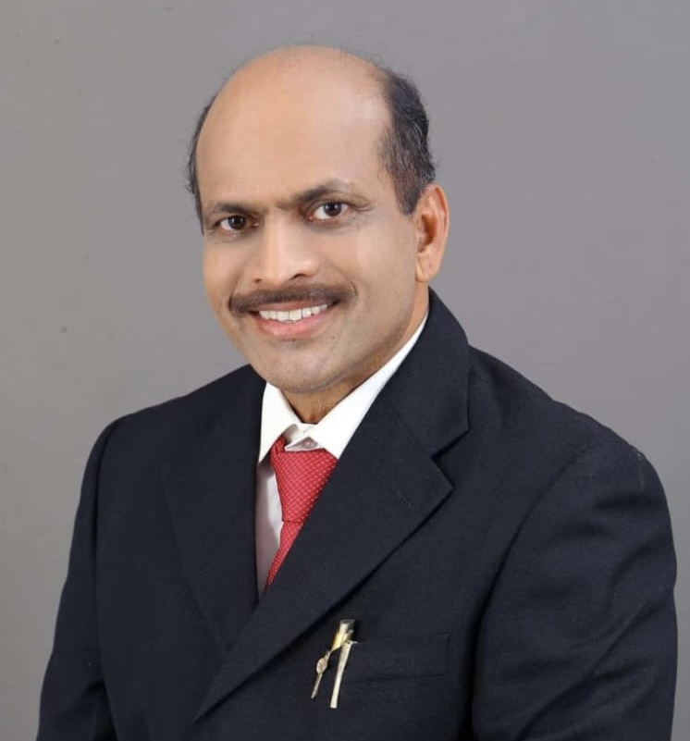


                COMMISSIONER OF INCOME TAX (EXEMPTIONS),
                KERALA
                OUTREACH PROGRAME
                ISSUES ON IT AMENDMENTS
                AND IMPACT ON TRUSTS
CA. P J JOHNEY, PALLIVATHUKKAL
B.Sc., FCA,
JOHNEY & Co. EDAPPALLY
Ph: 9388601505
Email: auditor.jandco@gmail.com

Slide 2
Issues on IT Amendments and Impact on Charitable Institutions
TOPICS
MANDATORY BOOKS OF ACCOUNTS
AUDIT AND AUDIT REPORT
COMPUTATION OF INCOME AND ITR 7
INTER CHARITY DONATION
NEW PROCEDURES & FORMS FOR REGISTRATION
MANDATORY CLAUSES
CANCELLATION OF REGISTRATION/REJECTION OF APPLICATION
8. APPLICATION OF INCOME

Slide 3
Issues on IT Amendments and Impact on trusts
TOPICS
9. SUPREME COURT DECISIONS
10. SPECIFIED INCOME U/S 115BBI
11. 80G & FORM 10BD
12. NEW PENALTIES
13. PERSONS HAVING SUBSTANITIAL INTEREST U/S 13(3) LIMIT – RS. 50,000
14. REPAYMENT OF LOAN & ELIGIBILITY FOR APPLICATION OF INCOME.

Slide 4
1. MANDATORY BOOKS OF ACCOUNTS

Slide 5
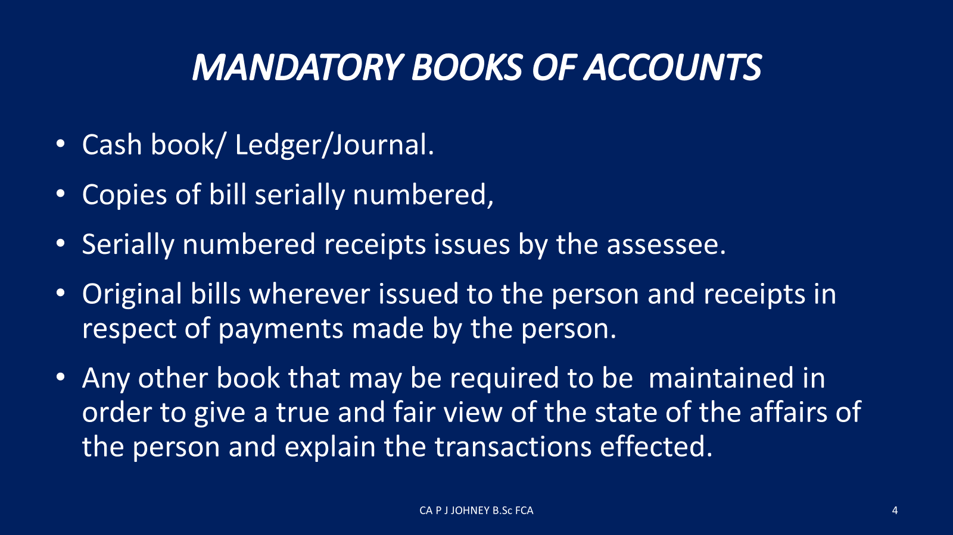

Slide 6
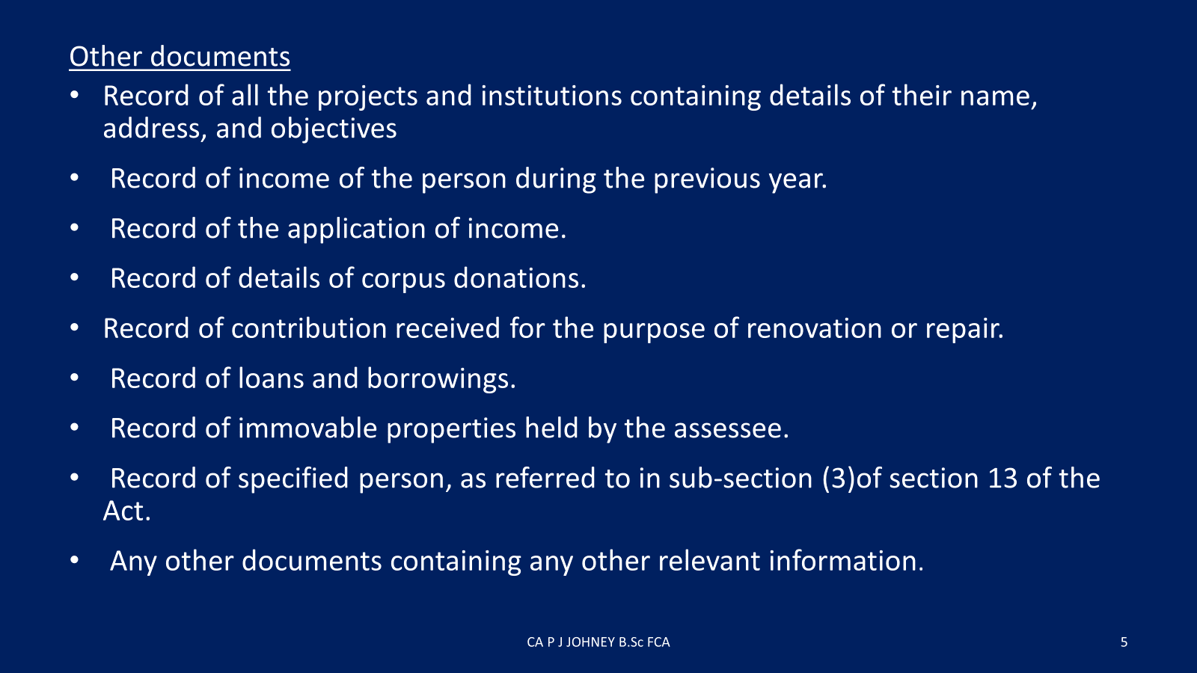

Slide 7
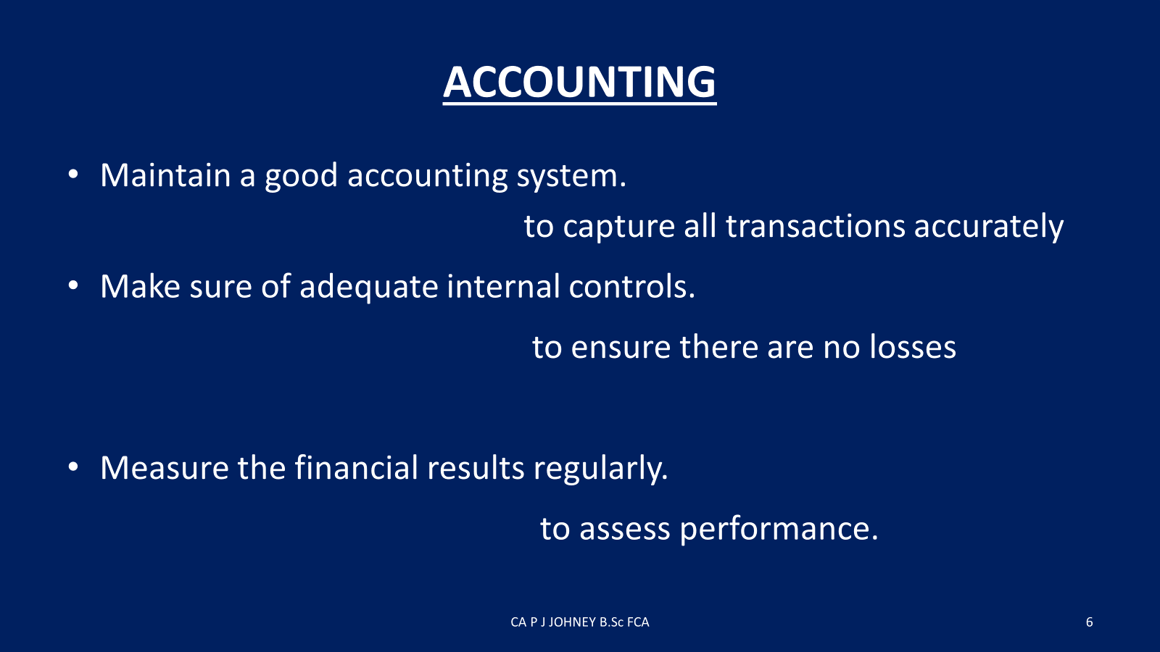

Slide 8
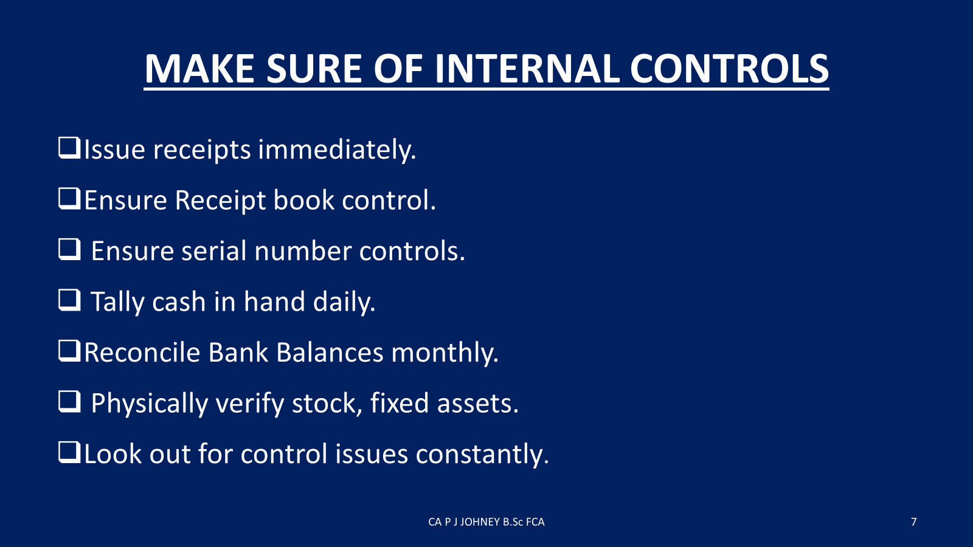

Slide 9
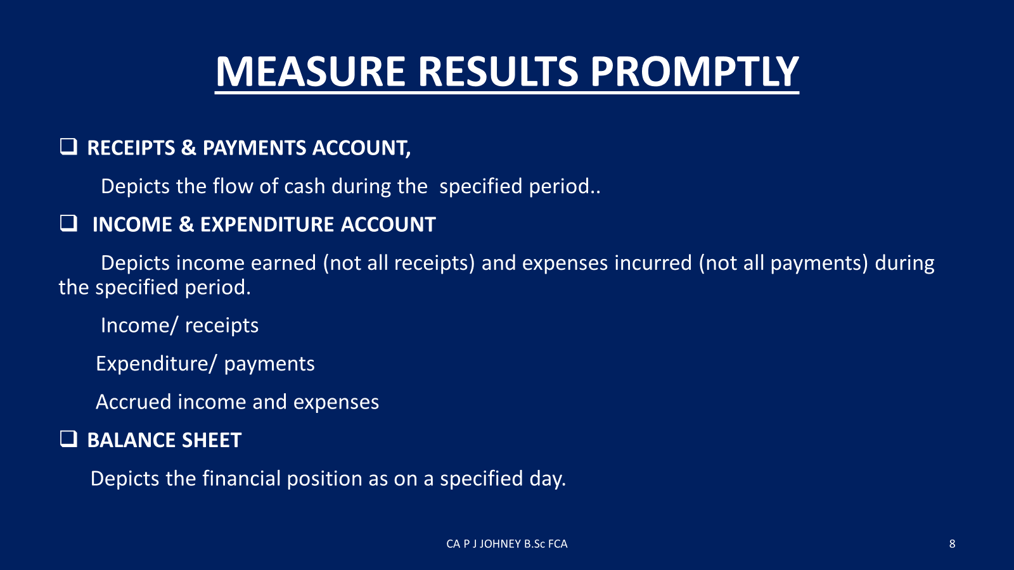

Slide 10
2.AUDIT AND AUDIT REPORT

Slide 11
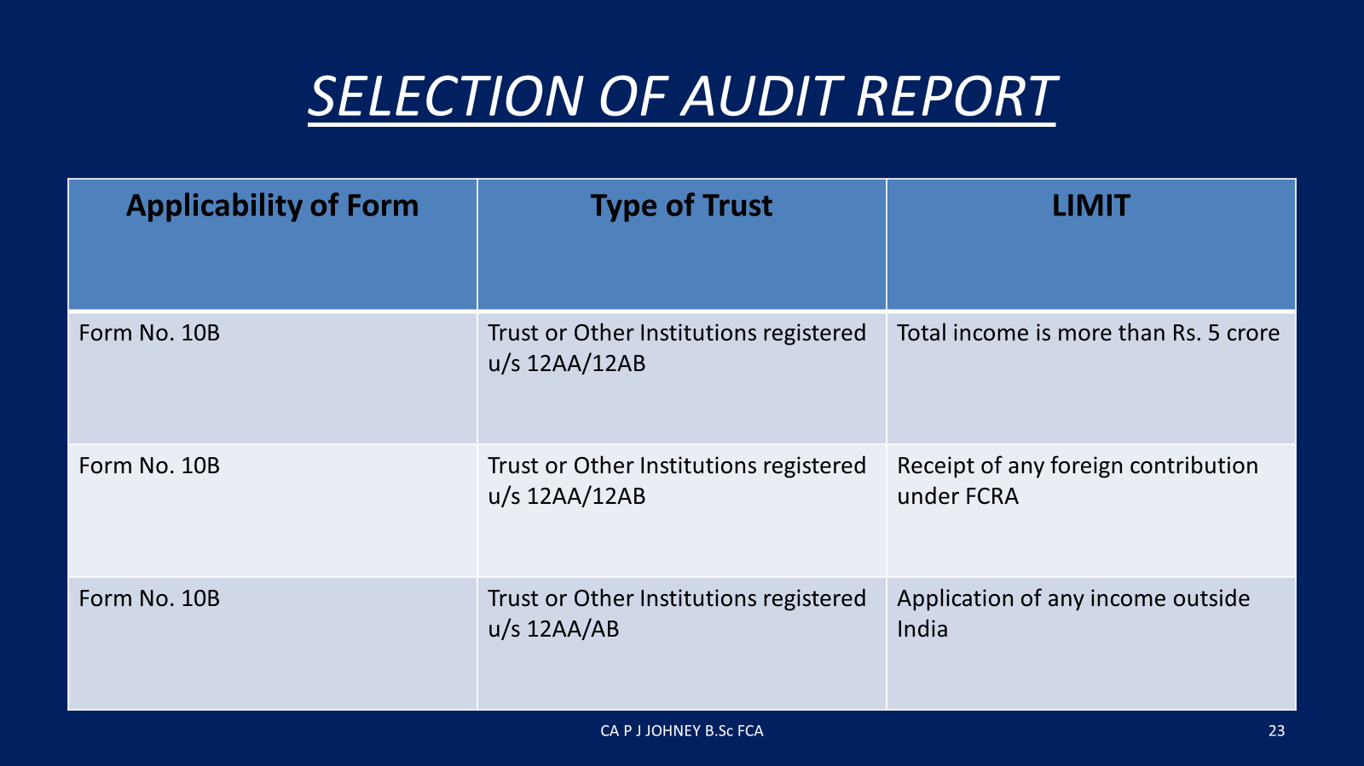
CA P J JOHNEY B.Sc FCA

Slide 12
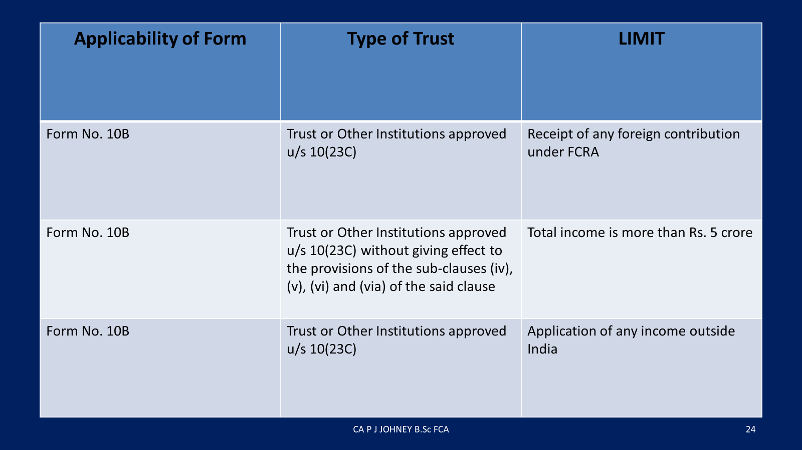

Slide 13
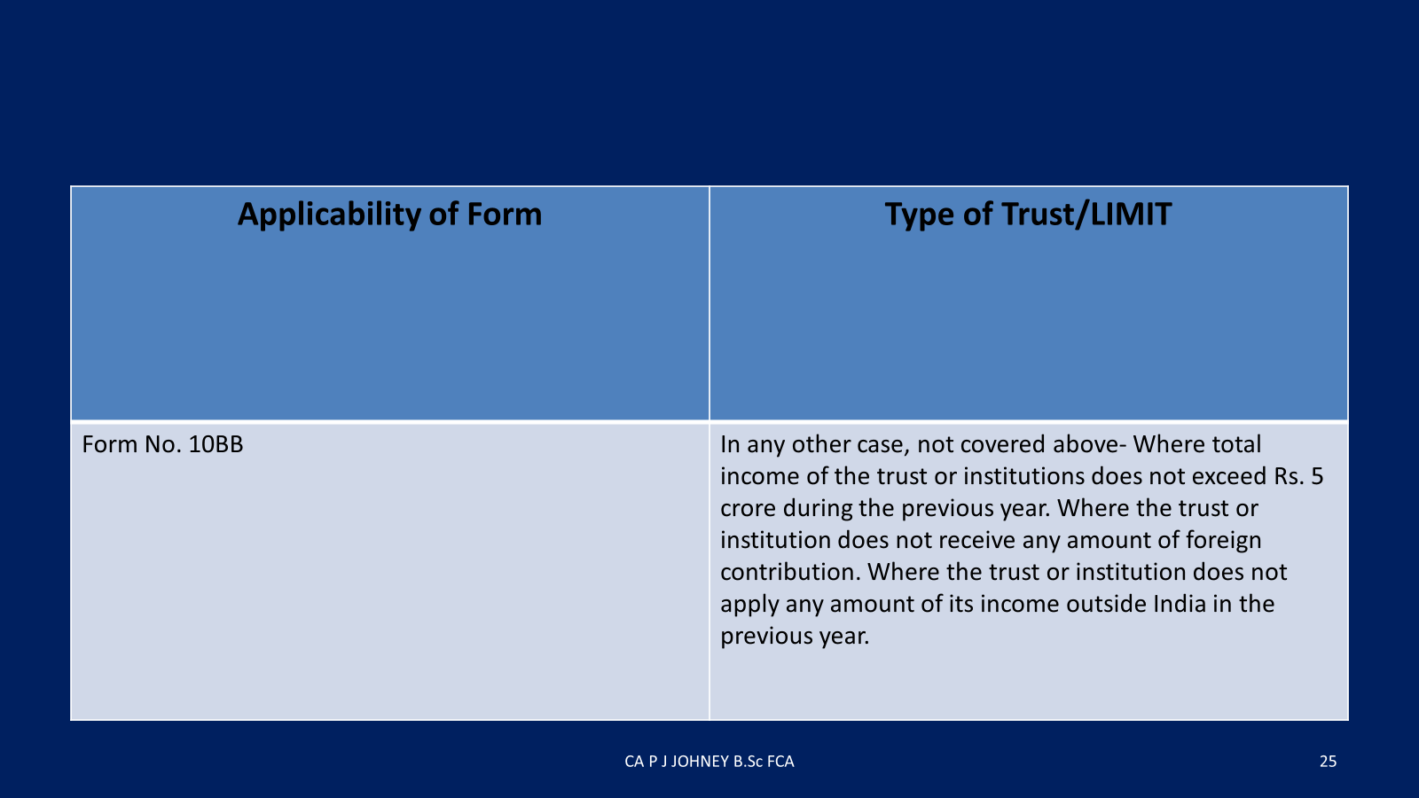

Slide 14
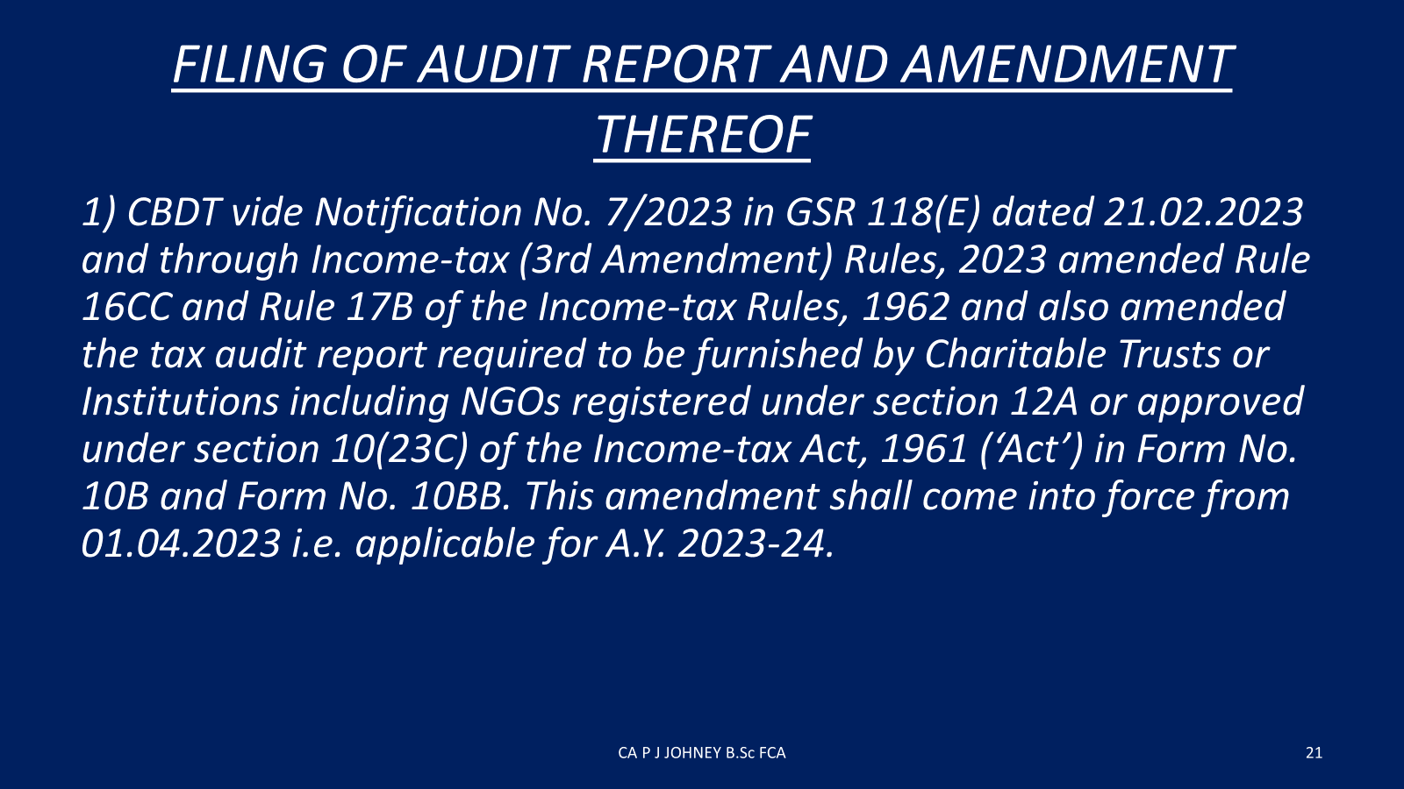

Slide 15
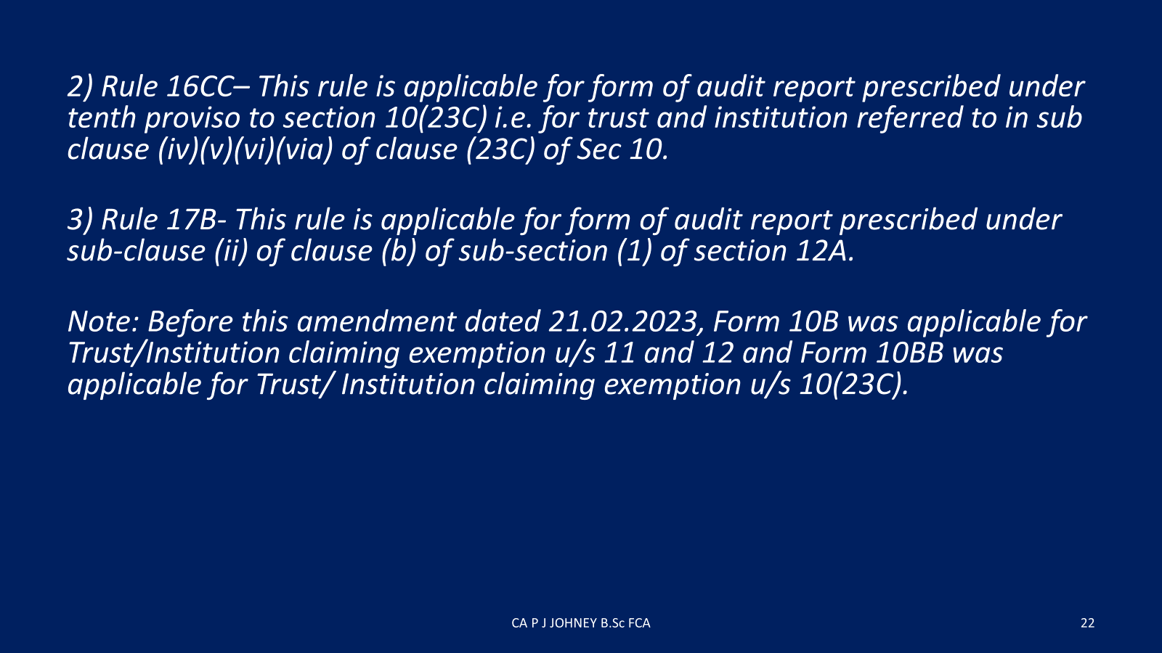

Slide 16
3. COMPUTATION OF INCOME AND ITR 7

Slide 17
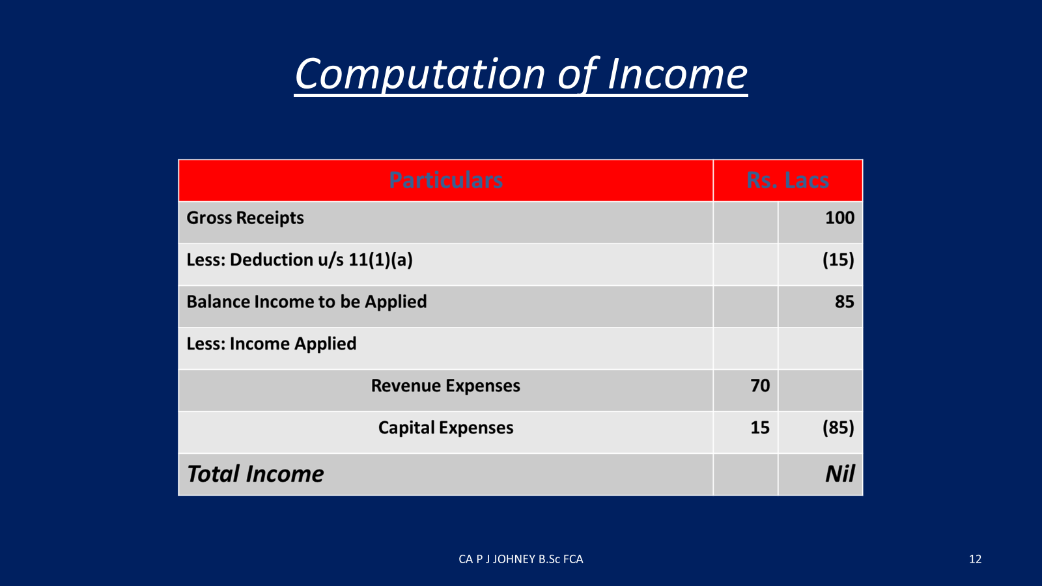

Slide 18
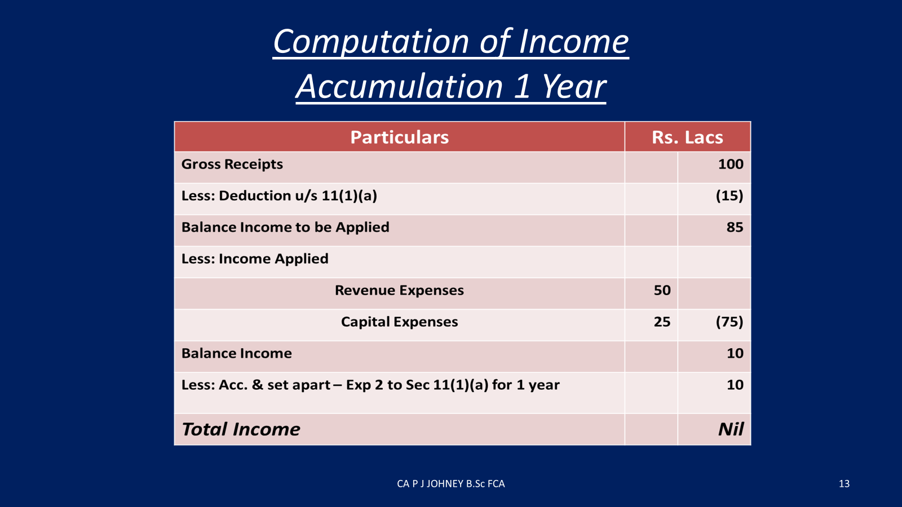

Slide 19
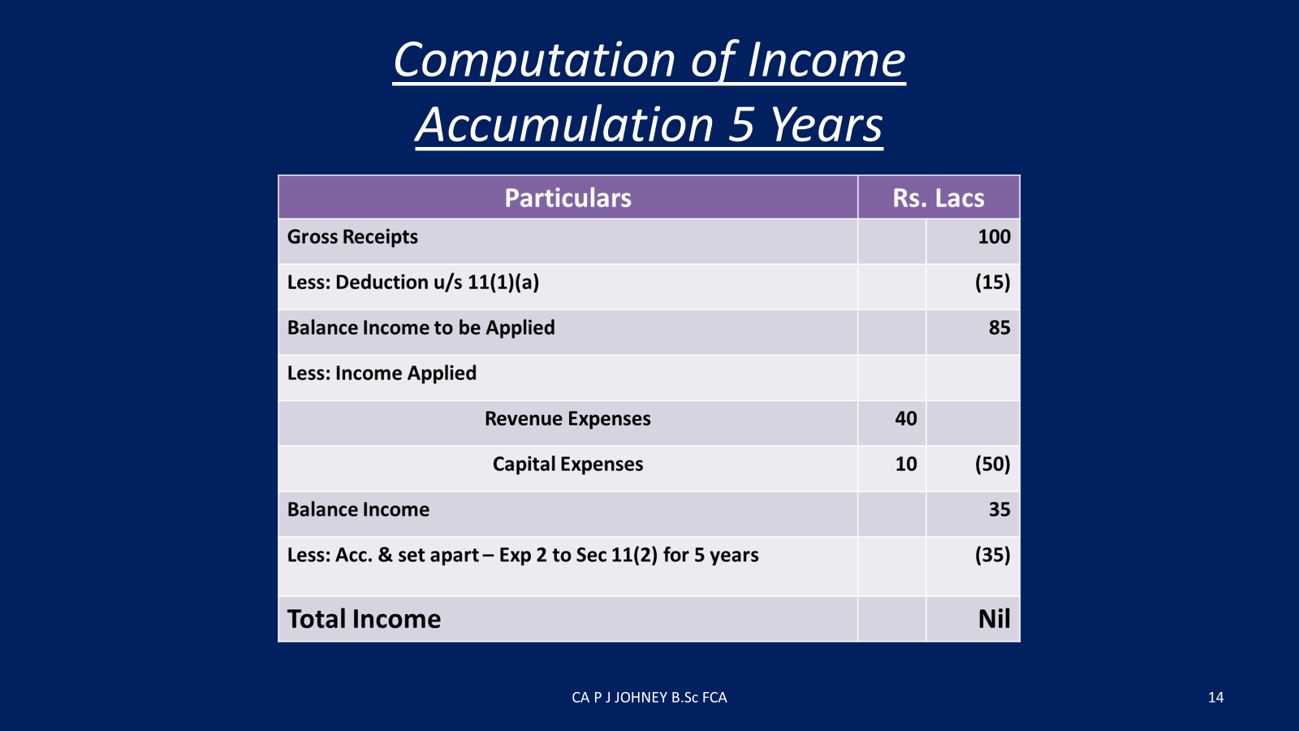

Slide 20
FILING OF INCOME TAX RETURNS(ITR-7)
It is mandatory to file ITR for claiming exemption u/s.11 & 12, 10(23C), if the total income exceeds the maximum amount which is not chargeable to tax (Rs.2.50 lakhs)
Entities |  | Sec.
Trusts/Societies/ Educational institutions/ Hospitals | claiming exemption u/s.11 & 12 | 139(4A)
 | Claiming exemption u/s.10(23C) | 139(4C)
Due date | The due date has been extended from 31st October, 2023 to 30th November, 2023 ( Circular No.16/2023 dt.18-09-2023 )
Consequences of not filing ITR | benefit of accumulation u/s.11(2) will not be available & benefit of exemption will not be available & the income will be taxed on net basis (after allowing deductions on expenditures Penalty u/s.272A(2)(e) @ Rs.500/every day. ( Finance Act, 2022 w.e.f.01-04-2023 )
Filing of updated returns : Updated return can be filed but will not get any benefit of exemption u/s.11 & 12.

Slide 21
4. INTER CHARITY DONATION

Slide 22
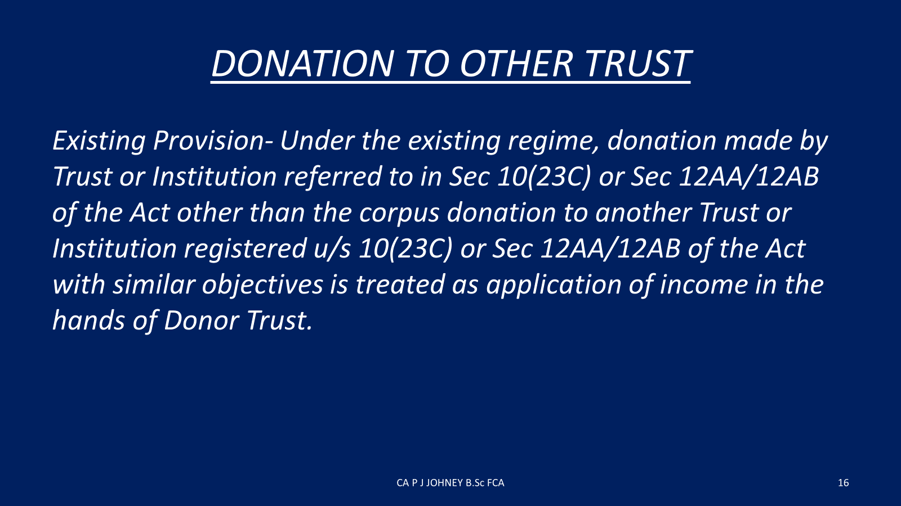

Slide 23
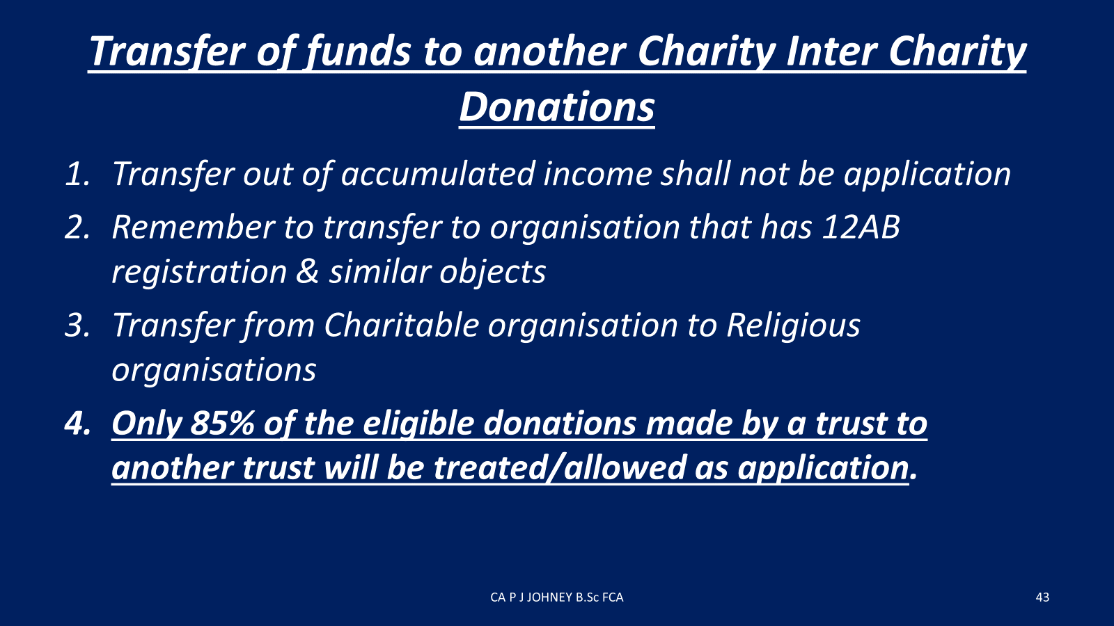

Slide 24
A. BACKGROUND
AMENDMENTS U/S 10(23 C) and 12AB of the IT ACT
In order to ensure intended application toward charitable or religious purpose, only 85% of the eligible donations made by a trust or institution under the first or the second regime to another trust under the first or second regime shall be treated as application only to the extent of 85% of such donation.
Accordingly, the following amendments with effect from 1st April 2024 and will apply for Assessment Year 2024-25 and subsequent years:
“a) clause (iii) in Explanation 2 to the third proviso of clause (23C) of section 10 of the Act to provide that
“any amount credited or paid out of income of any fund or trust or institution or any university or other educational institution or any hospital or other medical institution referred to in sub-clause (iv) or sub-clause (v) or sub-clause (vi) or sub-clause (via) of clause (23C) of section 10 of the Act, other than the amount referred to in the twelfth proviso, to any other fund or trust or institution or any university or other educational institution or any hospital or other medical institution referred to in sub-clause(iv) or sub-clause (v) or sub-clause (vi) or sub-clause (via) of clause (23C) of section 10 of the Act or trust or institution registered under section 12AB of the Act, as the case may be, shall be treated as application for charitable or religious purposes only to the extent of eighty-five per cent. of such amount credited or paid”.

Slide 25
B. ISSUES
. Kind attention of Government that voluntary donations are received by one charitable institution or religious trust from general public. The recipient trust utilized part of donation for which it has received, and balance amount of donation given to other trusts having similar objects since such trust would have necessary infrastructure to utilize such donations received.
on account of the amendment, religious trusts as well as charitable institutions would be required to pay income tax on 15% of such donation granted to other trusts or institutions. even 100% of such donations given are actually spent as utilized by recipient trust actually in operation.
B2. As per the format of ITR – 7, when a contribution is given to a charitable institution (for e.g., an aided school etc), which are not registered u/s 12A, it is fully disallowed. When school is allotted to a particular management, it is their duty to maintain infrastructure at their cost. Aided schools having no other income depend upon their management for aid to do the maintenance work. In the present situation, when management gives a contribution to school having different pan number, the same amount is disallowed from the utilization and the donor institution is forced to pay the tax. The above educational institution files return u/s 10(23C) (iii(ab)). Hence, we request to allow payment of contribution to unregistered institution which are filing return under the Income Tax Act.

Slide 26
5. NEW PROCEDURES & FORMS FOR REGISTRATION

Slide 27
There are only 2 types applications:
Provisional registration ( 3 years ) and
Final registration or Re-registration (5 years).

Slide 28
6. MANDATORY CLAUSES

Slide 29
MANDATORY CLAUSES
Area of operation
Dissolution
Investment
Audit clause
Amendment
Irrevocable
Beneficiary
Benefit of public at large
Income tax clauses

Slide 30
7. CANCELLATION OF REGISTRATION/REJECTION OF APPLICATION

Slide 31
Cancellation of Registration U/sec.12AB
“ Specified violation” u/sec.12AB(4)(a)&(b)
Sec 143(3) reference by A.O. that violation is found
Risk management strategy selection
Consequence of cancellation w.e.f 01-04-2022
a) No sec.11 exemption
b) sec.56(2)(x) applicable –i) corpus Donation taxable.
ii) Donee loses exemption
c) No 80G
d) Exit tax u/sec.115TD at MMR on FMV of assets over
liabilities

Slide 32
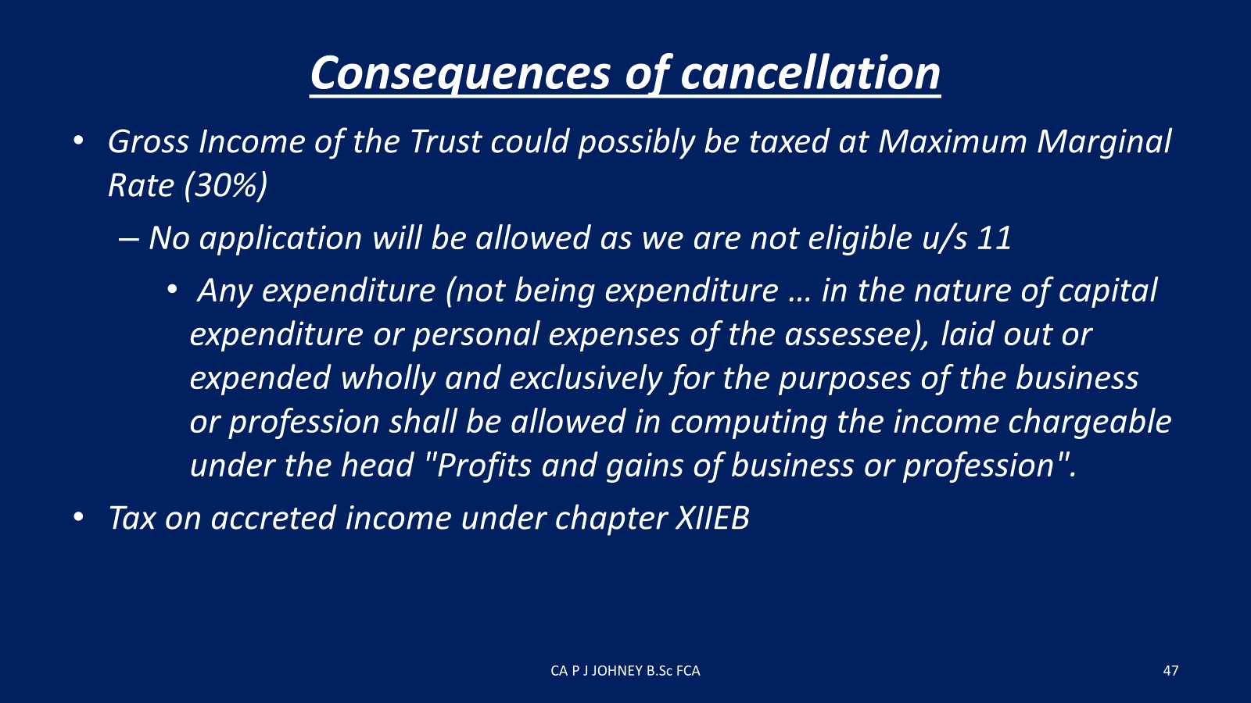

Slide 33
8. APPLICATION OF INCOME

Slide 34
Application of income
Donation given by a charitable /religious trust to another charitable /religious trust is treated as “ application of income for the donor trust.
Sec. 11(2) provides that where 85% of the income is not applied or is not deemed to have been applied to charitable or religious purposes but is accumulated or set apart
The accumulated shortfall should use for religious or charitable purposes within the next 5 years.

Slide 35
9. SUPREME COURT DECISIONS

Slide 36
SC decision in New Noble EdnSty
New Noble Educational Society& Others Vs. CCIT (2022) 448 ITR 594 (SC)
Solely for Education-Scholastic
Not for the purpose of profit- markup
Incidental activities—income under Other
sources
Regn should be with State Endowments dept
- in future

Slide 37
S.C.decision in Ahmedabad Urban Dev.Authority (AUDA)
A business is carried on as per sec.2(15)- Advancement of
any other object of General Public Utility— (GPU)
Proviso (ii)- 20% >of gross receipts- Not Charitable
CIT Vs. Ahmedabad Urban Dev. Authority 400 ITR 1
If Govt promoted –profit is not a concern.
If others promote “Profit should not be a predominant one”. Nominal Mark-up.
Eg:- where activities are not in nature of business .
Gandhi Peace Foundation disseminating Mahatma Gandhi’s philosophy through museums and exhibitions and publishing his works, for nominal cost is not business or
providing access to low-cost hostels to weaker segments of society, where the fee or charges recovered cover the costs (including administrative expenditure) plus nominal mark up;
renting marriage halls for low amounts, again with a fee meant to cover costs;
blood bank services, again with fee to cover costs

Slide 38
10. SPECIFIED INCOME U/S 115BBI

Slide 39
Specified Income –Sec. 115BBI
Tax is @ 30%
Specified Income means
a)Income accumulated is more than 15%
-Form 10 or Form 9A filed-violation–3types-
taxable
b) Sec.11(5) violation-read with Sec 13(1)(d)
c) Sec.13(3)-Income applied-specified persons
d) Income applied outside India

Slide 40
11. 80G & FORM 10BD

Slide 41
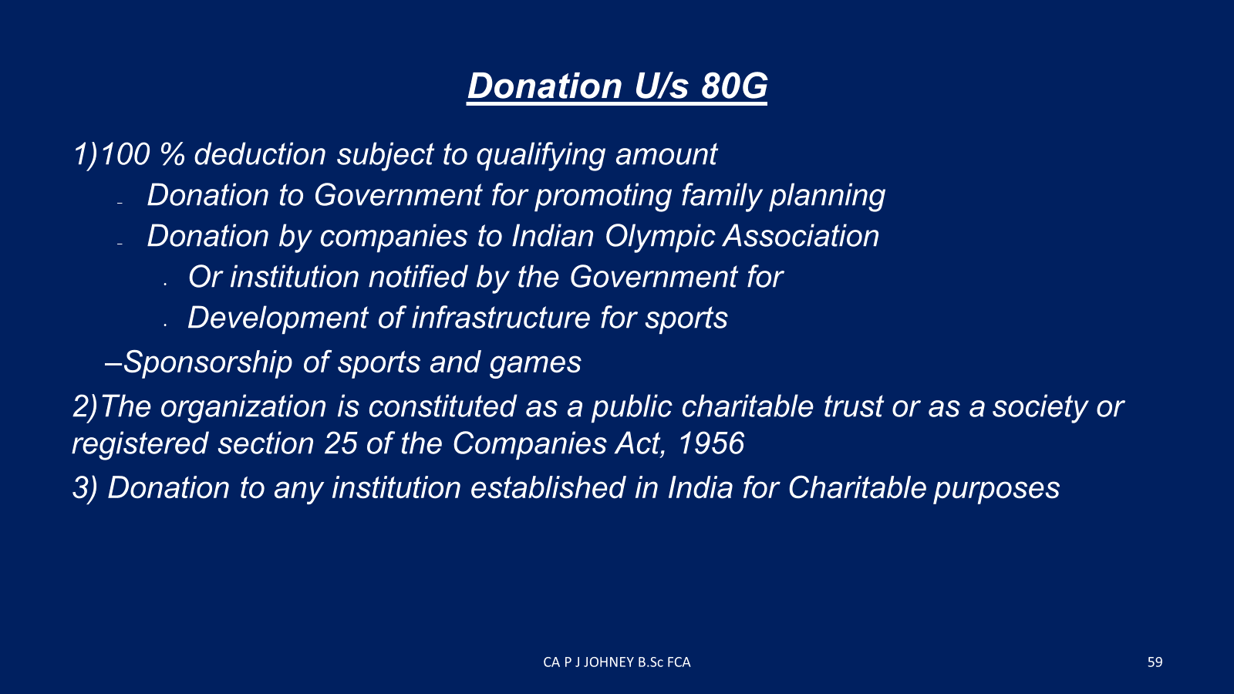

Slide 42
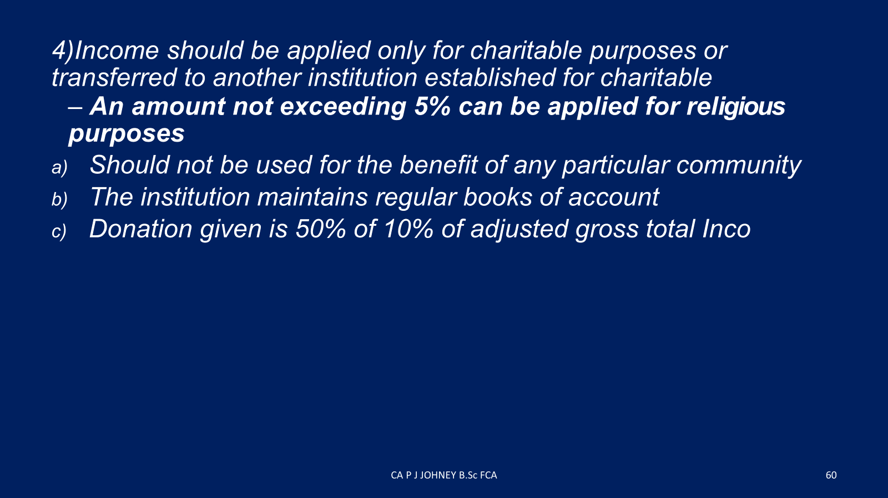

Slide 43
 | Form 10BD | Form 10BE
To be Furnished to | The Department | The donor
Due date | 31st May | 31 st May
Consequences | Delay for filing | Rs.200/day
 | Penalty | Rs.10,000/- upto Rs.1 lakh
 | Exemption | No tax exemption to the donor

Slide 44
12. NEW PENALTIES

Slide 45
New Penalties
Sec. 271AAE- Benefits to related parties
Trust should pay
a) first time 100% of benefit passed on
b) any second/subsequent time@ 200% of such
benefit amount
Sec. 271K - failure to file Form 10-BD statement attracts
penalty, shall not be less than Rs.10,000/- but may
extend up to Rs.1,00,000/-
Sec. 115 TD- On the total Market value of
Asset , over liabilities—Accreted Income
@ 30% in case of a)Regn is cancelled
b) Fresh Regn or Renewal is rejected
c ) fails to make an Application in the previous year

Slide 46
13. PERSONS HAVING SUBSTANITIAL INTEREST U/S 13(3) LIMIT – RS. 50,000

Slide 47
BACKGROUND
Section 13(3)(b) specifies the persons which are covered by the restrictions of Section 13(1)(c) and Section 13(2).
These `Specified persons ’ are the following:
(a) the author of the trust or the founder of the institution
(b) any person who has made a substantial contribution to the trust or institution, [that is to say, any person whose total contribution up to the end of the relevant previous year exceeds fifty thousand rupees];
(c) where such author, founder or person is a Hindu undivided family, a member of the family;
(cc) any trustee of the trust or manager (by whatever name called) of the institution;]
(d) any relative of any such author, founder, person, member, trustee or manager as aforesaid;
(e) any concern in which any of the persons referred to in clauses (a), (b), (c , (cc) and
(d) has a substantial interest.

Slide 48
ISSUES
1. The amount specified u/s 13(3)(b)Rs. 50,000 (rupees fifty thousand only) was substituted in the Taxation Laws (Amendment) Act,1984 w.e.f 01.04. 1985.
Considering the money value of Rs. 50,000 today, compared with the amount fixed w.e.f 01.04 1985 is very small amount which is practically very difficult to implement
2. As per Sec 13(1)(c) specified persons include a person who have made a substantial contribution to a trust or institution which exceeds Rs.50,000. But in the Act, it is not mentioned whether Rs.50,000 is for a particular year or up to the end of relevant previous year from the beginning of the trust which may be clarified.

Slide 49
ISSUES
3. Penalty clause
Sec. 271AAE – Benefits to related parties
Trust should pay.
First time 100% of benefit passed on.
Any second / subsequent time @ 200% of such benefit amount.
4. Specified Income Section.115BBI
Tax is 30% of income applied to specified person.

Slide 50
14. REPAYMENT OF LOAN & ELIGIBILITY FOR APPLICATION OF INCOME

Slide 51
BACKGROUND
As per Clause (ii) of Explanation 4 to section 11(1), any repayment of loan shall not be treated as application of income, if loan or borrowing is made on or before 31st day March 2021.

Slide 52
ISSUES
Many institutions have made their capital expenditure from loan taken from the banks and financial institutions which is repaid in instalment during a period of 5 to 7 years. But due to the introduction of above explanation in section 11(1) all these repayments are not allowed as utilization and these institutions are now forced to pay huge amount as income tax. The cut-off date to change from 31/03/2021 to 31/03/2016.

Slide 53
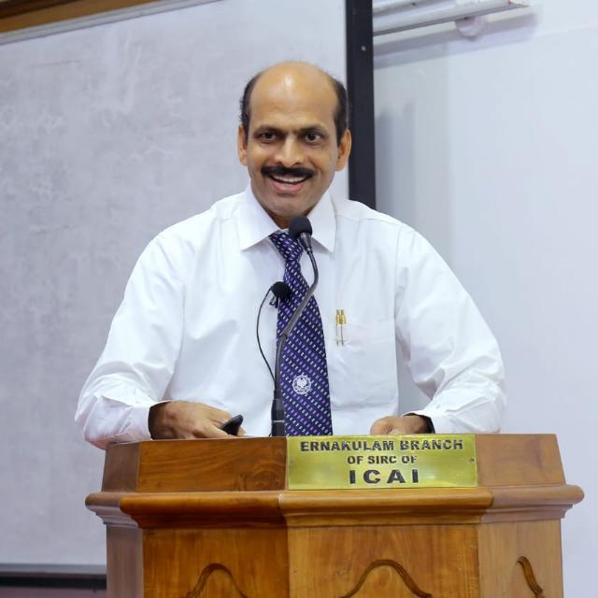
THANK YOU
CA. P J JOHNEY, PALLIVATHUKKAL, B.Sc., FCA

