Slide 1
Overview of Tax Audit Report
CA. Remya S Menon, FCA

Slide 2
APPLICABILITY OF TAX AUDIT REPORT
Tax audit is compulsory in following cases:
a) Business - If T/O > Rs 1 crore during the P.Y.
b) Profession - If Gross receipts > Rs 50 lakhs during the P.Y.
c) If assessee covered by Sec. 44AD or Sec. 44ADA and assessee claimed income less than 8%/ 6% or 50% and his total income is more than Basic exemption
d) If assessee covered by Sec. 44AE, 44BB, 44BBB and assessee claimed income less than PGBP deemed under those sections.
Note: In case of business, turnover limit for audit shall be considered as 10 crores instead of 1 crore if following conditions are satisfied: Cash receipts out of total receipts should be up to 5% during the PY; and Cash payment out of total payments should be up to 5% during the PY.

Slide 3
CLAUSES OF FORM 3CD
Clauses in Form 3CD
Part A- General Information
(Clause 1-8)
Part B- Disclosures of specified transactions.
(Clause 9-44)

Slide 4
Clause 13-ICDS Adjustments
Serial Number | ICDS Issued
I | ICDS I relating to accounting policies
II | ICDS II relating to valuation of inventories
III | ICDS III relating to construction contracts
IV | ICDS IV relating to revenue recognition
V | ICDS V relating to tangible fixed assets
VI | ICDS VI relating to the effects of changes in foreign exchange rates
VII | ICDS VII relating to government grants
VIII | ICDS VIII relating to securities
IX | ICDS IX relating to borrowing costs
X | ICDS X relating to provisions, contingent liabilities and contingent assets

Slide 5
ICDS | As per ICDS | As per IND AS | As per AS
ICDS I- Accounting policies | Marked to market loss or an expected loss shall not be recognised unless the recognition of such loss is in accordance with the provisions of any other ICDS | Marked to market/Fair value measurement adjustments are made as and when required as per the relevant IND AS’ | MTM adjustments can be made under Indian GAAP as per prudence concept.
ICDS II- Valuation of inventories | In case of dissolution of partnership, Association of Persons, Body of Individuals irrespective of dissolution of business, inventory will be valued at net realisable value. | Similar to Indian GAAP | Inventory valued at net realizable value only when going concern is affected.
ICDS III/IV- Construction contracts | Completed service method is not permitted under ICDS IV | Revenue is recognised as per IND AS 115 | Revenue from service transactions can be recognised by the completed service method.

Slide 6
ICDS | As per ICDS | As per IND AS | As per AS
ICDS III/IV- Construction contracts and Revenue | Contract revenue should be recognised when there is reasonable certainty of its ultimate collection. | Revenue is recorded when it is probable that the entity will collect the consideration to which it will be entitled in exchange for the goods or services that will be transferred to the customer. | Under AS 9, revenue is recognised when it is not unreasonable to expect ultimate collection.
ICDS III | Contract revenue shall comprise of variations in contract work, claims and incentive payments to the extent that it is probable that they will result in revenue and their capable of being reliably measured. | Variable considerations (including potentially contingent considerations) are only included in the transaction price to the extent that it is probable that the amount of cumulative revenue recognised would not be subject to a significant future revenue reversal when such estimates are revised. | Incentive payments are included in contract revenue when the contract is sufficiently advanced that it is probable the specified performance standards will be met or exceeded and the amount of the incentive payments can be measured reliably.

Slide 7
ICDS | As per ICDS | As per IND AS | As per AS
ICDS III- Construction contracts | Under ICDS III, during early stages, where outcome of the contract cannot be reliably estimated, revenue is recognised to the extent of costs incurred up to to the point where 25% of the work is completed otherwise proportionate method will apply. Thus, profit recognition has to start compulsorily once 25% stage is completed. | For each performance obligation satisfied over time, revenue is recognised by measuring the progress towards complete satisfaction (by using either output or input methods) and only if it can reasonably measure its progress towards completion; else, revenue should be recognised only to the extent of contract costs incurred of which recovery is probable. | Contract revenue and contract costs to be recognised as revenue or expenses by reference to the percentage of completion method if the outcome of the contract can be estimated reliably; else, revenue should be recognised only to the extent of contract costs incurred of which recovery is probable.
ICDS IV- Revenue | Interest shall accrue on time basis | Interest shall be calculated by using the effective interest rate method. | Interest accrues, in most circumstances, on the time basis determined by the amount outstanding and the rate applicable.

Slide 8
ICDS | As per ICDS | As per IND AS | As per AS
ICDS VI-Foreign currency differences | Any premium or discount arising at the inception of a forward exchange contract is amortized as expense or income over the life of the contract | As per IND AS 109 | Similar to ICDS in respect of forward exchange contracts not intended for trading or speculation purposes
ICDS VI | For other forward exchange contracts that are intended for trading or speculation purposes or that are entered into to hedge the foreign currency risk of a firm commitment or a highly probable forecast transaction, premium, discount or exchange difference, shall be recognised at the time of settlement. | As per IND AS 109 | The premium or discount on the contract is ignored and at each balance sheet date, the value of the contract is marked to its current market value and the gain or loss on the contract is recognised.

Slide 9
ICDS | As per ICDS | As per IND AS | As per AS
ICDS VII- Government grants | Government grants should not be recognised until there is reasonable assurance that (i) the entity shall comply with the conditions attached to them, and (ii) the grants shall be received. However, recognition of Government grant shall not be postponed beyond the date of actual receipt. | Similar to Indian GAAP | Mere receipt of a grant is not necessarily a conclusive evidence that conditions attaching to the grant have been or will be fulfilled. Government grants available to the enterprise are considered for inclusion in accounts: i. where there is reasonable assurance that the enterprise will comply with the conditions attached to them. ii. where such benefits have been earned by the enterprise and it is reasonably certain that the ultimate collection will be made.
ICDS VII | Where Government grant relates to a depreciable fixed asset, the grant shall be deducted from the actual cost of the asset/ WDV of block of assets to which concerned asset belonged to. | Grants related to assets, including nonmonetary grants at fair value, should be presented in the balance sheet only by setting up the grant as deferred income. | Grants related to depreciable assets are either treated as deferred income and transferred to the statement of profit and loss in proportion to depreciation, or deducted from the cost of the asset.

Slide 10
ICDS | As per ICDS | As per IND AS | As per AS
ICDS IX- Borrowing costs | Exchange differences arising from foreign currency borrowings to the extent that they are regarded as an adjustment to interest cost are not covered under this ICDS and hence are not adjusted to borrowing costs. | Same as Indian GAAP | Borrowing costs include Exchange differences arising from foreign currency borrowings to the extent that they are regarded as an adjustment to interest costs.
ICDS IX | The income from temporary investments of those borrowings is not reduced from the amount of borrowing costs for capitalisation. | Similar to Indian GAAP | The income from temporary investments of those borrowings is reduced from the amount of borrowing costs for capitalisation.
ICDS IX | General borrowing costs will be capitalised based on the below formula: A*(B/C) A= Borrowing costs incurred during the previous year, except specific borrowing costs. B= Average of costs of qualifying asset C= the average of the amount of total assets other than assets to the extent that are directly funded out of specific borrowings | Similar to Indian GAAP | Borrowing costs eligible for capitalisation should be determined by applying a capitalisation rate to the expenditure on that asset.

Slide 11
CLAUSE 26 – Disclosures w.r.t Section 43B
Particulars of items of Section 43B | Incurred during the relevant FY |  | Balance of amount disallowed in previous years.
 | Paid within due date | Not Paid within due date (31.10.20XX)/ (30.11.20XX) | Amount B/f (Not paid in earlier years) | Paid during the year (i.e till 31.03.20XX)
New Major Amendments/Additions to Section 43B:
Any sum payable by the assessee to a micro or small enterprise beyond the time limit specified in section 15 of the Micro, Small and Medium Enterprises Development Act, 2006 ( w.e.f 1-04-2024).

Slide 12
CLAUSE 26 – RELEVANT ISSUES
Whether interest outstanding, converted to a loan/debenture would be considered as paid w.r.t Section 43B? (Explanation 3C,3CA,3D to Section 43B)
Whether GST payable should be included in Clause 26 (Section 43B) as the same is not routed through P&L?
Whether subsequent reversal of items shown in section 43B can be claimed as deduction during the relevant previous year?
Whether commission to whole time directors is to be considered as an item under 43B(c) i.e “Any sum paid to an employee as bonus or commission for services rendered, where such sum would not have been payable to him as profits or dividend if it had not been paid as bonus or commission” ?
Whether interest accrued but not due needs to be shown under section 43B?
How to identify whether gratuity is to be shown under 43B or 40A(7)?

Slide 13
The following items debited to profit or loss needs to be disclosed under Clause 21 of Tax Audit Report
1. Capital expenditure | 2. Personal expenditure
3. Advertisement expenditure in any souvenir, brochure, tract, pamphlet or the like, published by a political party. | 4. Expenditure incurred at clubs being entrance fees and subscriptions.
5. Expenditure incurred at clubs being cost for club services and facilities used. | 6. Expenditure by way of penalty or fine for violation of any law for the time being force.
7. Expenditure incurred for any purpose which is an offence or which is prohibited by law. | 8. Amounts inadmissible under section 40(a)
9. Amounts inadmissible under section 40(b)/40(ba) | 10. Disallowance under 40A(3)
11. Provision not allowable under section 40A(7) | 12. Any sum paid by the assessee as an employer not allowable under section 40A(9)
13. Particulars of any liability of a contingent nature | 14. Amount of deduction inadmissible u/s 14A in respect of the expenditure incurred in relation to exempt income
15. Amount inadmissible under the proviso to section 36(1)(iii)

Slide 14
Clause 21: 40 Disallowances
      40(a)(i): Payment made to Non-Resident:
      Amount paid or credited to Non-resident or foreign Co.& if
      (i) TDS has not been deducted in P.Y. or,
      (ii) TDS deducted but not paid to Govt up to due date of return filing,
      Then such sum (100%) shall not be allowed as deduction in current P.Y.
      Sec 40(a)(ia):Payment made to Resident:
      Any amount paid or credited to Resident & if:-
      (i) TDS has not been deducted in P.Y. or,
      (ii) TDS deducted but not paid to Govt upto due date of return filing,
      Then 30% of such sum shall not be allowed as deduction in current P.Y.

Slide 15
Clause 21: 40 Disallowances
40(a)(ib): Non-deduction of Equalisation Levy
Any consideration paid or payable to a non-resident for a specified service on which equalisation levy is deductible under the provisions of Chapter VIII of the Finance Act, 2016, and such levy has not been deducted or after deduction, has not been paid on or before the due date specified in sub-section (1) of section 139.
Provided that where in respect of any such consideration, the equalisation levy has been deducted in any subsequent year or has been deducted during the previous year but paid after the due date specified in sub-section (1) of section 139, such sum shall be allowed as a deduction in computing the income of the previous year in which such levy has been paid

Slide 16
DISALLOWANCES U/S 40 - RELEVANT ISSUES
      Appellate authorities/ tribunals/ courts have held that provisions of sec. 40(a)(ia)can be invoked only in event of non-deduction of tax at source but not for lesser deduction of tax at source.
      Whether 40a(ia) can be invoked for non-deduction cases in case of expense provisions wherein the parties are not identified?
      Where TDS has not been deducted by the assessee, but the income with respect to the transaction on which no TDS has been deducted has been offered to tax by the party in their ITR, whether TDS can be claimed? (Form 26)
      Whether TDS would be applicable on import of goods/services of more than 2 crores from a single party as the same would result in the party having significant economic presence as per section 9 read with rule 11UD and hence being liable to tax in India under the Income Tax Act,1961?

Slide 17
DISALLOWANCES U/S 40 - RECENT CHANGES
      TDS u/s 194R for deduction of tax on benefit or perquisite in respect of business or profession
      TDS u/s 194S for deduction of tax on payments made on transfer of virtual digital assets.
      TDS u/s 194BA for deduction of tax on winnings from online games.
      TDS u/s 194Q for deduction of tax on purchase of goods.

Slide 18
Clause 21: Section 40A(3)
Cash Payment > 10,000 to a single person in a single day
  Where the assessee incurs any expenditure in respect of which a payment or aggregate of payments made to a person in a day, otherwise than by an account payee cheque drawn on a bank or account payee bank draft, or use of electronic clearing system through a bank account or through such other electronic mode as may be prescribed, exceeds ten thousand rupees, no deduction shall be allowed in respect of such expenditure. Note:
  If payment made to transporter then limit is Rs 35,000/-
  If the expenditure is claimed as deduction in earlier year on accrual basis & if such expenses is subsequently paid in cash or bearer cheque then deduction allowed earlier shall be withdrawn and taxable as PGBP.
  If expenditure paid by cross cheque - deduction not allowed.

Slide 19
Clause 21: Section 40A(3) - Rule 6DD
  Exceptions of Sec 40A(3) [Rule 6DD] (Examples)
  Payment made to RBI/LIC/Banks/Govt.
  Payment made through NEFT/RTGS/Debit card/ECS/credit card/UPI/BHIM
  Payments by book entry (adjustment).
  Payment of producers of agriculture product, forest product, poultry product, fish product, live-stock etc.
  Payment of salary to an employee who is posted to any other place for 15 days or more other than his normal place of duty.
  Payment made where Banking facility is not available.
  Payment is made by an authorized dealer or a money changer against purchase of foreign currency or travelers cheques in the normal course of his business.
  Retrenchment benefits paid to an employee if its not exceeding Rs 50,000/-.

Slide 20
Clause 21: Section 40A(3) - Relevant Issues
Whether payments made in cash above ten thousand is disallowable u/s 40A(3), if such payments were made to KSEB ?
Whether cash payments made to a party on multiple days, each day payment being below ten thousand for a single invoice whose value exceeds ten thousand, is disallowable u/s 40A(3)?
Whether cash payments made to a single party for multiple invoices in a single day exceeded ten thousand would invoke 40A(3)?
Where cash payments are made in excess of the prescribed limit and TDS has also not been deducted on the same, under which section would the disallowance get invoked?

Slide 21
Clause 21: Disallowance u/s 14A
  Section 14A: No deduction shall be allowed in respect of expenditure incurred by assessee in relation to income which do not form part of total income (exempt Income) under the Act.
  Manner of computation of disallowance (by AO) : Rule 8D
  Amount of expenses directly relating to exempt income
  Amount equal to 1% of this annual average of the monthly average of the opening and closing balance of investment, income from which is exempt.
    Total amount is dis-allowable u/s 14 A = (a + b)

Slide 22
Section 37 disallowances - Relevant Issues
    Whether penalty expenses which are compensatory in nature and paid for breach of a contract or statute is deductible?
    Whether interest on income taxes paid or delay in remittance of TDS is allowable as business expenditure?
    Whether late fees paid for late filing of GST returns are allowed as business expenditure?
    Whether expenses incurred for IPO, FPO, right shares and increase in authorized share capital etc. are capital in nature?

Slide 23
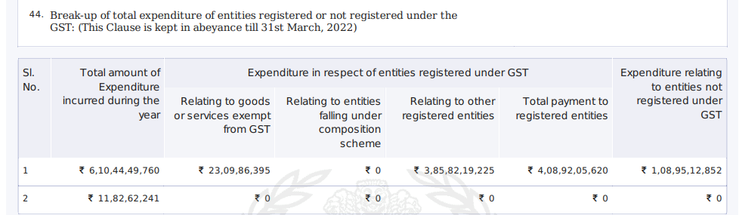
Clause 44: Goods and Services Tax Compliance
    Clause 44 requires disclosure related to the break up total expenditure of entities registered or not registered under GST:

Slide 24
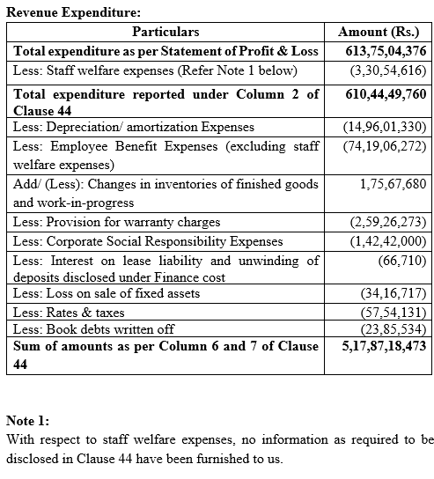
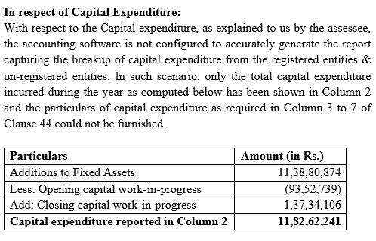
Clause 44
    Disclosures related to Clause 44:

Slide 25
Clause 44: Goods and Services Tax Compliance
    Important Points as mentioned in the Guidance Note:
    Total expenses should include purchases.
    Head wise/Nature wise break-up of expenditure is not envisaged in the above clause.
    Separate reporting of capital expenditure is recommended.
    An appropriate disclosure should be made for the view taken in relation to the meaning of “Total Expenditure” and the method of filling up the appropriate columns.
    In case of ineligible input tax credits and purchases from composition levy suppliers, it is a normal practice to not record GSTIN of the said suppliers in the accounting software. Remark with respect to the same maybe included in the report.
    Items that are outside GST purview like depreciation, employee benefits, changes in inventories, balances written off, other provisions etc. are not disclosed in column 6 or 7 of the clause and can be shown as a reconciliation separately.

Slide 26
Clause 30A: Primary adjustment to transfer price u/s 92CE(1)
Difference between ALP and Transaction price
Primary Adjustment
Whether excess money has been repatriated within prescribed time(90 days)
Deemed to be an advance and interest to be computed on such advance.(Secondary Adjustment)
No
Yes
Interest Rate: 1 year MCLR of SBI+ 325 basis points as on 01.04.XX
Interest Rate:
6 months LIBOR+300 basis points as on 30.09.XX
INR
FC
No Adjustments

Slide 27
Clause 30A: Primary adjustment to transfer price u/s 92CE(1)
Exceptions to Secondary Adjustment
Secondary adjustment not applicable for domestic transactions
Where primary adjustment does not exceed One crore.
No secondary adjustment for primary adjustment of AY 16-17 or earlier.

Slide 28
Clause 30A: Primary adjustment to transfer price u/s 92CE(1)
Relevant Issues
Whether primary adjustment made with respect to any AY, but made during the period of the relevant PY should be disclosed in Clause 30A?
Whether primary adjustment made by the AO but currently under litigation needs to be disclosed?

Slide 29
Clause 30B: Expenditure incurred exceeding limit u/s 94B(1)
Expenditure by way of interest exceeding more than Rs.1 crore to NR AE or to a lender where AE provides either an implicit or explicit guarantee or deposits of similar amount.
Total Interest paid in excess of 30% of EBITDA
Interest paid or payable to AEs for that previous year
Whichever is lower
Excess Interest- to be disallowed

Slide 30
Clause 30C: Impermissible avoidance arrangement (GAAR) u/s 96
Whether the assessee has entered into an impermissible avoidance arrangement?
If yes, the following disclosures shall be made:
Nature of impermissible avoidance agreement
Amount of tax benefit in the PY arising, in aggregate, to all the parties to the arrangement

Slide 31
Clause 42: Information pertaining to Form 61/61A/61B
Details of statements furnished in Form No.61,Form No 61A or Form No 61B to be disclosed under this clause.
Form No. | Due Date | Applicability
61 | 31st October where declarations in Form No. 60 have been received before 30 September; and by 30th April where declarations in Form No. 60 have been received by 31st March of the immediately preceding financial year. | Form No. 61 is to be filed by specified persons who have received any declaration in Form No. 60.
61A | 31st May of the immediately following financial year | To be filed by persons mentioned in Rule 114E(2) required to file SFT
61B | 31st May of the immediately following financial year | For reporting information under Rule114F,114G,114H

Slide 32
Clause 43: Details of Report u/s 286(2)
Whether the assessee or its parent entity or alternate reporting entity is liable to furnish the report as referred to in sub-section (2) of section 286 Form No 3CEAC:
Section 286 deals with filing of Country by Country Report by ‘international group’.
Conditions for filing Form No 3CEAC :
If assessee is a parent entity of an international group.
If assessee is resident in India and has been designated as the alternate reporting entity of an international group.
If the assessee is a constituent of the international group with its parent entity resident in India and the group has not designated any other resident constituent entity as the alternate reporting entity.(Parent entity to file Form 3CEAC)
If the assessee is neither the parent entity nor has it been designated as the alternate reporting entity, but other constituent entity resident in India of the international group has been designated as the alternate reporting entity by the group. (Other constituent entity to file form 3CEAC)

Slide 33
Thank you!!

