Slide 1
GST Annual Return
GSTR – 9

Slide 2
What is Annual Return
Compilation of outward supplies, inward supplies, tax liability, ITC claimed and reversed during the year, Amendment made, etc. filed once in year

Slide 3
Applicability
Section 44(1) of CGST Act, 2017
Every registered person, other than
an Input Service Distributor,
a person paying tax under section 51 or section 52,
a casual taxable person and
a non-resident taxable person,
shall furnish an annual return for every financial year electronically in such form and manner as may be prescribed on or before the thirty-first day of December following the end of such financial year.

Slide 4
Prescribed forms for filing Annual Return
For Regular Taxpayers - Form GSTR 9
For Composition Taxpayers - Form GSTR 9A/GSTR 4

Slide 5
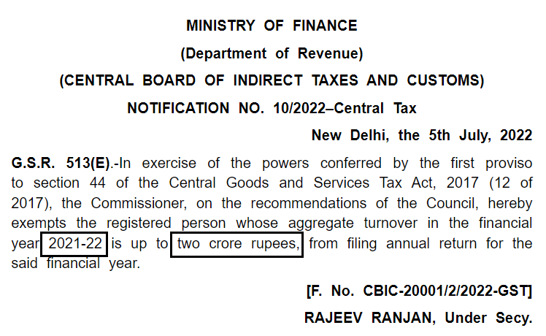

Slide 6
Threshold limit for FY 2021-2022
Aggregate turnover not exceeding Rs. 2 Crore
Optional to file
Aggregate turnover exceeding Rs. 2 crore but not Rs. 5 crores
Both GSTR 9 and
GSTR 9C mandatory
Aggregate turnover exceeding Rs. 5 crores
GSTR 9 is mandatory
GSTR 9C optional

Slide 7
Aggregate Turnover
Section 2(6) of CGST Act, 2017 :
"Aggregate turnover” means the aggregate value of all taxable supplies (excluding the value of inward supplies on which tax is payable by a person on reverse charge basis), exempt supplies, exports of goods or services or both and inter-State supplies of persons having the same Permanent Account Number to be computed on an all-India basis but excludes Central tax, State tax, Union territory tax, Integrated tax and cess.

Slide 8
Due date for filing Annual Return GSTR 9 for FY 2021-22
31st December 2022

Slide 9
Consequences of late / non-filing of Annual Return
Late Filing - Rs.200 per day or 0.25 percent of the turnover in the State/ Union territory
Non- Filing - General Penalty of Rs. 25000 under Section 125 of CGST Act can be imposed
Proper Officer has been given authority to suspend/ cancel the registration
Notes:
Power of officer to cancel the registration vide……notification

Slide 10
Any Queries on Applicability of Annual Return?

Slide 11
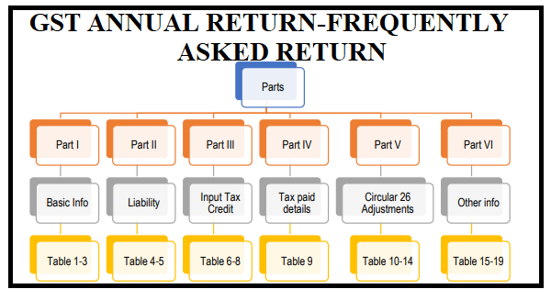
Glimpse of Annual Return

Slide 12
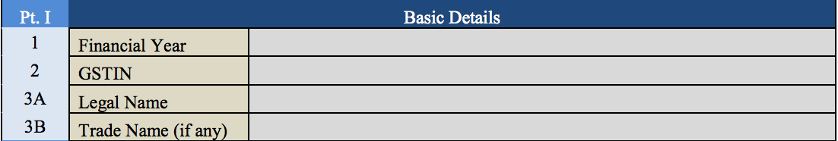
PART – 1 BASIC INFORMATION

Slide 13
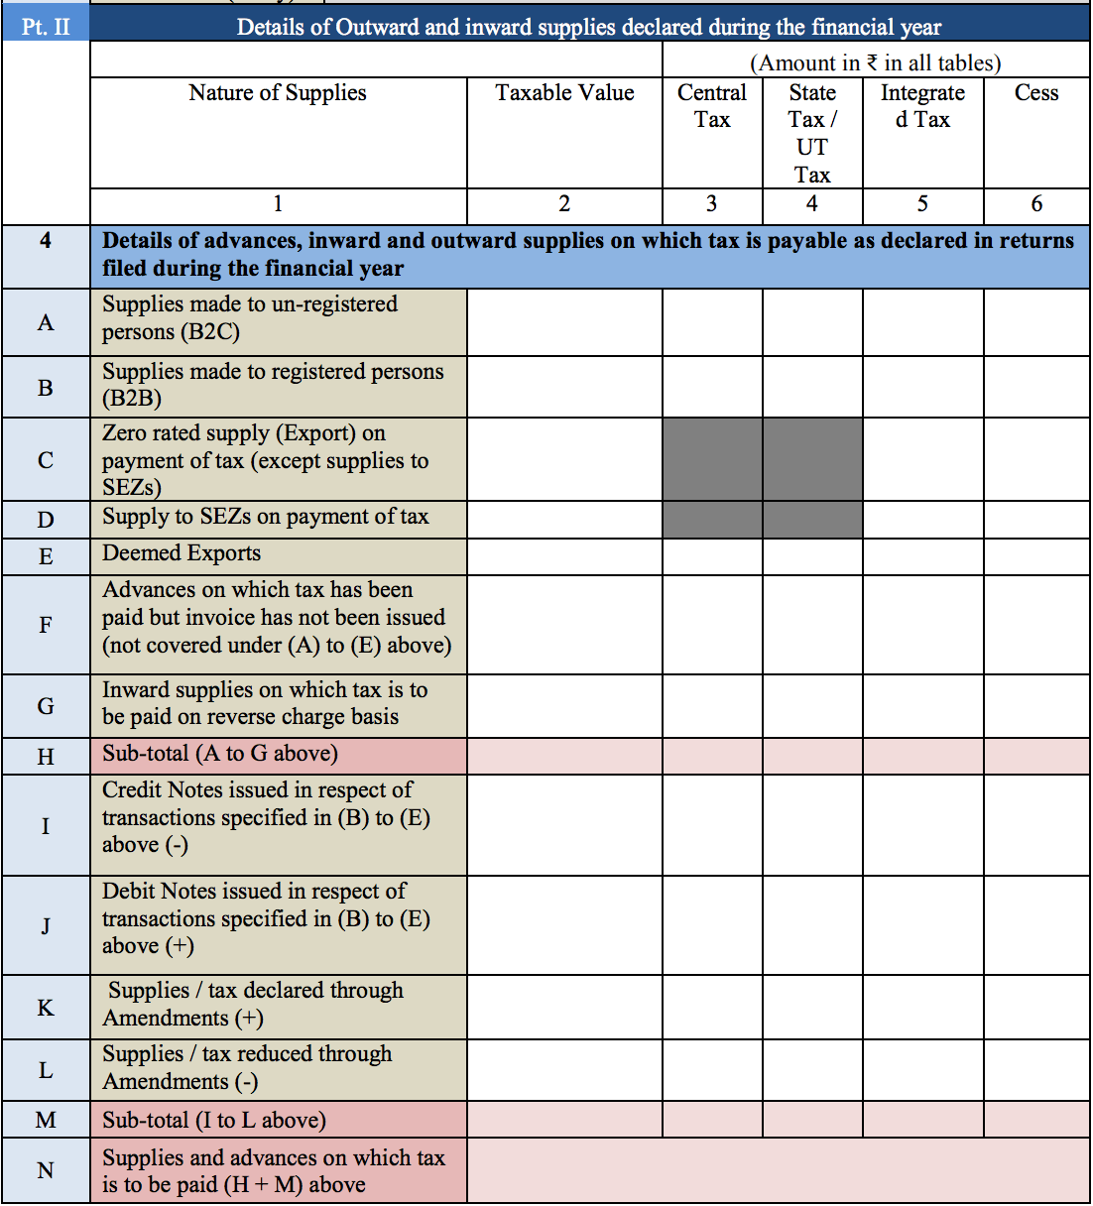

Slide 14
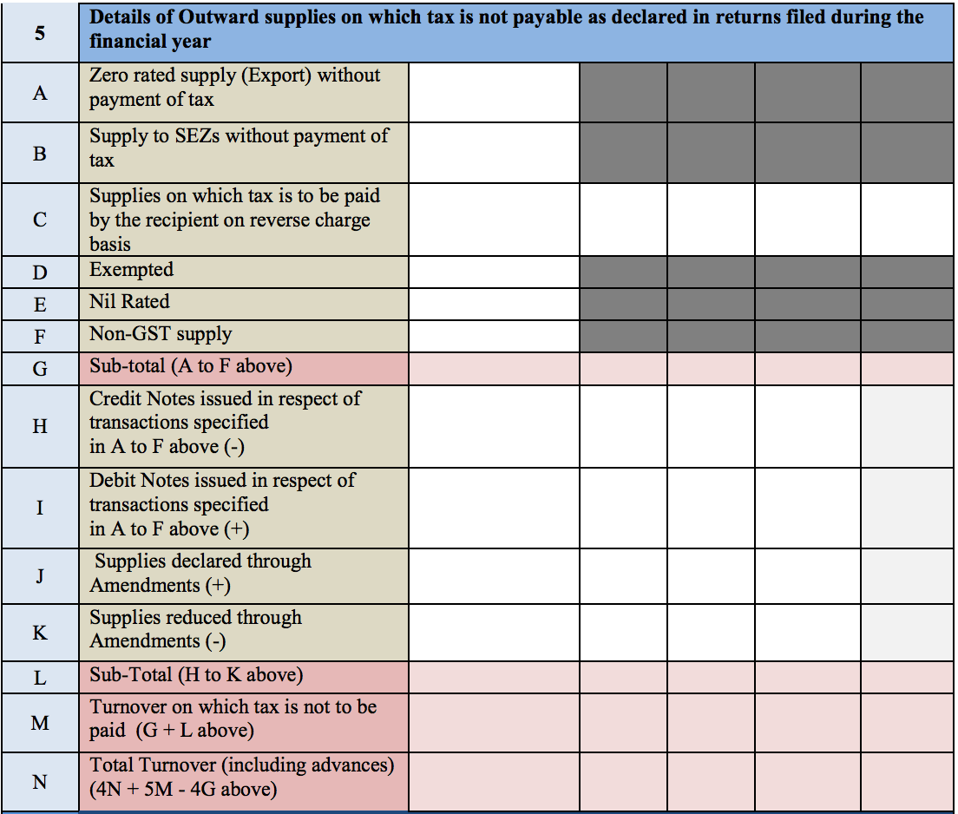

Slide 15
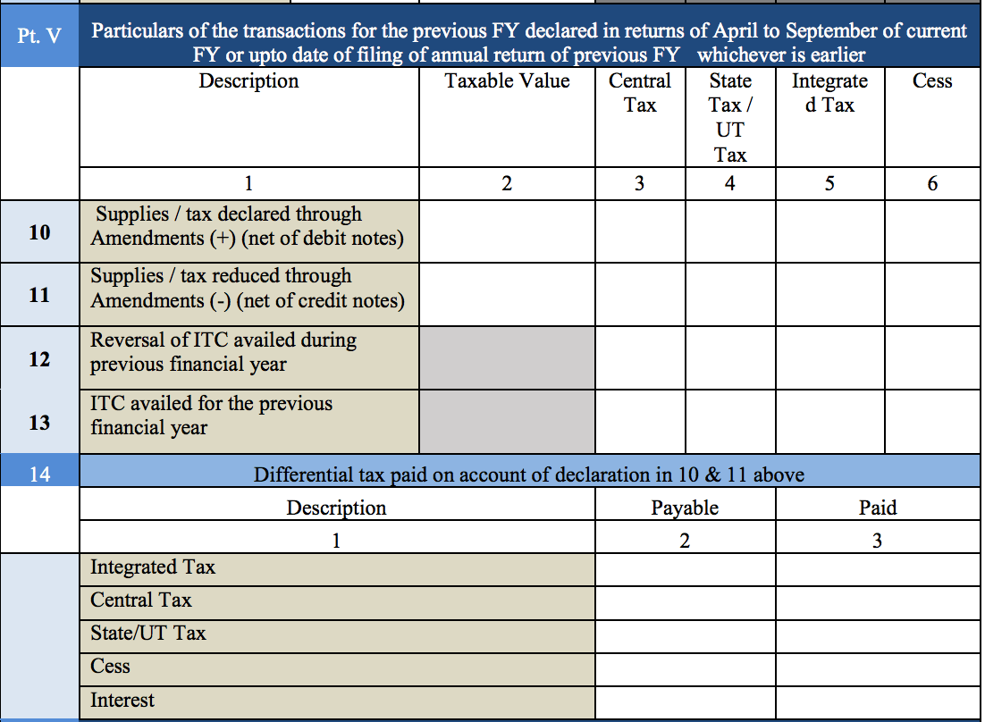

Slide 16
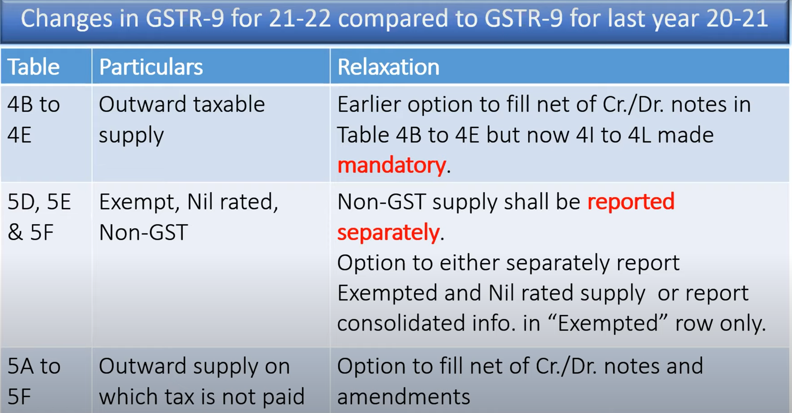

Slide 17
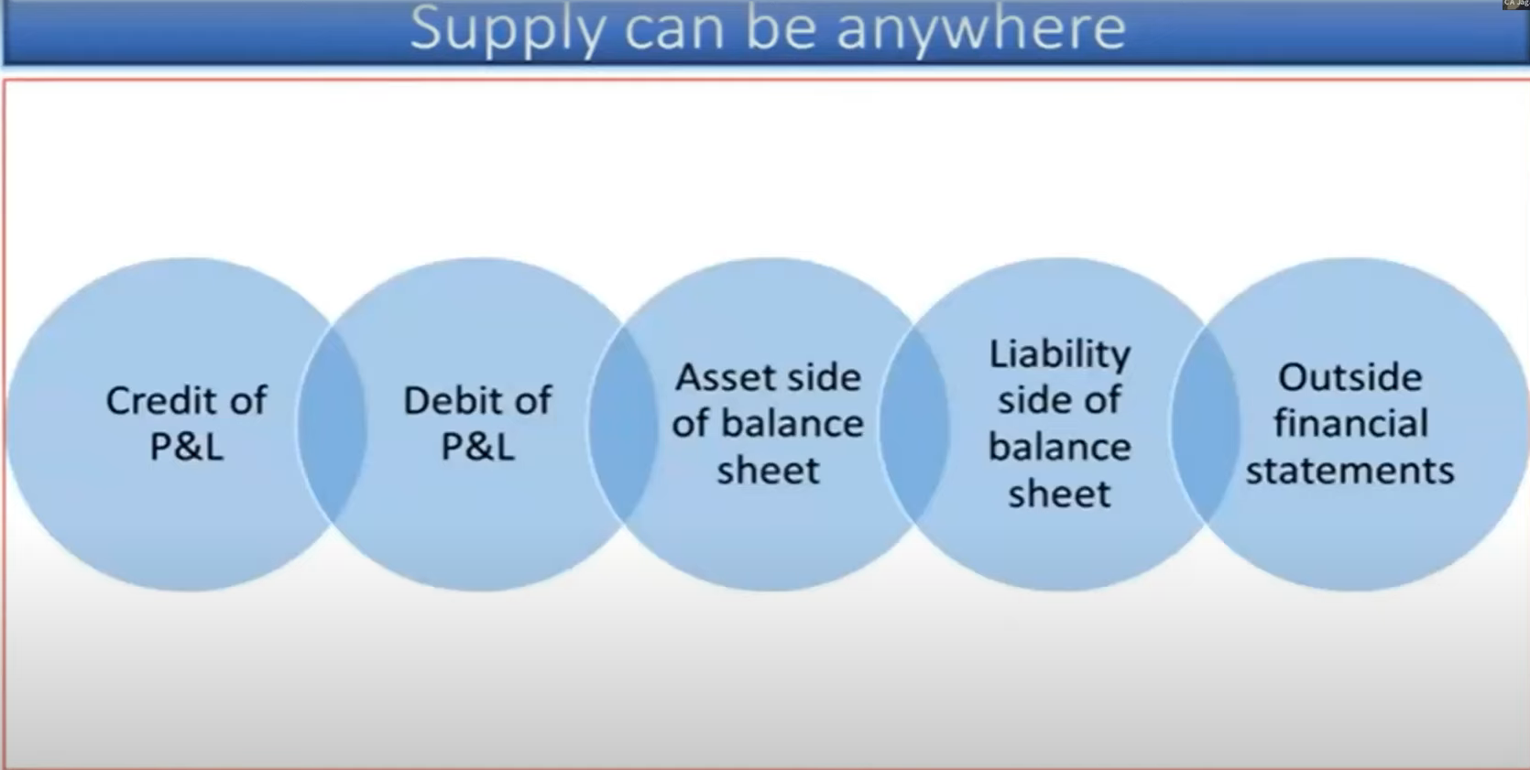

Slide 18
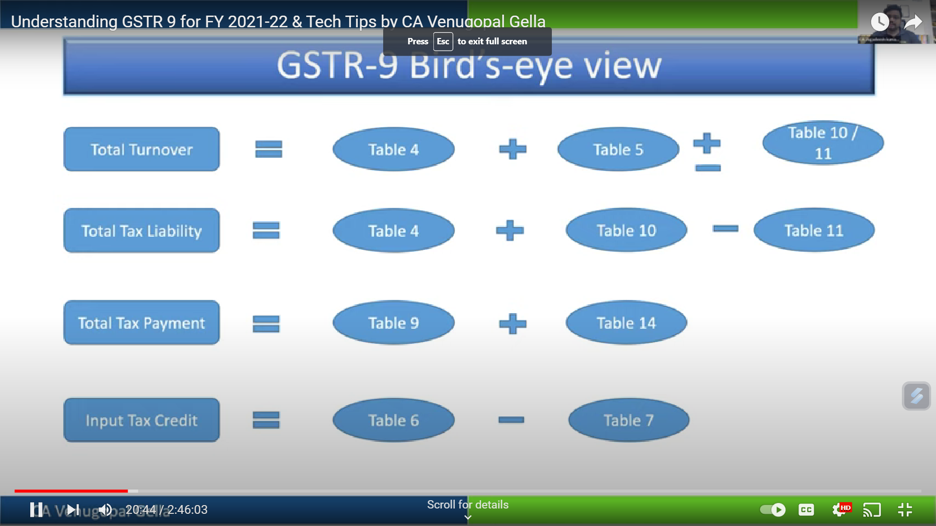
GSTR -9 Birds Eye View

Slide 19
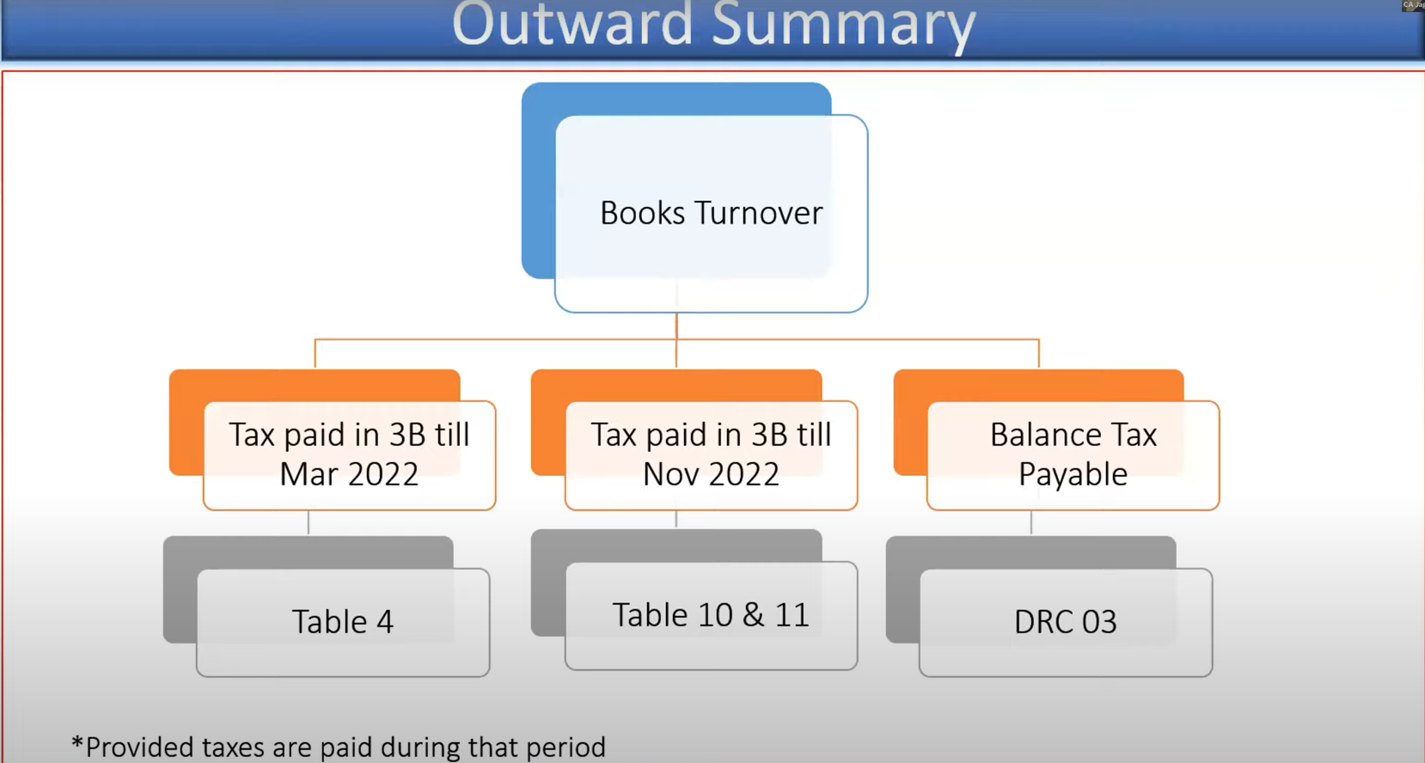
Disclose in Table 4 and pay the tax through DRC 03

Slide 20
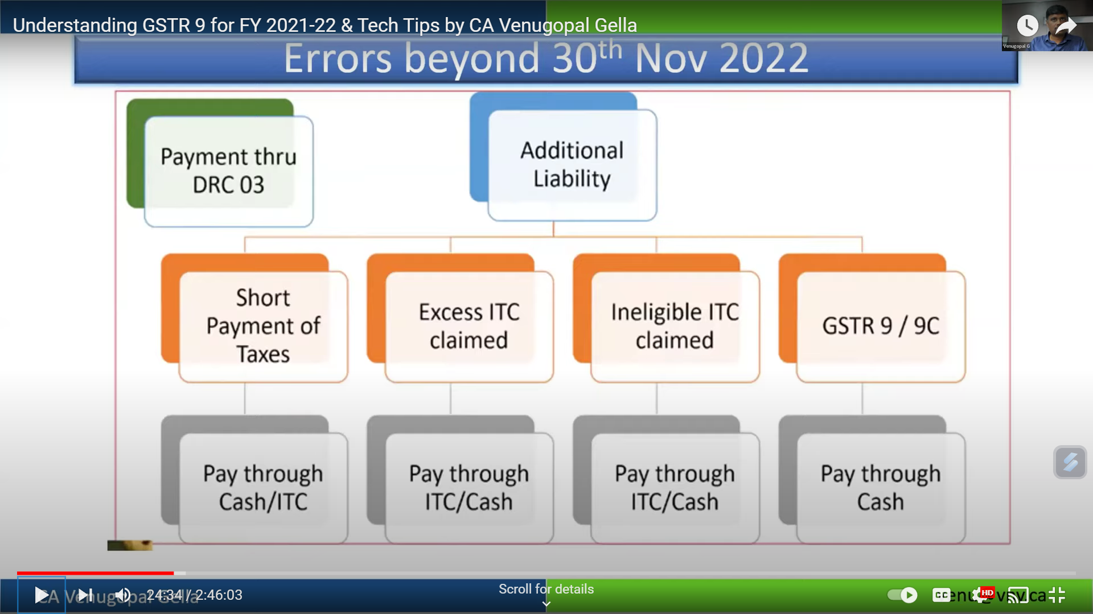
Payment of additional Liability on errors up to and after 30th November 2022

Slide 21
Examples : Turnover Reporting

Slide 22
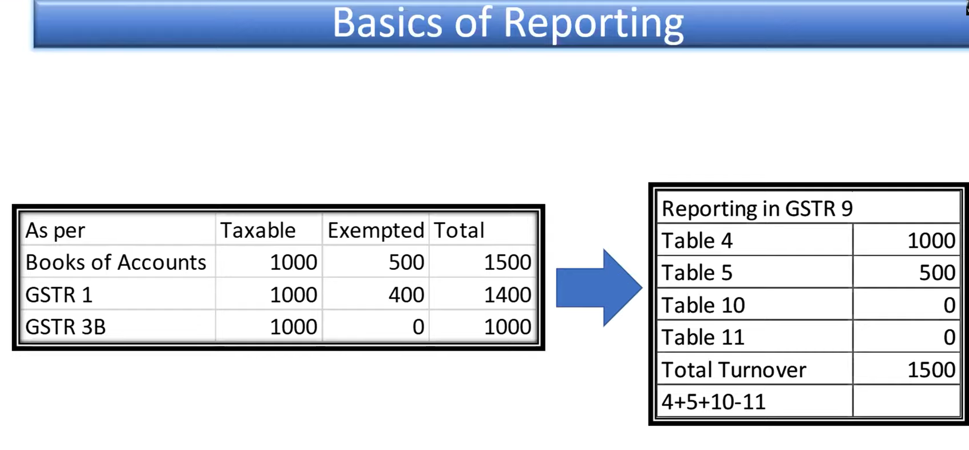

Slide 23
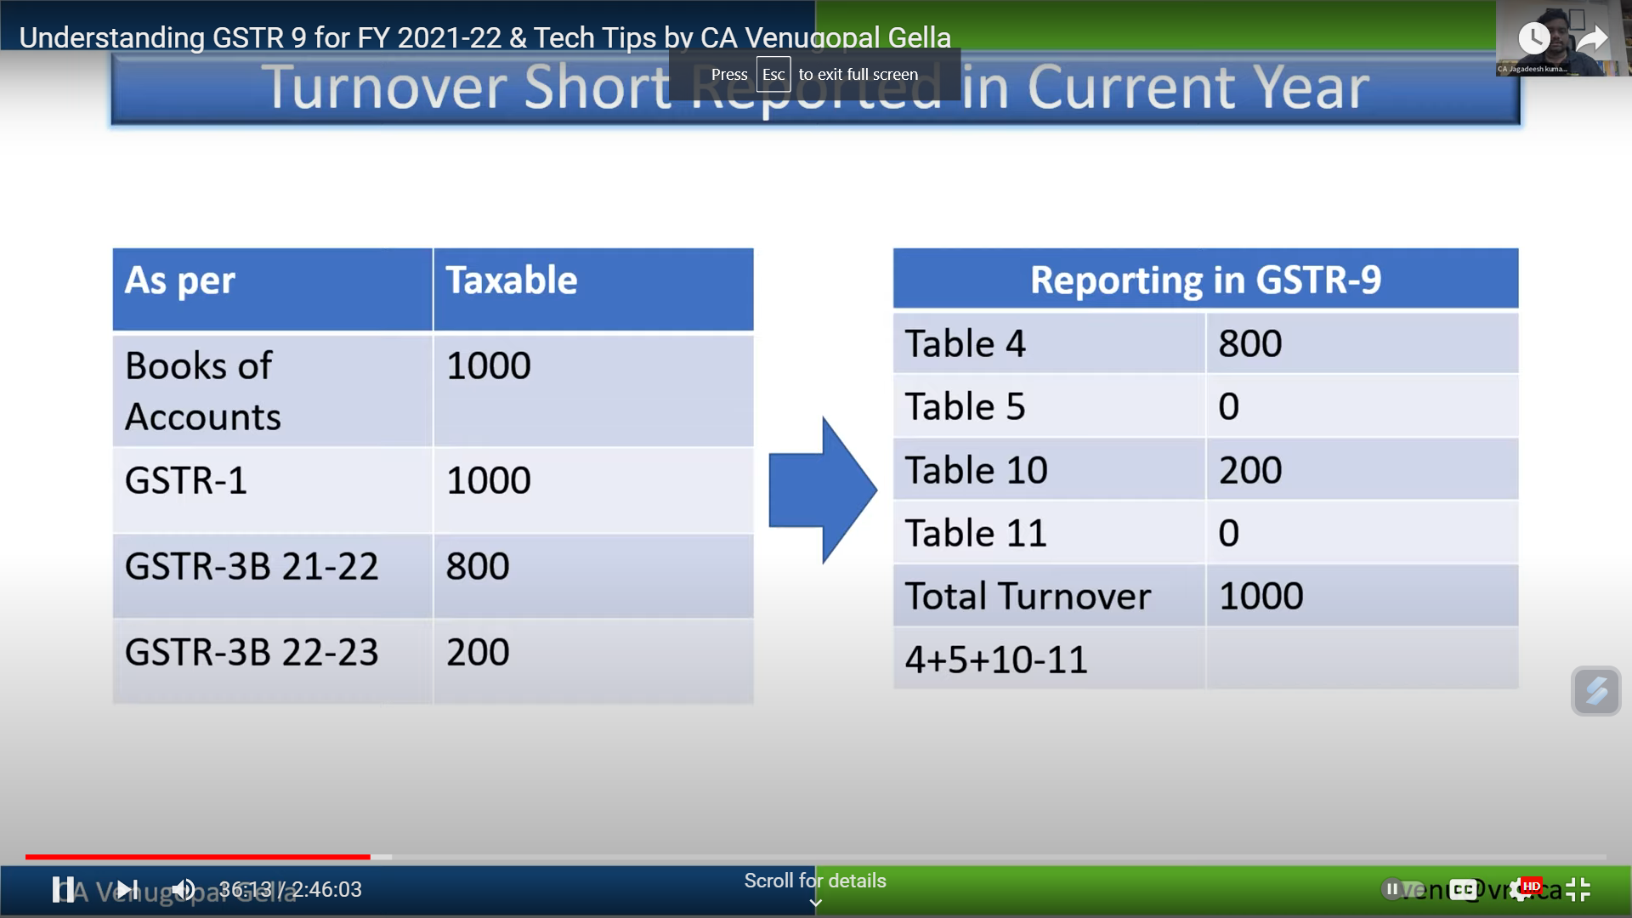
Turnover short reported in FY 2021-2022

Slide 24
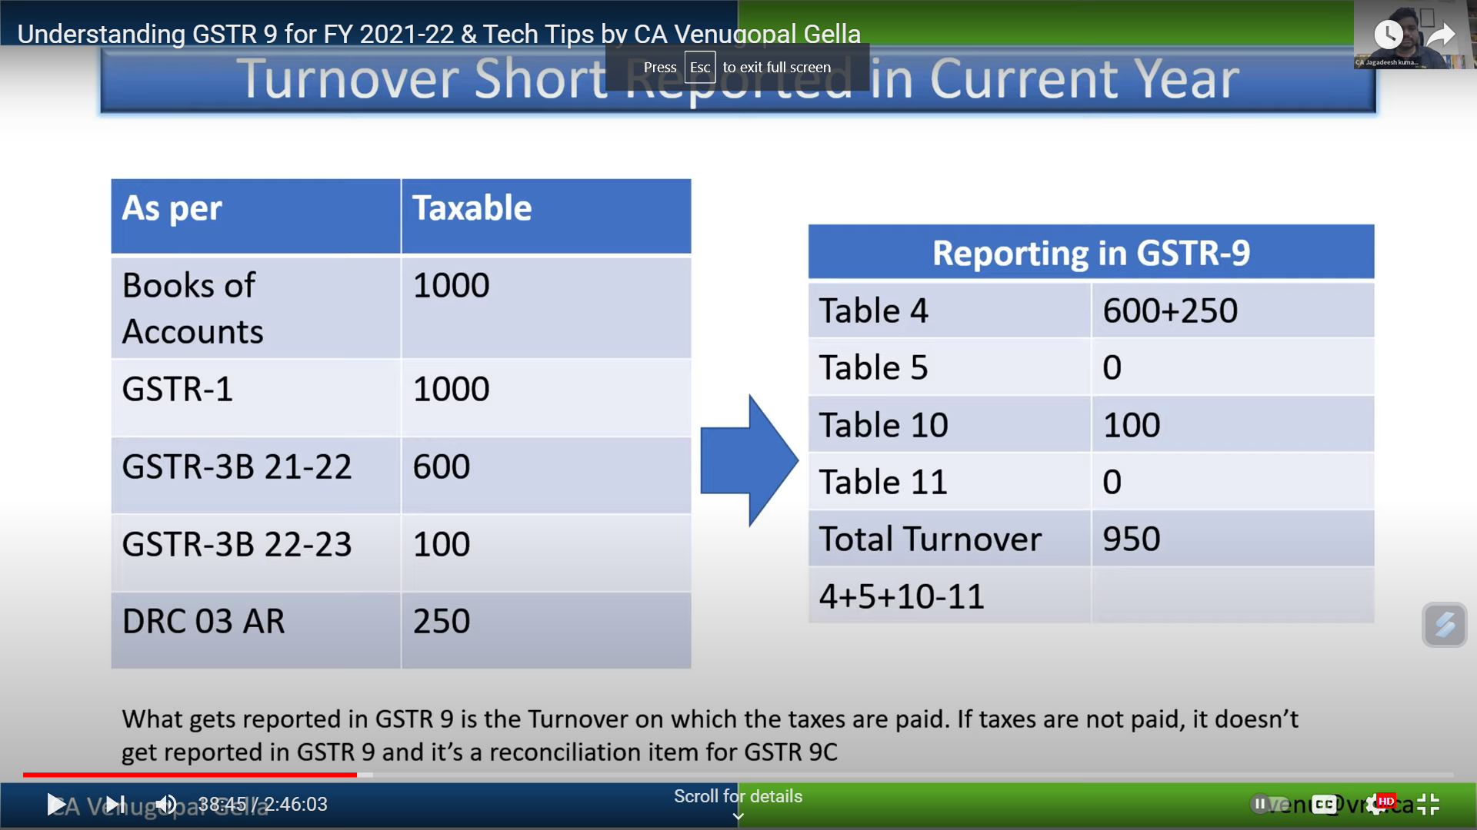
Turnover short reported in FY 2021-2022

Slide 25
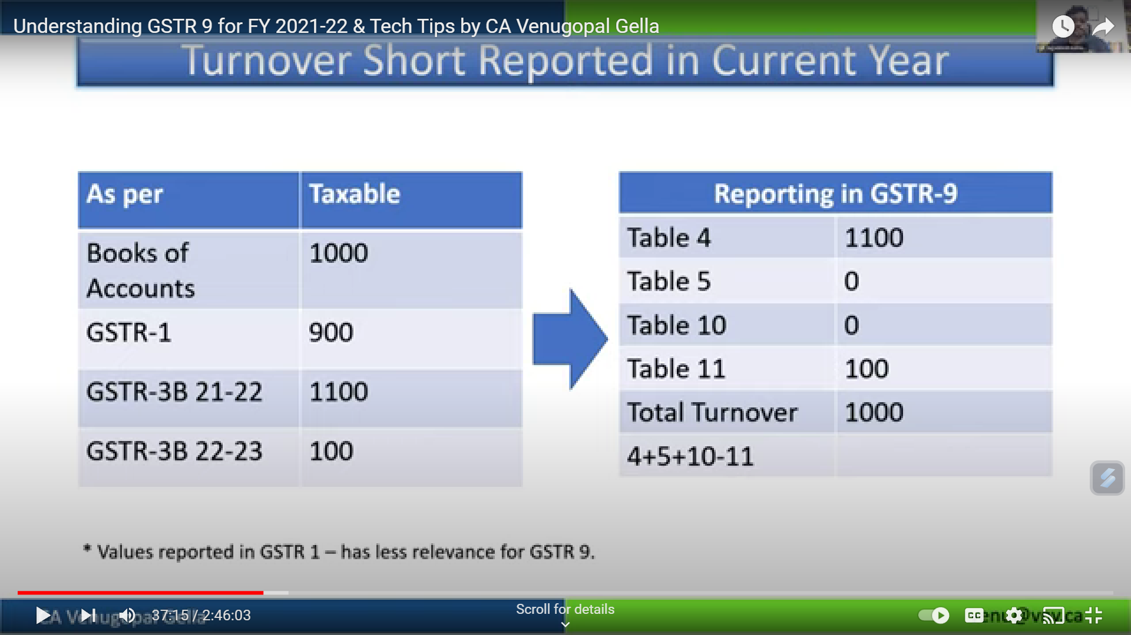
Turnover short reported in current financial year

Slide 26
Error relating to classification in GSTR 1
Issue: B2B Sales wrongly shown as B2C or vice versa
Can this be rectified in GSTR9?
Can the recipient be eligible to take ITC?

Slide 27
Payment of RCM liabilities of FY 2021-2022 in FY 2022-23
Issue: RCM liabilities of FY 2021-2022 disclosed in returns of FY 2022-23 before November 30th 2022.
In which table should the same be disclosed?

Slide 28
Late fees
Where the Annual return is filed voluntarily but belatedly, the portal is not calculating the late fees? Should the late fee be calculated manually and paid?

Slide 29
Any Queries?

Slide 30
Part III
INPUT TAX CREDIT
( Table 6, 7, 8)

Slide 31
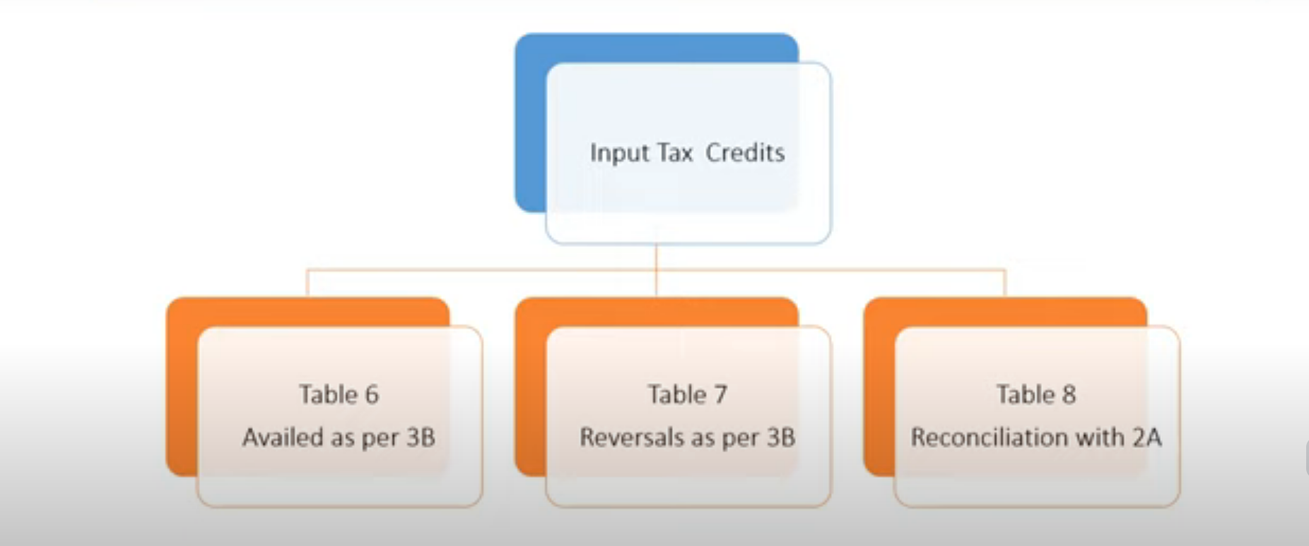
Part III – Details of Input Tax Credits

Slide 32
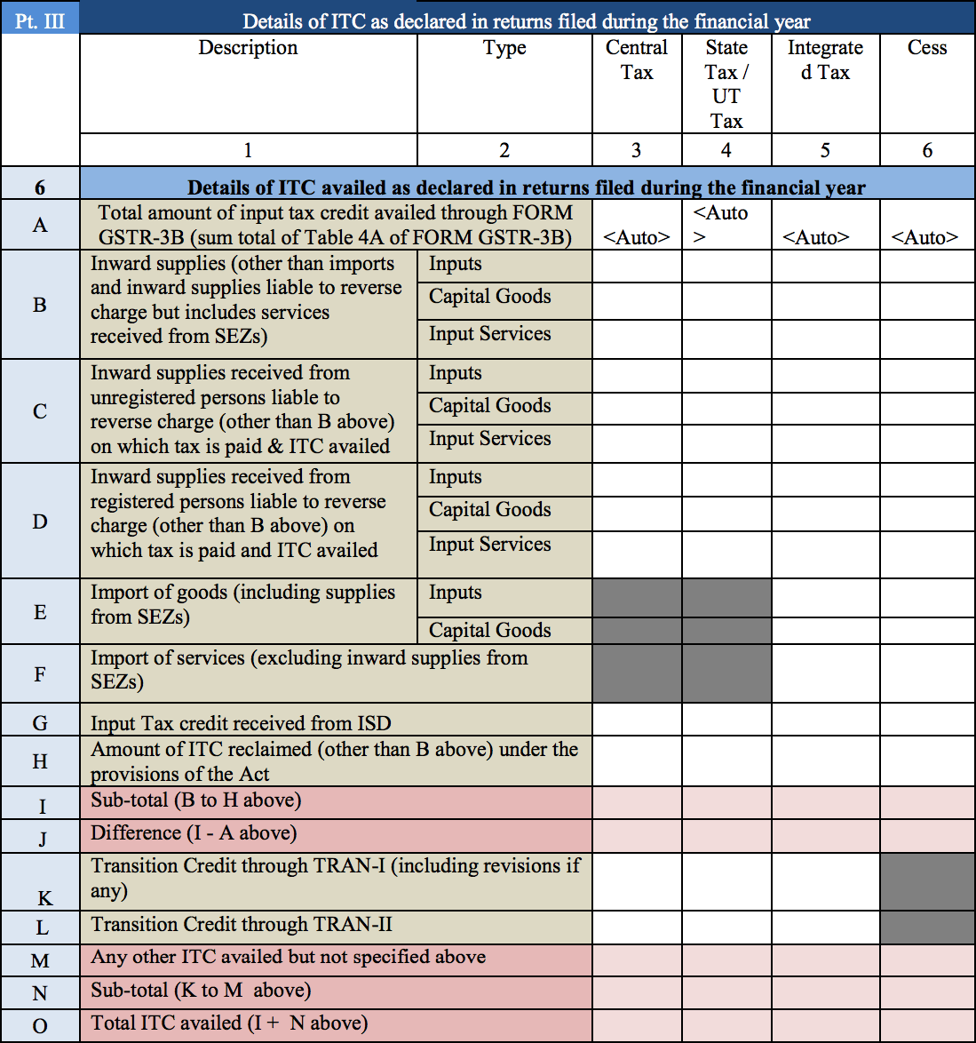

Slide 33
Part III: Details of ITC as declared in returns filed during the financial year

Slide 34
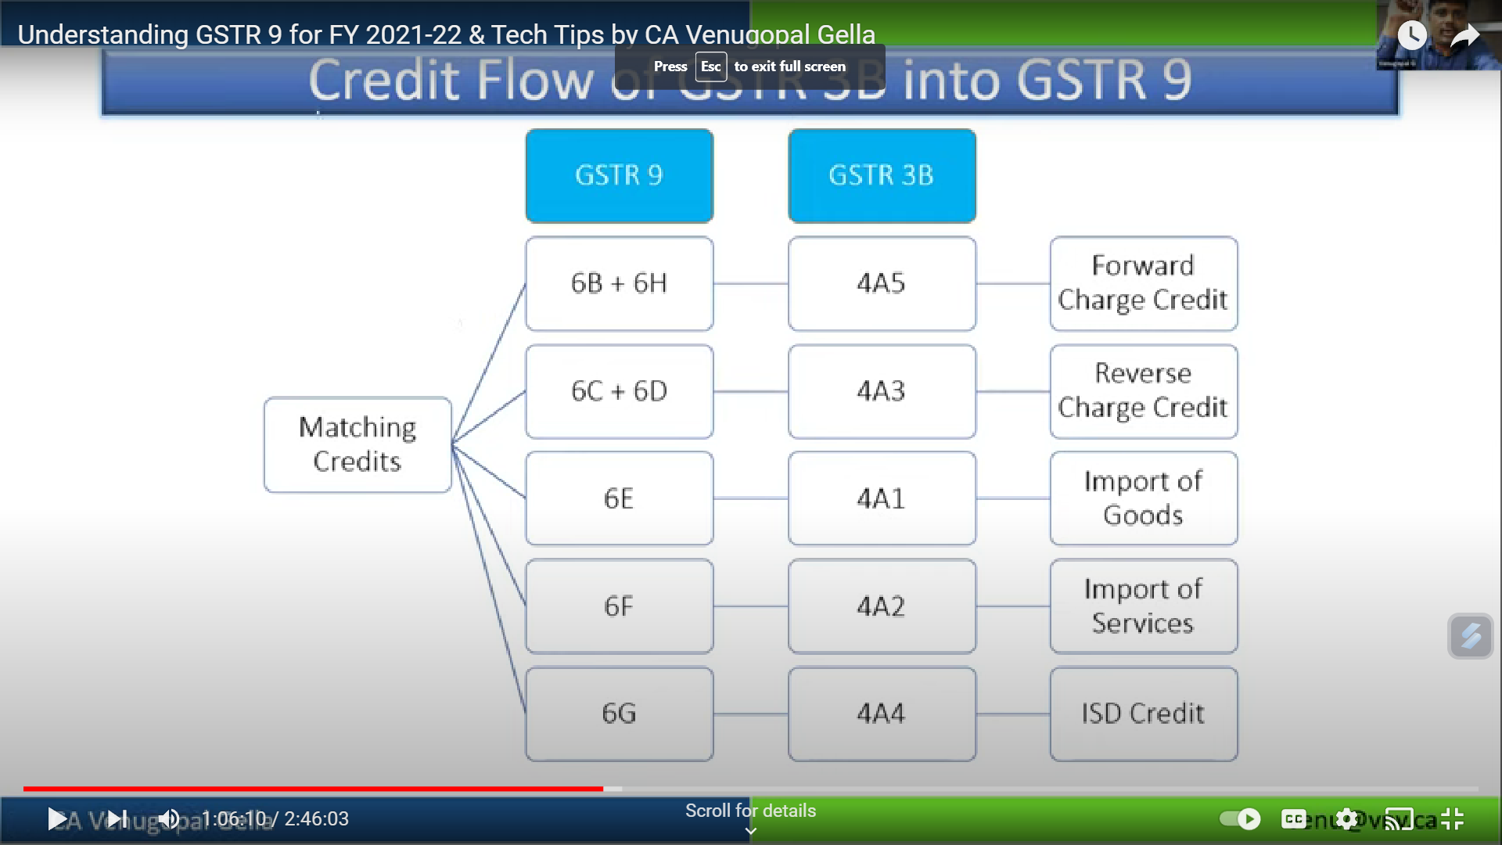
Credit Flow of GSTR 3B into GSTR 9

Slide 35
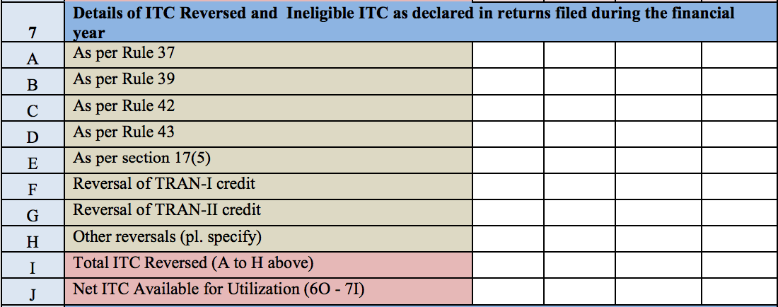

Slide 36
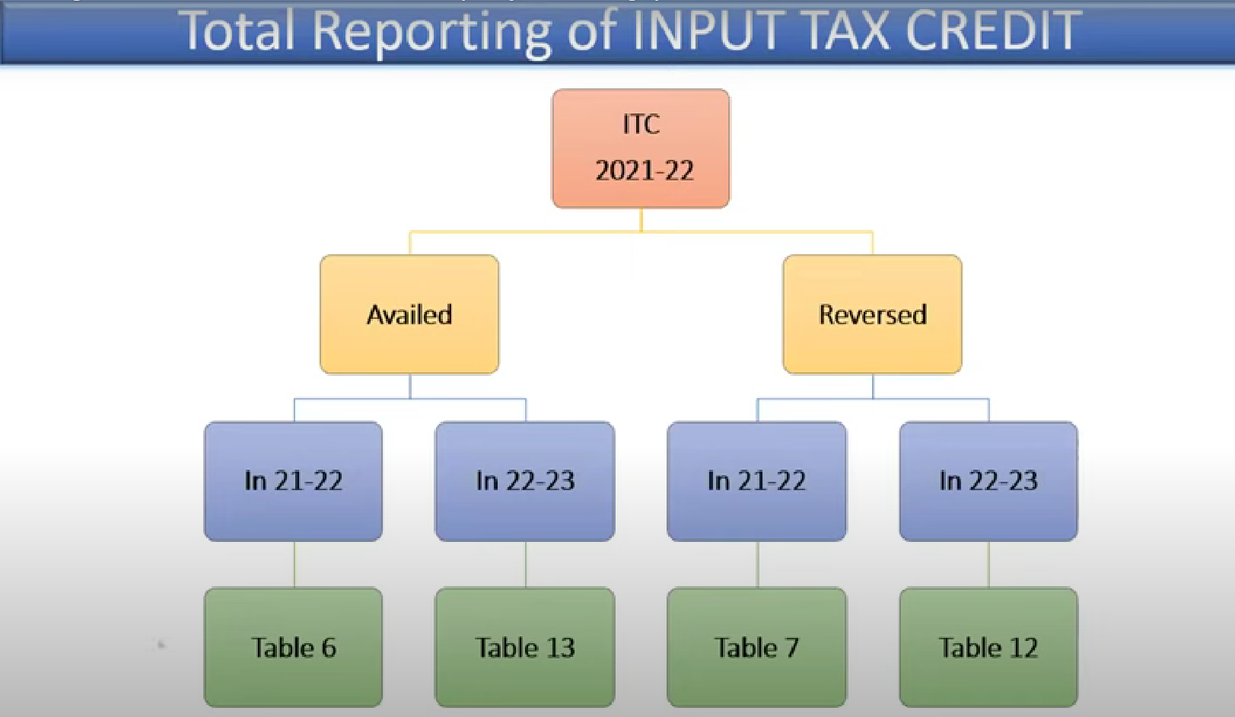

Slide 37
Reversal of Excess ITC Availed
Excess Availment of ITC
Reversed in GSTR 3B of current year (2021-22)
Reversed in GSTR 3B of subsequent year (April 2022 to November 2022)
Reversed in GSTR 9
Disclose in Table 7 of GSTR 9
Disclose in Table 13 of GSTR 9
Disclose in Table 7 of GSTR 9
Payment through GSTR 3B
Payment through GSTR 3B
Payment through DRC 03

Slide 38
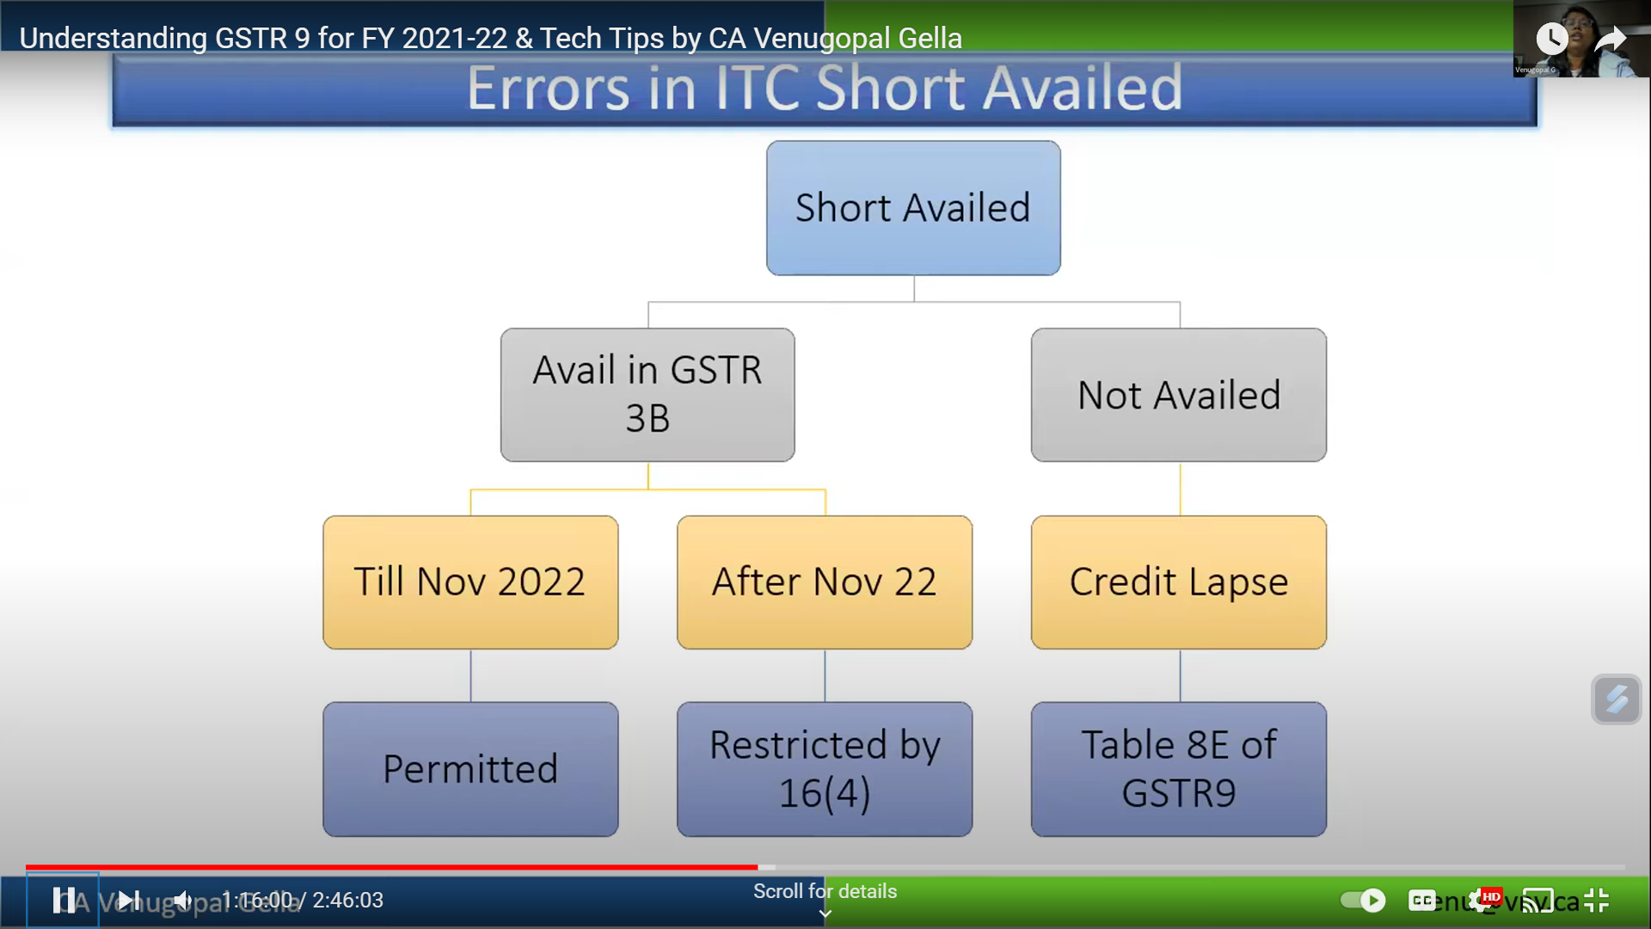
Short Availment of ITC in the current financial year

Slide 39
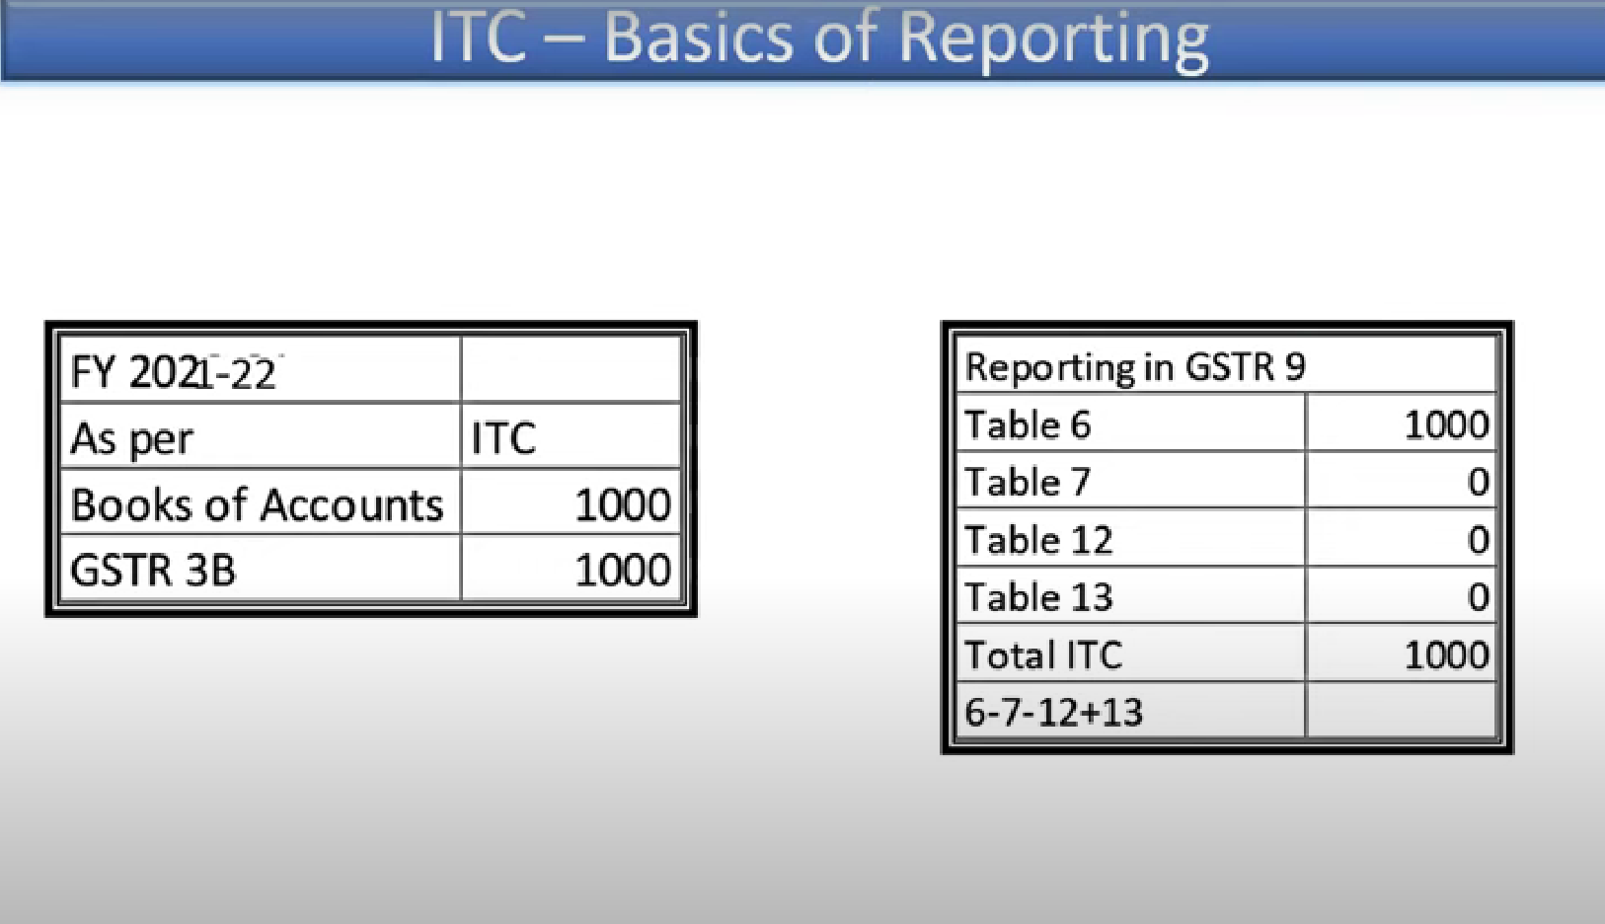

Slide 40
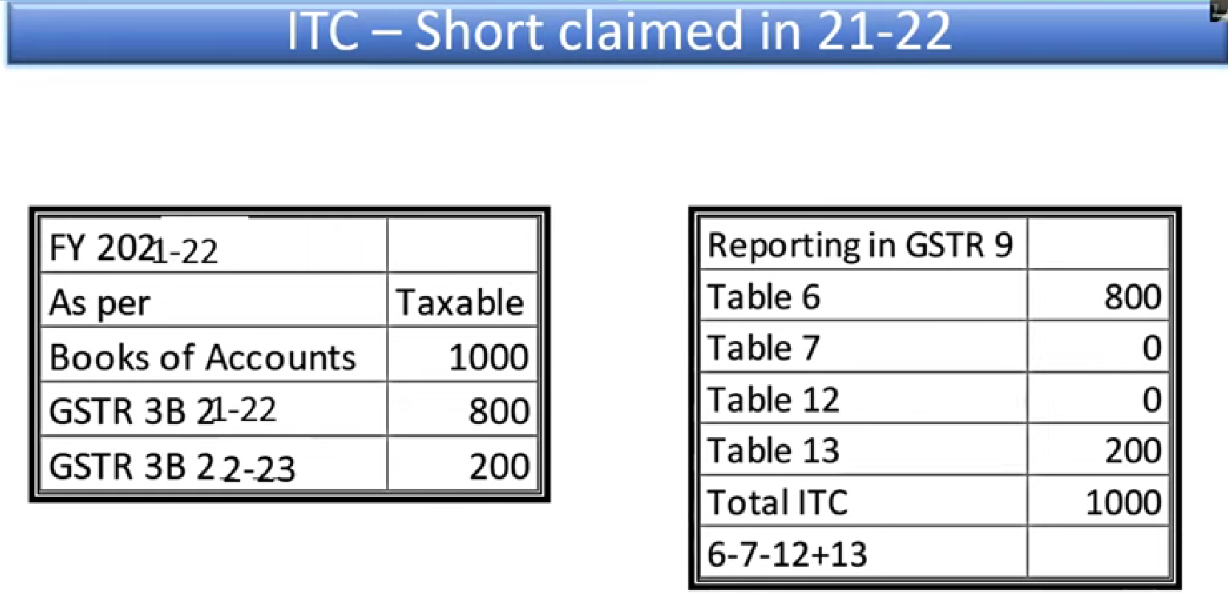

Slide 41
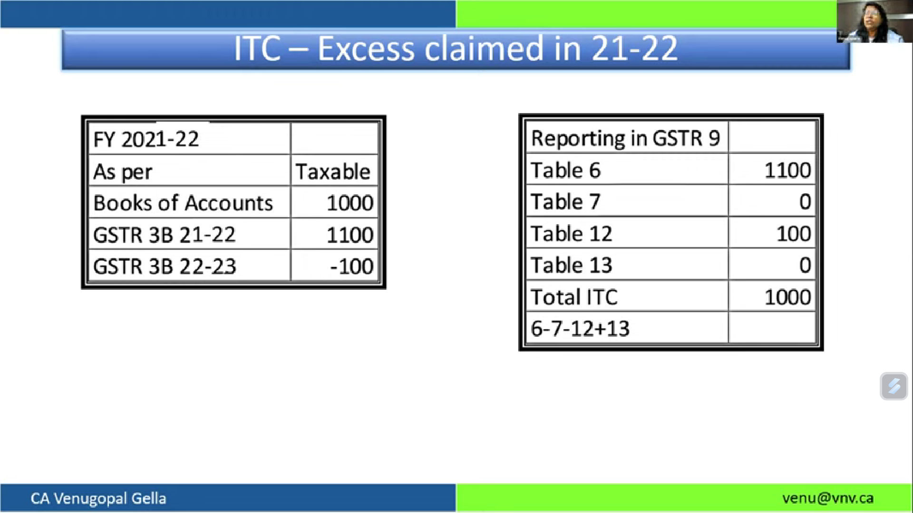

Slide 42
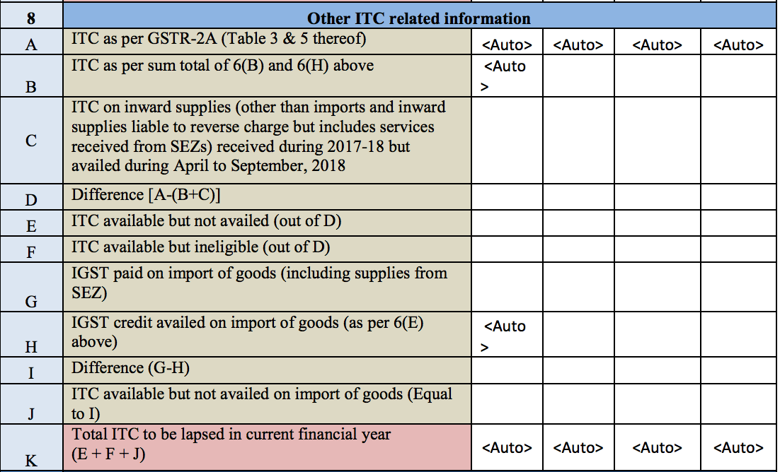
2021-22
November 2022

Slide 43
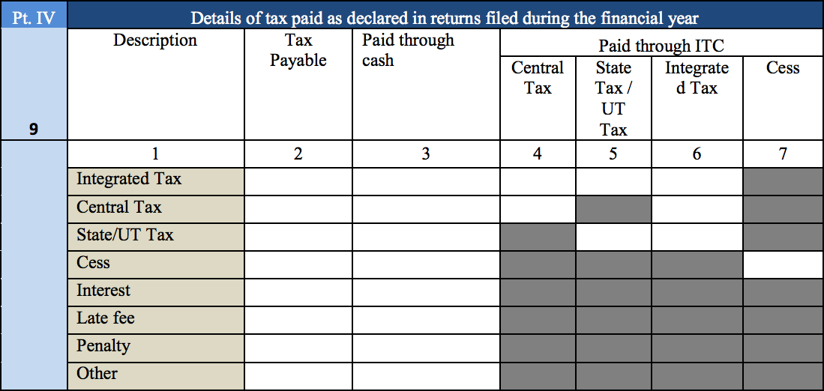

Slide 45
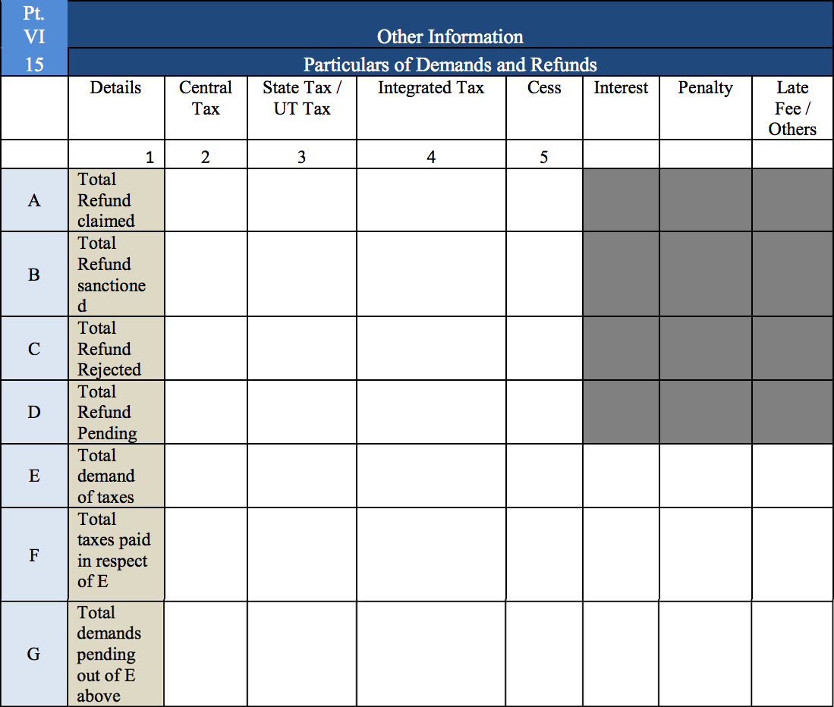

Slide 46
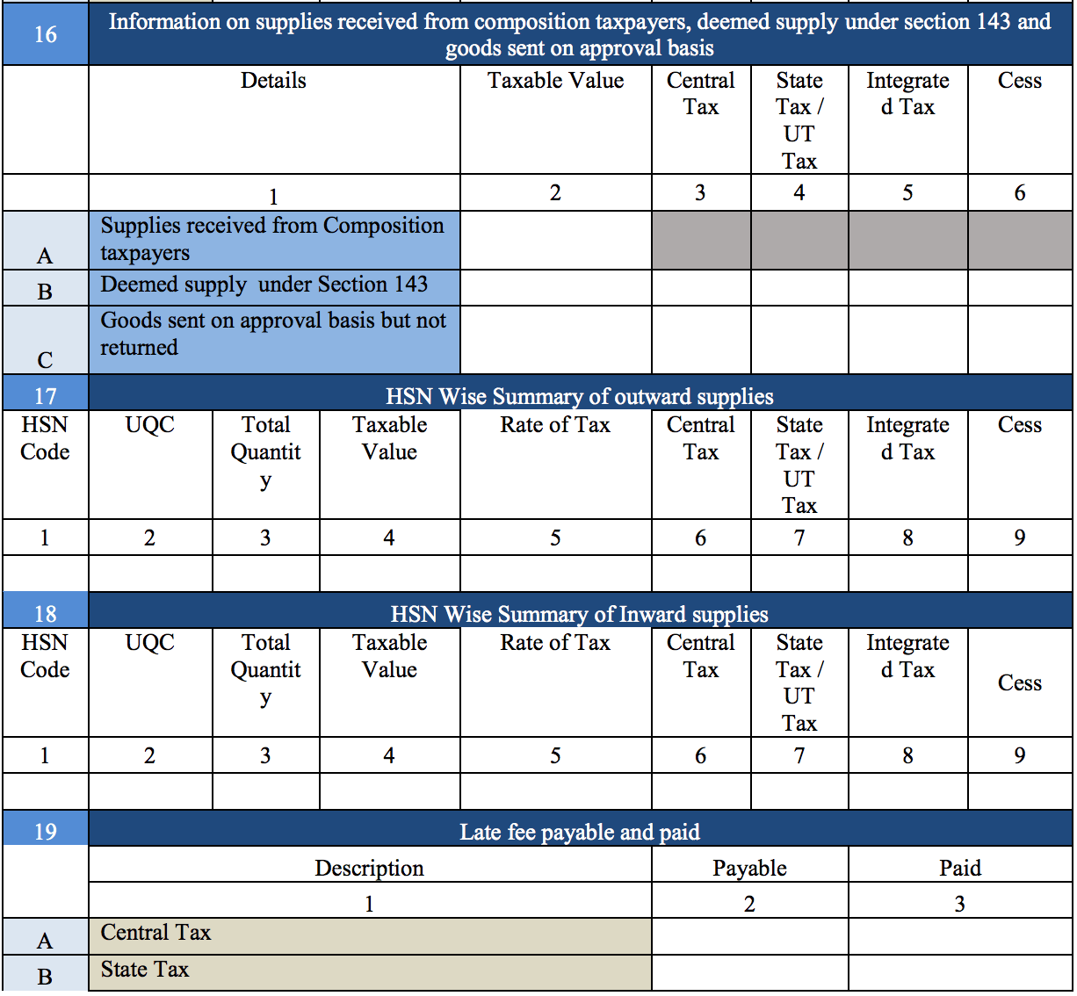

Slide 47
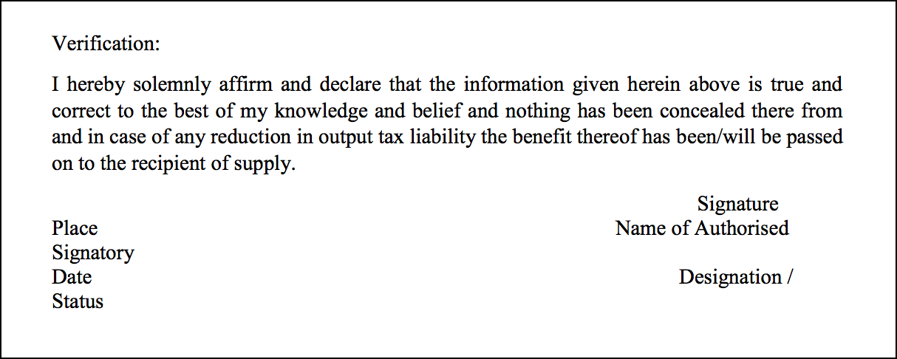

Slide 48
Any Queries?

Slide 49


Slide 50
What is GSTR 9C?
It is a Statement of reconciliation between –
The Annual Return in GSTR 9 filed for a FY and
The figures as per the audited annual Financial Statements of the taxpayer.

Slide 51
Applicability (For the FY 2021-2022)
Applicable to all registered taxpayers if the aggregate turnover exceeds Rs. 5 crores.
Notes:
Though applicable to all the registered persons irrespective of the turnover , Power given to the department to decide the threshold limit to exempt certain categories has to be mentioned

Slide 52
Details required for filing GSTR 9C
Annual Return (GSTR -9)
Audited Financial Statement
Ratewise Split of Turnover
Purchase register for arriving at ITC as per books
Expense-wise split of ITC
Sales register

Slide 53
Contents of GSTR 9C
GSTR 9C consists of two main parts:
Part – A: Reconciliation Statement
Part – B: Self-Certification

Slide 54
Contents of Reconciliation Statement
Basic Details
Reconciliation of Total turnover and Taxable turnover declared in Audited Annual Financial Statement with turnover declared in Annual return
Reconciliation of Tax Paid
Reconciliation of ITC

Slide 55
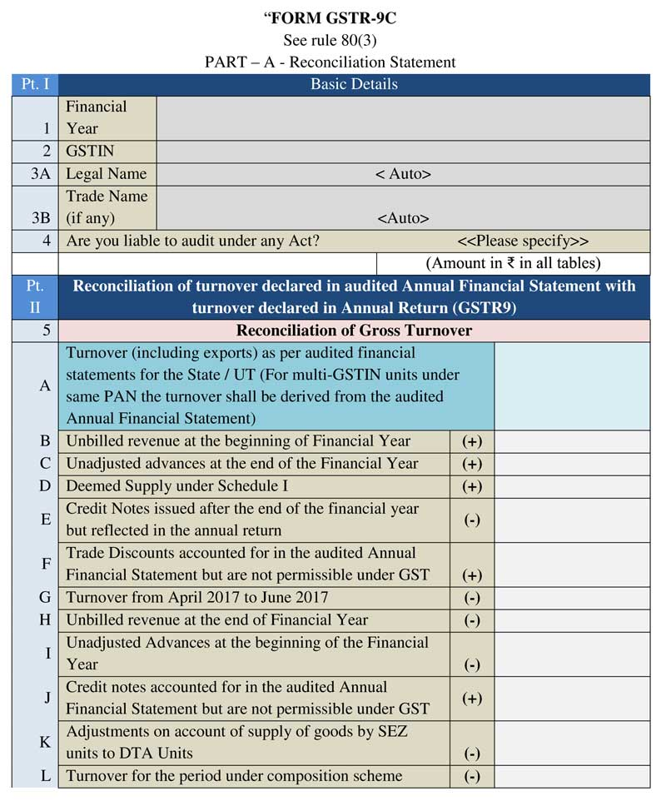

Slide 56
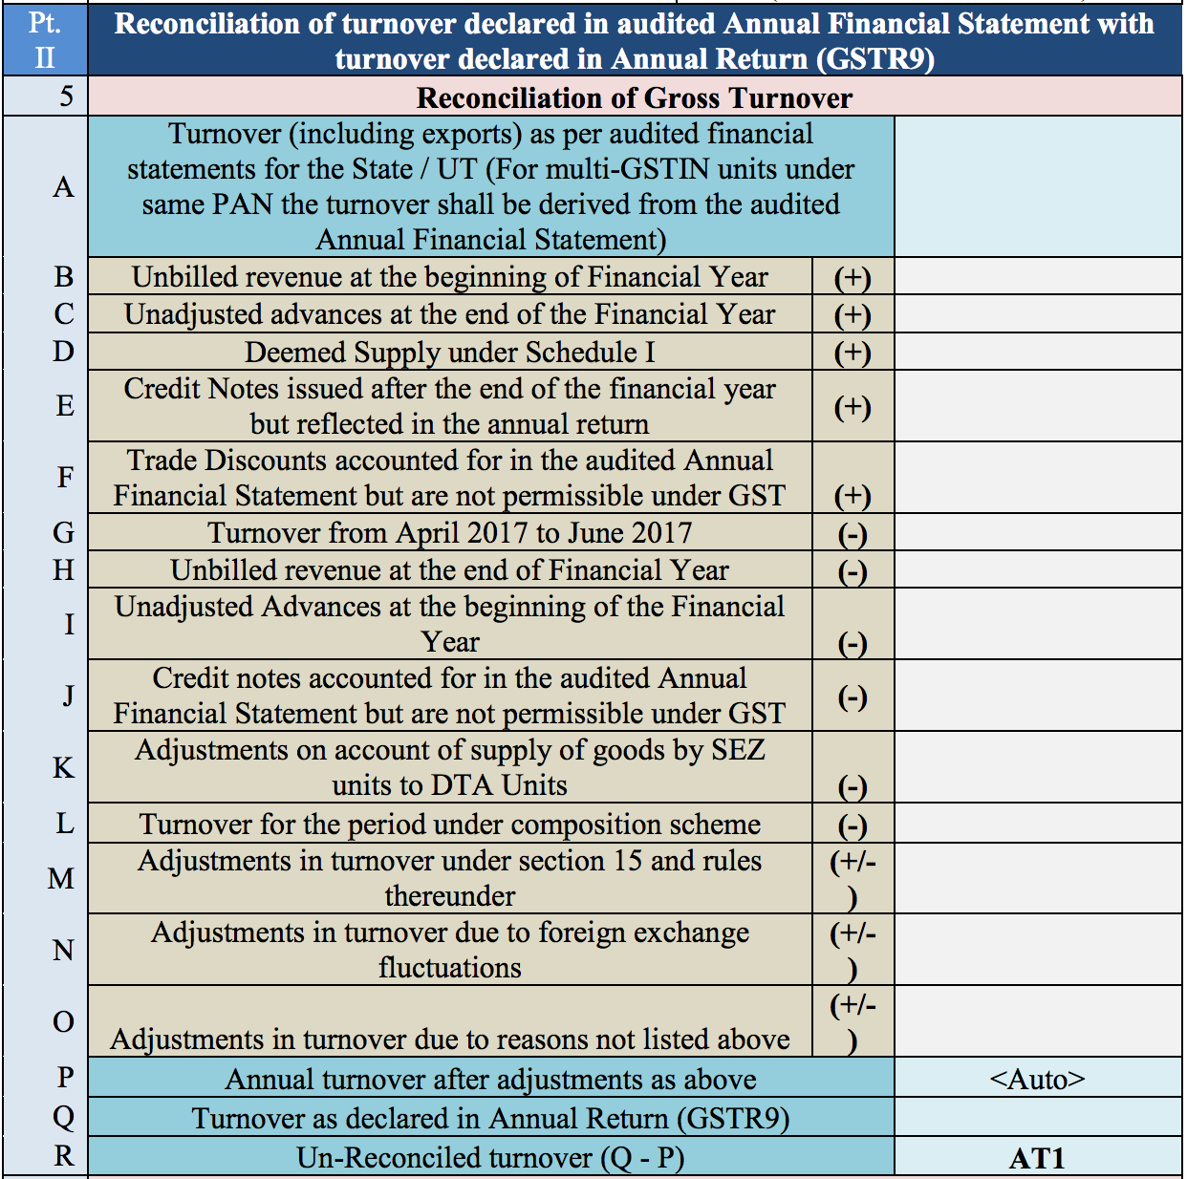

Slide 57
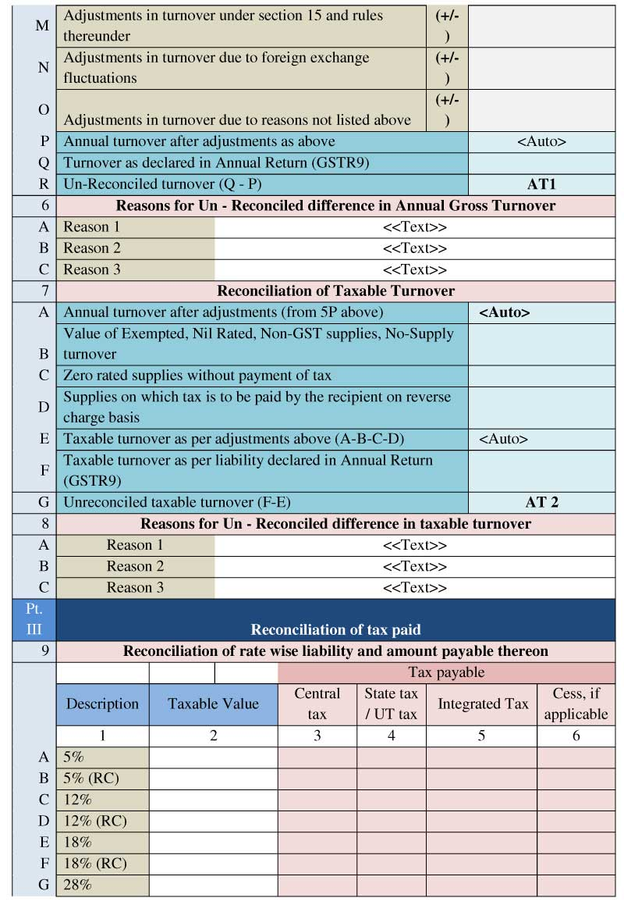

Slide 59
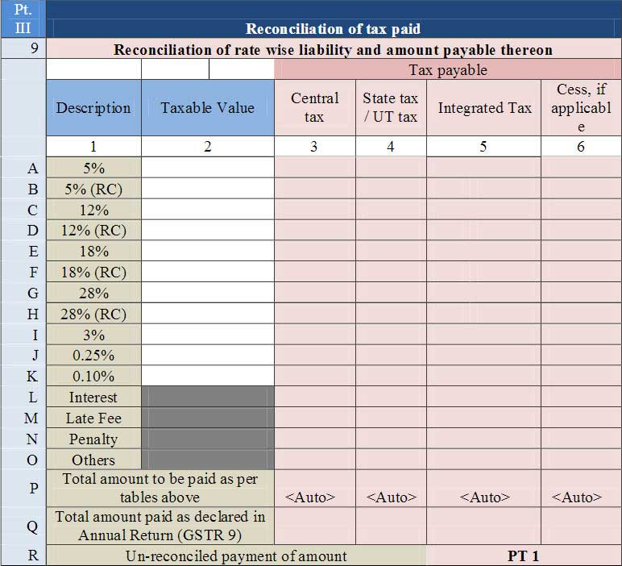

Slide 60
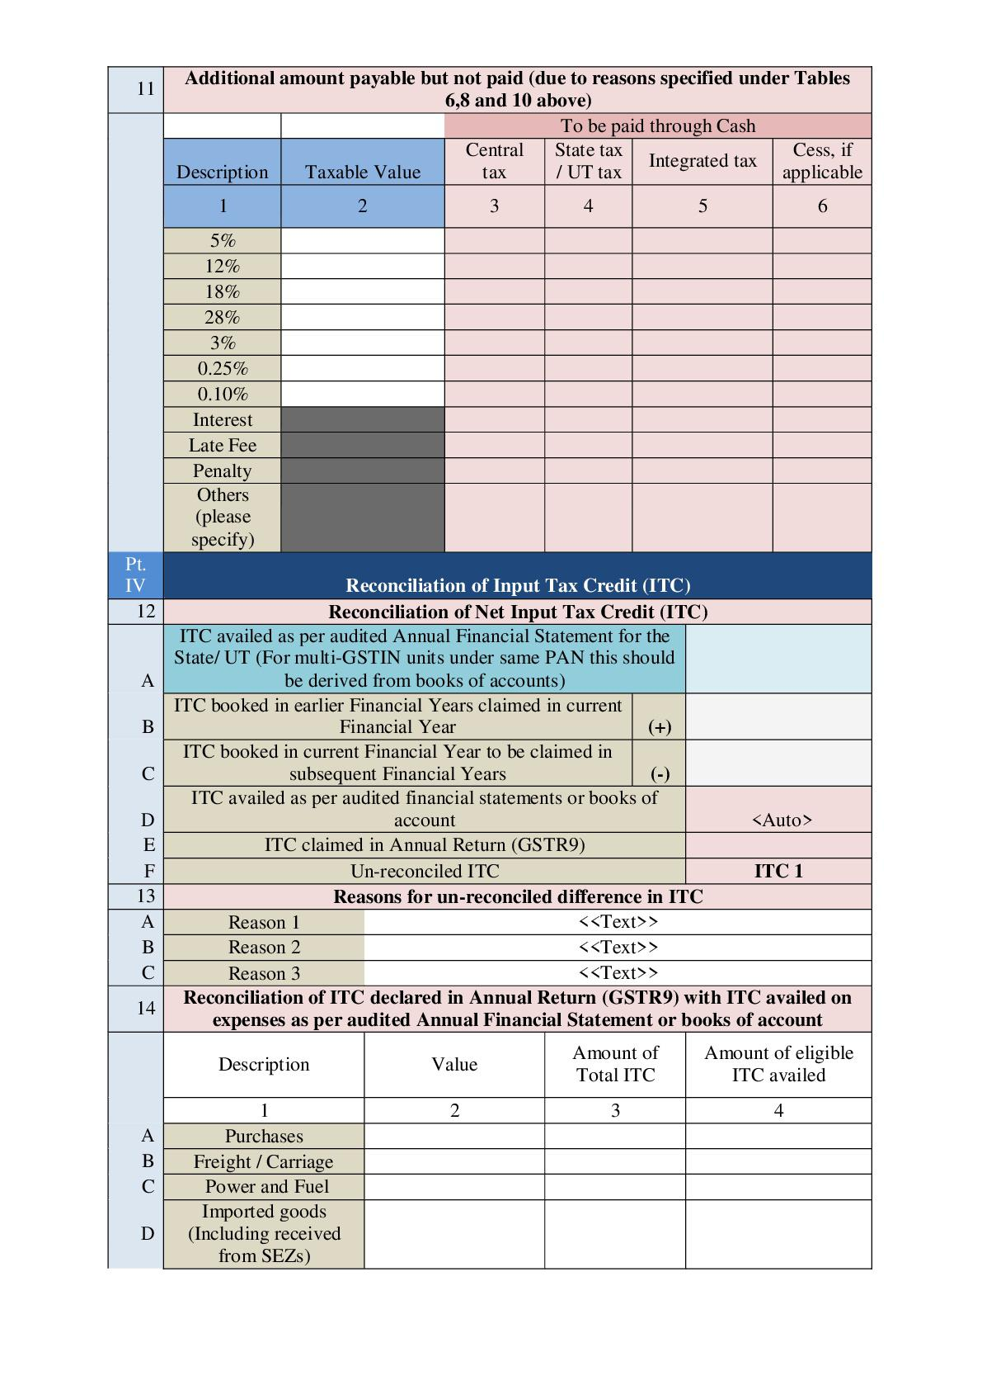

Slide 62
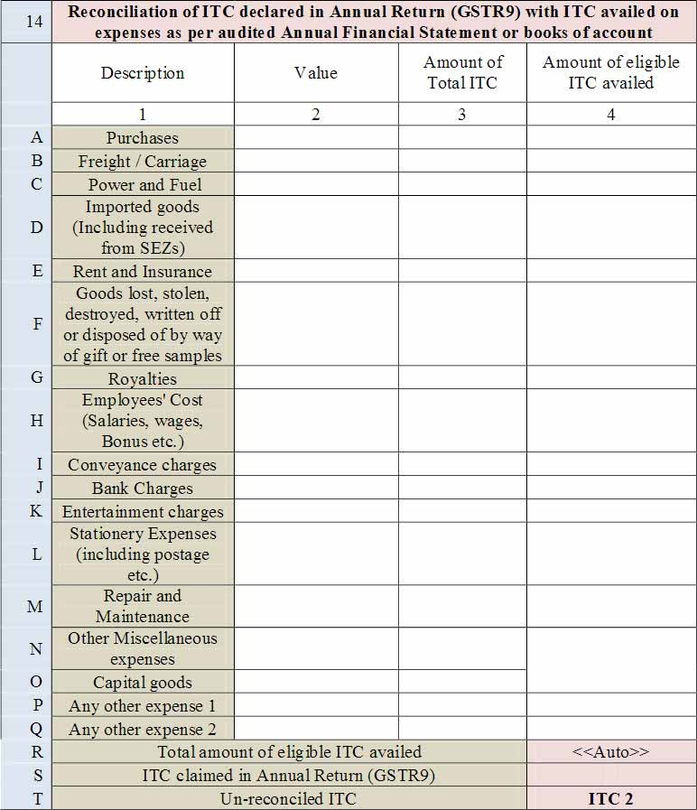

Slide 63
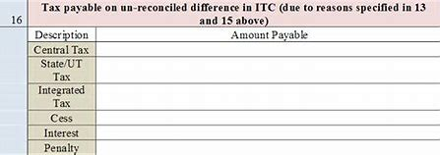

Slide 64
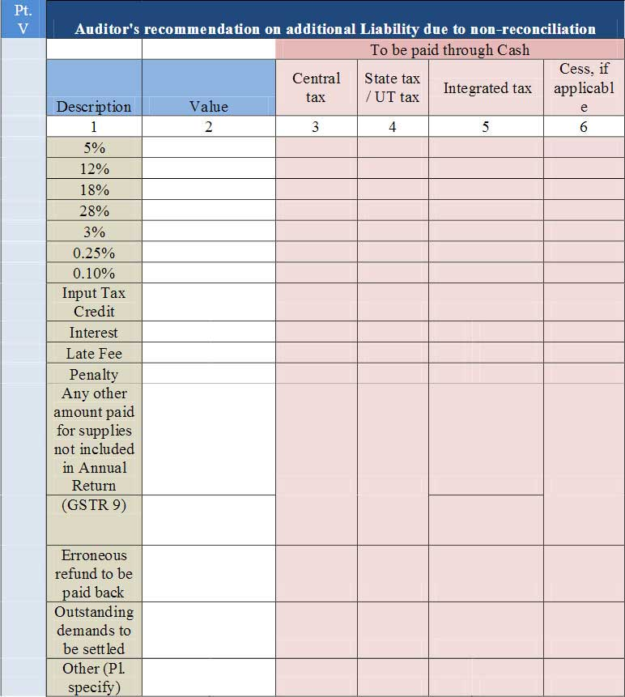

Slide 65
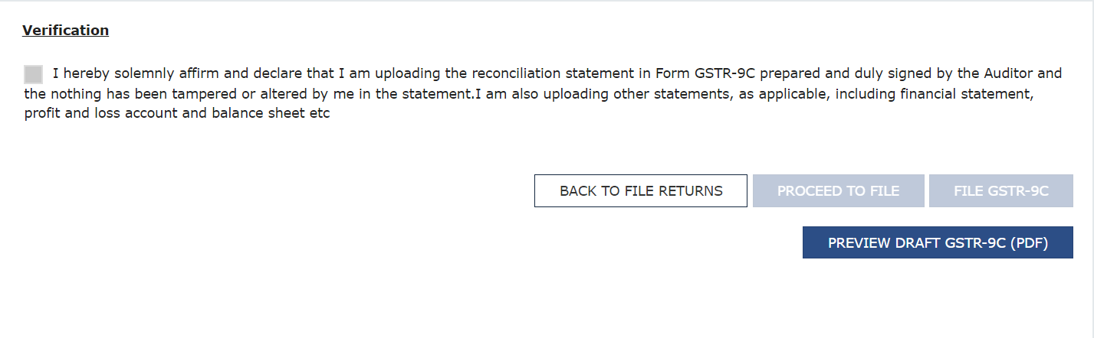

Slide 66
Any Queries?

