Slide 1
National Conference on GST at Ernakulam Topic: Classification Concepts under GST 26th August 2022 CA. Viral M Khandhar
The Institute of Chartered Accountants of India
GST & Indirect Taxes Committee
GST & Indirect Taxes Committee, ICAI

Slide 2
CLASSIFICATION UNDER GST
OVERVIEW
What is classification?
Why is classification required?
What is the legal framework in GST for classification?
How to classify goods and services?

Slide 3
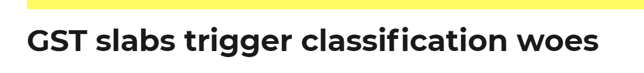
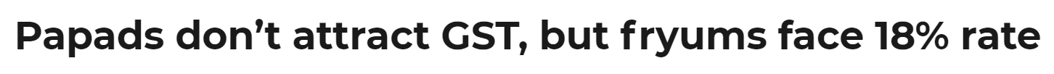
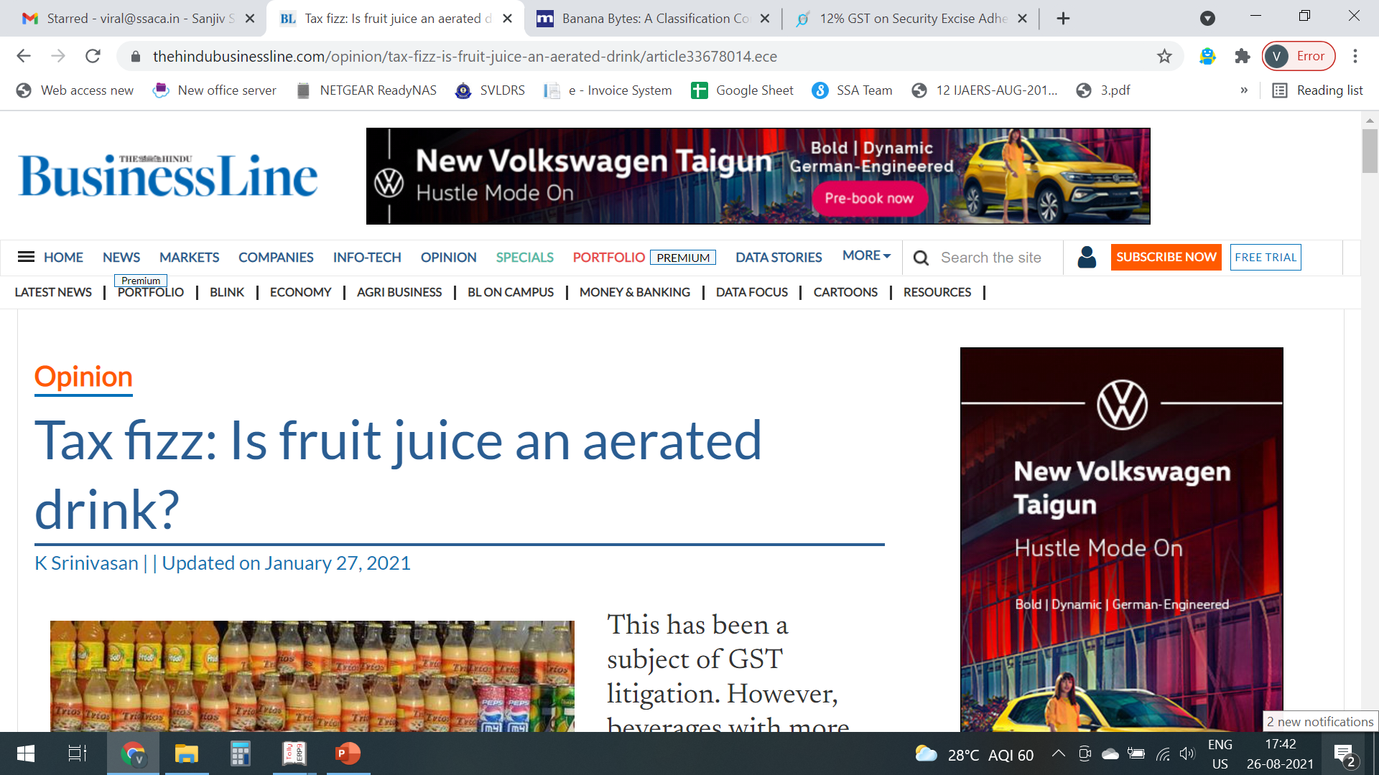
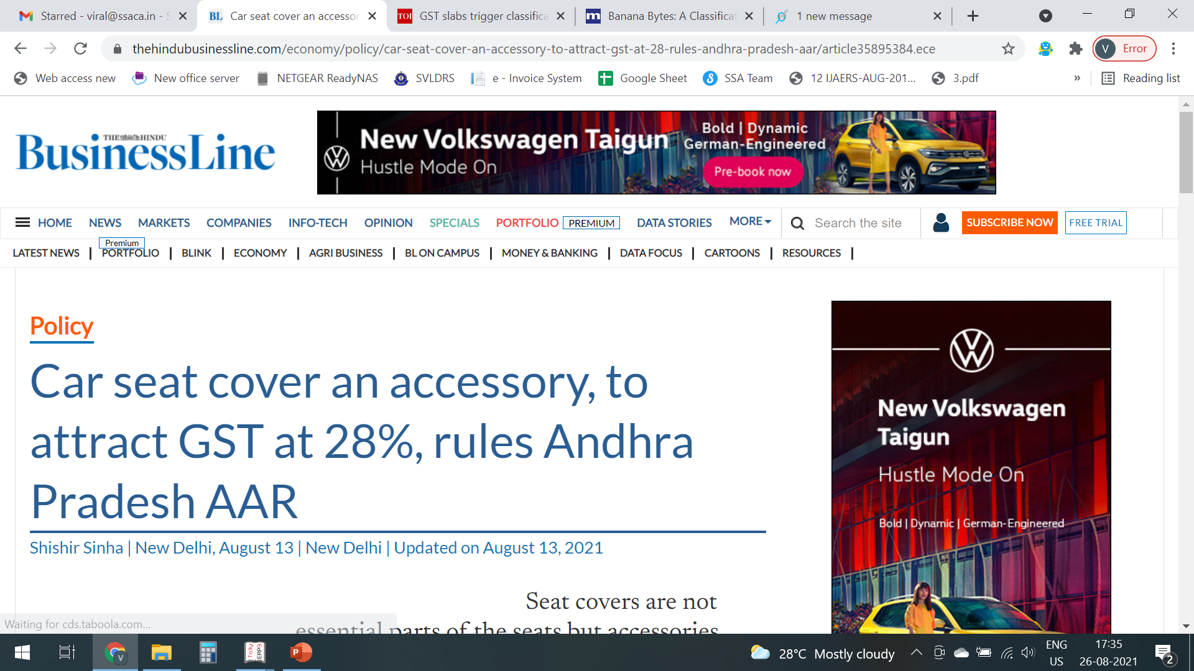
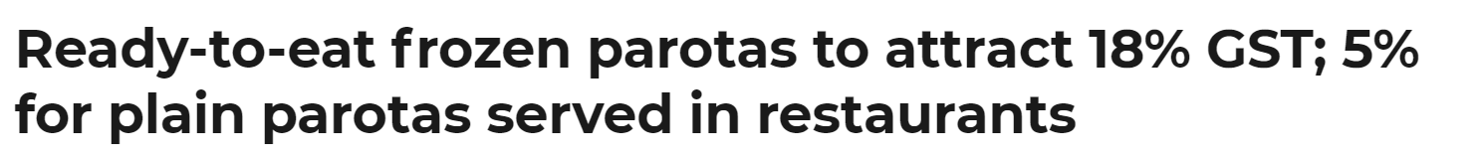
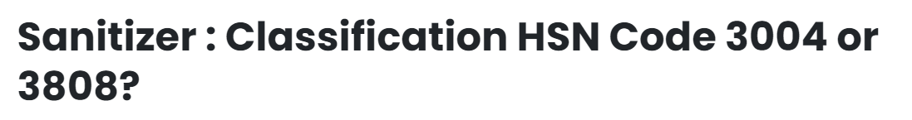
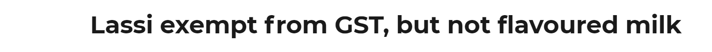
Notes:
The Amritsar bench of ITAT in a recent ruling held that iPads are communicating devices and thus, not a substitute for computers, which had sparked a debate among tax professionals warranting a discussion.
There is apprehension about whether the dominance test must be evaluated from the taxpayer's perspective or through common parlance”.

Slide 4
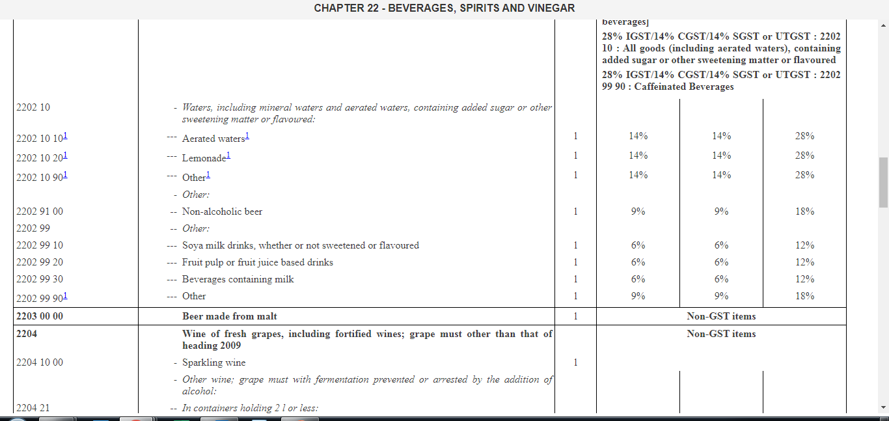

Slide 5
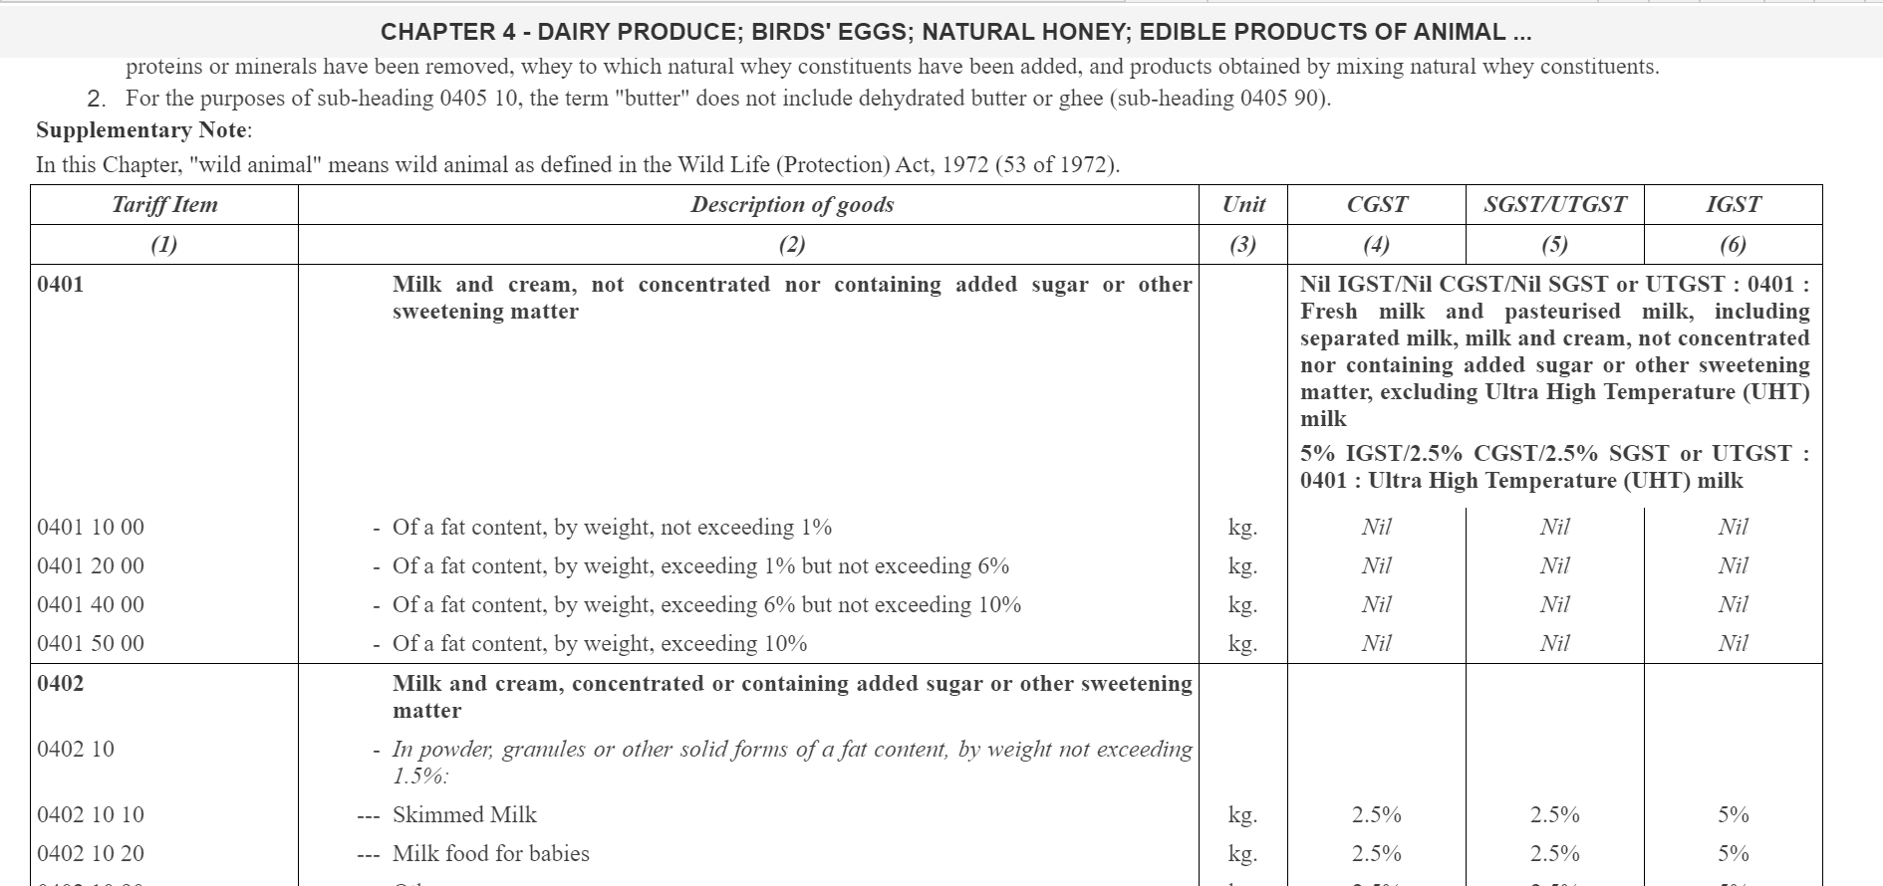

Slide 6
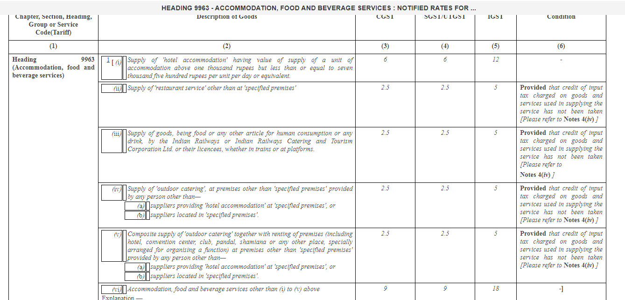

Slide 7
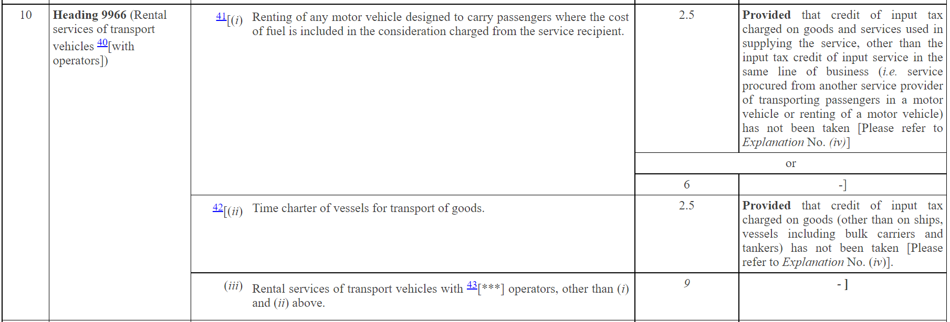
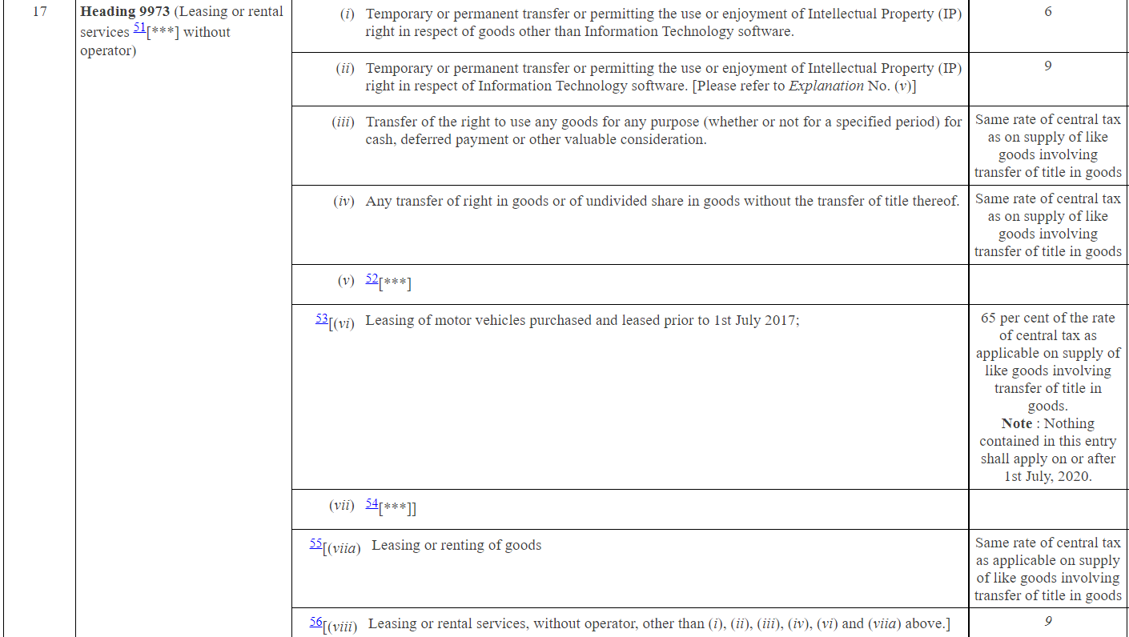

Slide 8
CLASSIFICATION IN GST
LEGAL FRAMEWORK

Slide 9
LEVY AND COLLECTION – SECTION 9
(1) Subject to the provisions of sub-section (2), there shall be levied a tax called the central goods and services tax on all intra-State supplies of goods or services or both, except on the supply of alcoholic liquor for human consumption, on the value determined under section 15 and at such rates, not exceeding twenty per cent, as may be notified by the Government on the recommendations of the Council and collected in such manner as may be prescribed and shall be paid by the taxable person.

Slide 10
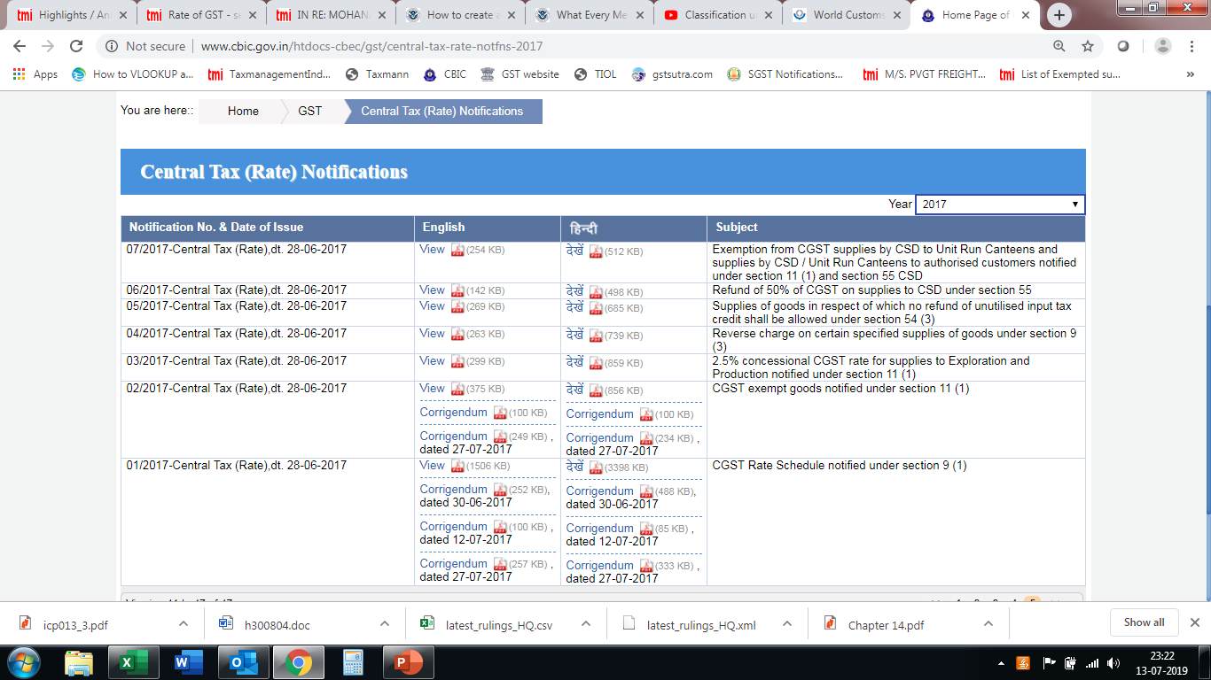

Slide 11
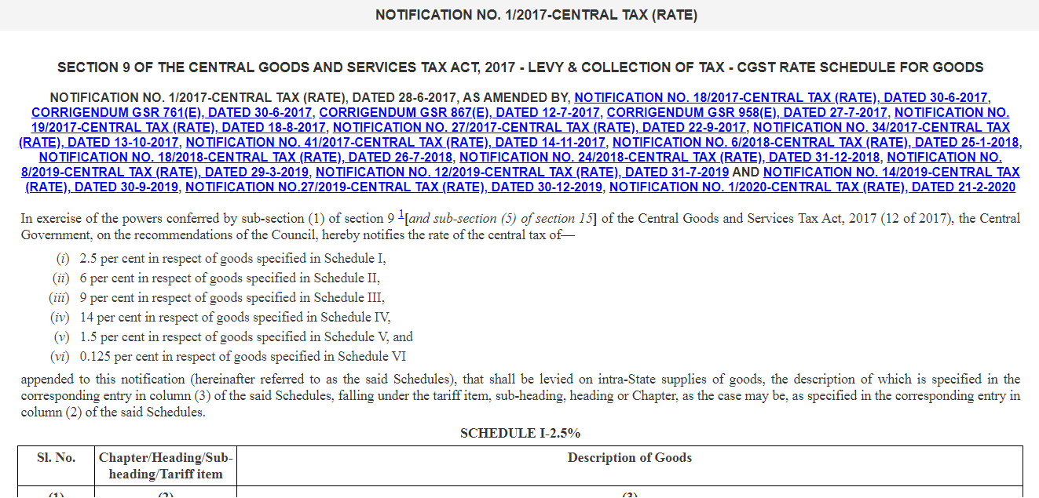

Slide 12
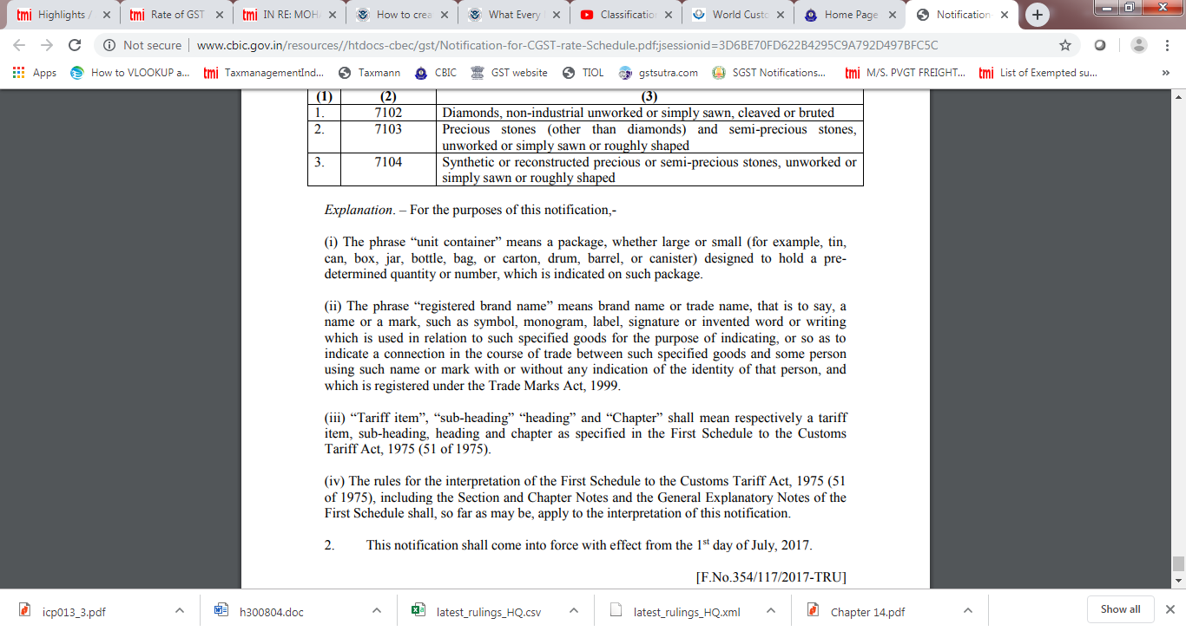

Slide 13
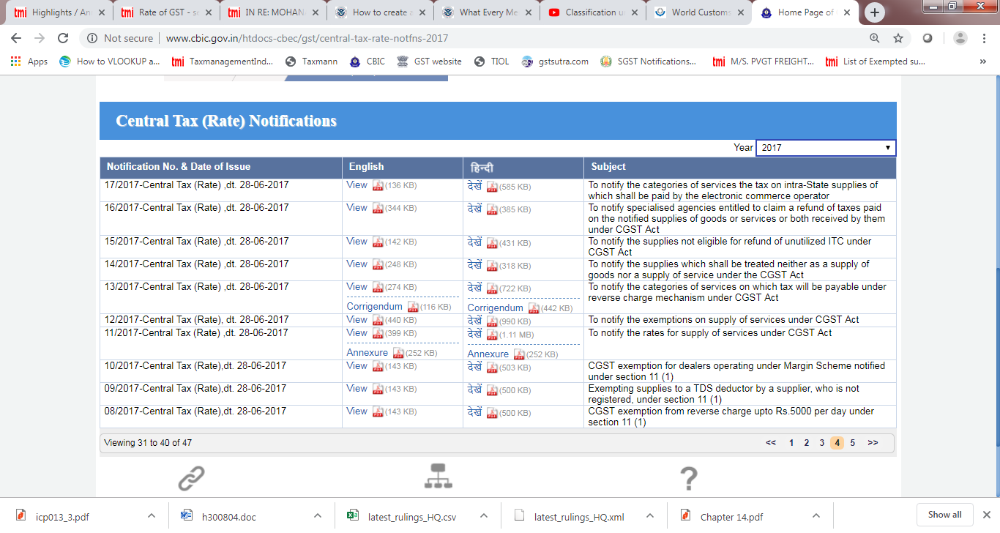

Slide 14
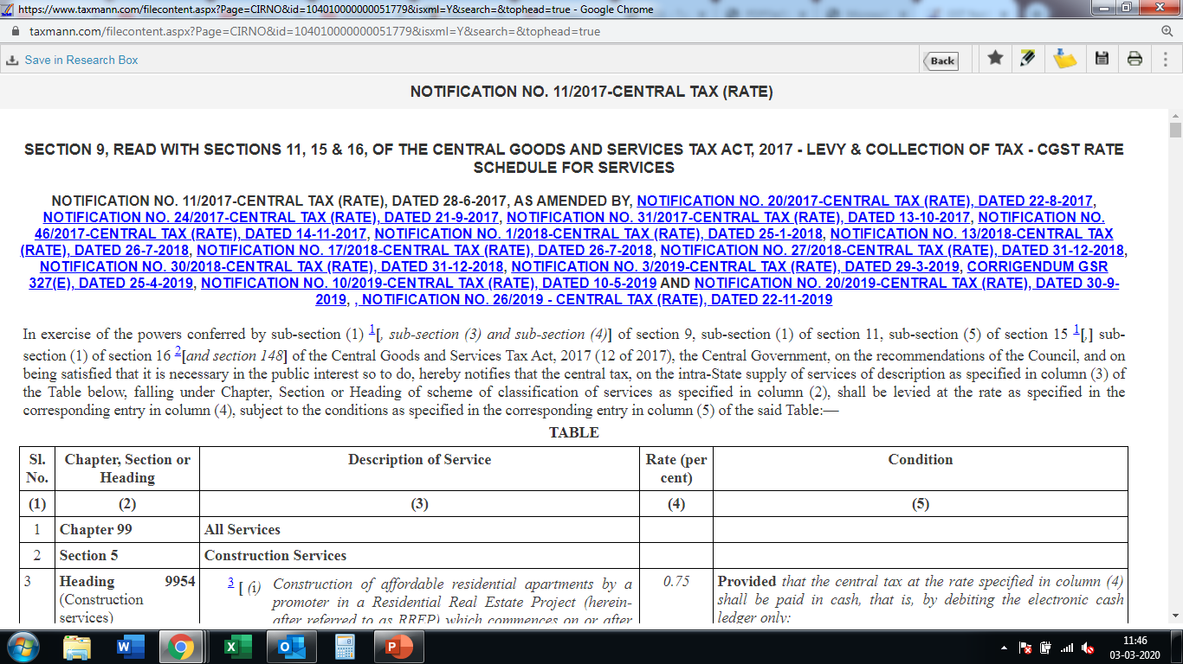

Slide 15
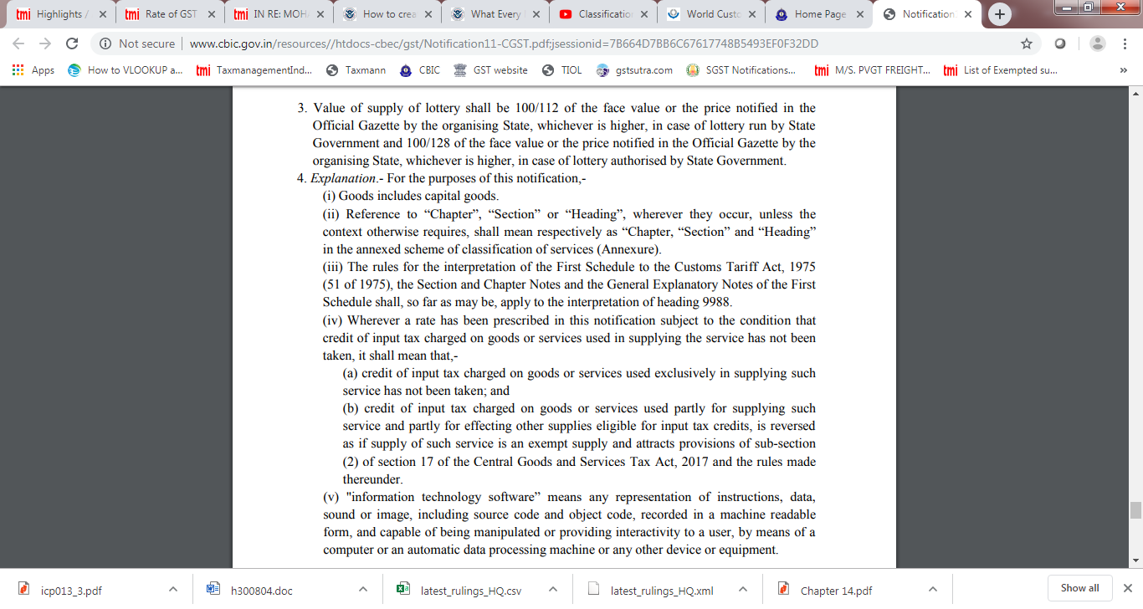

Slide 16
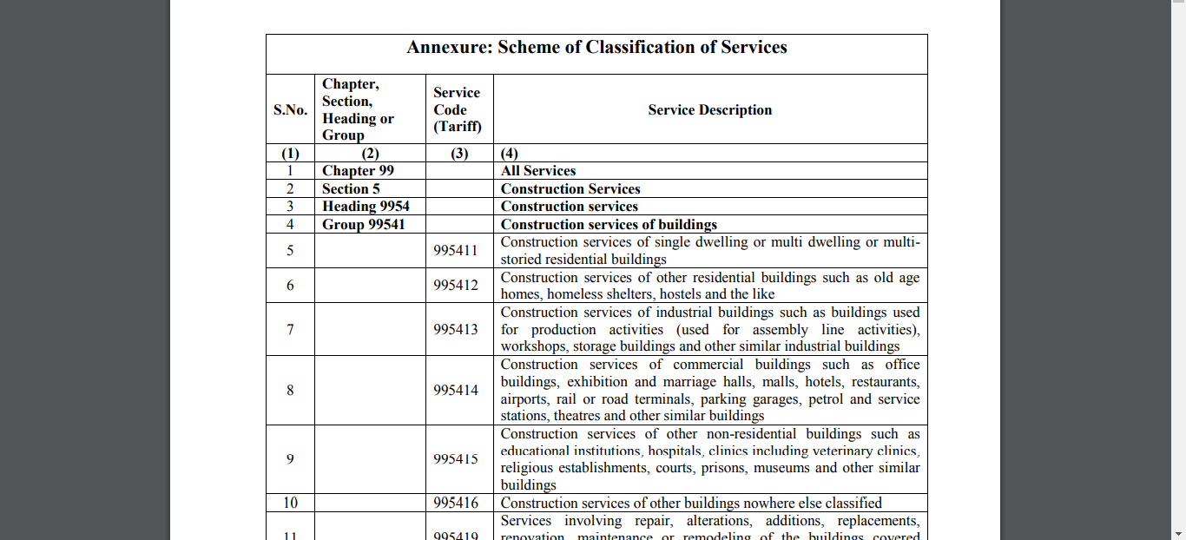

Slide 17
CUSTOMS TARIFF ACT, 1975
CUSTOMS TARIFF ACT, 1975
FIRST SCHEDULE IMPORT TARIFF
SECOND SCHEDULE EXPORT TARIFF

Slide 18
FIRST SCHEDULE TO CUSTOMS TARIFF ACT, 1975
SECTION
CHAPTER
HEADING
SUB-HEADING
TARIFF ITEM
21 SECTIONS
98 CHAPTERS
1244 HEADINGS
5244 SUB-HEADINGS

Slide 19
ROSES
(HSN 06 03 11 00)
06
The First two digits indicates the Chapter Number
03
The next two digits indicates the Heading under the Chapter
11
The next two digits indicates the sub-heading under the Heading – 6 digit code
00
The last two digits classify the product under the sub-heading – Tariff item

Slide 20
SECTIONS
SECTION I. LIVE ANIMALS, ANIMAL PRODUCTS
SECTION II. VEGETABLE PRODUCTS
SECTION VII. PLASTICS AND ARTICLES THEREOF, RUBBER AND ARTICLES THEREOF
SECTION XI. TEXTILE & TEXTILE ARTICLES
SECTION XVII. VEHICLES; AIRCRAFT; VESSELS & ASSOCIATED TRANSPORT EQUIPMENT
SECTION XIX. ARMS AND AMMUNITION; PARTS AND ACCESSORIES THEREOF
SECTION XXI. WORKS OF ART, COLLECTORS' PIECES AND ANTIQUES

Slide 21
SECTION II
Chapter 6 - Live trees and other plants; bulbs, roots and the like; cut flowers and ornamental foliage
Chapter 7 - Edible vegetables and certain roots and tubers
Chapter 8- Edible fruit and nuts; peel of citrus fruits or melons
Chapter 10 - Cereals
Chapter 9 - Coffee, tea, mate and spices

Slide 22
Chapter 10 – Cereals
1001 – WHEAT AND MESLIN
1002 - RYE
1003 - BARLEY
1005 – MAIZE (CORN)
1004 – OATS
1006 – RICE

Slide 23
1006 – RICE
1006 10 – Rice in the husk ( Paddy or rough)
1006 20 - Husked (Brown) Rice
1006 30 - Semi-milled or wholly-milled rice, whether or not polished or glazed :
1006 30 10 - - - Rice, parboiled
1006 30 20 - - - Basmati Rice
1006 30 90 - - - Other

Slide 24
TOOLS OF CLASSIFICATION
TOOLS FOR CLASSIFICATION OF GOODS
6 RULES OF INTERPRETATION
SECTION AND CHAPTER NOTES
HSN EXPLANATORY NOTES BY WCO

Slide 25
SECTION NOTES & CHAPTER NOTES
Certain Sections and Chapters are preceded by Notes which form an integral part of the Harmonized System and have the same legal force.
Defines the precise scope and limits of each sub-heading or headings.
Made the drafting of the heading, sub-heading simpler and also defined terms that are essential to avoid confusion
Referred to as the “Legal Notes”

Slide 26
HSN EXPLANATORY NOTES
For ensuring uniformity, the World Customs Organization has published various Explanatory Notes to various heading/sub-headings.
They do not form part of the legal provisions of the HS but are the official interpretation of the WCO.
Not exhaustive, unchangeable commentary on the overall scope of the headings and sub-headings.
Gives a better understanding of the tariff headings
5 volumes and amending supplements

Slide 27
Is the HSN really this simple??
Think about
Parts and Accessories
Sets and Kits
Emerging products and trends
Product consisting of mixed materials
Multi-purpose goods
Combination of machines

Slide 28
CLASSIFICATION IN GST
GENERAL RULES OF INTERPRETATION
Notes:
s laid down by this Court in Commissioner of Central Excise Vs. Simplex Mills Co. Ltd, the General Rules of Interpretation will come into play, as mandated in Rule 1 itself, only when no clear picture emerges from the terms of the Headings and the relevant section or chapter notes;

Slide 29
GENERAL RULES OF INTERPRETATION – RULE 1
The titles of Sections, Chapters and sub-chapters are provided for ease of reference only; for legal purposes, classification shall be determined according to the terms of the headings and any relative Section or Chapter Notes
The titles of Sections, Chapters do not have any legal force.
Terms of heading read with relevant section or chapter notes are legally relevant for the purpose of classification
The rules of Interpretation need not be resorted to when classification is possible on the basis of description in heading, sub-heading, chapter notes and section notes.
Notes of one Chapter cannot be applied for interpreting entries in other Chapters or Sections.

Slide 30
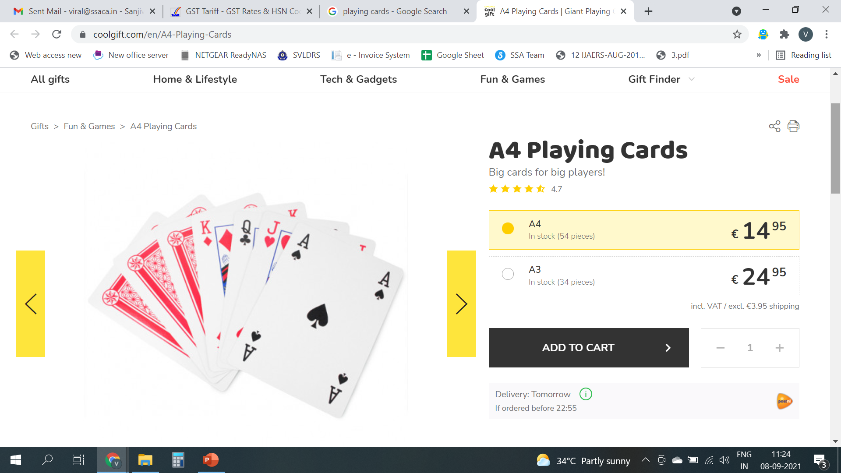
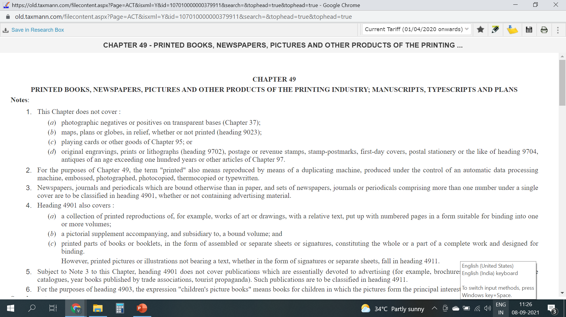
Playing Cards
Classified under Chapter 49 –”product of the printing industry” or as “Toys/Games” under Chapter 95?

Slide 31
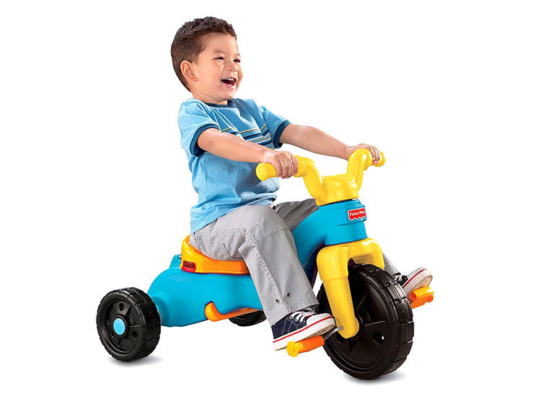
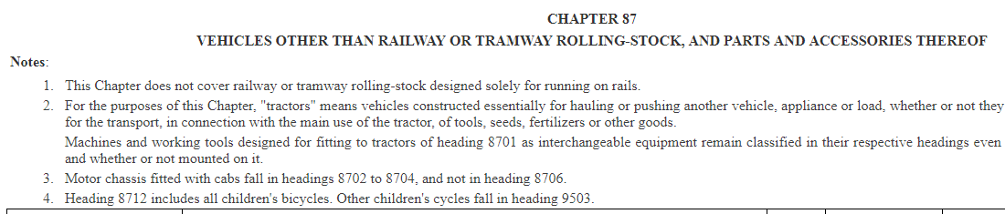
Children Tricycle
Chapter 87 - VEHICLES OTHER THAN RAILWAY OR TRAMWAY ROLLING-STOCK, AND PARTS AND ACCESSORIES THEREOF ?
Chapter 95 - TOYS, GAMES AND SPORTS REQUISITES; PARTS AND ACCESSORIES THEREOF ?

Slide 32
GENERAL RULES OF INTERPRETATION – RULE 2(a)
Any reference in a heading to an article shall be taken to include a reference to that article incomplete or unfinished, provided that, as presented, the incomplete or unfinished articles has the essential character of the complete or finished article. It shall also be taken to include a reference to that article complete or finished (or falling to be classified as complete or finished by virtue of this rule), presented unassembled or disassembled.
Applies only when Rule 1 has failed
Extends the scope of any heading which refers to a particular article to cover not only the complete article but also that article incomplete or unfinished, provided that, as presented, it has the essential character of the complete or finished article

Slide 33
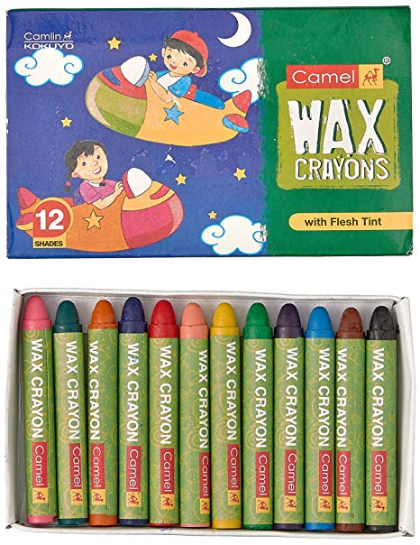
Camlin Limited was manufacturing plastic crayon falling under sub-heading 9609.00 which is chargeable to nil rate of duty, in the manufacture of which an in-process product known as crayplas shapeless plastic crayon (impugned good) comes into being.
It was classifying the same under CETH 9609 00 which covers “pencils, crayons, pencil leads, pastels, drawing charcoals, writing or drawing chalks”, whereas the Department asserted coverage under sub-heading CETH 3204.19 relating to pigments and preparation based thereon other than those in unformulated and unstandardized or unprepared form, not ready for use.” as the same are nothing but plastic crayon compound and are covered under Chapter 32 in view of being a preparation
Camlin Ltd. v. CCE (2003) 155 ELT 138 (CEGAT) [affirmed in (2005)180 E.L.T. 307 (S.C.)]
GIR 2(a) also, allows classification of incomplete or unfinished goods having the essential characteristics of complete or finished goods. In the instant case, the impugned goods only require to be given the shape of crayons before they can be made into finished crayons and as such, they can be considered as incomplete or unfinished goods.

Slide 34
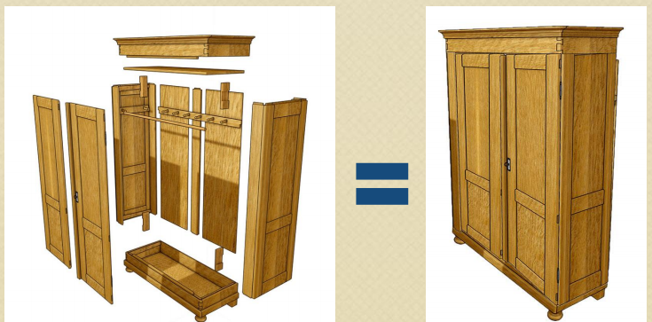
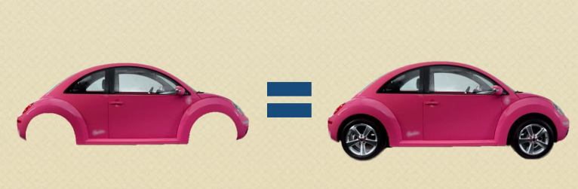

Slide 35
GENERAL RULES OF INTERPRETATION – RULE 2(b)
Any reference in a heading to a material or substance shall be taken to include a reference to mixtures or combinations of that material or substance with other materials or substances. Any reference to goods of a given material or substance shall be taken to include a reference to goods consisting wholly or partly of such material or substance. The classification of goods consisting of more than one material or substance shall be according to the principles of rule 3
Applies only when Rule 1 has failed
Extends the scope of any heading which refers to a particular article to cover not only the complete article but also that article incomplete or unfinished, provided that, as presented, it has the essential character of the complete or finished article
Notes:
A mixture of rye and barley (50/50) can be included in heading 1002 (rye) but also in heading 1003 (barley) according to GR 2b) sentence1 because the heading is also applicable for mixtures. A steel spoon with a wooden handle can be placed in heading 4419 and in heading 8215, because the terms of the headings are also applicable for goods which are made in part of a certain material

Slide 36
The term Coffee will include coffee mixed with Chicory
Natural rubber will cover a mixture of natural and synthetic rubber
Articles of gold will include articles which is made partly of gold

Slide 37
GENERAL RULES OF INTERPRETATION – RULE 3(a)
When by application of rule 2(b) or for any other reason, goods are, prima facie, classifiable under two or more headings, classification shall be effected as follows:
(a) The heading which provides the most specific description shall be preferred to headings providing a more general description.
However, when two or more headings each refer to part only of the materials or substances contained in mixed or composite goods or to part only of the items in a set put up for retail sale, those headings are to be regarded as equally specific in relation to those goods, even if one of them gives a more complete or precise description of the goods

Slide 38
Engine parts made of Steel classifiable under
8409 – “Parts suitable for use solely or principally with the engines of heading 8407 or 8408” OR
7325 – “ Other cast articles of Iron or Steel”
Classify under 8409 as it is more specific
Electric Shaving Machine classifiable under
85.10 – Shavers and hair clippers with self contained electric motors OR
85.09 – Electro-mechanical domestic appliances with self –contained electric motor
Classify under 85.10 as it is more specific
Plastic name plate for motor vehicle is to be classified as “accessory of motor vehicle” and not “other articles of plastic”

Slide 39
GENERAL RULES OF INTERPRETATION – RULE 3(b)
(b) Mixtures, composite goods consisting of different materials or made up of different components, and goods put up in sets for retail sale, which cannot be classified by reference to (a), shall be classified as if they consisted of the material or component which gives them their essential character, in so far as this criterion is applicable

Slide 40
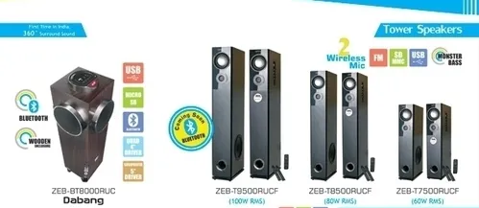
Multimedia speakers with additional facilities such as USB, SD card and FM radio etc. -whether classified under
CTH 8518 - Loudspeakers, whether or not mounted in their enclosures: headphones and earphones, whether or not combined with a microphone, and sets consisting of a microphone and one or more loudspeakers: audio-frequency electric amplifiers: electric sound amplifier sets; or under
CTH 8519 – “Sound recording or reproducing apparatus”
The Tribunal held that the impugned goods are speakers with added function and the main role of the item, in question, remains amplifying the sound received from outside source or from inbuilt feature. The Tribunal held that the product should be classified as speakers only.

Slide 41
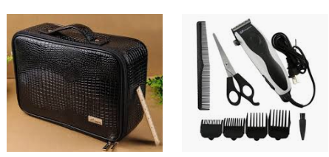

A hairdressing kit made up of electric hair clippers (heading 85.10), a comb (heading 96.15), a pair of scissors (heading 82.13), a brush (heading 96.03), put up in a leather case (heading 42.02).
The clippers are considered to have the essential character, so the whole kit would be classified under heading 85.10.
What would be the classification??

Slide 42
GENERAL RULES OF INTERPRETATION – RULE 3(c)
(c) When goods cannot be classified by reference to (a) or (b), they shall be classified under the heading which occurs last in numerical order among those which equally merit consideration

Slide 43
GENERAL RULES OF INTERPRETATION – RULE 4
Goods which cannot be classified in accordance with the above rules shall be classified under the heading appropriate to the goods to which they are most akin
“Latter the better” Rule or “Tie-breaker” Rule.

Slide 44
GENERAL RULES OF INTERPRETATION – RULE 5
5. In addition to the foregoing provisions, the following rules shall apply in respect of the goods referred to therein:
Camera cases, musical instrument cases, gun cases, drawing instrument cases, necklace cases and similar containers, specially shaped or fitted to contain a specific article or set of articles, suitable for long-term use and presented with the articles for which they are intended, shall be classified with such articles when of a kind normally sold therewith. This rule does not, however, apply to containers which give the whole its essential character;
Subject to the provisions of (a) above, packing materials and packing containers presented with the goods therein shall be classified with the goods if they are of a kind normally used for packing such goods. However, this provisions does not apply when such packing materials or packing containers are clearly suitable for repetitive use.

Slide 45
GENERAL RULES OF INTERPRETATION – RULE 6
For legal purposes, the classification of goods in the sub-headings of a heading shall be determined according to the terms of those sub headings and any related sub headings Notes and, mutatis mutandis, to the above rules, on the understanding that only sub headings at the same level are comparable. For the purposes of this rule the relative Section and Chapter Notes also apply, unless the context otherwise requires

Slide 46
CLASSIFICATION THEORIES – TRADE PARLANCE THEORY
A word in statute should be construed in its popular sense and not in the strict or technical sense, ‘Popular sense’ means that which people conversant with the subject matter with which the statue is dealing would attribute to it.
“Where a word has a scientific or technical meaning and also an ordinary meaning according to common parlance, it is in the latter sense that in a taxing statute the word must be held to have been used, unless contrary intention is clearly expressed by the Legislature.”
The test ignores the technical meaning or scientific meaning if open market exists for the commodities commonly traded.

Slide 47

CCE v. Connaught Plaza Restaurant P. Ltd (2012) 286 ELT 321 (SC)
Assessee was of the view that that “soft-serve” is a product distinct and separate from “ice-cream” since ice-cream is commonly understood to have milk fat content above 8% whereas their product does not contain more than 5%. Hence it cannot be considered as ice- cream.
“Soft-serve”, in the absence of a definition of the term “ice cream”, it is to be construed as per common parlance, even if under the provisions of Food Adulteration Act, it may not fall within the meaning of ice cream.
What matters is the way the consumer perceives the product.

Slide 48
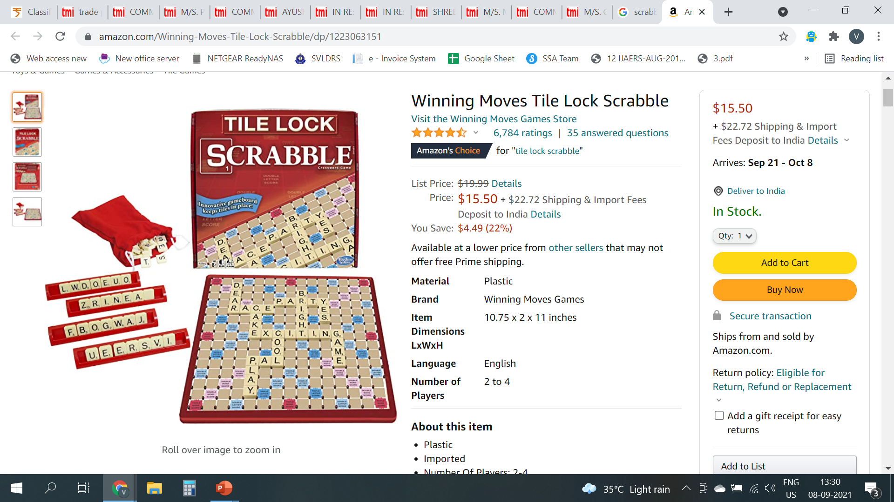
Whether "Scrabble" is a puzzle or a game or a toy?
Assessee classified the product under 9503 as a puzzle but Department sought to classify it under 9504 as a board game. It could not be classified under sub-heading 9503 as all games which contain boards and pieces were classifiable under sub-heading 9504 and since "Scrabble" has board(s) and pieces it was classifiable under sub-heading 9504.
Assessee also furnished affidavits of purchasers of "Scrabble" who deposed that "Scrabble" was an educational toy used for imparting education to children and is treated as a puzzle by adults.
The difference between a "game" and a "puzzle" is brought out by three distinct features, viz., outcome, clue-chance and skill. In a puzzle outcome is pre-determined and fixed – Eg. Crossword, jigsaw puzzle. It is not so in "Scrabble".
The other important difference is that in a "Scrabble" there are no clues whereas in crossword puzzle, as stated above, words are written according to clues.
Applying the said test of "common parlance" or trade meaning and commercial nomenclatures, we are of the view that "Scrabble" is a board game. "Scrabble" is put in the board game section and not in the section for puzzles.
M/S. PLEASANTIME PRODUCTS AND ANR. VERSUS COMMISSIONER OF CENTRAL EXCISE, MUMBAI-I – [2009 (11) TMI 5 - SUPREME COURT]
Notes:
In "Scrabble" there is an element of chance and skill. The player in "Scrabble" gets lettered tiles to create words by chance. These tiles are initially kept in a pouch from which every player picks up the tiles. This is pure matter of chance. Further, apart from the element of chance there is also an element of skill involved in "Scrabble". Each lettered tile has an assigned value and the player has to create words. He tries to create words which attain maximum value; tries to gain maximum value from the lettered tiles which come by chance to him.

Slide 49
CLASSIFICATION THEORIES – END USE/FUNCTIONAL TEST CLASSIFICATION
This test provides classification of goods on the basis of the predominant use of the goods.
This test can be used when the entry under consideration links the taxable object with its general or ordinary use or
Cases where the meaning of the term in common parlance is derived by the predominant use to which the goods are put to irrespective of the other minor use for which they can also be used.
This test has its own limitations - Certain goods may be put to different uses by different persons.
May be applied only when all other tests are inconclusive.

Slide 50
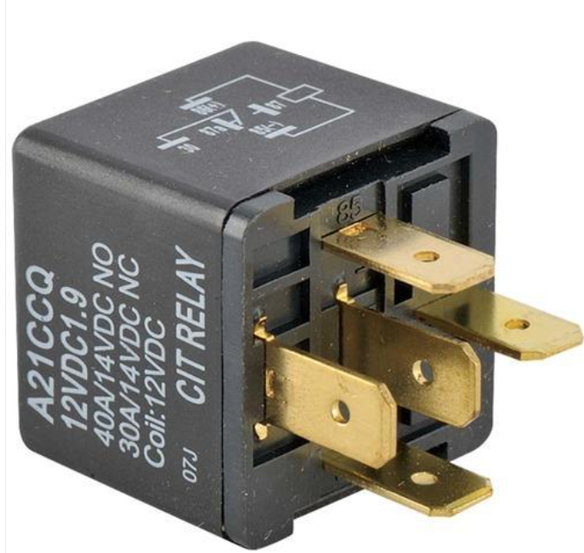
CLASSIFICATION OF PARTS
RELAYS – PART OF THE RAILWAY SIGNALLING SYSTEM
To be classified under
8536 - Electrical apparatus for switching or protecting electrical circuits, or for making connections to or in electrical circuits (for example, switches, relays, fuses, surge suppressors, plugs, sockets, lamp-holders and other connectors, junction boxes) or
8608 - Railway or tramway track fixtures and fittings; mechanical (including electo-mechanical) signalling, safety or traffic control equipment for railways, tramways, roads, inland waterways, parking facilities, port installations or air-fields; parts of the foregoing?

Slide 51
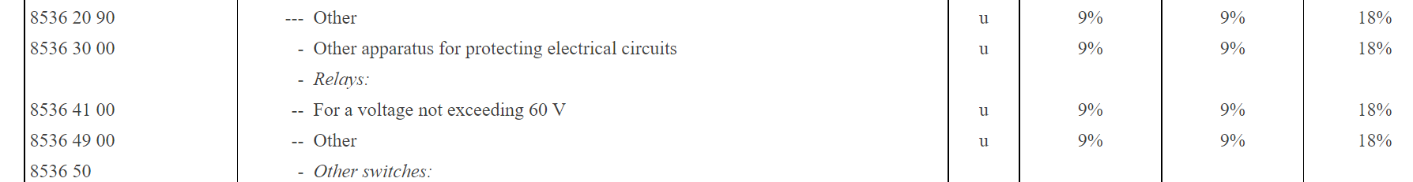
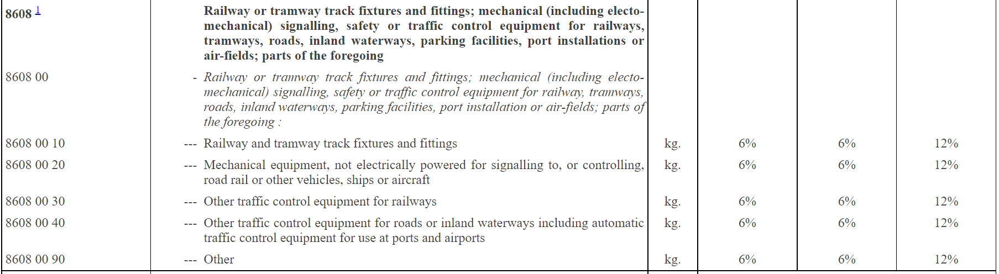

Slide 52
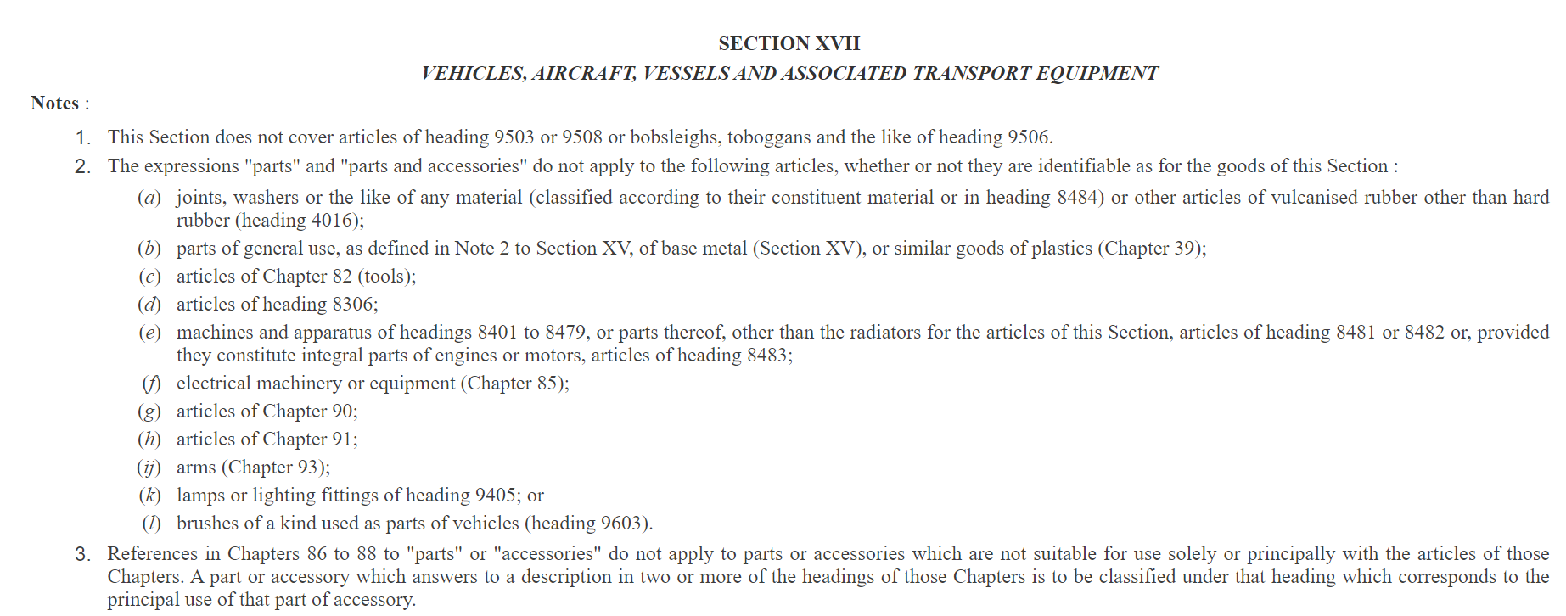
CLASSIFICATION OF PARTS

Slide 53
CLASSIFICATION OF PARTS
HSN Explanatory Notes to Section XVII lays down 3 tests to be satisfied for a part to be classified under Chapter 86-88
They must not be excluded by the terms of Note 2 to Section XVII to this Section AND
They must be suitable for use solely or principally with the articles of Chapter 86 -88 AND
They must not be more specifically included elsewhere in the Nomenclature
In WESTINGHOUSE SAXBY FARMER LTD. VERSUS COMMR. OF CENTRAL EXCISE CALCUTTA [2021 (3) TMI 291 - SUPREME COURT], it was held that Relays will be classified under 8608 in view of Note 3 of Section XVII.
Notes:
Note 2 made redundant
Effects automobile industry
Divergent view taken in Uniproducts India Ltd case wherein car mats where considered as textile floor coverings and not an accessory of a motor vehicle

Slide 54
CLASSIFICATION IN GST
CLASSIFICATION OF SERVICES

Slide 55
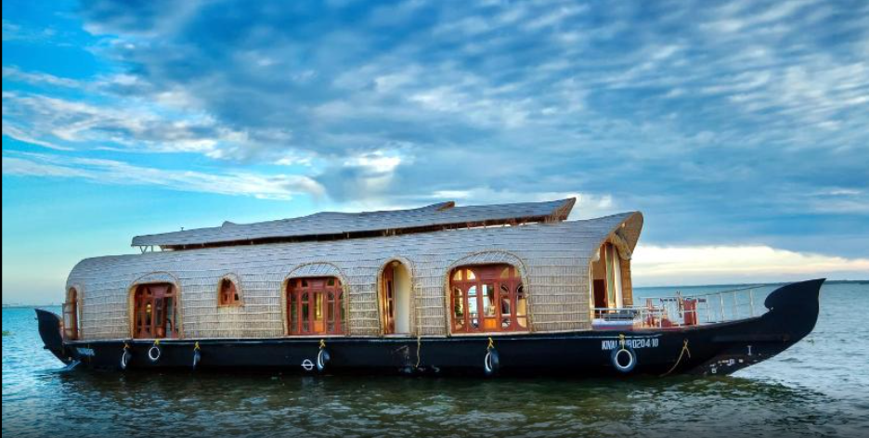
SUPPLIES BY A HOUSE BOAT
These house boats are to be used for cruises, overnight cruises and for day trips. Meals are provided as part of a package.
The boats procured are to be furnished with state-of-the-art bedrooms, dining rooms, halls and kitchens.
The rate proposed to be charged is an all-inclusive fare for transportation, accommodation, food services and other incidental services.
The above service to be classified under SAC 996415 ( Local transportation services of passengers) or as under SAC 9963 (accommodation services, food and beverage service) or any other SAC?

Slide 56
996415 - Local water transport services of passengers
This service code includes
passenger transportation services on rivers, on canals and on other inland waters by ferries, including hydrofoils and hovercraft, whether on a scheduled or non-scheduled basis;
inland water cruises that include transportation, accommodation, food services and other incidental services in an all-inclusive fare;
passenger transportation services on rivers, canals and other inland waters on a scheduled or non- schedules basis by vessels other than ferries, cruise ships, sightseeing and excursion boats;
transportation services of accompanying vehicles, luggage, animals and other items;
water taxis
996311 - Room or unit accommodation services
This service code includes accommodation services consisting of rooms or units, with or without kitchens& with or without daily housekeeping services, provided by Hotels, INN, Guest houses, Clubs & other similar establishments on a single or multi occupancy basis, for purposes of leisure or business or others.

Slide 57
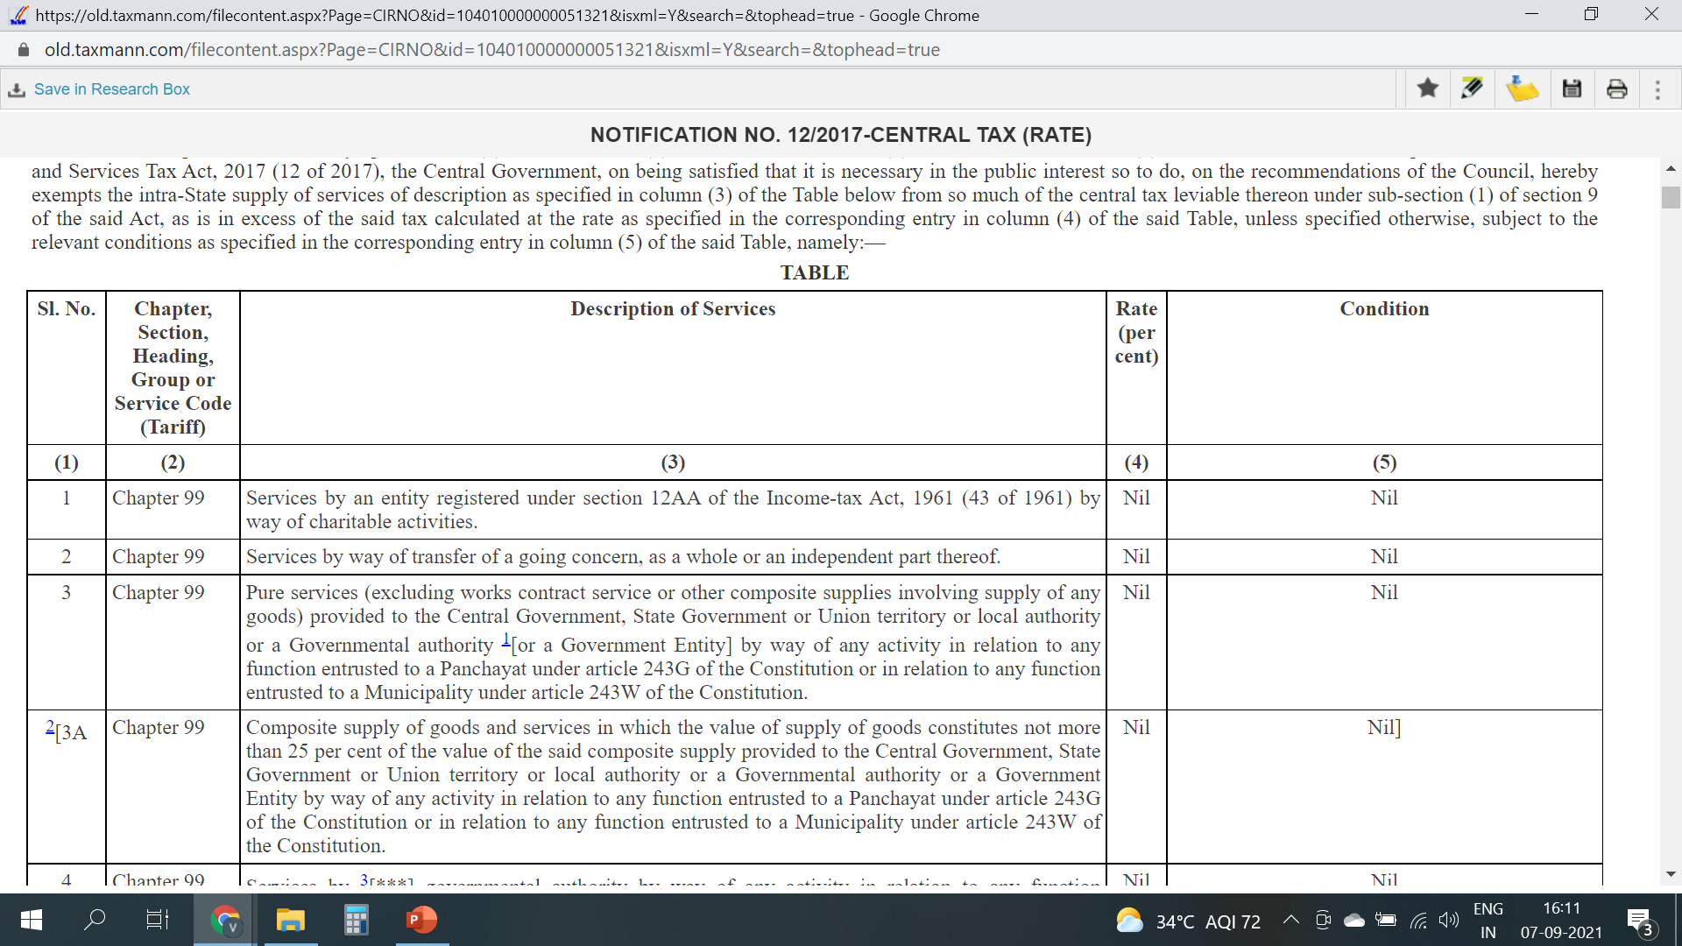
CHARITABLE ACTIVITIES

Slide 58
CHARITABLE ACTIVITIES
A Trust registered under 12AA is conducting a marathon race for raising donations from runners and also through corporate donations for charitable purposes like donating to NGOs, Hospitals, Trusts and other such organizations.
The amount so received is utilized for the conduct of the event that includes permit and approval fees, fees paid to the government authorities, expenses for the conduct of the event that includes prize money for the winners and the balance left is paid as donations to the NGOs supporting the cause or directly to the beneficiaries.
The receipts are exempted u/s 80G.
Merely by obtaining a registration under 12AA of the Income Tax Act, 1961, does the activities of the person be exempted from the levy of GST?

Slide 59
CHARITABLE ACTIVITIES
Definition of Charitable activities - “charitable activities” means activities relating to -
(i) public health by way of,-
(A) care or counseling of
(I) terminally ill persons or persons with severe physical or mental disability;
(II) persons afflicted with HIV or AIDS;
(III) persons addicted to a dependence-forming substance such as narcotics drugs or alcohol; or
(B) public awareness of preventive health, family planning or prevention of HIV infection;
(ii) advancement of religion, spirituality or yoga;
(iii) advancement of educational programmes or skill development relating to,-
(A) abandoned, orphaned or homeless children;
(B) physically or mentally abused and traumatized persons;
(C) prisoners; or
(D) persons over the age of 65 years residing in a rural area;
(iv) preservation of environment including watershed, forests and wildlife;

Slide 60
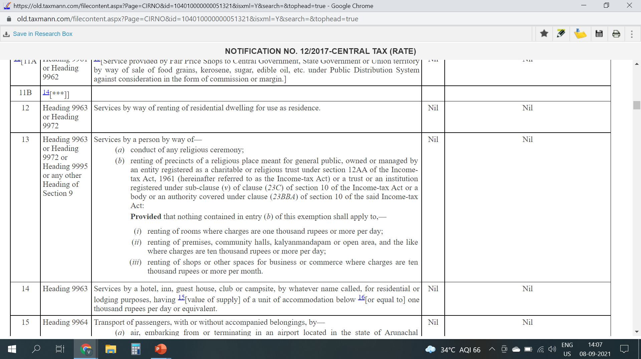
SUPPLIES BY RELIGIOUS PLACES

Slide 61
SUPPLIES BY RELIGIOUS PLACES
Sale of Prasadam
Exempt vide Entry No. 98 of 2/2017
Vehicle Entry fee
Taxable
Tonsuring of head of devotees
Taxable
Renting of commercial shops
Exempt if rent is less than Rs. 10,000/- per month vide Entry No. 13
Seva Charges
Exempt vide Entry No. 13 (a) of 12/2017
Renting of marriage halls
Exempt if rent is less than Rs. 10,000/- per day vide Entry No. 13
Accommodation Charges
Exempt if rent is less than Rs. 1000/- per day vide Entry

Slide 62
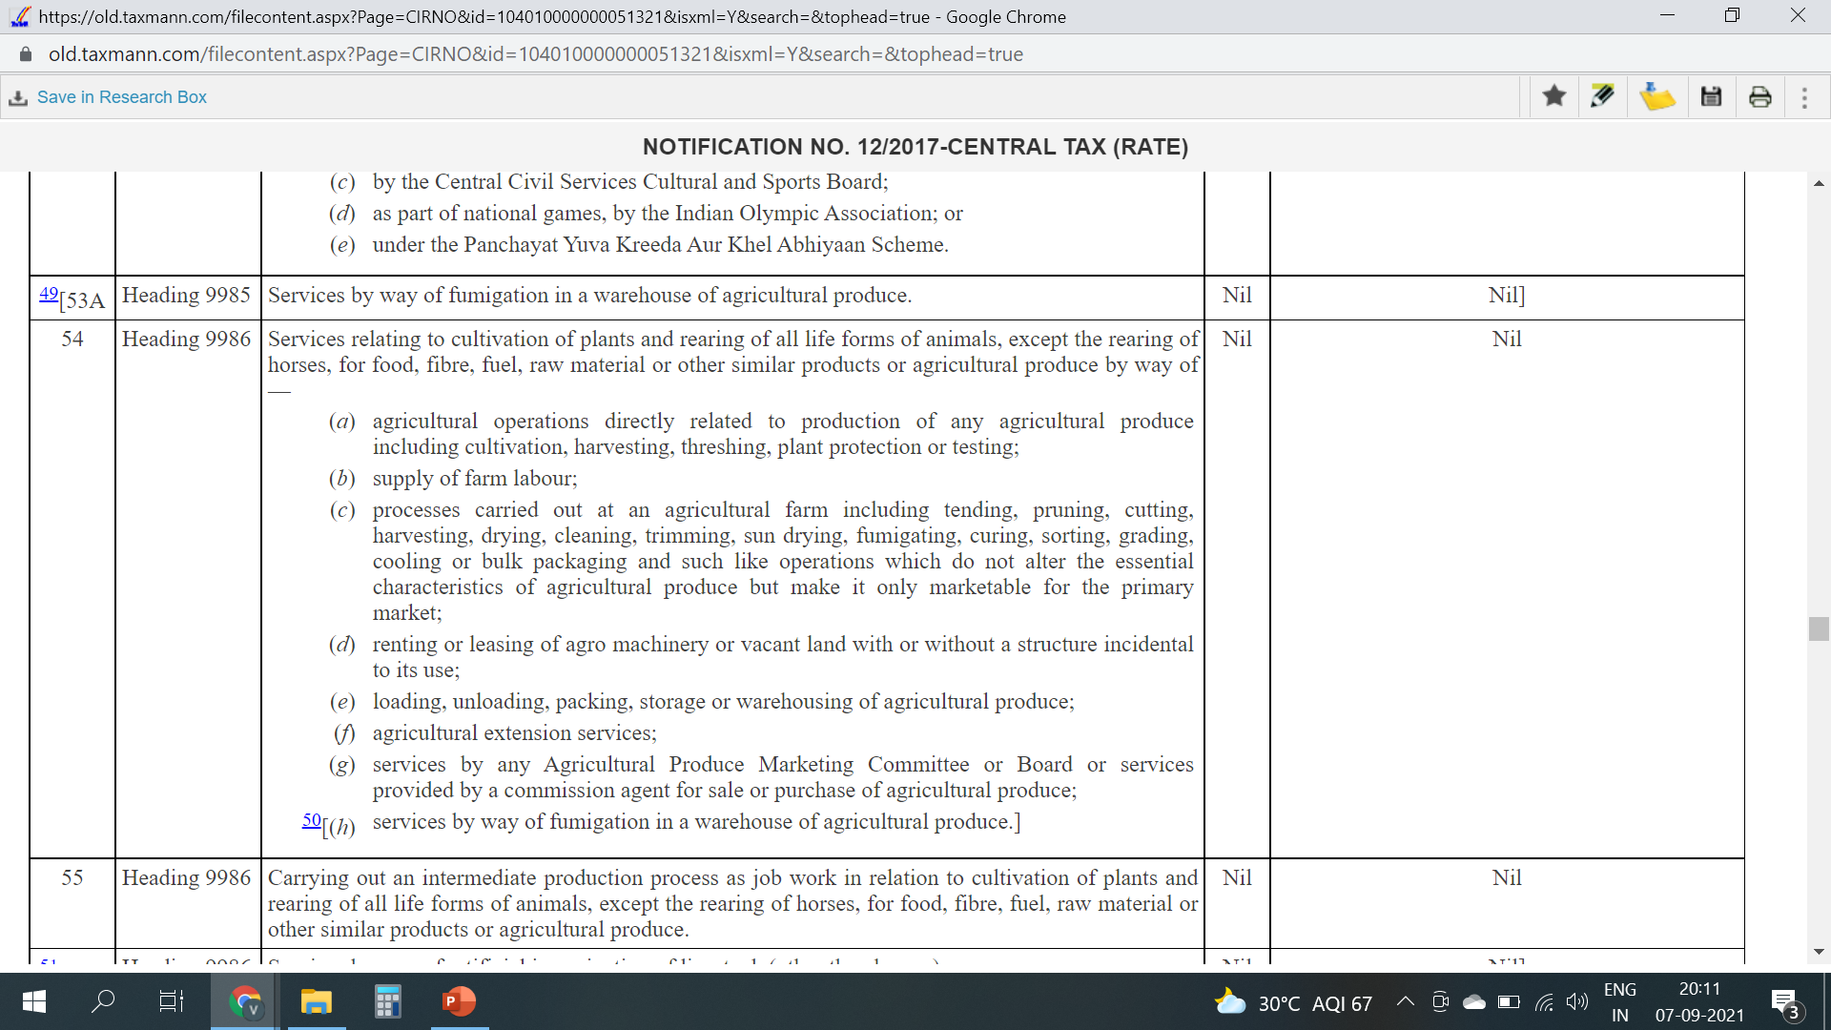
AGRICULTURAL OPERATIONS
Notes:
Renting of godown for storage of agri produce

Slide 63
AGRICULTURAL OPERATIONS
Company is primarily engaged in the business of providing various support services including sampling, inspection, verification, testing and certification services (hereinafter referred to as ‘inspection and testing service’) on fresh table grapes and other agricultural produce. By way of this testing the applicant identifies residues of chemicals in fresh table grapes and determine as to whether the grapes are of exportable quality or not for its customers who are Indian exporters/pack houses/farmers/importers.
In the pre-GST regime, under Service Tax for the period effective 01.07.2012, no service tax was discharged on the service of ‘laboratory testing’.
The company has classified their services under heading 9983- ‘other professional, technical and business services’ and charged GST @ 18% as it is unsure whether same exemption is carried forward in GST or not.
Whether the service will be classified under ‘inspection or testing service’ (taxable at 18%) or ‘support service of agriculture’ (exempted from tax)?

Slide 64
AGRICULTURAL OPERATIONS
Definition of Agricultural Produce - "agricultural produce" means any produce out of cultivation of plants and rearing of all life forms of animals, except the rearing of horses, for food, fibre, fuel, raw material or other similar products, on which either no further processing is done or such processing is done as is usually done by a cultivator or producer which does not alter its essential characteristics but makes it marketable for primary market;
Explanatory Notes to 99861 covers support services necessary for Crop Production and includes activities of Post-harvest services of crop for preparation for Primary markets. Preparation of crops for primary market in, jives activities which are essential for selling the produce. Without these activities by the farmers, the produce would not be sold in primary market. This could include activities such as threshing to separate the grains from the stalks in the case of cereals as in the primary market, only grains are purchased and not the stalks. Such activities would be essential for the production of the crop, without which the crop would not be ready for primary market.
Thus the service will be classified under 9983 and taxable at 18%.

Slide 65

Thank You
Name – CA. Viral M Khandhar
Email- viralkhandhar@gmail.com
Mobile - 9884115250
Notes:
Taxpayers should undertake proper research and meticulous study before arriving upon the classification of their goods/services. A revisit to the classifications is also warranted in case of any amendment/judicial pronouncements affecting the product/service of the Taxpayer. In case the taxpayer is of the view that the classification adopted is incorrect, the taxpayer should carefully evaluate the future course of action to be adopted which will involve minimal financial burden on the taxpayer/their recipient and is also within the four corners of the law.

