Slide 1
CPE SEMINAR ON Standards on Auditing – Documentation a practical approach (10th August 2022)
GOVIND P. FCA
Hosted by – Ernakulam branch of SIRC of ICAI

Slide 2
Independence & Audit Quality – Hallmarks of the Profession
HOW TO PROVE?

Slide 3
ASSURANCE ENGAGEMENT
Responsible Party
Subject Matter
Intended Users
Provides Opinion
practitioner
Criteria
Evaluates

Slide 4
Why Standards on Auditing?
Guidance to auditors
Protection to auditors
Ensures quality & uniformity
In line with global standards
Mandated by law (Sec 143(2) & 143(9))

Slide 5
The Audit workflow
Audit Communication
Audit Planning
Audit Execution
Audit reporting

Slide 6
SA 300 – Planning an audit of FS
Scope
Auditor’s responsibility to plan an audit of FS
Framed in the context of recurring engagements
Planning is not a discrete phase but continuous
Objectives
To plan the audit so that it will be performed in an effective manner
Requirements
Involvement of Key engagement team members
Communicating the audit plan with the client

Slide 7
How does planning help?
To devote appropriate attention to important areas of audit
Identifying and resolving problems on a timely basis
Organising & managing the audit – Effectiveness and Efficiency
Selection of a competent engagement team, their direction & supervision
Coordination of work done by component auditors & experts

Slide 8
Planning Activities
Overall Audit Strategy
Audit Plan
Audit Program

Slide 9
Audit Strategy
Key decisions
Nature of engagement
Audit Plan
Selection of team
RAAP
Audit Program
Procedures to be performed
Documentation to be maintained
Reporting requirements
Coverage
Reliance on work of others
Effect of IT and use of CAAD
Further audit procedures
NET of procedures
Management and supervision of resources
Relates to actual performance

Slide 10
Audit Program
A series of verification procedures to be applied to FS & accounts to obtain sufficient & appropriate audit evidence
One single common audit program – may not suit all businesses
Audit program should be periodically reviewed
Construction of an Audit Program
Stay within the limitation & scope of assignment
Identify the best evidence available
Consider all possibilities of error
Coordinate the procedure to be applied to related items

Slide 11
Overall audit strategy
Overall audit strategy
Assists in making decisions about
Resources to deploy for specific areas considering their experience & expertise
Amount of resources to be allocated to specific audit areas
When the resources are to be deployed (Interim dates or cut-off dates)
How the resources are managed, supervised and directed
Assists in making decisions about
Resources to deploy for specific areas considering their experience & expertise
Amount of resources to be allocated to specific audit areas
When the resources are to be deployed (Interim dates or cut-off dates)
How the resources are managed, supervised and directed
Audit Plan
Audit plan shall include
NET of planned RAP as per SA 315
NET of planned FAP as per SA 330
Other planned audit procedures for the engagement to comply with SA
Audit plan is more detailed that audit strategy
Audit plan & strategy may be changed due to unexpected events, results obtained from audit procedures etc.
Both Audit strategy & Audit plan are the auditor’s responsibility

Slide 12
Strategy
Engagement characteristics
1) FRF
2) Branches
3) Other auditors
Reporting Objectives
1) Timelines
2) Communication
Plan
Bank
1) Ensure that BRS is prepared
2) Ensure that accounts are opened and closed with proper approvals
Salary
1) Check payroll cost calculation
2) Ensure PF ESI are calculated properly
Other factors
1) Materiality
2) Industry developments
General
1) Resource deployment
2) Meetings and Reviews

Slide 13
Documentation
Overall conclusion wrt audit strategy
Audit plans for all material classes of transactions, account balances and disclosures
Resources required and their allocation for planned audit areas
Time required execution of each audit program
Nature of audit procedures planned (substantive procedures or test of controls)
Description of audit procedures

Slide 14
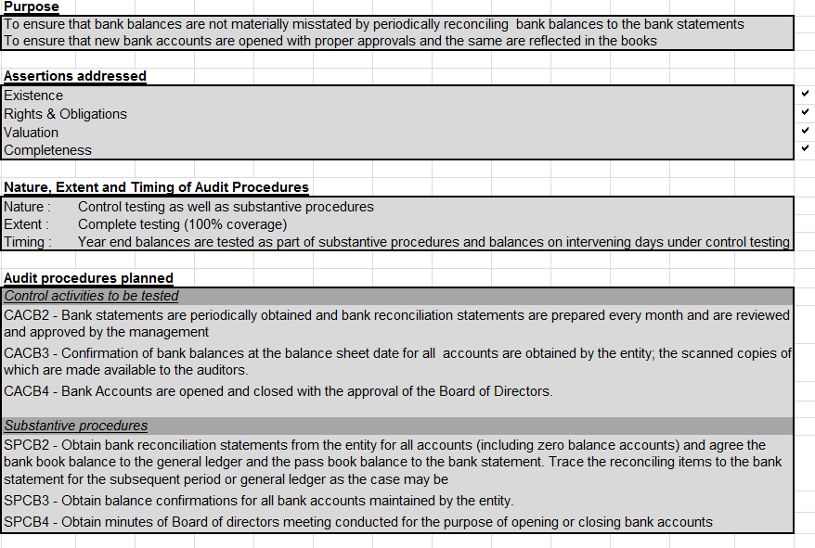

Slide 15
SA 320 – Materiality in planning and performing an audit
Concept of Materiality
Any information that has the power to influence economic decisions of users
Judgment based. Affected by size or nature of misstatement (or a combination of both)
Such judgments are based on consideration of the common financial needs of users as a group
Materiality is applied while planning the audit as well as evaluating the effect of identified misstatements/uncorrected misstatements

Slide 16
Important considerations
There can be different levels for different COTABD
Setting of materiality doesn’t mean that uncorrected misstatements below such materiality (individually or in aggregate) will always be immaterial
Materiality is not just a measure of size. It depends on the nature of misstatement as well
That is, Items may be quantitatively or qualitatively material
Performance materiality – This is an amount set at less than the materiality level
To reduce the risk of aggregate of uncorrected/undetected misstatements at less than materiality level

Slide 17
Materiality and Performance Materiality
Aggregate of uncorrected / undetected misstatements
Materiality
Performance Materiality

Slide 18
Calculation of Materiality
Can be based on various factors – Revenue, Profits, Net asset size etc
The percentage chosen is based on the auditor’s professional judgment
Materiality can be revised as well upon the auditor becoming aware of new information during the audit
Materiality, PM and revisions all should be documented

Slide 19
SA 315 – Identifying & assessing the RoMM through understanding the entity & its environment
Scope
Auditor’s responsibilities to identify and assess the RoMM through understanding the entity & its environment, including its internal control
Definitions
Assertions – Representations by mgmt, explicit or not that are embodied in the FS, used by auditor to consider different misstatements that may occur
Business risk – From significant events, conditions, actions/inactions that prevent an entity from achieving its objectives/strategies or setting them up

Slide 20
Requirements – What the auditor is supposed to do?
Perform RAP to identify & assess RoMM at FS & assertion levels
RAP to include
Inquiries with mgmt/Other individuals
Analytical procedures
Observation & inspection
Info from other engagements
Previous experience with entity
Discussion with engagement team

Slide 21
Understanding of the entity and its environment
Relevant industry, regulatory & other factors including FRF
Nature of entity including its operations, ownership, investments made, structure etc to understand COTABD
Entity’s selection of accounting policies & whether consistent with FRF
Entity’s objectives & strategies and related business risks
Measurement & review of entity’s financial performance

Slide 22
Understanding the entity’s internal control
Internal Control
Control environment
Entity’s RAP
Control activities relevant to audit
Information system relevant to FR & communication
Monitoring of controls

Slide 23
Identifying & assessing the RoMM
Identify risks through understanding the entity & its environment, Internal controls and considering significant COTABD
Assess risks & evaluate if they relate more pervasively to the FS as a whole and potentially affect many assertions (Eg: mgmt’s lack of competence, integrity, override of controls, non reliability of records etc)
Relate the identified risks to what can go wrong at the assertion level (Inherent risks) taking into account the relevant controls
Consider the likelihood of misstatement and if it is of such magnitude that could result in material misstatement
Assertions
Occurrence, Completeness, Accuracy, Cutoff, Classification - Wrt Transactions & events for the period
Existence, Rights & Obligations, Completeness, Valuation & allocation - Wrt Assets, Liabilities & Equity
Occurrence, Completeness, Classification & understandability, Accuracy & Valuation – Wrt presentation & disclosure

Slide 24
Documentation
Identified risks of material misstatement
Whether the risk is a significant risk
Type of RAAP used (Can include checklists etc)
Pervasiveness of the risk
Likelihood of occurrence of the risk
Affected assertions
Affected stakeholders

Slide 25
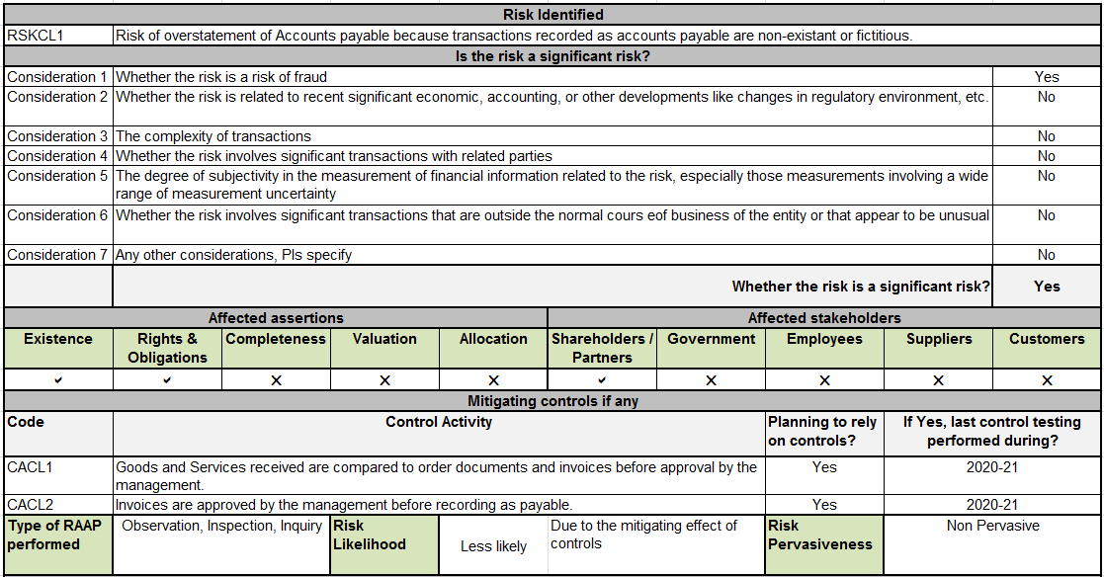
Example

Slide 26
SA 330 – Auditor’s responses to assessed risks
Scope
Auditor’s responsibilities to design and implement responses to the RoMM as per SA 315
Definitions
Substantive procedures – Designed to detect MM at assertion level. Consists of TOD & Analytical
Tests of controls – Designed to evaluate the OE of controls in preventing or detecting and correcting MM at assertion level

Slide 27
Considerations while planning FAP
Reasons for assessment given to RoMM. How did the risk come into existence?
Likelihood of occurrence of the MM
Whether the risk assessment takes into account the relevant controls
If yes, auditor will have to obtain evidence wrt OE of controls
Obtain more persuasive evidence the higher the auditor’s assessment of the risk

Slide 28
Test of Controls
When auditor expects controls to be OE during risk assessment
When substantive procedures alone are not enough
Whether to use audit evidence from previous audits
Whether entity applies the controls and whether the control is effective with very little deviations
Whether the controls are automated or manual
Whether IT controls are generally effective at the entity

Slide 29
Audit evidence from interim period
Check if there are significant changes to the controls subsequent to the interim period
Determine the additional evidence to be obtained for the remaining period
Use of previous year’s audit evidence
Significant change in control rendering its relevance questionable
Yes
No
Test the control in current year as well
Test once in every 3 audits

Slide 30
Substantive procedures
Includes TOD & Analytical procedures
Irrespective of assessed RoMM, auditor should design & perform substantive procedures for each MCOTABD
Should consider if external confirmation procedures are to be performed
Substantive procedures wrt Significant risk
Perform additional substantive procedures specific to that risk
If the FAP consists only of substantive procedures, must include TOD

Slide 31
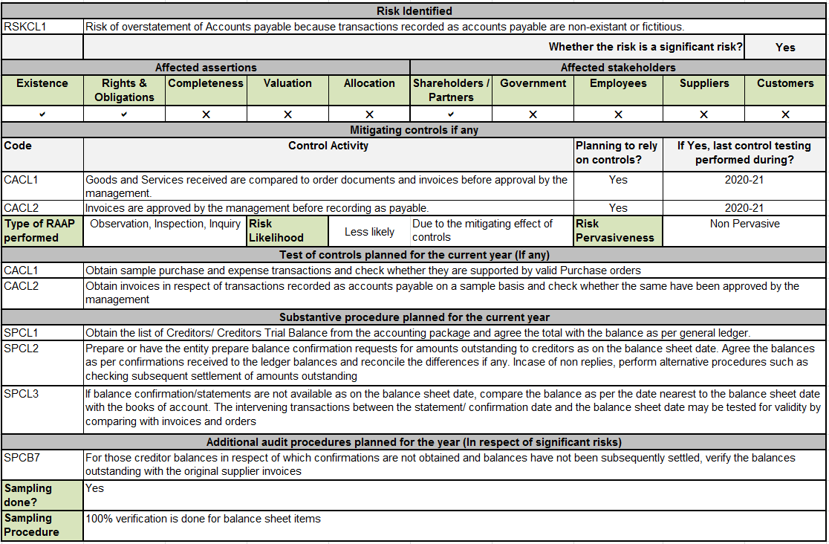
Example

Slide 32
Material Class of Transaction | Risks Identified | Assertions affected | Control Activities | Substantive Procedures
Cash & Bank | Risk 1 Risk 2 | Rights Existence | Control 1 Control 2 Control 3 | Substantive 1 Substantive 2
Fixed Assets | Risk 1 Risk 2 | Existence Ownership Completeness Valuation | N/A | Substantive 1 Substantive 2
Salaries & Allowances | Risk 1 Risk 2 Risk 3 | Occurrence Completeness | Control 1 | Substantive 1 Substantive 2 Substantive 3
Revenue | Risk 1 | Occurrence Completeness Cutoff | Control 1 Control 2 Control 3 | Substantive 1

Slide 33
SA 450 – Evaluation of misstatements identified during the audit
Scope
Auditor’s responsibility to evaluate the effect of identified misstatements on the audit
Effect of uncorrected misstatements on FS
Has a direct effect on forming an opinion as per SA 700
Must apply the concept of materiality as per SA 320 while planning & performing the audit

Slide 34
Objective of the auditor
Evaluate the effect of identified misstatements on the audit
Evaluate the effect of uncorrected misstatements on FS
Definition of Misstatement
Misstatement – Difference between a reported FS item and what was required to be reported as per FRF wrt AMOUNTS, CLASSIFICATION, PRESENTATION AND DISCLOSURE.
They can be factual, judgmental or projected misstatements
Notes:
Acceptable FR framework may depend on
Nature of entity
The purpose of FS
Whether there is a law or regulation
Written representations may be obtained from mgmt wrt acknowledgement of their responsibilities

Slide 35
Requirements – What the auditor is supposed to do?
Accumulation of misstatements other than clearly trivial ones – Uncorrected misstatements
Consideration of misstatements as the audit progresses
Communication & correction of misstatements
Evaluating the effect of uncorrected misstatements
Obtain written representation

Slide 36
Important points to note
It may not be appropriate to offset an individual material misstatement with another one. Eg: Overstatement of revenue with overstatement of expenses
Offsetting within the same account or COT may be appropriate
Cumulative effects of misstatements of prior years may have a material impact on CY FS.
Written representation from mgmt/TCWG whether they believe the uncorrected misstatements are immaterial to the FS as a whole. A summary of such misstatements to be attached to the representation

Slide 37
Documentation
List out all major observations related to MCOTABD
Give appropriate link to the respective WPs
Comment on whether the observations are material
If material, mention how they have been addressed in the audit report/other communications
Give links to the respective reports/communications

Slide 38
SA 230 Audit Documentation
Procedural Standard
It is the auditor’s responsibility to prepare audit documentation

Slide 39
What is audit documentation?
Record of
Audit procedures performed
Audit evidences obtained
Conclusion Auditor reached

Slide 40
Purpose of audit documentation
Nature and purpose of audit documentation
Evidence
Next slide
Additional purposes
Evidence of the auditors basis for conclusion about the achievement of overall objectives
Evidence that audit was planned and performed properly

Slide 41
Purpose of audit documentation
Helps in future audits
Assisting the engagement team
Assisting members to direct and supervise the work
Enabling engagement team to be accountable for its work
Enabling the conduct of external inspections
When to prepare?
In a timely manner. On a real time basis (preferably)
Within 60 days of audit completion
Should be retained for 7 years

Slide 42
Form, content & extent of audit documentation?
Enable the experienced auditor to understand
Nature timing and extent of audit procedures performed
The result of audit procedures performed
The significant matters arising during the audit and the conclusion reached
Details of discussion of significant matters with management,TCWG

Slide 43
Form, content & extent of audit documentation?
What is the purpose of each working paper (Objectives)
What were the tests done (Audit program)
Who prepared the working paper
Who reviewed the working paper
Observations if any
Conclusion reached

Slide 44
Documentation – Practical aspects
Prepare a Completion memorandum
List out all the observations
List out the actions to be taken wrt each observation
Give links to the respective audit reports / annexures / communications
Modification
Disallowance
Communication with TCWG/Management
Give links to the respective working papers
U may group the SAs and related workings based on their basic nature and can also have checklists for each SA

Slide 45
Thank You!!
GOVIND P. FCA
Partner
Rajasekharan & Mathew Chartered Accountants
Vyttila, Kochi
Mob: 9037102693

