Slide 1

WELCOME TO NSIC
BRANCH OFFICE :KOCHI
S-67,GCDA COMMERCIAL COMPLEX
MARINE DRIVE ,SHANMUGHAM ROAD,
KOCHI-682031
PH:0484-2381850,2368149,2351440
E-mail: bococh@nsic.co.in

Slide 2


Slide 3


Slide 4


Slide 5
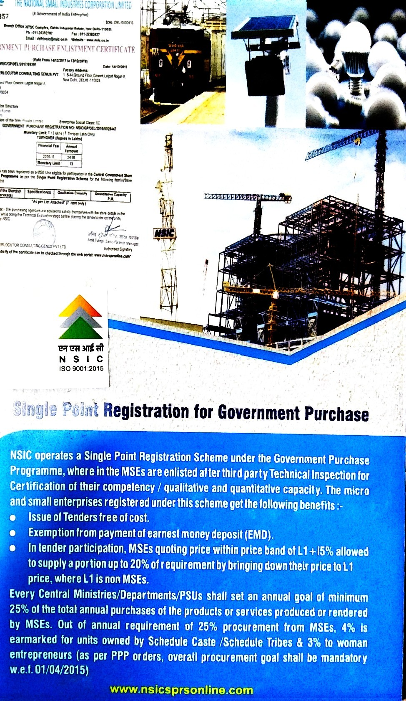

Slide 6


Slide 7
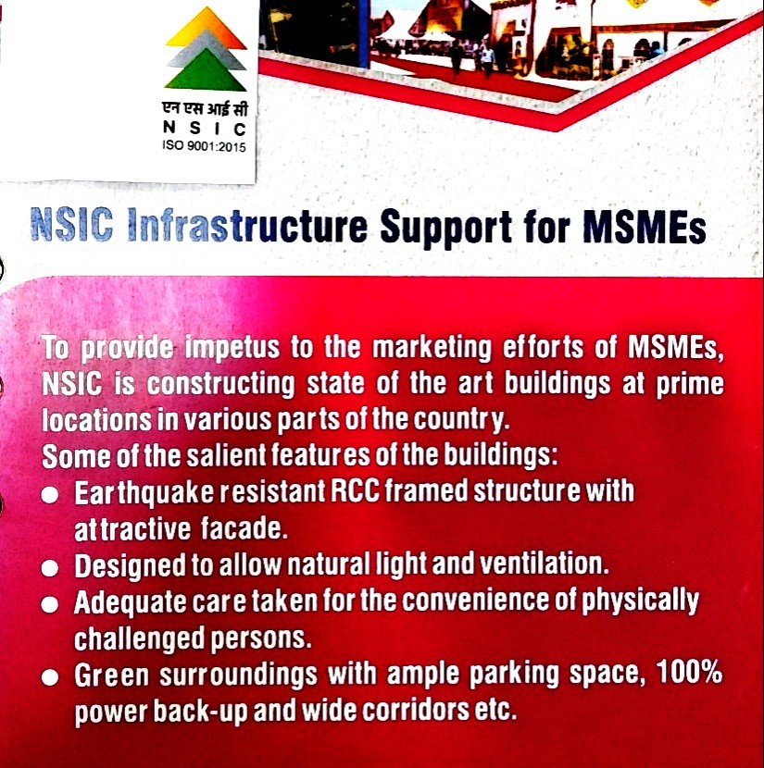

Slide 8


Slide 9


Slide 10
THANK YOU

