Slide 1
Virtual CPE Workshop on DA and IS Audit
Information System Audit – Professional Oppertunities
Dr. Vinay Kumar Saini
Notes:
1

Slide 2

Why CAs require IT Competencies
CAs need to embrace IT due to the very reason that IT is a key enabler in enterprises
CAs require IT competencies,
For survival – with everything turning digital, online and E-returns, E-reports…..the very subsistence depends on IT competencies. CA firms have to use IT in their own offices to provide services.
To avail new opportunities – With automation of their client’s operations resulting in most of the client’s data turning digital, new opportunities exist in Assurance & Consulting areas.
2

Slide 3
Opportunities for CAs in IT
Opportunities exist in Auditing, Assurance as well as consulting areas. CAs can facilitate implementation of innovative delivery capabilities for new service offerings to existing /new clients.
CAs can provide services in the areas of:-
IT Governance,
Risk Management,
Compliance Assurance,
Consulting and Implementation
Notes:
The most critical factor in protecting information assets and privacy is laying the foundation for effective information security management.
This chapter highlights fundamentals of ISM and related issues so that DISA candidate understands and can
3

Slide 4
Innovative delivery capabilities
Problem: Waiting for Billing on counter in Malls
(more specifically on Saturday and Sunday evening)
Risk
Potential Loss of Customers

Slide 5
Innovative delivery capabilities (2)
Problem: Waiting for Billing on counter in Malls
(more specifically on Saturday and Sunday evening)
Feasible Solutions
Using RFID instead of Barcode
+
Supplemented by Online Order processing facility
(with free home delivery service)

Slide 6
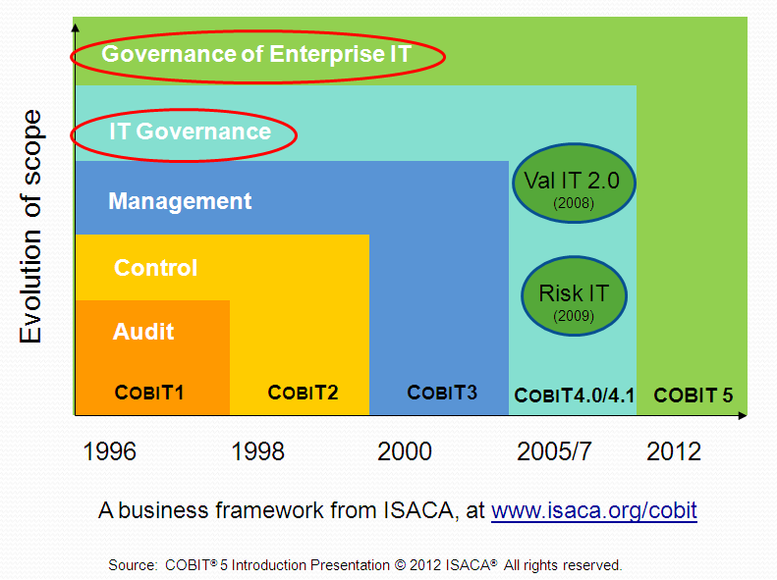
Assurance of Global Best Practices
2019
COBIT

Slide 7
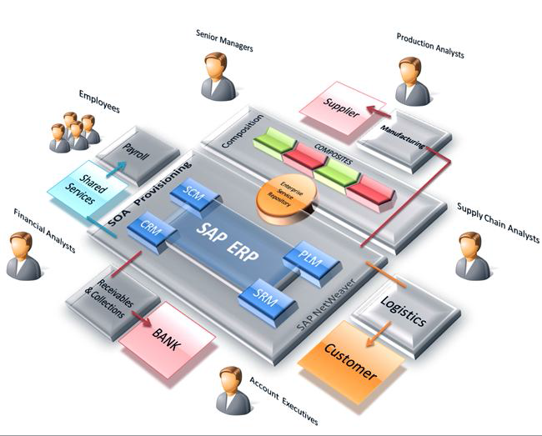
ERP package implementation

Slide 8

Compliance Assurance in E-Commerce
The Payment Card Industry Data Security Standard (PCI DSS) is a proprietary information security standard for organizations that handle cardholder information for the major debit, credit, prepaid, e-purse, ATM, and POS cards.
Defined by the Payment Card Industry Security Standards Council, the standard was created to increase controls around cardholder data to reduce credit card fraud via its exposure.
Validation of compliance is done annually by an external Qualified Security Assessor (QSA) that creates a Report on Compliance (ROC) for organizations handling large Volumes of transactions, or by Self-Assessment Questionnaire (SAQ)for companies handling smaller volumes.

Slide 9
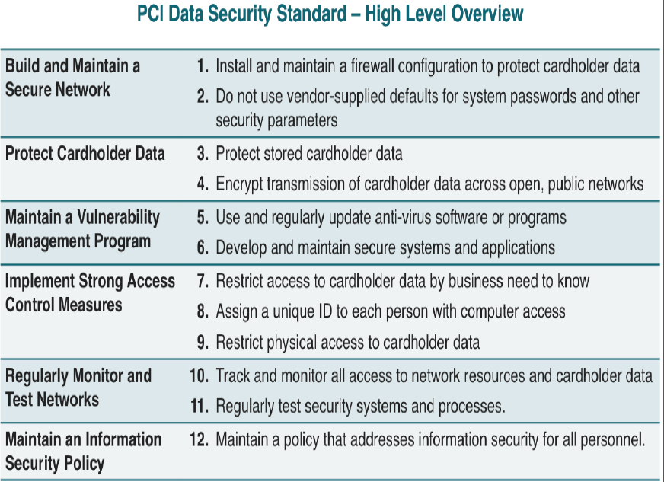
Compliance Assurance in E-Commerce

Slide 10
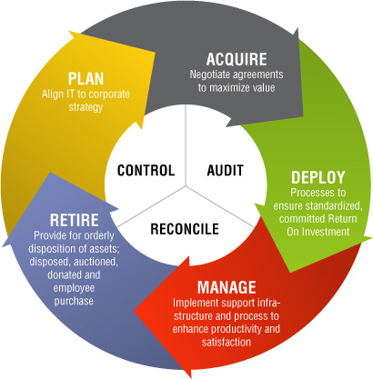
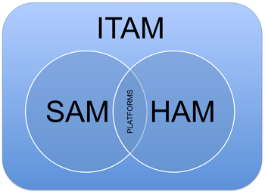
Information Technology Asset Management (ITAM)
SAM Software Asset Management
HAM Hardware Asset Management
Notes:
10

Slide 11
Software Asset Management
Acquisition
Version control
Software License
General Public License Agreements
End User License Agreement (EULA)
Intellectual Property Rights (IPR) (ex. copy rights, patents)
Digital Rights Management (DRM)
(copy prevention, read only)
Notes:
11

Slide 12
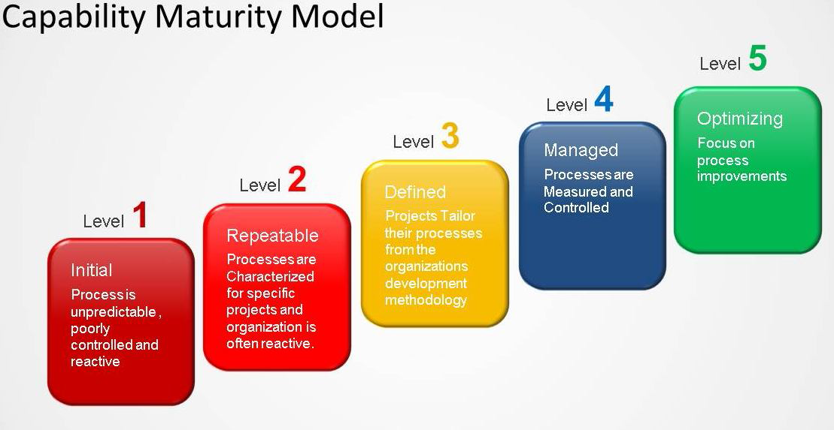
Systems quality Assurance

Slide 13
Business Process Outsourcing
Medical Transcription
Act of converting voice-recorded medical Reports into text
Legal Transcription
Converting audio dictation by legal professionals and other recordings from legal cases into the printed word
Data Entry and Processing
Area of accounting and many other business processes are increasingly being outsourced because of cost effectiveness
IT Helpdesk Suport
Provides a single point of contact service to end users for all kinds of IT support.
Application Development
Involves Outsourcing of development as well as maintenance and support of applications
13

Slide 14
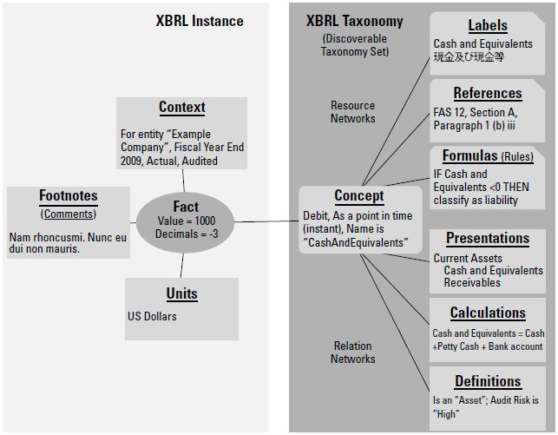
XBRL (eXtensible Business Reporting Language)
Development of Taxonomies

Slide 15
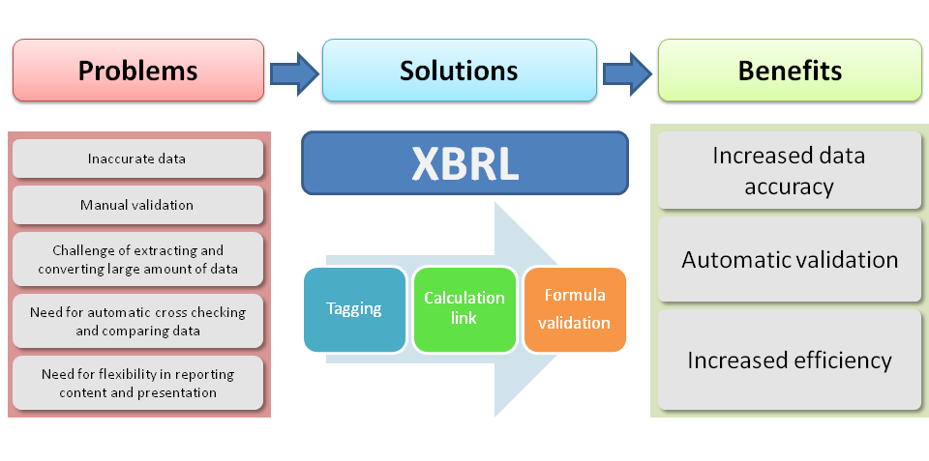
XBRL (eXtensible Business Reporting Language)
Benefits

Slide 16
Emerging Trends in IT
E-commerce
Business Intelligence
Data Analysis
Cloud Computing
Big Data Analytics
Mobile Computing and Bring Your Own Device(BYOD)
Internet of Things
Blockchain

Slide 17
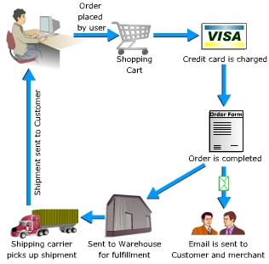
E-Commerce
E-commerce refers to the buying and selling of goods and services via electronic channels, primarily the Internet. Online retail is decidedly convenient due to its 24-hour availability, global reach and generally efficient customer service.

Slide 18
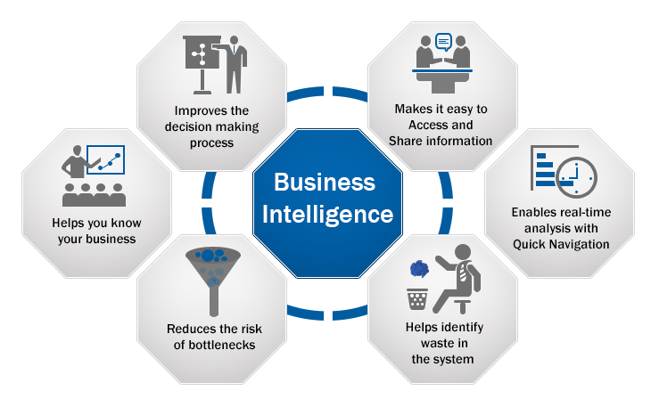
Business Intelligence

Slide 19

Data Analysis
Tools for Data Analysis
SQL
ACL
Idea
Ms-Excel
R Language
Python
MatLab
SPSS

Slide 20
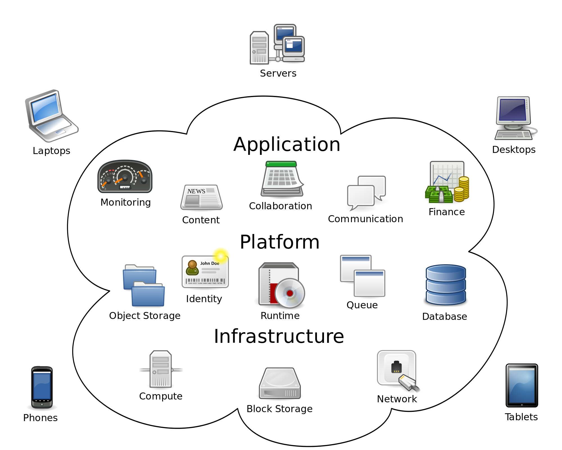
Cloud Computing

Slide 21

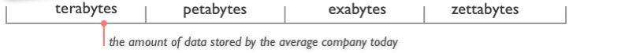
Big Data Analysis

Slide 22
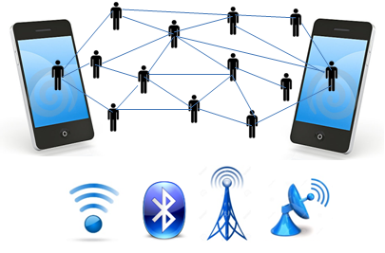
Mobile Communication

Slide 23
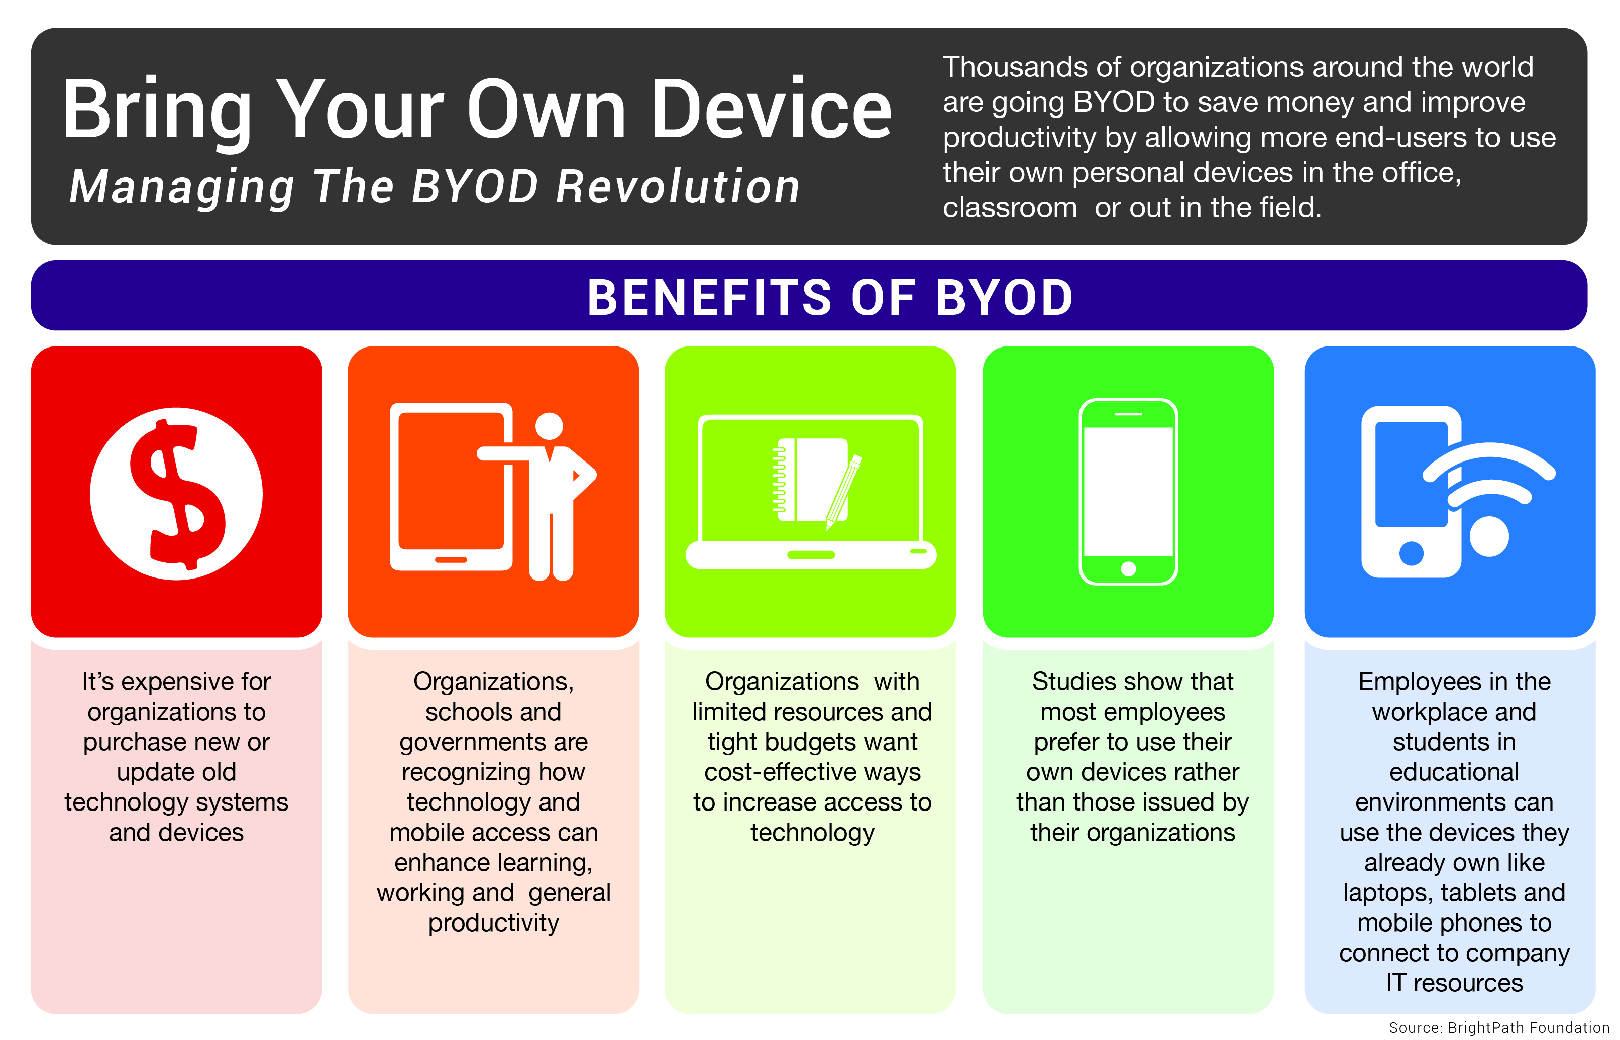

Slide 24
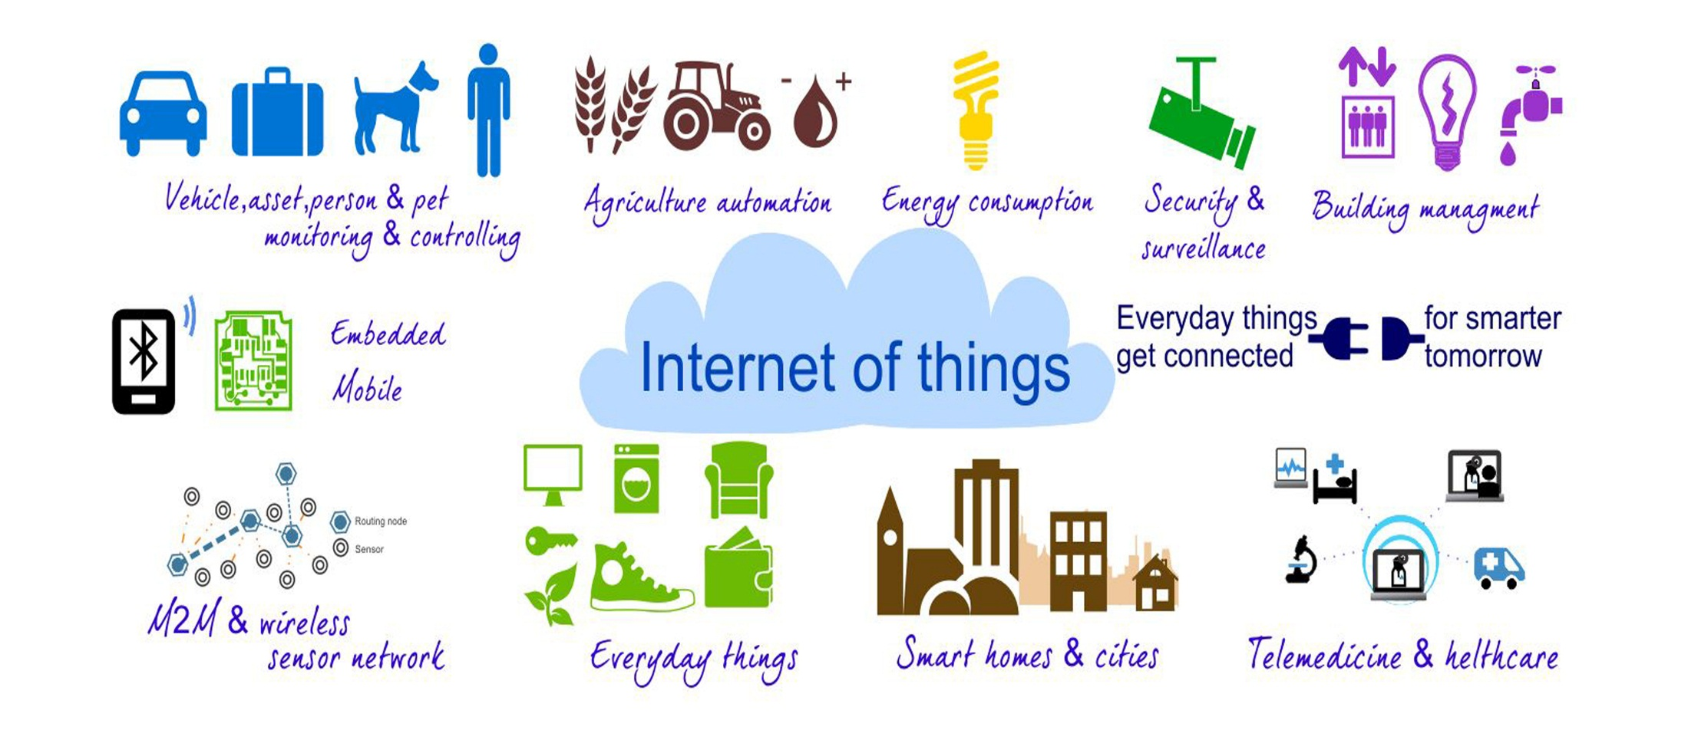
Internet of Things(IoT)

Slide 25
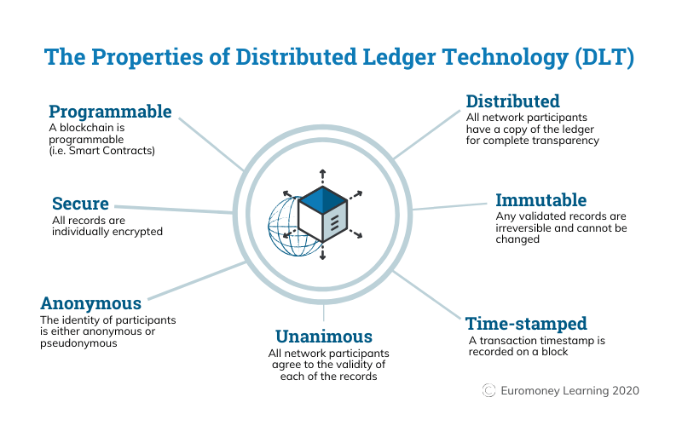
Blockchain

Slide 26
Questions?

Slide 27
Thank You
Dr. Vinay Kr Saini
vinay.kr.saini@gmail.com
(+91)9811703596
New Delhi, INDIA

