Slide 1
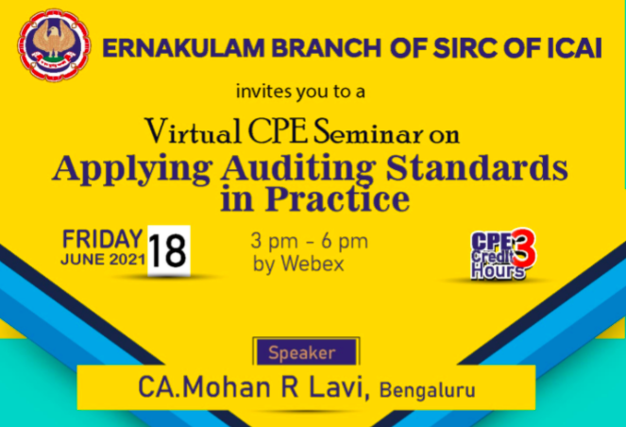

Slide 2
Legal Mandate
Companies Act, 2013
Every auditor shall comply with the Auditing Standards.
the Institute of Chartered Accountants of India in consultation with the National Financial Reporting Authority would recommend auditing standards for the Central Government to adopt. Till that time, the auditing standards issued by the ICAI would have to be followed.

Slide 3

Auditing Standards- India
Sl No | Area | No of Standards
1 | Quality Control | 1
2 | General Principles and Responsibilities | 9
3 | Risk Assessment and response to assessed risks | 6
4 | Audit Evidence | 11
5 | Using the work of others | 3
6 | Audit Conclusions and reporting | 6
7 | Specialised Areas | 3
8 | Standards on Review Engagements | 2
9 | Other Assurance Engagements | 5
 | Total | 46

Slide 4
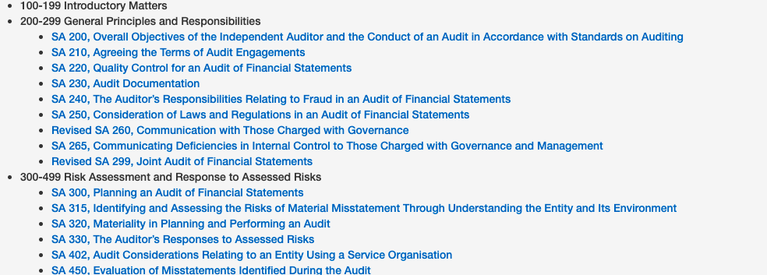
List of Standards

Slide 5
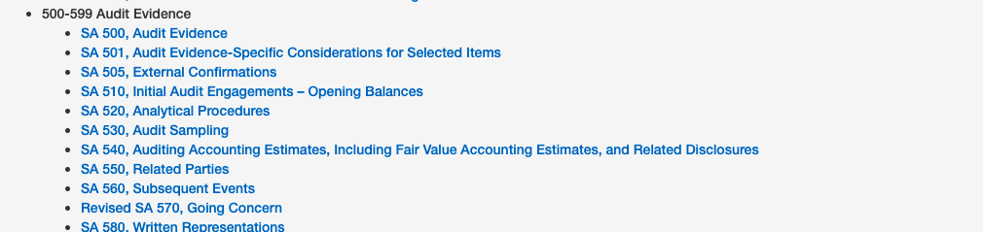
List of Standards

Slide 6
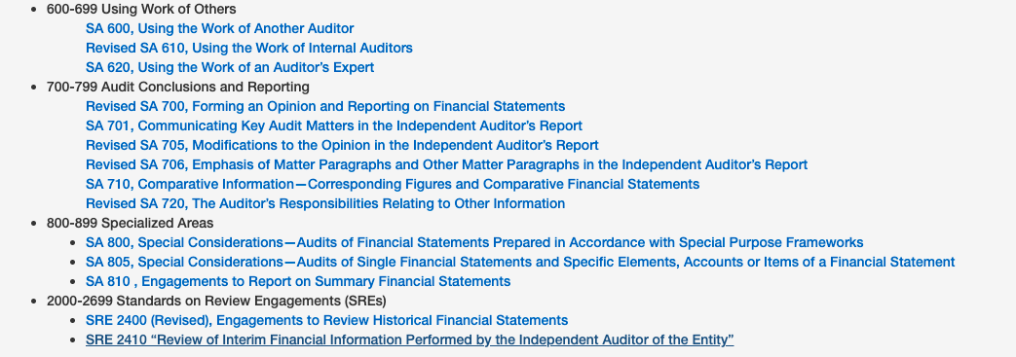
List of Standards

Slide 7
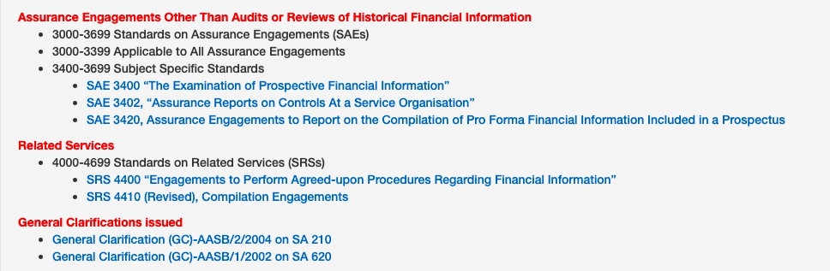
List of Standards

Slide 8
Auditing Standards
Basis for Opinion
We conducted our audit in accordance with the Standards on Auditing (SAs) specified under section 143(10) of the Companies Act, 2013. Our responsibilities under those Standards are further described in the Auditor’s Responsibilities for the Audit of the Consolidated Financial Statements section of our report.

Slide 9
Objectives of Audit
Our objectives are to obtain reasonable assurance about whether the consolidated financial statements as a whole are free from material misstatement, whether due to fraud or error, and to issue an auditor’s report that includes our opinion. Reasonable assurance is a high level of assurance, but is not a guarantee that an audit conducted in accordance with SAs will always detect a material misstatement when it exists. Misstatements can arise from fraud or error and are considered material if, individually or in the aggregate, they could reasonably be expected to influence the economic decisions of users taken on the basis of these consolidated financial statements.

Slide 10
Applying Auditing Standards in practice

Slide 11
Statutory Auditors of
31st March 2021
Audit to be completed by 31st July 2021

Slide 12
SQC 1
Theme of the Standard
“ The firm should establish policies and procedures”

Slide 13
Why?
We have complied with the relevant applicable requirements of the Standard on Quality Control (SQC) 1, Quality Control for Firms that Perform Audits and Reviews of Historical Financial Information, and Other Assurance and Related Services Engagements.

Slide 14
Mandate
The firm should establish a system of quality control designed to provide it with reasonable assurance that the firm and its personnel comply with professional standards and regulatory and legal requirements, and that reports issued by the firm or engagement partner(s) are appropriate in the circumstances.

Slide 15
Elements of a QC system
Leadership responsibilities for quality within the firm
Ethical requirements
Acceptance and continuance of client relationships
Human Resources
Engagement performance
Monitoring

Slide 16
Engagement documentation
Retention period
No shorter than seven years from the date of the auditors’ report

Slide 17
Monitoring
Such policies and procedures should include an ongoing consideration and evaluation of the firm’s system of quality control, including a periodic inspection of a selection of completed engagements.
Find out deficiencies, if any

Slide 18
Deficiencies
List out the deficiencies
Recommend remedial action

Slide 19
FACT Audit
SA 210- Agreeing to the terms of an audit engagement
SA 220- Audit Quality
SA 230- Audit Documentation

Slide 20
FACT Audit
SA 300- Planning an Audit of the financial statements
SA 315- Identifying and assessing the risks of material misstatement
SA 330- The Auditors’ response to the assessed risks
SA 320- Materiality in planning and performing the audit

Slide 21
Planning the audit
Staff required
Manager?
Need to change the signing partner?
Areas to be covered
Audit Plan
Physical verification?

Slide 22
SA 315/330
SA 315
During the audit, the staff of the auditor inform him that there is a risk of material misstatement in inventory because no convincing evidence has been given for the huge change in inventory valuation. ( positive change of 995%)

Slide 23
Response
Additional Procedures
Physical verification
Reverse-calculation.
Increase sample size to check valuation.

Slide 24
SA 230
Audit Documentation

Slide 25
Two parts
Requirements
Application and other explanatory material

Slide 26
Timely preparation
The auditor shall prepare audit documentation on a timely basis

Slide 27
Form, content and extent
The nature, timing, and extent of the audit procedures performed to comply with the SAs and applicable legal and regulatory requirements;
The results of the audit procedures performed, and the audit evidence obtained; and
Significant matters arising during the audit, the conclusions reached thereon, and significant professional judgments made in reaching those conclusions.

Slide 28
Shall record
The identifying characteristics of the specific items or matters tested;
Who performed the audit work and the date such work was completed; and
Who reviewed the audit work performed and the date and extent of such review.

Slide 29
Requirement
The auditor shall document discussions of significant matters with management, those charged with governance, and others, including the nature of the significant matters discussed and when and with whom the discussions took place
If the auditor identified information that is inconsistent with the auditor’s final conclusion regarding a significant matter, the auditor shall document how the auditor addressed the inconsistency

Slide 30
Assembly of final audit file
Timely basis
shall not delete or discard audit documentation of any nature before the end of its retention period
New documentation after file has been assembled
The specific reasons for making them; and
When and by whom they were made and reviewed

Slide 31
Assembly of final audit file
not more than 60 days after the date of the auditor’s report
Administrative changes after assembly of final audit file
Deleting or discarding superseded documentation.
Sorting, collating and cross referencing working papers.
Signing off on completion checklists relating to the file assembly process.
Documenting audit evidence that the auditor has obtained, discussed and agreed with the relevant members of the engagement team before the date of the auditor’s report

Slide 32
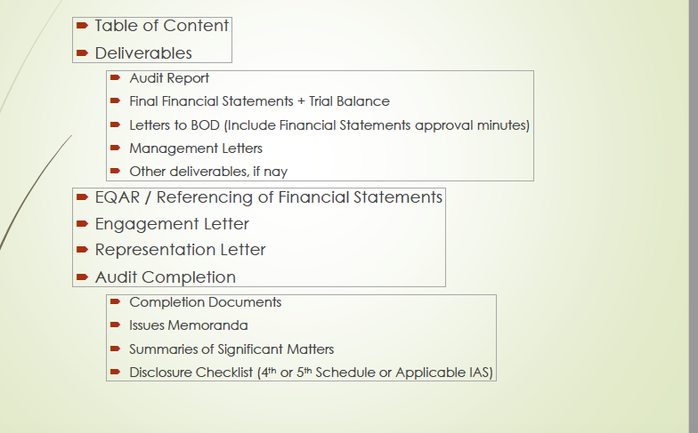
Audit file

Slide 33
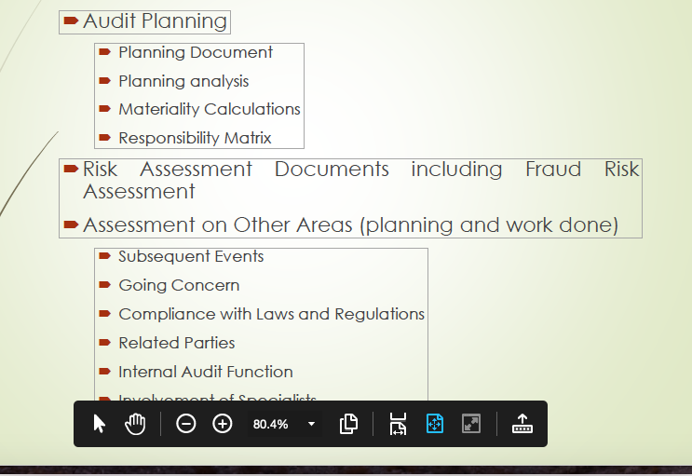
Audit file

Slide 34
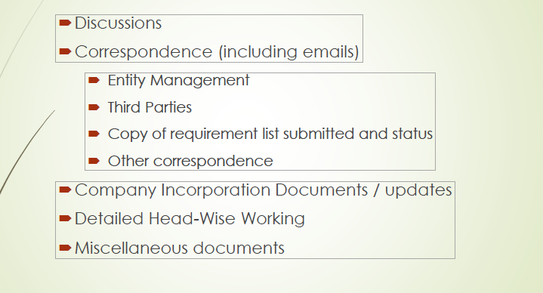
Audit File

Slide 35
What’s normally missing
Properly Organised file
Naming the persons who did the work
Cross-referencing with other documents
Note on conclusions reached

Slide 36
Retention period
Audit Documents
7 years

Slide 37
FACT Audit
500 series
SA 500-Audit Evidence
SA 505- External Confirmations
SA 510- Initial engagement- opening balances
SA 520- Analytical Procedures
SA 530- Audit Sampling

Slide 38
Audit Sampling
Sale of own products- Rs 1900 crores
Sale of traded products- Rs 65 crores
Subsidy/concession- Rs 870 crores
Sale of services – Rs 20 crores
How many invoices?
How many new customers?
Reco with GST Data

Slide 39
Audit Sampling
Purchases – Rs 100 crores
No of invoices/GST records
Salaries- Rs 233 crores
2/3 months salary walk-through
Finance Costs- Rs 300 crores
Confirmation

Slide 40
External Confirmations
Banks
Trade Receivables
Trade Payables
Subsidy
Related Parties

Slide 41
Analytical Procedures

Slide 42
Analytical Procedures
Gross Profit Ratio
Net Profit Ratio
Current Ratio
Debt Equity Ratio
Stock turnover ratio

Slide 43
Audit evidence
Invoices
Agreements
Minutes of meetings
Confirmations
Emails for some transactions

Slide 44
Auditing Standards
SA 600- Using the work of another auditor
SA 610- Using the work of internal auditor
SA 620- Using the work of an auditors’ expert

Slide 45
Internal Auditor
SA 610
You find that the reports of the internal auditor are repetitive
Queries raised and responses are almost similar in all four quarters
Response of the auditor?

Slide 46
SA 620
FACT have issued CCPS to some investors. The instrument is complex since the interest payment is made by FACT but guaranteed by the Government of India. The investors will not convert the shares but the same will be converted by the Government of India.
Repayment of the principal would be decided at the time of conversion.
As per Ind AS 32, the company has classified this as a Compound Financial Instrument.
As the auditor, you are not sure.
Independent opinion from an expert.

Slide 47
Impact of Covid on Audit report
Inventory
Impairment
Fair Value
Trade Receivables
Going Concern

Slide 48
SA 701
Communicating Key Audit Matters
Previous Years KAM
Accounting for Subsidy income from GOI
Purchase of raw material from a single vendor without tender
Current Year?
Copy/Paste?
Relook?

Slide 49
Most popular KAMS
Impairment
Revenue recognition
IT Controls

Slide 50
SA 706
Emphasis of Matter
Previous Year EOM
Revision of financial statements due to consolidation
Variance in Interest Provision
Non-compliance with Ind AS 116- Leases

Slide 51
SA 570
Going Concern
Tested every year
Specific para in SA 700
Cannot come under other paras

Slide 52
Going Concern
We draw attention to Note # 54 of Consolidated financial statements. The Company has accumulated loss amounting to Rs 1,21,353 lakhs (previous year Rs 2,18,532 lakhs) with a negative net worth of Rs 49,143 lakhs (previous year Rs 1,47,226 lakhs). However, the Company has reported net profit of Rs 97,552 lakhs during the year (previous year of Rs 16,269 lakhs). The Company has a balance under current assets of Cash and Cash Equivalents and Other Bank balances of Rs 66,717 lakhs (previous year Rs 7,467 lakhs) as at year end. The net current assets as at the year-end is Rs 13,234 lakhs (previous year Rs 11,026 lakhs). These conditions indicate that there is no uncertainty which may cast doubt as to the Company's ability to continue as a going concern. The Consolidated financial statements of the Company have been prepared on going concern basis. Our opinion is not modified in respect of this matter.

Slide 53
FACT Audit
With some difficulty, audit is completed on 2nd August 2021.
By when will you complete the documentation?
As per SA 230, it is 2nd October 2021

Slide 54
Importance of Auditing Standards

Slide 55
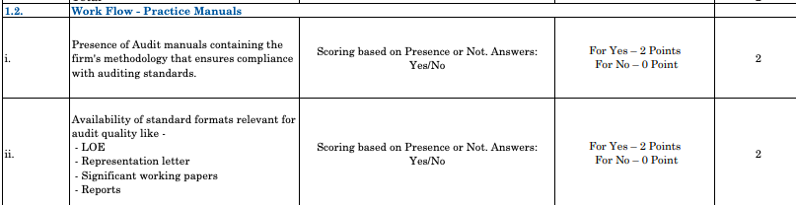
AQMM

Slide 56
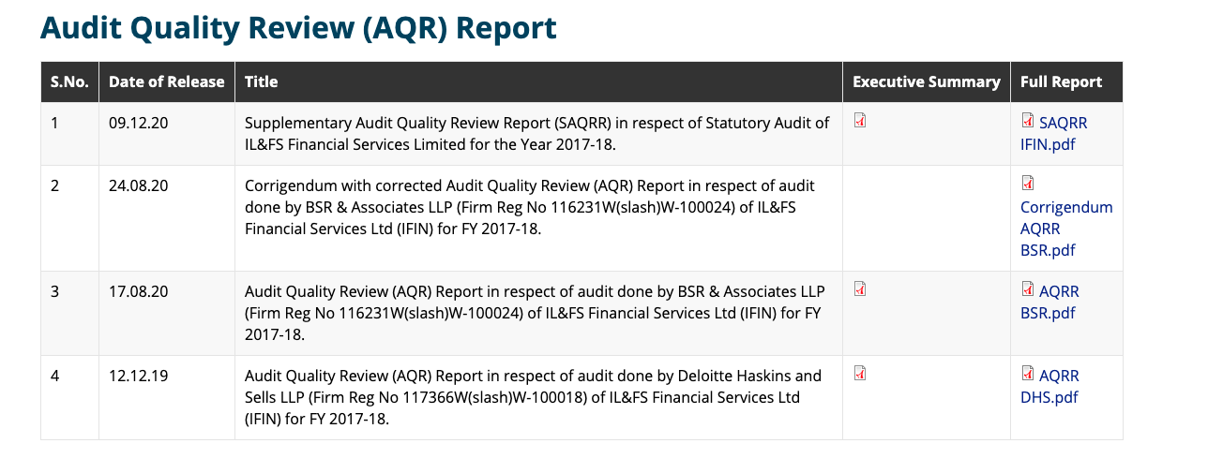
NFRA

Slide 57
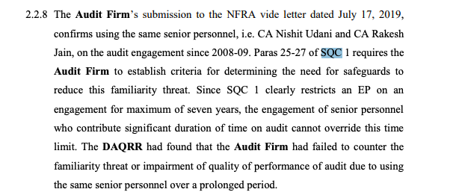
NFRA

Slide 58
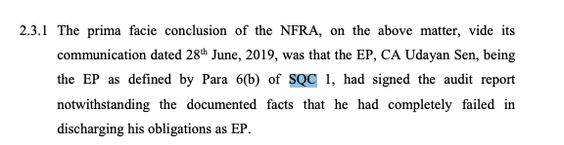
NFRA

Slide 59
Finally,
For medium sized firms
No exceptions from Auditing Standards!
Do as much as you can!

Slide 60
നന്നി
mohan.lavi@gmail.com
+ 91 99000 22040

