Slide 1

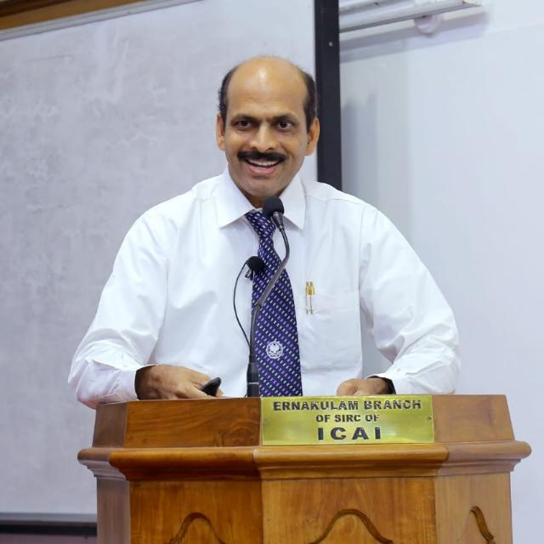
WEBINAR ON NEW REGISTRATION PROCEDURES OF CHARITABLE AND RELIGIOUS TRUSTS/INSTITUTIONS UNDER INCOME TAX ACT, FCRA RENEWAL,CSR REGISTRATION.
CA. P J JOHNEY, B.Sc., FCA,
JOHNEY & Co. EDAPPALLY
Ph: 9388601505
Email: auditor.jandco@gmail.com

Slide 2
AREAS COVERED
Introduction -Charitable Purpose-Section 2 (15)
Renewal of registration under section 10(23C) ,12AB, and 80G.
New Registration under section 10(23C) ,12AB, and 80G
Question – Answer Session
Issues and Suggestions
FCRA Renewal
Question – Answer Session
CSR Registration
Question – Answer Session
7. Summing Up

Slide 3
Finance Act 2020
The Finance Act 2020 vide Gazette Notification dated 27-03-2020 ,
Major amendments for Registration / Approval/Renewal u/s 10(23C) ,12AB , 35 and 80G to trust, society or other institutions.
Notification No. G.S.R. 212(E) dated 26.03.2021, Central Board of Direct Taxes, Ministry of Finance , prescribed rules 2C, 5CA, 5F,11AA, 17A,18AB and forms 10A , 10AB ,10AC, 10AD 10BD ,10BE.

Slide 4







Charitable Purpose – Section 2(15)
“Charitable Purpose” includes
Relief of the poor Education
Yoga
Medical Relief
Preservation of environment (including watersheds, forests and wildlife)
Preservation of monuments or places or objects of artistic or historic interest
The advancement of any other object of general public utility
4

Slide 5
Proviso to Section 2(15)
Advancement of any other object of general public utility shall not be a charitable purpose
I f it involves
Any activity in the nature of trade, commerce or business
Any activity of rendering services in relation to any trade, commerce or business
OR
For a consideration
Irrespective of the nature of application of income from such activity
5

Slide 6


Exclusion - Proviso to Section 2(15)
such activity is undertaken in the course of
actual carrying out of such advancement of any other object of general public utility
aggregate receipts from such activities
do not exceed 20% of the total receipts, of the trust of that previous year
&
6

Slide 7
Renewal of registration under section 10(23C) ,12AB, and 80G
Section 12-Income of trusts or institutions from contributions
Section 12A-Conditions for applicability of sections 11 and 12.
Section 12AA-Procedure for registration.
Section 12AB-Procedure for fresh registration.

Slide 8
Renewal of registration under section 10(23C) ,12AB, and 80G
Earlier the registration under section 12AA, approval under section 10(23C) and 80G were given without any expiry period.
Now, these registration and approvals shall be given only for a limited time period of 5 years.
On expiry of every 5 years, the registration/ approval has to be re obtained.
This will keep a check on inactive registrations.

Slide 9
Renewal of registration under section 10(23C) ,12AB, and 80G
The application for renewal of the approval/ registration will have to be given within the period of 3 months from the date of coming in to force of the amendment.
Due to the COVID-19 outbreak, the effective date of this provision has been deferred to 1st April 2021.

Slide 10
Renewal of registration under section 10(23C) ,12AB, and 80G
On receipt of the application, the PCIT/ CIT will pass an order for registration/ approval for the period of 5 years.
The order for registration / approval in such cases will be required to be passed within 3 months from the end of the month in which the application will be filed.

Slide 11
Renewal of registration under section 10(23C) ,12AB, and 80G
The new approval/ registration will be applicable from the assessment year from which the approval/ registration was originally granted under the existing provisions.

Slide 12
Rationalising and digitalising the process of registration for Charitable Institute.
In order to simplify the compliance for the new and existing charity institutions, it is proposed to make the process of Registration completely electronic under which a Unique Registration Number (URN) shall be issued to all new and existing charity institutions.
The step will simply the compliance for the new and existing charity institute. It will introduce uniformity in the registration process and promote ease of doing.

Slide 13
New Registration
The provisional approval may be granted for the period of 3 years (without any discretion in the hands of the authorities for any period less than 3 years etc.).
Later, full/ final registration/ approval may be granted in the prescribed procedure.

Slide 14
New Registration
The application for fresh registration/ approval (towards 12AB, 10(23C) and 80G) is to be made at least one month prior to the commencement of the previous year relevant to the assessment year from which said approval / registration is sought.

Slide 15
RULES AND FORMS
FORMS | SECTION | RULE
Form 10A | 10(23C), 12AB,80G | 2C or 5CA or 11AA or 17A
Form 10 AB | 10(23C), 12AB,80G | 2C or 5CA or 11AA or 17A
Form 10 AC | 10(23C), 12AB, 80G | 2C or 11AA or 17A
Form 10 AD | 10(23C), 12AB,80G | 2C or 11AA or 17A
10BD | 80 G | 18AB
10BE | 80 G | 18AB
3CF | 35 | 5C, 5D, 5E and 5F

Slide 16
RULES AND FORMS
FORM NO. 10A
( Rule 2C or 5CA or 11AA or 17A)
Application for registration or provisional registration or intimation or approval or provisional approval
Trust or Institution having existing registration u/s 12A or 12AA or existing approval of 10(23C) or 80G.
Provisional registration /approval for new applicants u/s 12AB,10(23C) or 80G.
Intimation under section 35(1)

Slide 17
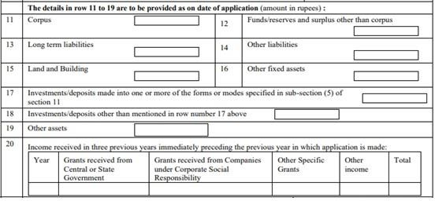
CHANGE IN EXISTING FORM 10A

Slide 18
CHANGE IN EXISTING FORM 10A
In case if applicant is already registered u/s 12A or 12AA and have filed ITR of last assessment year, above Asset & Liabilities and Income detail is not mandatory.
In form no. 10A, instruction no. 10 , Row No. 11 to 20 are not required to filled if
Trust or institution is already registered u/s 12A or 12AA or approval u/s 80G.
Trust or institution is already registered u/s10(23C) with certain conditions and restrictions.

Slide 19
RULES AND FORMS
FORM NO. 10AB
(Rule 2C or 5CA or 11AA or 17A)
Application for registration or approval
Trust or institution is registered under section 12AB and 10(23C) or 80G (As per New Amendments) the period of the said registration is to expire.
Trust or institution has been provisionally registered under section 12AB or has provisional approval u/s10(23C) or 80G and such provisional registration/ Approval is due to expire.

Slide 20
Trust or institution has adopted or undertaken modifications of the objects which do not conform to the conditions of registration.
Registration of the trust or institution has become inoperative due to the first proviso to sub-section (7) of section 11. (Registration u/s 12A or 12AA shall become inoperative from the date on which the trust or institution is approved under clause (23C) of section 10)

Slide 21
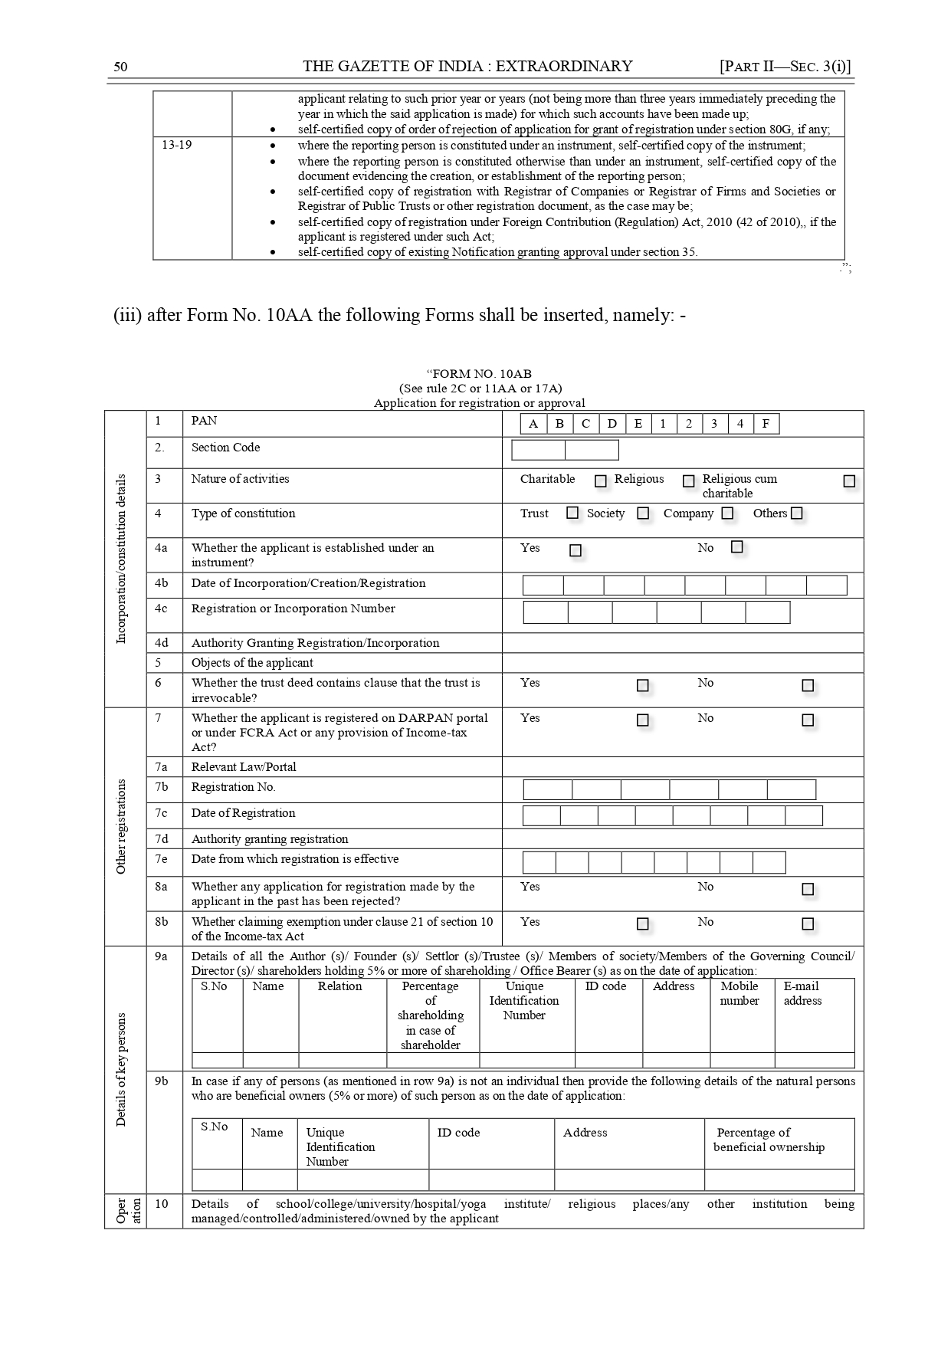
Form 10AB

Slide 22
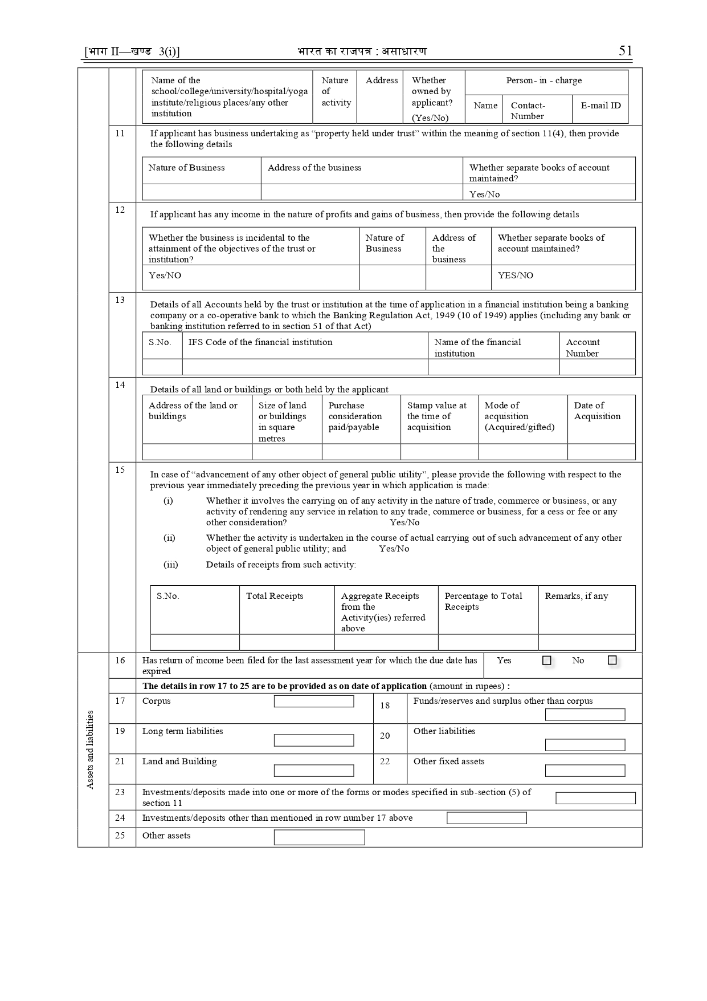

Slide 23
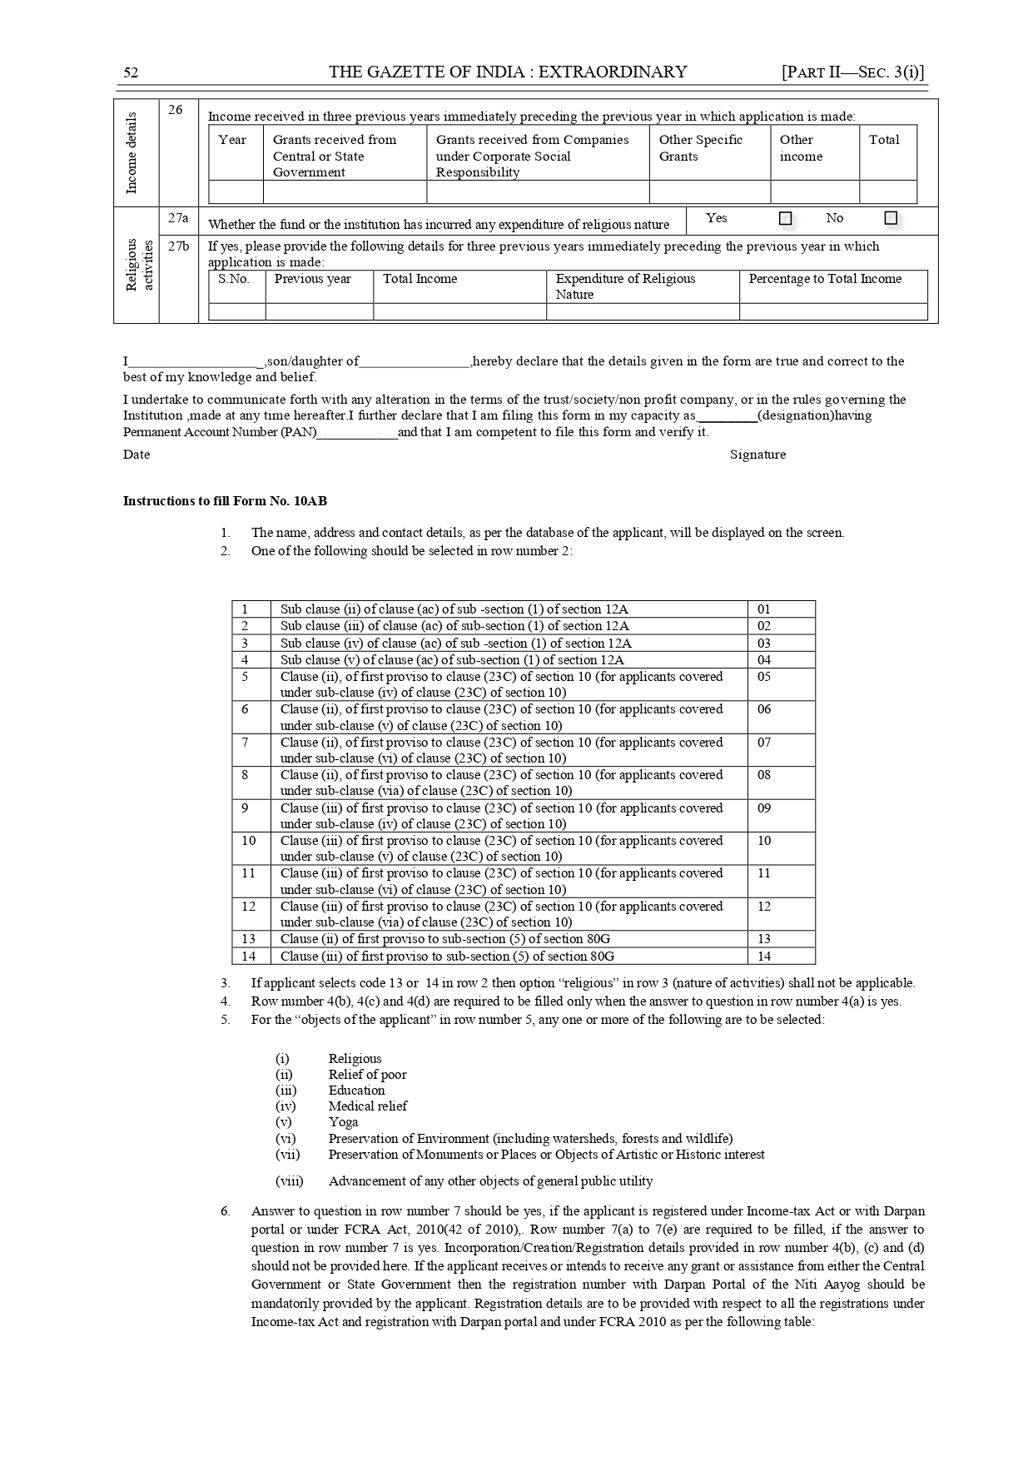

Slide 24
Issues In 10AB
Row No. 10
Details of school/ college/university/hospital/yoga institute/ religious places/any other institution being managed/controlled/administered/owned by the applicant.
Row No. 11
If applicant has business undertaking as “property held under trust” within the meaning of section 11(4).

Slide 25
Row No. 12
If applicant has any income in the nature of profits and gains of business.
Row No. 13
Details of all Accounts held by the trust or institution at the time of application in a financial institution being a banking company or a co-operative bank to which the Banking Regulation Act, 1949 (10 of 1949) applies (including any bank or banking institution referred to in section 51 of that Act)

Slide 26
Row No. 14
Details of all land or buildings or both held by the applicant.
Row No. 15
In case of “advancement of any other object of general public utility”, please provide the following with respect to the previous year immediately preceding the previous year in which application is made:

Slide 27
(i) Whether it involves the carrying on of any activity in the nature of trade, commerce or business, or any activity of rendering any service in relation to any trade, commerce or business, for a cess or fee or any other consideration?
(ii) Whether the activity is undertaken in the course of actual carrying out of such advancement of any other object of general public utility; and (iii) Details of receipts from such activity

Slide 28
Row No. 16
Has return of income been filed for the last assessment year for which the due date has expired.
Row No. 17 to 20
Details of Assets and Liabilities as on date of application.
Row No. 26
Income received in three previous years immediately preceding the previous year in which application is made.

Slide 29
Row No. 27a
Whether the fund or the institution has incurred any expenditure of religious nature.
Row No. 27b
If yes, please provide the following details for three previous years immediately preceding the previous year in which application is made.

Slide 30
RULES AND FORMS
FORM NO. 10AC
(See rule 2C or 11AA or 17A)
Order for registration or provisional registration or approval or provisional approval.
Application is submitted in Form 10A.

Slide 31
RULES AND FORMS
FORM NO. 10AD
(See rule 2C or 11AA or 17A)
Order for registration or approval or rejection or cancellation
Application is submitted in Form 10AB.

Slide 32
FORM No. 10BD
( See rule 18AB)
[e -Form]
Statement of particulars to be filed by reporting person under clause (viii) of sub-section (5) of section 80G and clause (i) to sub-section (1A) of section 35 of the Income-tax Act, 1961

Slide 33
FORM NO. 10BE
(See rule 18AB)
Certificate of donation under clause (ix) of sub-section (5) of section 80G and under clause (ii) to sub-section (1A) of section 35 of the Income-tax Act, 1961

Slide 34
RULES AND FORMS
“FORM NO. 3CF
(See rules 5C, 5D, 5E and 5F)
Application for registration or approval
Application form for approval under clause(ii) or clause (iii) of Sub section(1) of Section 35 of the Income –Tax Act 1961 in the case of a research association.

Slide 35
Process of Registration
Applicant (Trust, society or other Institutions) shall apply for registration over Income Tax Portal using their Income Tax Login credentials in Form No. 10A (or 10AB as the case) within the time limit along with documents prescribed.

Slide 36
List Of Documents to be attached
Where the applicant is created, or established, under an instrument, self-certified copy of such instrument creating or establishing the applicant
where the applicant is created, is established, otherwise than under an instrument, self-certified copy of the document evidencing the creation or establishment of the applicant;
Self-certified copy of registration with Registrar of Companies or Registrar of Firms and Societies or Registrar of Public Trusts, as the case may be;

Slide 37
Various Statutes For Registration Of Instruments
1(a). PUBLIC TRUSTS UNDER THE INDIAN TRUST ACT 1882.
1(b). THE BOMBAY PUBLIC TRUSTS ACT, 1950

Slide 38
Various Statutes For Registration Of Instruments
2(a). SOCIETIES UNDER THE TRAVANCORE-COCHIN LITERARY, SCIENTIFIC AND CHARITABLE SOCIETIES REGISTRATION ACT, 1955.
2(b). SOCIETIES UNDER THE SOCIETIES REGISTRATION ACT, 1860.
3. SECTION 8 COMPANY UNDER THE COMPANIES ACT 2013.

Slide 39
List Of Documents to be attached
self-certified copy of registration under Foreign Contribution (Regulation) Act, 2010, if the applicant is registered under such Act; the registration number with Darpan Portal of the Niti Aayog if the applicant is registered in the Darpan Portal.
self-certified copy of existing order granting registration under section 12A or section 12AA or section 12AB, as the case may be;
self-certified copy of order of rejection of application for grant of registration under section 12A or section 12AA or section 12AB, as the case may be, if any;

Slide 40
List Of Documents to be attached
7. where the applicant has been in existence during any year or years prior to the financial year in which the application for registration is made, self-certified copies of the annual accounts of the applicant relating to such prior year or years (not being more than three years immediately preceding the year in which the said application is made) for which such accounts have been made up;

Slide 41
List Of Documents to be attached
8. where a business undertaking is held by the applicant as per the provisions of sub-section (4) of section 11 and the applicant has been in existence during any year or years prior to the financial year in which the application for registration is made, self-certified copies of the annual accounts of such business undertaking relating to such prior year or years (not being more than three years immediately preceding the year in which the said application is made) for which such accounts have been made up and self- certified copy of the report of audit as per the provisions of section 44AB for such period;

Slide 42
List Of Documents to be attached
9. where the income of the applicant includes profits and gains of business as per the provisions of sub- section (4A) of section 11 and the applicant has been in existence during any year or years prior to the financial year in which the application for registration is made, self-certified copies of the annual accounts of such business relating to such prior year or years (not being more than three years immediately preceding the year in which the said application is made) for which such accounts have been made up and self-certified copy of the report of audit as per the provisions of section 44AB for such period;

Slide 43
Process of Registration
Form no.10A or 10AB as the case may be required to be digitally signed, if Income Tax Return to be furnished with DSC otherwise, same can be submitted with Electronic Verification Code.
Form Nos. 10A or 10AB, as the case may be, shall be verified by the person who is authorised to verify the Income Tax Return.

Slide 44
Process of Registration
On receipt of an application in Form No. 10A (or 10AB as the case may be), the Principal Commissioner or Commissioner, authorised by the Board shall,

Slide 45
Process of Registration
1. In case of applicant who is already registered u/s 12AA or in case of Provisional Registration where Form 10A has been submitted
– shall pass an order in writing granting registration in Form No.10AC and issue a 16 digit alphanumeric Unique Registration Number (URN) to the applicant.

Slide 46
Process of Registration
2. In other cases ,
where Form 10AB has been submitted, the order of registration or rejection or cancellation of registration shall be in Form No.10AD and
In case if the registration is granted,
16 alphanumeric number Unique Registration Number (URN) shall be issued.

Slide 47
Process of Registration
3. In case Commissioner or Principal Commissioner thinks necessary in order to satisfy himself about the genuineness of activities of the trust or institution,
the compliance of such requirements of any other law
for the time being in force by the trust or institution as are
material for the purpose of achieving its objects,

Slide 48
Process of Registration
he may call for such documents or information from the trust or institution or make such inquiries.
If he is still not so satisfied, he may pass an order in writing rejecting such application and also cancelling its registration after providing
a reasonable opportunity of being heard to applicant.

Slide 49
Process of Registration
4. If, at any point of time, it is noticed that Form No. 10A has not been duly filled in by not providing, fully or partly, or by providing false or incorrect information or documents required or by not complying with the requirements rules,
the Principal Commissioner or Commissioner, after giving an opportunity of being heard, may cancel the registration in Form No. 10AC and Unique Registration Number (URN) and such registration or such Unique Registration Number (URN) shall be deemed to have never been granted or issued.
i.e. cancellation will be effective from day one.

Slide 50
QUESTIONS? ISSUES

Slide 51
ISSUES / SUGGESTIONS
1.AWARENESS
2. REPEATED RENEWAL-EVERY 5 YEARS.
3. TIME LIMIT FOR RENEWAL-3 MONTHS-30-6-2021.
4. URN-COMMINICATION TO ALL AUTHORITIES.
5. PROVISIONAL APPROVAL- APPLICATION IN FORM 10 AB WITHIN 6 MONTHS BEFORE EXPIRY OF PROVISIONAL APPROVAL.
6. PAN OF BOARD MEMBERS AND THEIR ITR

Slide 52
ISSUES / SUGGESTIONS
7.ASSETS AND LIABILITIES AS ON THE DATE OF APPLICATION
8. OTHER INCOME FOR FY 2020-21.
9. FILING OF ITR OF EARLIER YEARS.
10. APPLICANT CREATED OTHERWISE THAN BY AN INSTRUMENT- CERTIFIED COPY .
11. EARLIER YEAR’S ACCOUNTS AND ITR
12. BUSINESS INCOME - ITR, 44AB AUDIT REPORT

Slide 53
ISSUES / SUGGESTIONS
13.JURISDICTION
14. NON COMPLIANCE OF ANY OTHER LAW
15. OPPURTUNITY OF BEING HEARD UNDER COVID 19 SCENARIO AND OTHER SITUATIONS.
16.INCOMPLETE/WRONG DATA-A REASON FOR CANCELLATION/REJECTION.

Slide 54
ISSUES / SUGGESTIONS
17. PHYSICAL VERIFICATION OF REGISTERED OFFICE.
18. ADDRESS PROOF
19 .PHOTOGRAPH OF BUILDING
20. NO OBJECTION CERTIFICATE/CONSENT
21. LEASE DEED/ RENT AGREEMENT
22. VARIOUS DECLARATIONS.

Slide 55
ISSUES / SUGGESTIONS
23. MANDATORY CLAUSES IN THE DOCUMENT
24.COVERING LETTER
25. TIMELY RESPONSE TO NOTICES
26. COMMUNICATION OF NOTICES/ORDERS THROUGH INCOME TAX PORTAL.
27. LINKING OF PAN AND AADHAR CARD WITH MOBILE NUMBER.
28. NOTES ON ACTIVITIES,MINUTES BOOK.
29. VERIFICATION OF ORGINAL DEED/CERTIFICATE
30. INSTITUTIONS CREATED WITHOUT ANY REGISTRATION.

Slide 56
FCRA RENEWAL

Slide 57
FCRA 2010
validity of the registration certificate for a period of 5 years. It may be noted that in the old law FCRA registration was virtually permanent in nature unless it was revoked. FCRA 2010 provides for renewal of registration of organizations after every 5 years.
Association which desire to renew their registration certificate may apply online in Form FC-3C six months before the expiry of their existing registration.

Slide 58
FCRA 2010
The existing registration under FCRA, 2010, will cease from the date of completion of the period of five years from the date of grant of registration and will not be eligible for receiving of foreign contribution .
In such a case, the association has to apply afresh for grant of registration.

Slide 59
FCRA Amendment Act, 2020 a. Inquiry
The FCRA Amendment Act, 2020 dated 29th September 2020, specifies that the central government is empowered to make inquiries and satisfy itself with respect to compliance of Section 12(4) prior to FCRA renewal.
Section 12(4) is the provision under which verification at that time of granting registration is made. In other words, the government may also make similar inquiries before granting renewal of FCRA registration. Hence, by the proposed amendment renewal process has become similar with that of process of registration or Prior permission.

Slide 60
b. Delayed Application for Renewal
In case an NGO fails to apply for renewal within the due date, its registration shall become invalid.
The department may condone the delay if satisfactory reasons for not submitting the renewal application are provided.
A delayed application for renewal can be filed up to 1 year from the date of the expiry of the FCRA Certificate

Slide 61
c. Fees
Rule 12(6) of FC(R) Rules 2011 provides that in case no application for renewal of registration is received or such application is not accompanied by the requisite fee, the validity of the certificate of registration of such person shall be deemed to have ceased from the date of completion of the period of five years from the date of the grant of registration.

Slide 62
c. Fees
For example, if no application is received or is not accompanied by the renewal fee, the validity of the registration certificate issued on the 1st November, 2016 shall be deemed to have lapsed with effect from the close of the day on 31st October, 2021.

Slide 63
c. Fees
An application made for the renewal of the registration shall be accompanied by a fee of Rs. 1500 (Fifteen hundred only). However, a delayed renewal application shall be accompanied by a fee of Rs. 5000(Five thousand only).

Slide 64
Documents required for the renewal of the FCRA Registration
Image of signature of Chief Functionary
Image of seal of the Association.
Registration certificate of the Association
Memorandum of Association/ Trust Deed.

Slide 65
Documents required for the renewal of the FCRA Registration
FCRA Registration Certificate of Association issued by MHA.
Associations has to upload affidavit of each key functionary
Details of each key functionary including Aadhar of the Board members in case of Indian members and copy of passport or overseas citizen card (OCI) in case of foreign members.

Slide 66
QUESTIONS?

Slide 67
CSR REGISTRATION (CORPORATE SOCIAL RESPONSIBILITY)

Slide 68
What is CSR ?
As per Section 135(1) ,
Every company having net worth Of Rs 500 crore or more, or turnover of Rs 1,000 crore or more or a net profit of Rs 5 crore or more during any financial year shall constitute a Corporate Social Responsibility Committee of the Board consisting of three or more directors, out of which at least one director shall be an independent director.

Slide 69
What is CSR ?
As per 135(5) ,
The Board of every company referred to in sub-section (1), shall ensure that the company spends, in every financial year, at least 2 % of the average net profits of the company made during the three immediately preceding financial years, in pursuance of its Corporate Social Responsibility Policy.

Slide 70
Entities for undertaking CSR Activities
Company established under Section 8 of the Companies Act, 2013 with Section 12A and Section 80G registrations under the Income Tax Act, 1961.
Registered Public Trust with Section 12A and Section 80G registrations under the Income Tax Act, 1961.

Slide 71
Entities for undertaking CSR Activities
Registered Society with Section 12A and Section 80G registrations under the Income Tax Act, 1961.
Company established under Section 8 of the Companies Act, 2013 or Registered Trust or Registered Society established by the Central Government or State Government.
Entity established under an Act of Parliament or State Legislature.

Slide 72
CSR Compliances:
As per the notification G.S.R 40(E) dated 22-01-2021,
An unregistered trust will not be eligible for CSR Funding Mandatory Registration with MCA for Getting CSR Funding
All the trust accepting CSR funds from corporate entities should obtain ‘Unique CSR Registration No ’ from Ministry of Corporate Affairs.

Slide 73
CSR Compliances:
• Trusts are required to fill Form CSR – 01,for obtaining the Unique CSR Registration Number
• Trusts are mandatorily required registration under the provisions of section 12A & 80G (New Section – 12AB) of the income tax act.

Slide 74
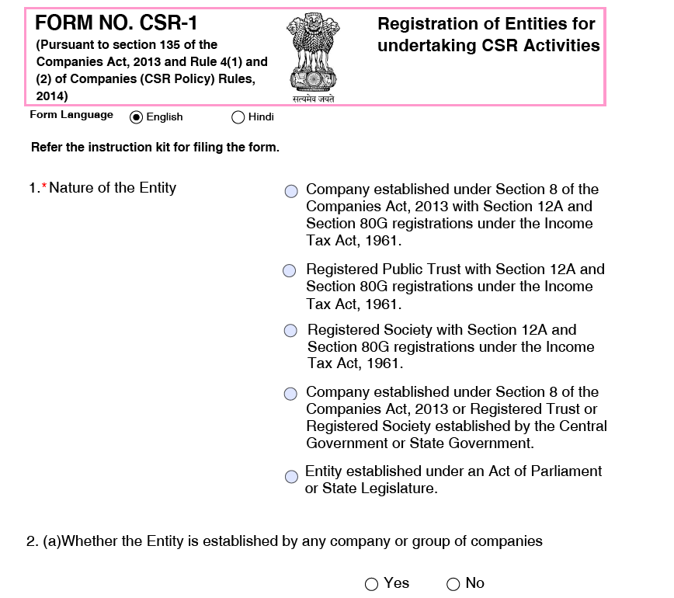
Registration Process -CSR -01 FORM

Slide 75
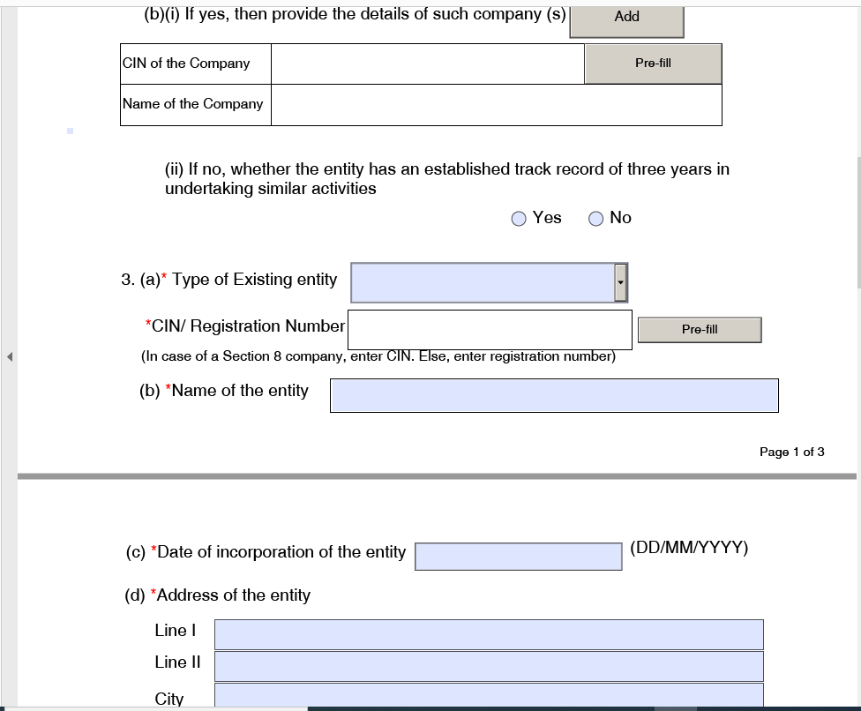
Registration Process -CSR -01 FORM

Slide 76
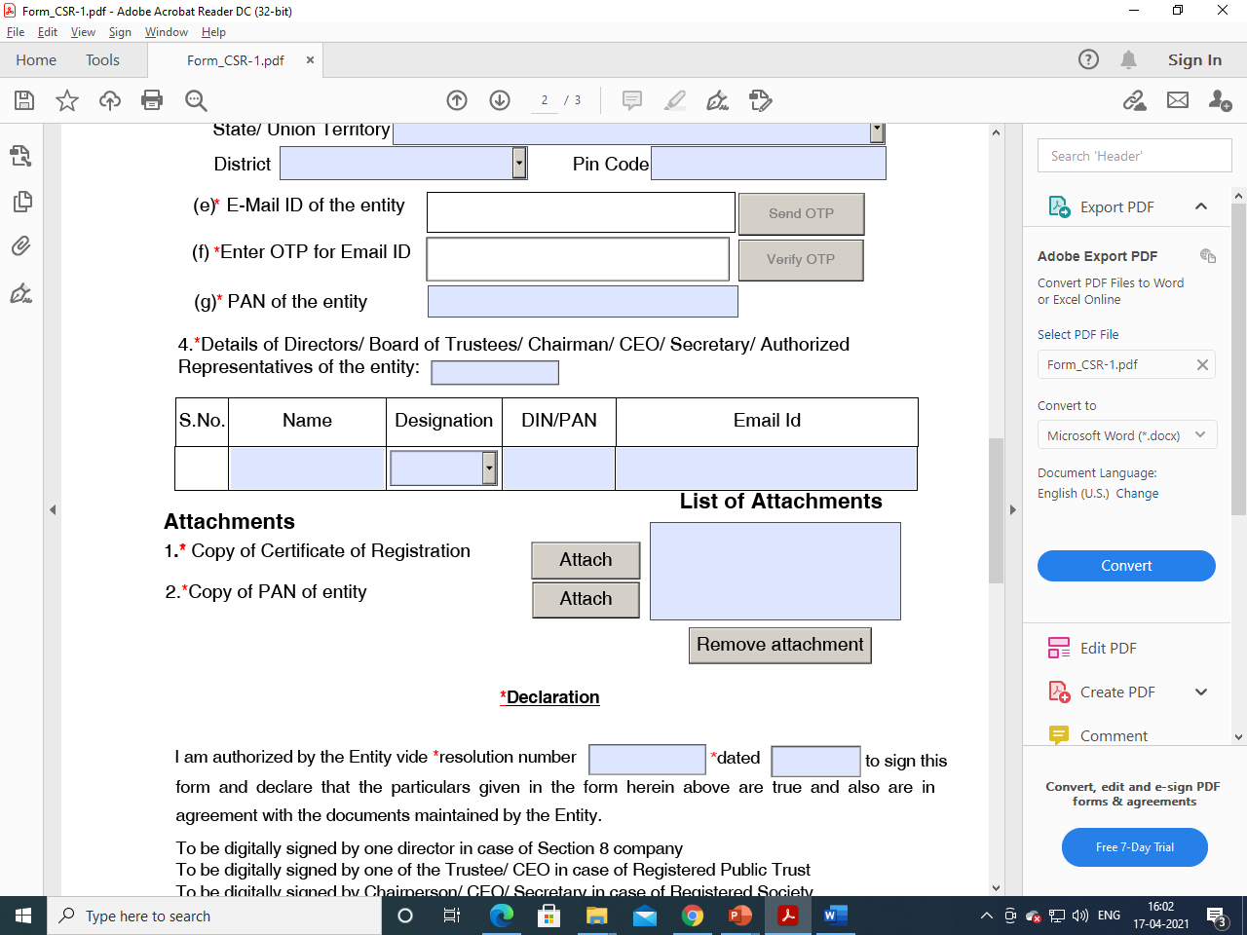
Registration Process -CSR -01 FORM

Slide 77
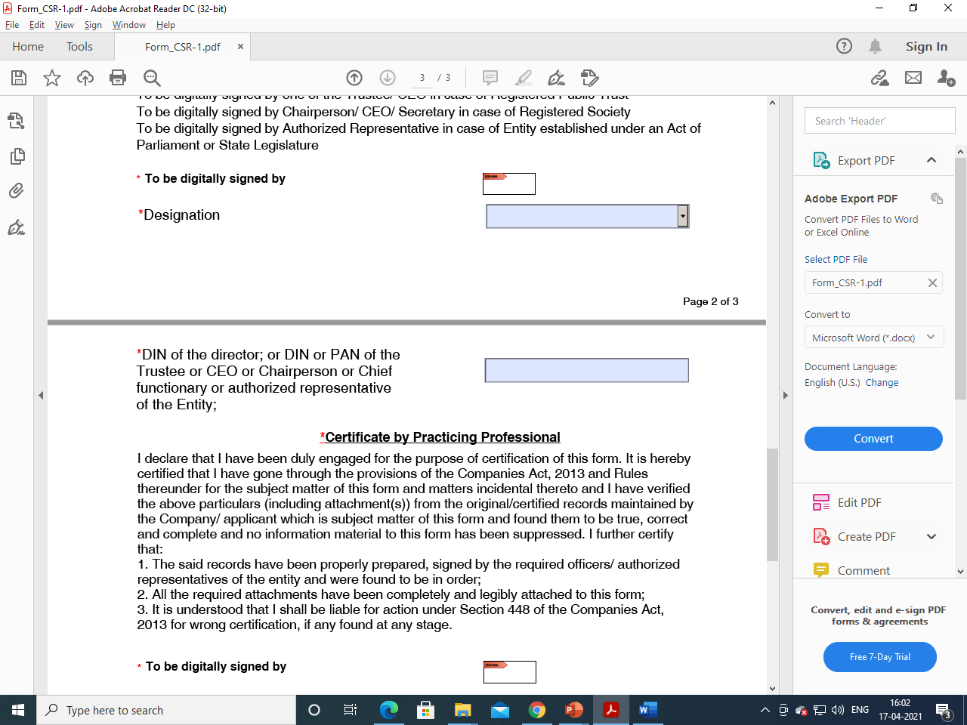
Registration Process -CSR -01 FORM

Slide 78
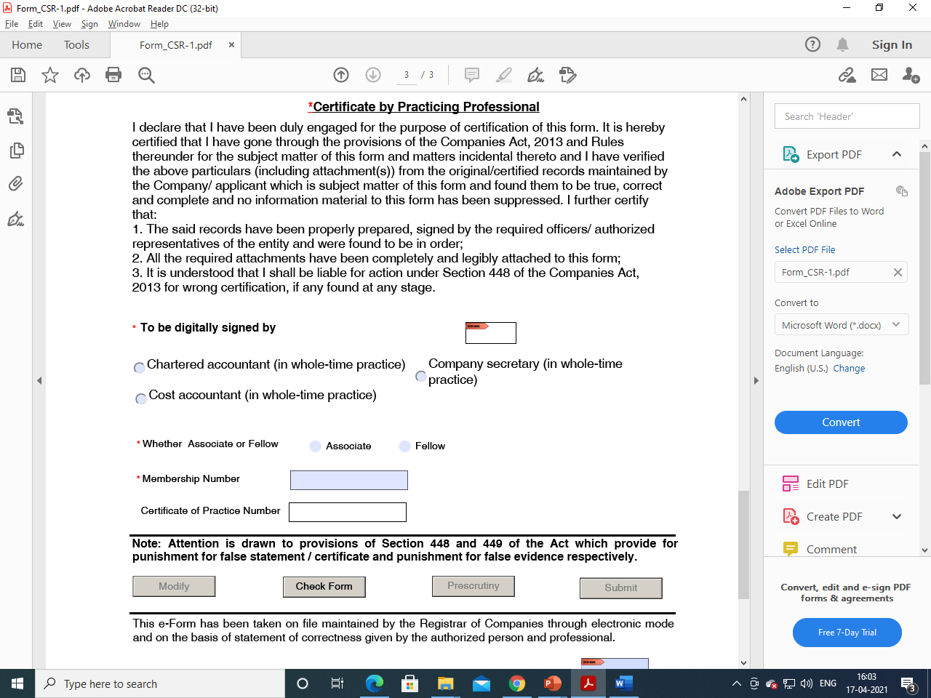
Registration Process -CSR -01 FORM

Slide 79
Documents required for filing Form CSR-1
1. Copy of PAN Card of the NGO
2. Mail ID and Mobile Number
3. Details of Governing Body Members (Updated Change Report)

Slide 80
Documents required for filing Form CSR-1
4. Copy of Registration Certificate
5.Board Resolution Authorising The Representative For The Compliance
6. Digital Signature of the Authorised Person with his PAN Number.

Slide 81
DECLARATION
To be digitally signed by either:
Designation
DIN of the director; or DIN or PAN of the Trustee or CEO or Chairperson or Chief functionary
-To be digitally signed by one director in case of Section 8 company

Slide 82
DECLARATION
-To be digitally signed by one of the Trustee/ CEO in case of Registered Public
-To be digitally signed by Chairperson/ CEO/ Secretary in case of Registered Society
-To be digitally signed by Authorized Representative in case of Entity established under an Act of Parliament or State Legislature.

Slide 83
Certificate By Practicing Professional
(Chartered Accountant /Company secretary/Cost Accountant)
Particulars in the form CSR-01
Maintenance of proper records.

Slide 84
QUESTIONS?

Slide 85
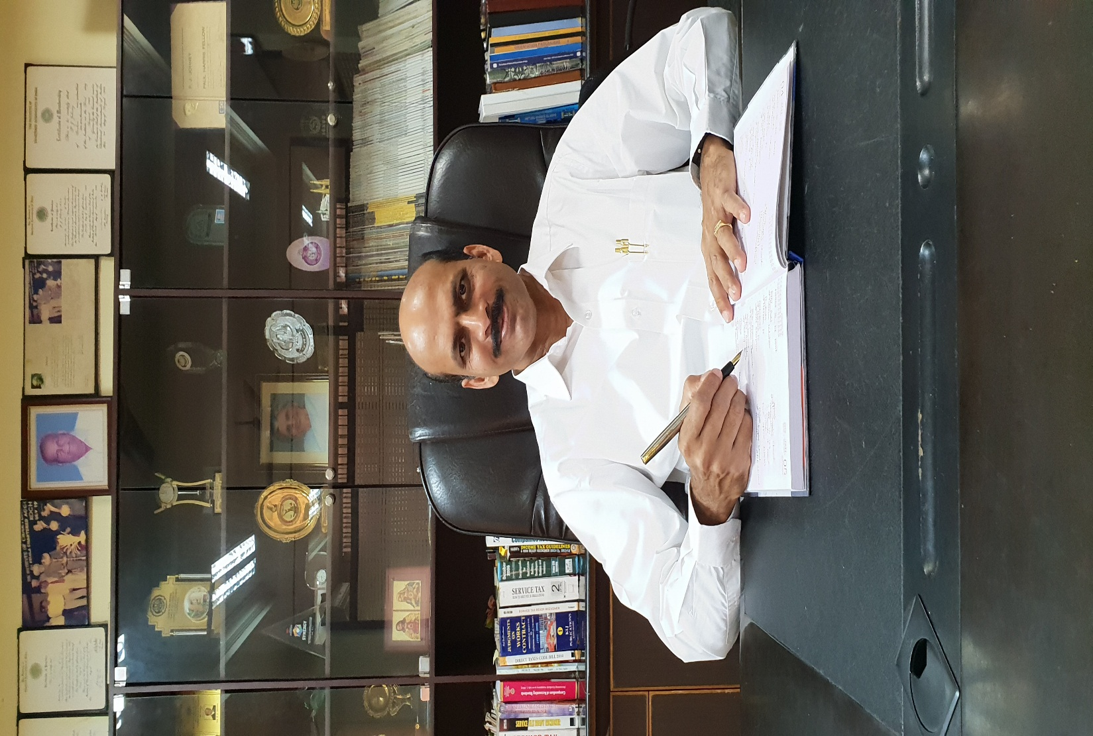
THANK YOU

