Slide 1

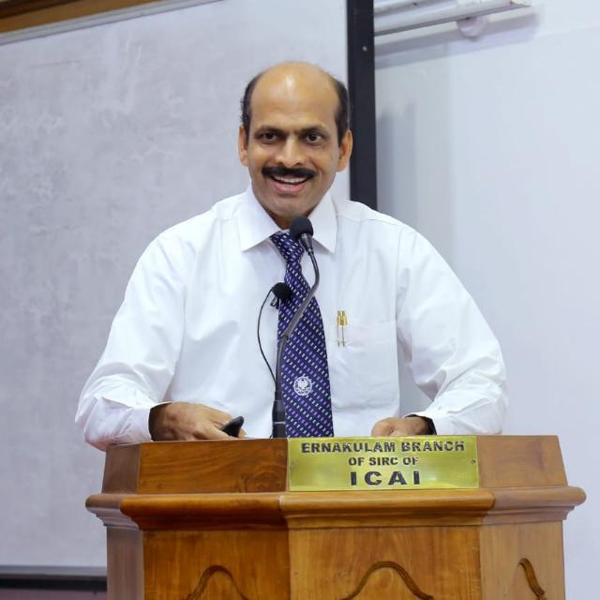
SEMINAR ON NEW REGISTRATION PROCEDURES OF CHARITABLE AND RELIGIOUS TRUSTS UNDER INCOME TAX ACT ON 10TH APRIL 2021
CA. P J JOHNEY, B.Sc., FCA,
JOHNEY & Co. EDAPPALLY
Ph: 9388601505
Email: auditor.jandco@gmail.com

Slide 2
Finance Act 2020
The Finance Act 2020 vide Gazette Notification dated 27-03-2020 ,
Major amendments for granting exemptions u/s 12A, 10(23C) and donation u/s 80G to trust, society or other institutions .
Notification No. G.S.R. 212(E) dated 26.03.2021, Central Board of Direct Taxes, Ministry of Finance , prescribed rules 2C, 5CA, 5F,11AA, 17A,18AB and forms 10A , 10AB ,10AC, 10AD 10BD ,10BE.

Slide 3
Section 12AB Of The Income Tax Act 1961
Renewal/New Registration of Trusts, Societies
and other institutions registered under sections 12A,
12AA,10(23C) and 80G of The Income Tax Act 1961.

Slide 4
Renewal of registration under section 12AB, 10(23C) and 80G
Earlier the registration under section 12AA, approval under section 10(23C) and 80G were given without any expiry period.
Now, these registration and approvals shall be given only for a limited time period of 5 years.
On expiry of every 5 years, the registration/ approval has to be re obtained.
This will keep a check on inactive registrations.

Slide 5
Renewal of registration under section 12AB, 10(23C) and 80G
The application for renewal of the approval/ registration will have to be given within the period of 3 months from the date of coming in to force of the amendment.
Due to the COVID-19 outbreak, the effective date of this provision has been deferred to 1st April 2021.

Slide 6
Renewal of registration under section 12AB, 10(23C) and 80G
On receipt of the application, the PCIT/ CIT will pass an order for registration/ approval for the period of 5 years.
The order for registration / approval in such cases will be required to be passed within 3 months from the end of the month in which the application will be filed.

Slide 7
Renewal of registration under section 12AB, 10(23C) and 80G
The new approval/ registration will be applicable from the assessment year from which the approval/ registration was originally granted under the existing provisions.

Slide 8
Rationalising and digitalising the process of registration for Charitable Institute.
In order to simplify the compliance for the new and existing charity institutions, it is proposed to make the process of Registration completely electronic under which a Unique Registration Number (URN) shall be issued to all new and existing charity institutions.
The step will simply the compliance for the new and existing charity institute. It will introduce uniformity in the registration process and promote ease of doing.

Slide 9
New Applicants
The provisional approval may be granted for the period of 3 years (without any discretion in the hands of the authorities for any period less than 3 years etc.).
Later, full/ final registration/ approval may be granted in the prescribed procedure.

Slide 10
New Applicants
The application for fresh registration/ approval (towards 12AB, 10(23C) and 80G) is to be made at least one month prior to the commencement of the previous year relevant to the assessment year from which said approval / registration is sought.

Slide 11
RULES AND FORMS
FORM NO. 10A
( Rule 2C or 5CA or 11AA or 17A)
Application for registration or provisional registration or intimation or approval or provisional approval
Trust or Institution having existing registration u/s 12A or 12AA
Provisional registration

Slide 12
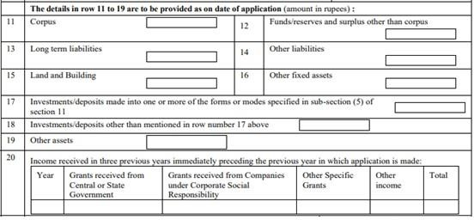
CHANGE IN EXISTING FORM 10A

Slide 13
CHANGE IN EXISTING FORM 10A
In case if applicant is already registered u/s 12AA and have filed ITR of last assessment year, above Asset & Liabilities and Income detail is not mandatory.

Slide 14
RULES AND FORMS
FORM NO. 10AB
(Rule 2C or 5CA or 11AA or 17A)
Application for registration or approval
Trust or institution is registered under section 12AB and the period of the said registration is to expire
Trust or institution has been provisionally registered under section 12AB
Trust or institution has adopted or undertaken modifications of the objects which do not conform to the conditions of registration

Slide 15
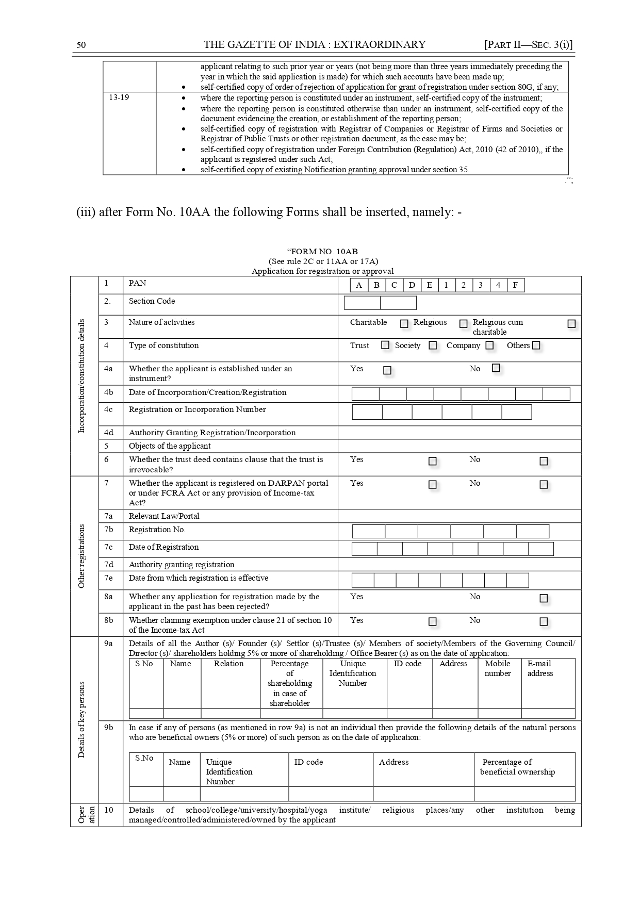
Form 10AB

Slide 16
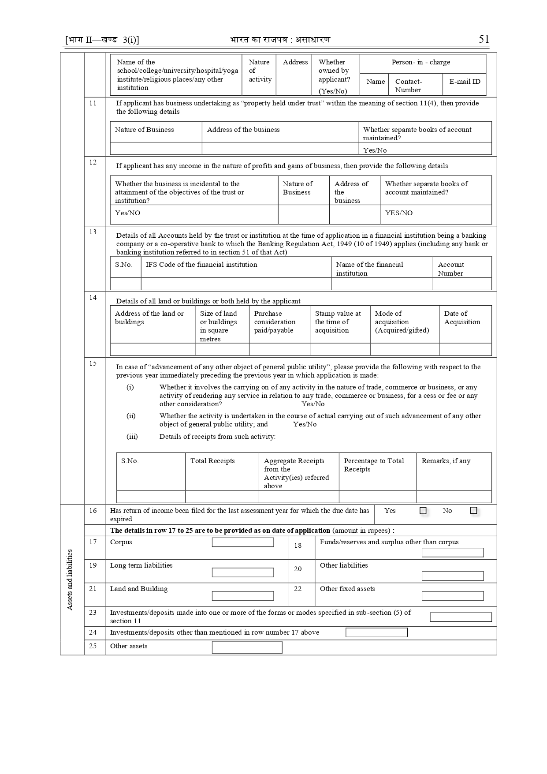

Slide 17
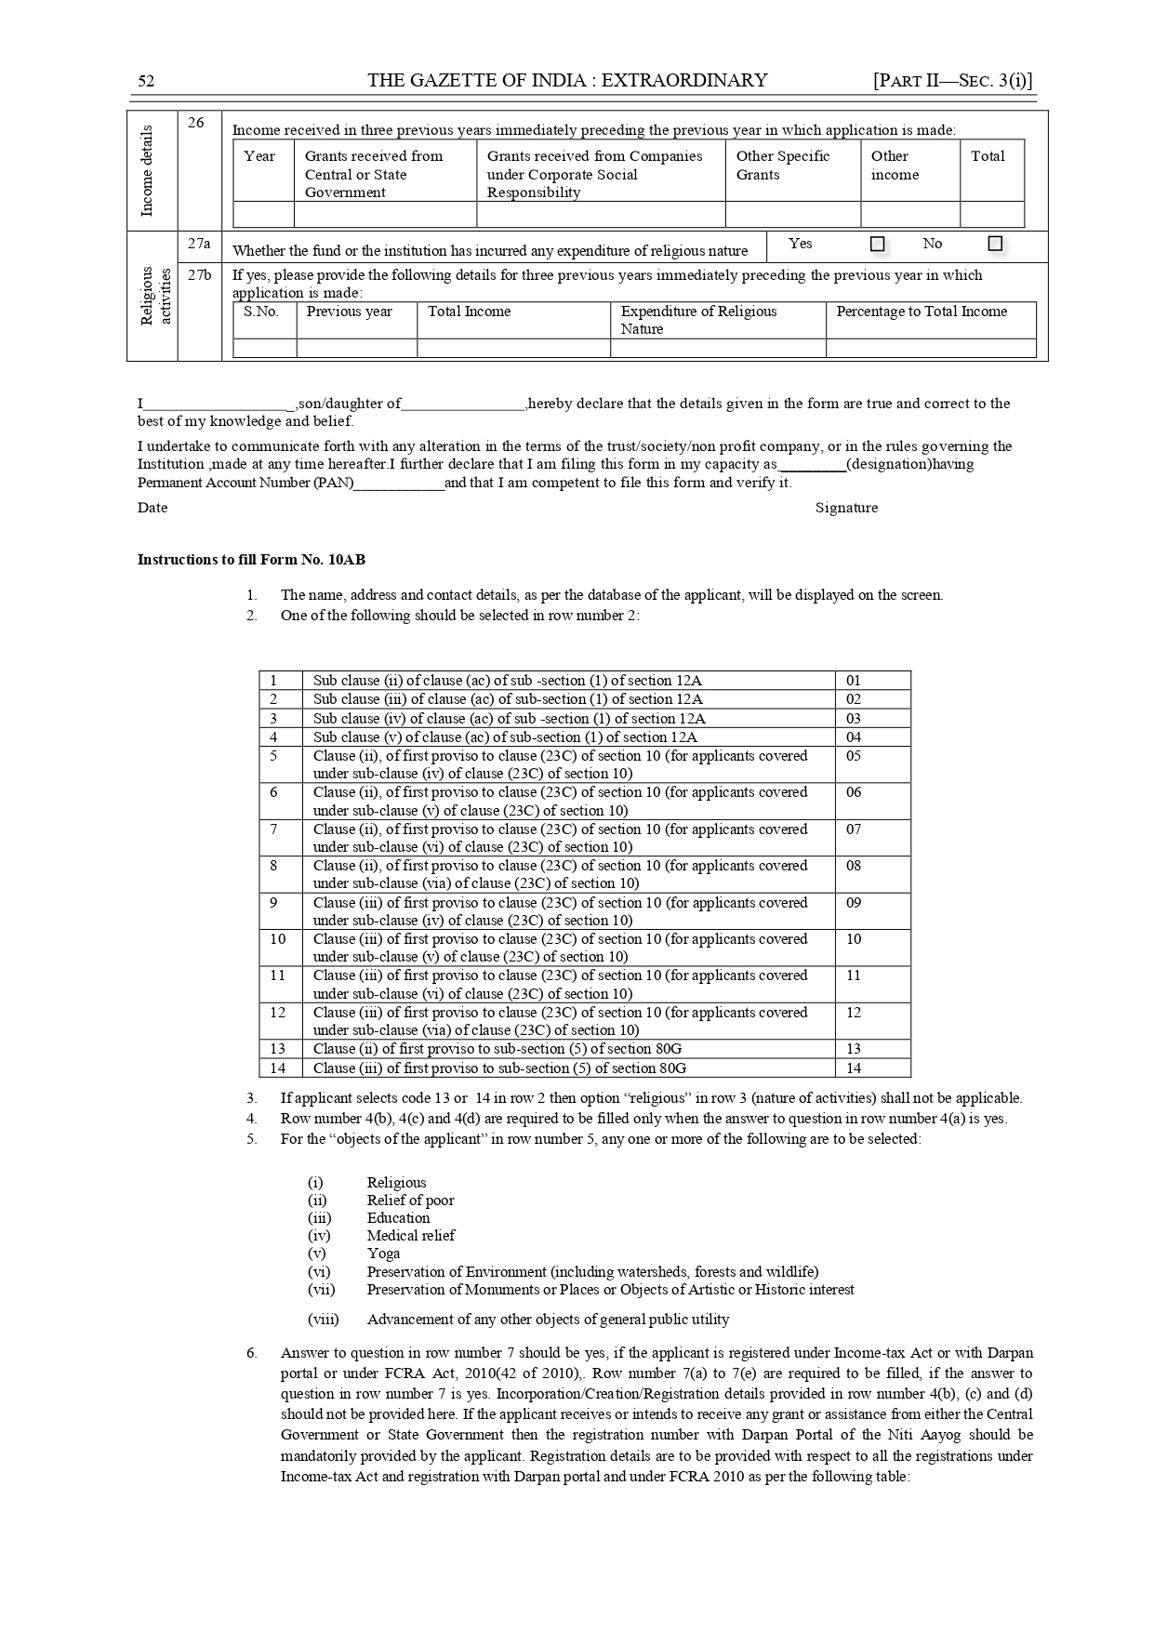

Slide 18
Form no.10A or 10AB as the case may be required to be digitally signed, if Income Tax Return to be furnished with DSC otherwise, same can be submitted with Electronic Verification Code.
Form Nos. 10A or 10AB, as the case may be, shall be verified by the person who is authorised to verify the Income Tax Return.

Slide 19
Process of Registration
Applicant (Trust, society or other Institutions) shall apply for registration over Income Tax Portal using their Income Tax Login credentials in Form No. 10A (or 10AB as the case) within the time limit along with documents prescribed.

Slide 20
List Of Documents to be attached
Where the applicant is created, or established, under an instrument, self-certified copy of such instrument creating or establishing the applicant
where the applicant is created, is established, otherwise than under an instrument, self-certified copy of the document evidencing the creation or establishment of the applicant;
Self-certified copy of registration with Registrar of Companies or Registrar of Firms and Societies or Registrar of Public Trusts, as the case may be;

Slide 21
Various Statutes For Registration Of Instruments
1(a). PUBLIC TRUSTS UNDER THE INDIAN TRUST ACT 1882.
1(b). THE BOMBAY PUBLIC TRUSTS ACT, 1950

Slide 22
Various Statutes For Registration Of Instruments
2(a). SOCIETIES UNDER THE TRAVANCORE-COCHIN LITERARY, SCIENTIFIC AND CHARITABLE SOCIETIES REGISTRATION ACT, 1955.
2(b). SOCIETIES UNDER THE SOCIETIES REGISTRATION ACT, 1860.
3. SECTION 8 COMPANY UNDER THE COMPANIES ACT 2013.

Slide 23
List Of Documents to be attached
self-certified copy of registration under Foreign Contribution (Regulation) Act, 2010, if the applicant is registered under such Act;
self-certified copy of existing order granting registration under section 12A or section 12AA or section 12AB, as the case may be;
self-certified copy of order of rejection of application for grant of registration under section 12A or section 12AA or section 12AB, as the case may be, if any;

Slide 24
List Of Documents to be attached
7. where the applicant has been in existence during any year or years prior to the financial year in which the application for registration is made, self-certified copies of the annual accounts of the applicant relating to such prior year or years (not being more than three years immediately preceding the year in which the said application is made) for which such accounts have been made up;

Slide 25
List Of Documents to be attached
8. where a business undertaking is held by the applicant as per the provisions of sub-section (4) of section 11 and the applicant has been in existence during any year or years prior to the financial year in which the application for registration is made, self-certified copies of the annual accounts of such business undertaking relating to such prior year or years (not being more than three years immediately preceding the year in which the said application is made) for which such accounts have been made up and self- certified copy of the report of audit as per the provisions of section 44AB for such period;

Slide 26
List Of Documents to be attached
9. where the income of the applicant includes profits and gains of business as per the provisions of sub- section (4A) of section 11 and the applicant has been in existence during any year or years prior to the financial year in which the application for registration is made, self-certified copies of the annual accounts of such business relating to such prior year or years (not being more than three years immediately preceding the year in which the said application is made) for which such accounts have been made up and self-certified copy of the report of audit as per the provisions of section 44AB for such period;

Slide 27
Process of Registration
On receipt of an application in Form No. 10A (or 10AB as the case may be), the Principal Commissioner or Commissioner, authorised by the Board shall,

Slide 28
1. In case of applicant who is already registered u/s 12AA or in case of Provisional Registration where Form 10A has been submitted
– shall pass an order in writing granting registration in Form No.10AC and issue a 16 digit alphanumeric Unique Registration Number (URN) to the applicant.

Slide 29
2. In other cases ,
where Form 10AB has been submitted, the order of registration or rejection or cancellation of registration shall be in Form No.10AD and
In case if the registration is granted,
16 alphanumeric number Unique Registration Number (URN) shall be issued.

Slide 30
3. In case Commissioner or Principal Commissioner thinks necessary in order to satisfy himself about the genuineness of activities of the trust or institution,
the compliance of such requirements of any other law
for the time being in force by the trust or institution as are
material for the purpose of achieving its objects,
he may call for such documents or information from the trust or institution or make such inquiries.
If he is still not so satisfied, he may pass an order in writing rejecting such application and also cancelling its registration after providing
a reasonable opportunity of being heard to applicant.

Slide 31
4. If, at any point of time, it is noticed that Form No. 10A has not been duly filled in by not providing, fully or partly, or by providing false or incorrect information or documents required or by not complying with the requirements rules,
the Principal Commissioner or Commissioner, after giving an opportunity of being heard, may cancel the registration in Form No. 10AC and Unique Registration Number (URN) and such registration or such Unique Registration Number (URN) shall be deemed to have never been granted or issued.
i.e. cancellation will be effective from day one.

Slide 32
QUESTIONS?
ISSUES

Slide 33
ISSUES / SUGGESTIONS
1.AWARENESS-COVID 19 ISSUES
2. REPEATED RENWAL- 5 YEARS.
3. TIME LIMIT FOR RENEWAL-3 MONTHS.
4. URN-COMMINICATION TO ALL AUTHORITIES.
5. PROVISIONAL APPROVAL- APPLICATION IN FORM 10 AB WITHIN 6 MONTHS BEFORE EXPIRY OF PROVISIONAL APPROVAL.
6. PAN OF BOARD MEMBERS AND ITR

Slide 34
ISSUES / SUGGESTIONS
7.ASSETS AND LIABILITIES AS ON THE DATE OF APPLICATION
8. OTHER INCOME FOR FY 2020-21.
9. FILING OF ITR OF EARLIER YEARS.
10. APPLICANT CREATED OTHERWISE THAN BY AN INSTRUMENT- CERTIFIED COPY .
11. EARLIER YEAR ACCOUNTS-ITR
12. BUSINESS INCOME - ITR, 44AB AUDIT

Slide 35
ISSUES / SUGGESTIONS
13.JURISDICTION
14. FORM 10 AC-CERTIFICATE
15. FORM 10 AD –REJECTION/CANCELLATION.
16. NON COMPLIANCE OF ANY OTHER LAW
17. NO OPPURTUNITY OF BEING HEARD UNDER COVID 19 SCENARIO AND OTHER SITUATIONS.
18.INCOMPLETE/WRONG DATA

Slide 36
ISSUES / SUGGESTIONS
19. PHYSICAL VERIFICATION.
20. ADDRESS PROOF
21 .PHOTOGRAPH OF BUILDING
22. NON OBJECTION CERTIFICATE/CONSENT
23. LEASE DEED/ RENT AGREEMENT
24. VARIOUS DECLARATIONS.

Slide 37
ISSUES / SUGGESTIONS
25. MANDATORY CLAUSES IN THE DOCUMENT
26.COVERING LETTER
27. TIMELY RESPONSE TO NOTICES
28. COMMUNICATION OF NOTICES/ORDERS THROUGH PORTAL.
29. LINKING OF PAN AND AADHAR CARD WITH MOBILE NUMBER.
30. NOTES ON ACTIVITIES, MINUTES BOOK

Slide 38
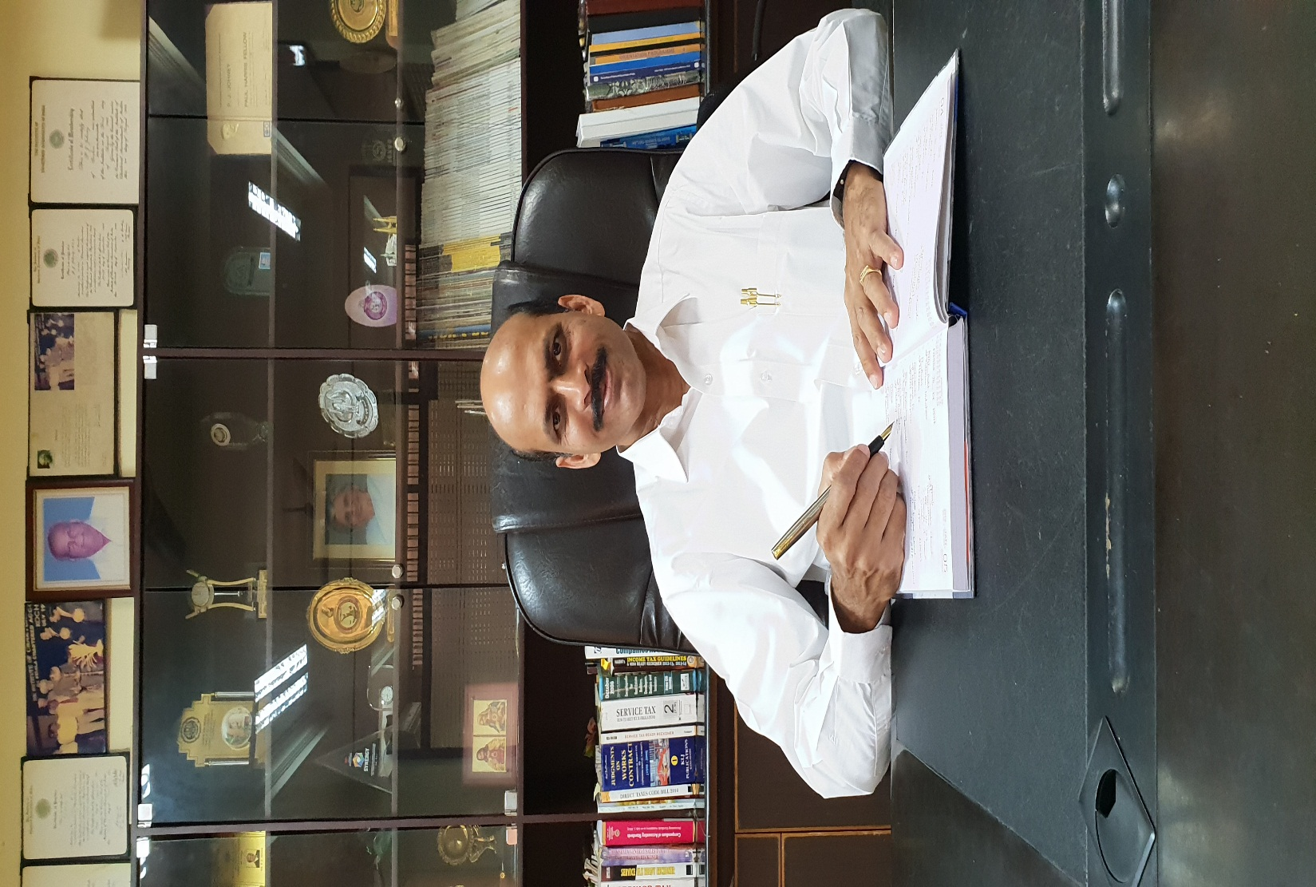
THANK YOU

