Slide 1

Bank Audit Using Ms-Excel
Ernakulam Branch
by
CA Saran Kumar U
saran@chaireturn.com
+91 702-234-5678
Date: 28^{h} March 2021

Slide 2
Roadmap of the Session
Getting Ready for the Bank Audit
What’s New in New LFAR
Introduction to Core Banking Solution
Different CBS and Menu List
Unstructured Data to Structured Data
Inferences out of stratification
NPA identification from the Structured Data
Ledger Account Analysis
Sampling and Reporting
Conclusion

Slide 3






Mindset of the Auditors
Compile Material
Attend Seminars
Step into Bank
Sign Report
Next Year
Circle

Slide 4
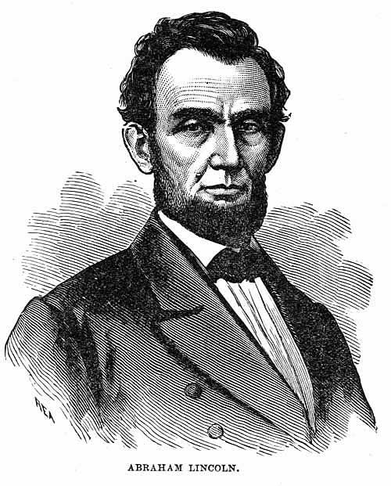

80:20 Approach

Slide 5
CBS Environment
Application Server
User/staff enters information into screens
Database Server
Structured Data Format
Text to Column using Delimited (mostly Comma)
Reporting Server
Unstructured Data Format
Text to Column using Fixed Width / Delimited

Slide 6
CBS
Major CBS
B@nks24
Finacle
Flexicube

Slide 7
Large Advances Calculation
A) Balance as on 31.03.2021 – Funded
B) Balance as on 31.03.2021 – Non-Funded
C) Total Advances – Funded (+) Non-Funded
Lower of Below is Large Advance
i) 10% of C
ii) Rs. 10 Crore
Refer – Working File 1

Slide 8
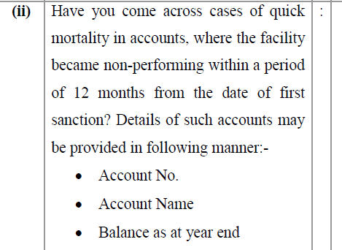
Quick Mortality in Accounts
Sanctioned Date
NPA Date
B-A
If the “C” is <365 then all those accounts
to be mentioned in LFAR 5.b.ii

Slide 9
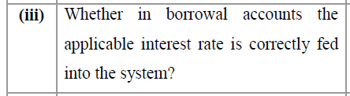
Interest Rate vs Accounts
Use Pivot Table for Interest
Get Maximum Interest for each Product Type or GL
Get Minimum Interest for each Product Type of GL
If the difference, is high then examine further
In case of adverse, please report
in LFAR 5.b.iii

Slide 10
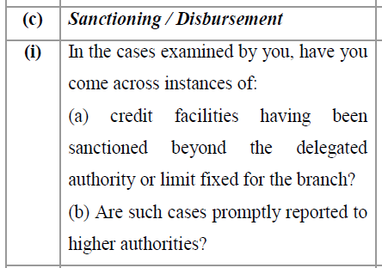
Sanctioning Authority
Insert a Column in the Loan Balance File Besides Sanctioned Amount
User VLOOKUP() from the Master Data of Sanctioning Authority Vs Limit
If the Difference is Higher, then check whether properly reported to Higher Authority
Report all the cases in LFAR 5.c.i

Slide 11
Other Stratification
Customer ID vs Account ID
Stratification of Advance Portfolio
Stratification of Year-wise Advances
Stratification of Irregularity
Stratification of Arrear Condition

Slide 12
Finacle Commands
CCODCHK - Credit and Interest Debits Check
M27R – Report of Accounts Sanctioned, Renewed and enhanced during the period of time
ADTRPT – Various Audit Reports Available
ADTRPT-28 – Audit Report to generate "range wise interest rate” account list to identify accounts where interest rate is not in accordance with Bank’s interest pattern.
HLARSH – EMI Calc – Loan Repayment Schedule

Slide 13
Unstructured Data to Structured Data
Text to Column
Filter
Remove junk data
Keeping data ready for the analysis

Slide 14
Thanks for your patient hearing!!!
CA Saran Kumar U
+91 702-234-5678
saran@chaireturn.com

